Slide 1
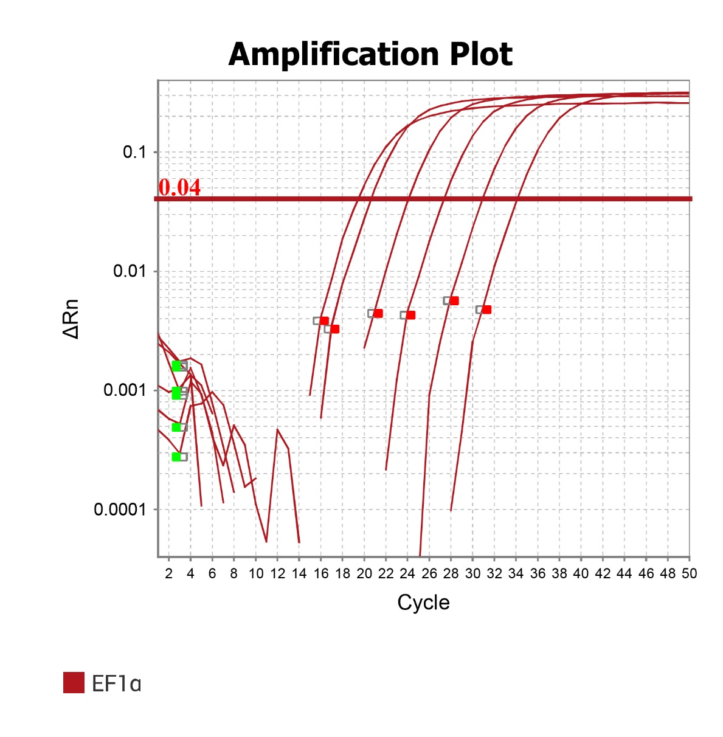
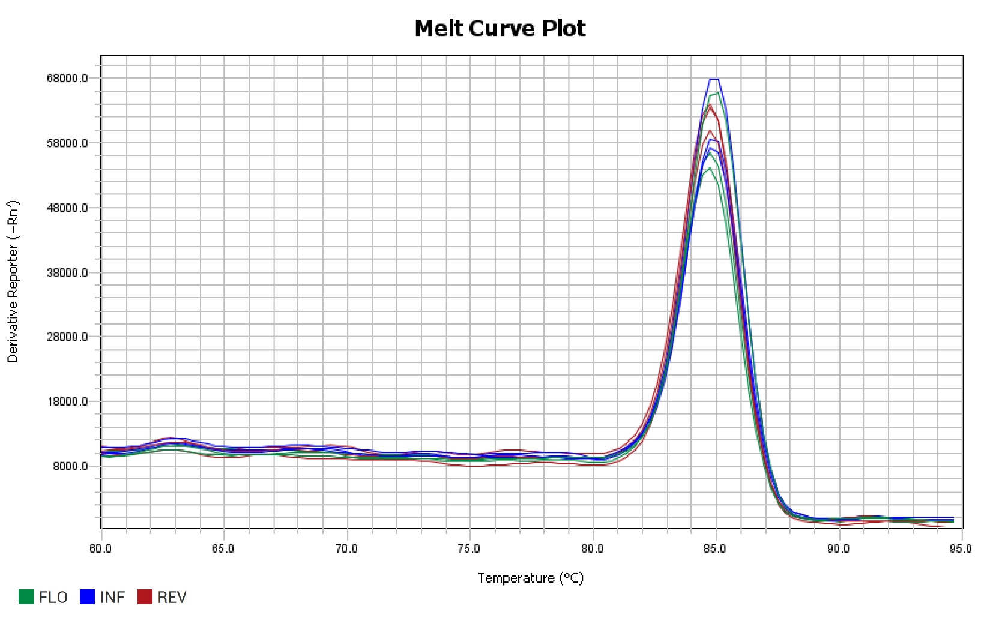
Gene: | Elongation Factor 1-alpha (Reference gene) | PCR Efficiency: | 105.81% | Melt Peak: | 84.573

Slide 2
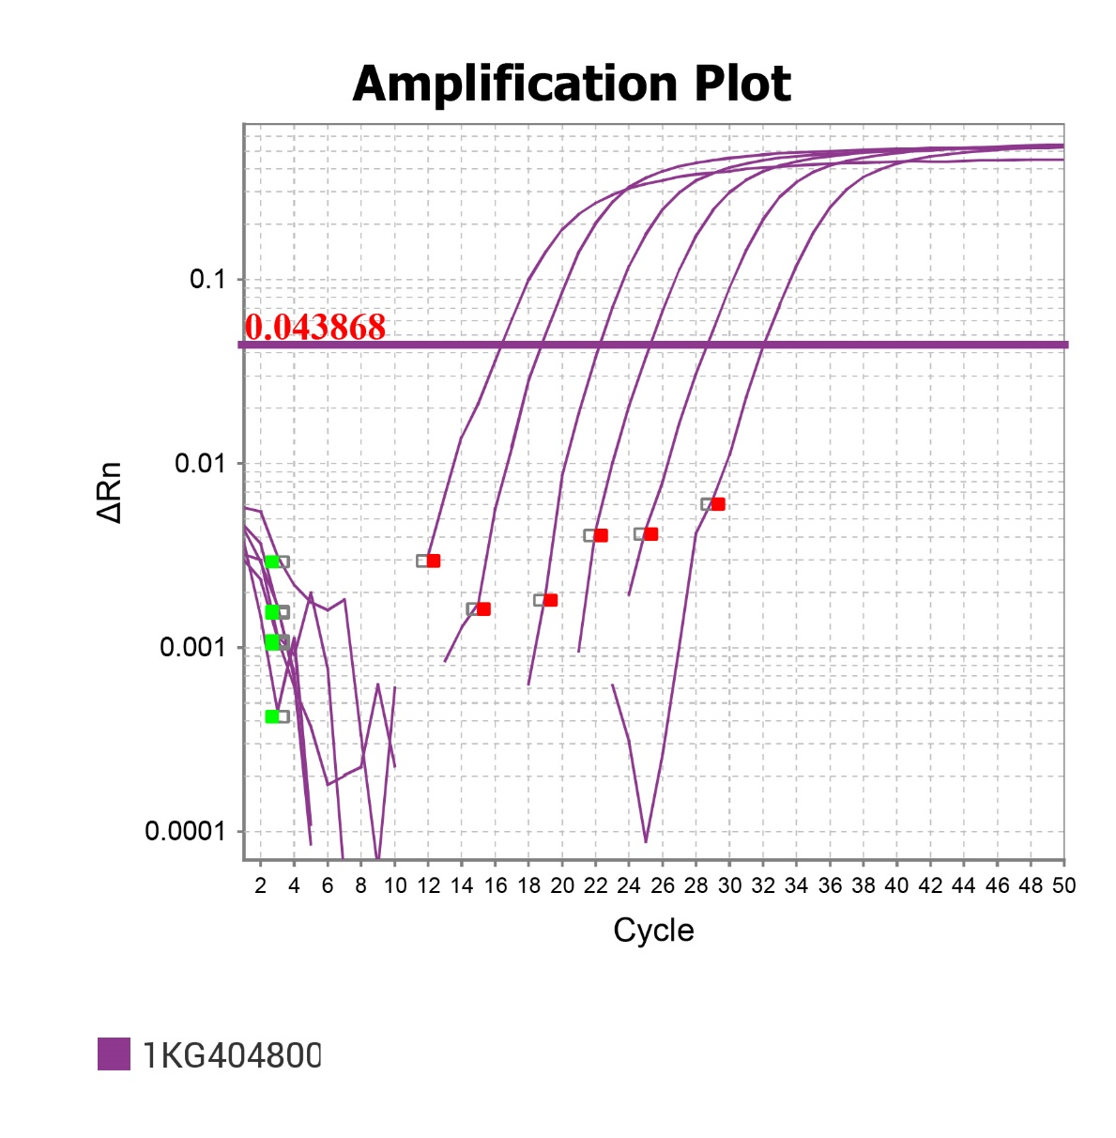
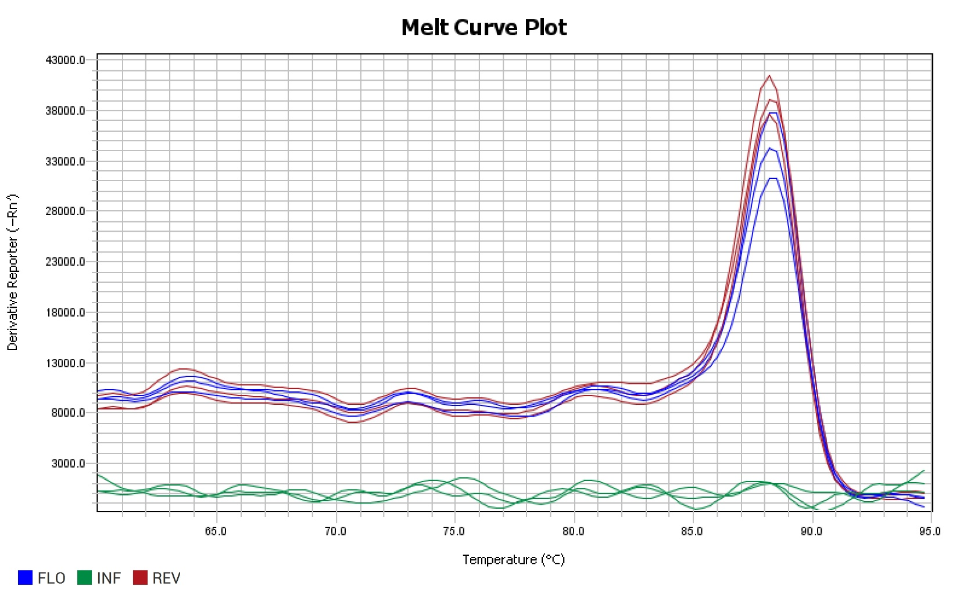
Gene: | Pavir.1KG404800 | PCR Efficiency: | 103.03% | Melt Peak: | 88.337

Slide 3
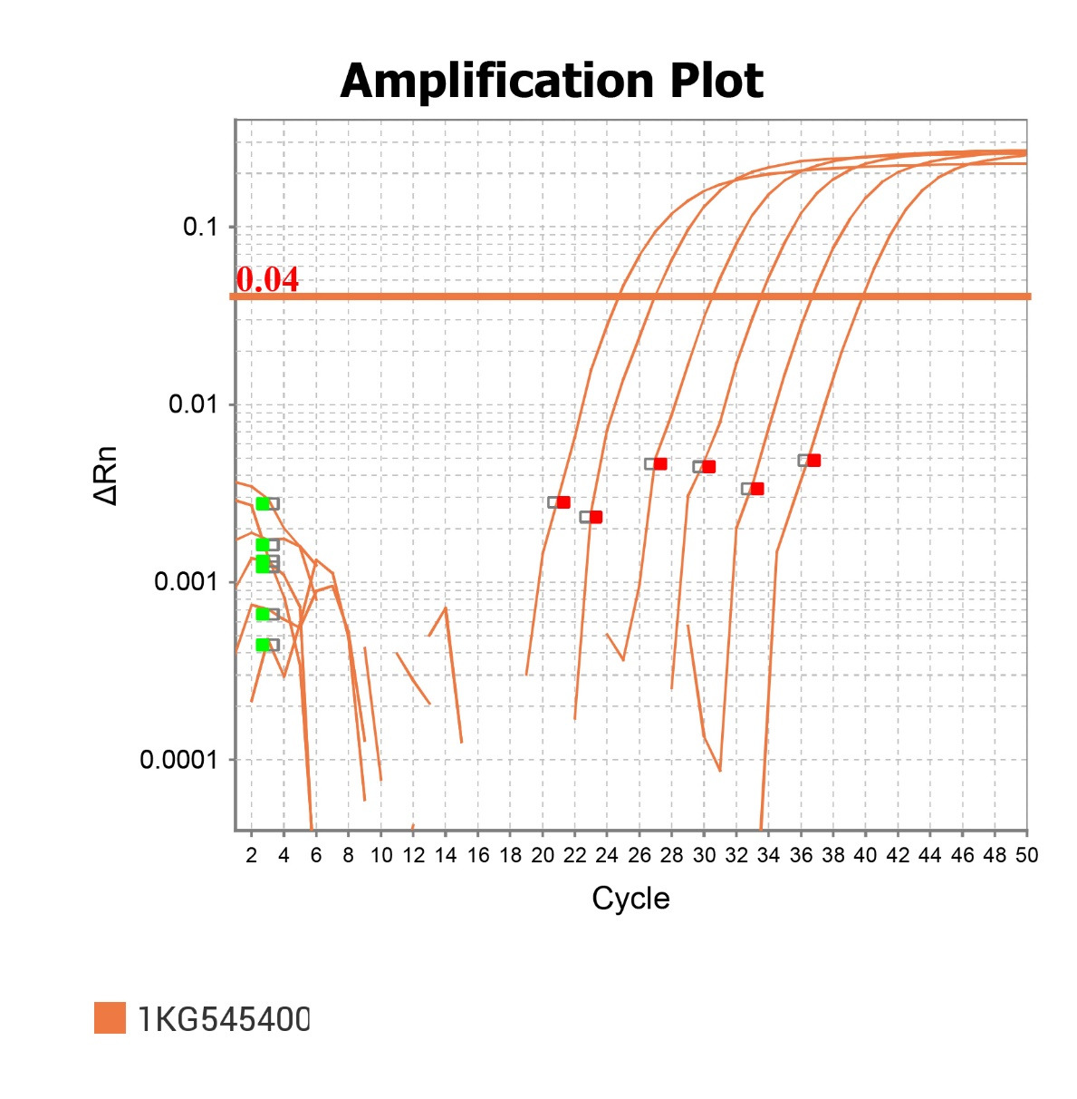
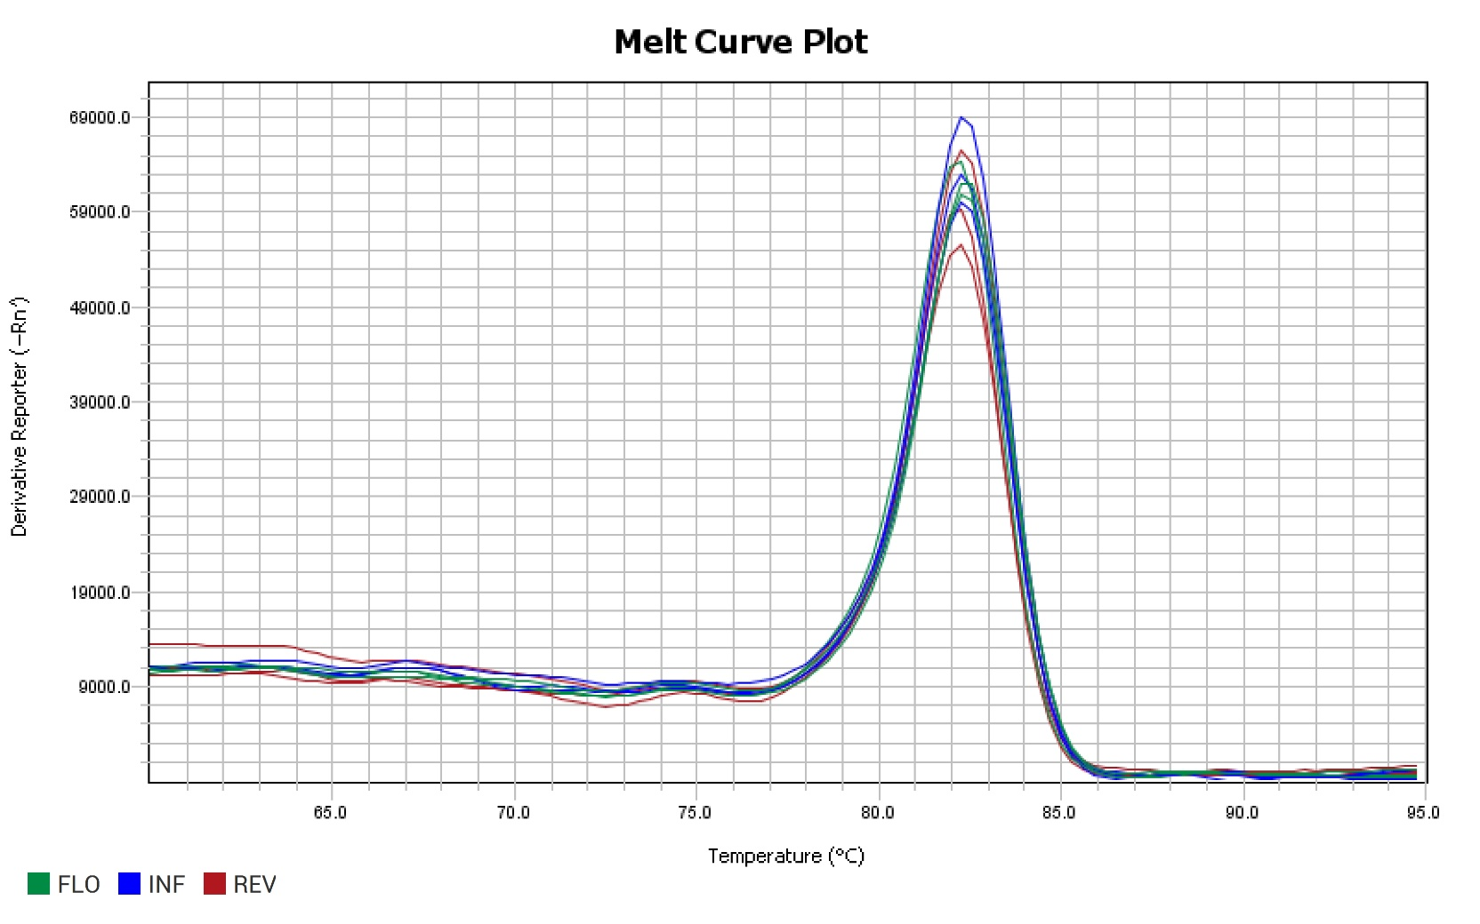
Gene: | Pavir.1KG545400 | PCR Efficiency: | 106.62% | Melt Peak: | 82.257

Slide 4
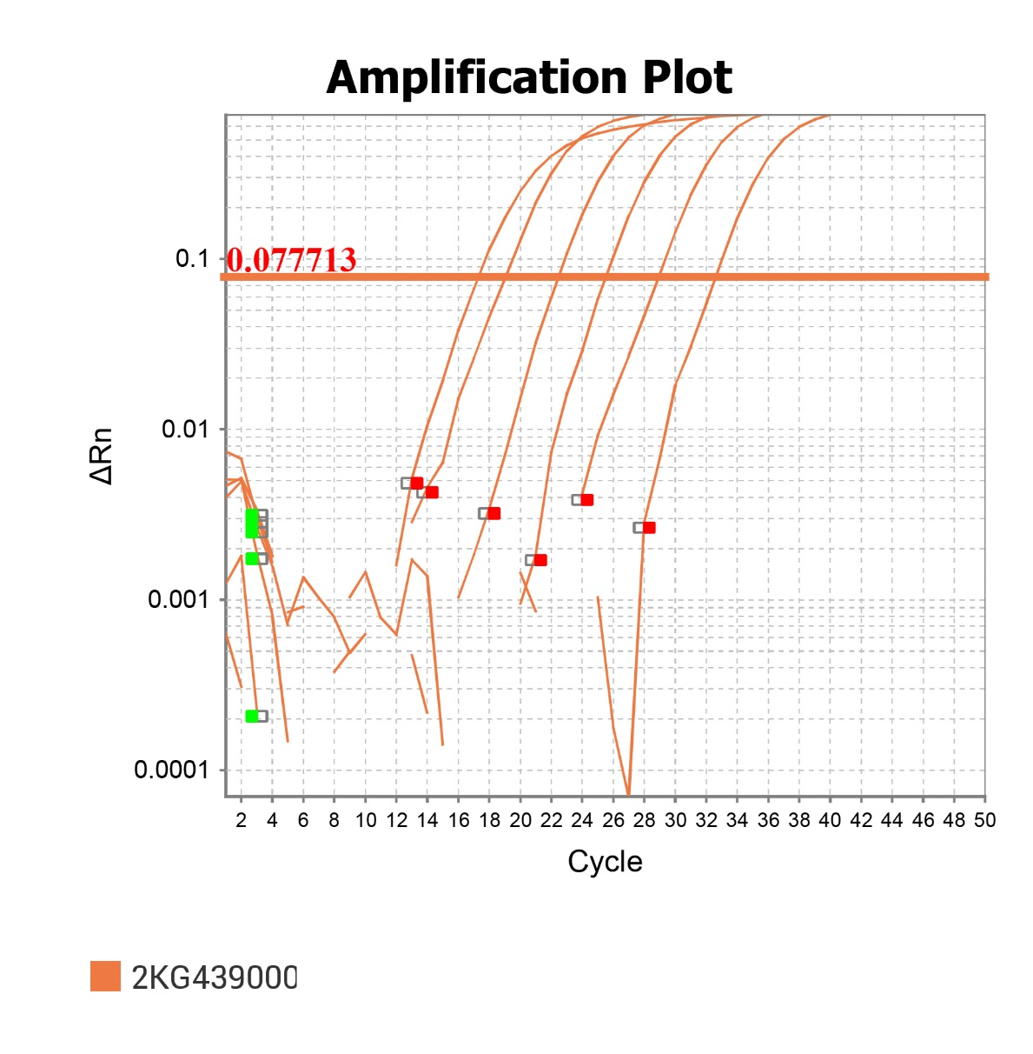
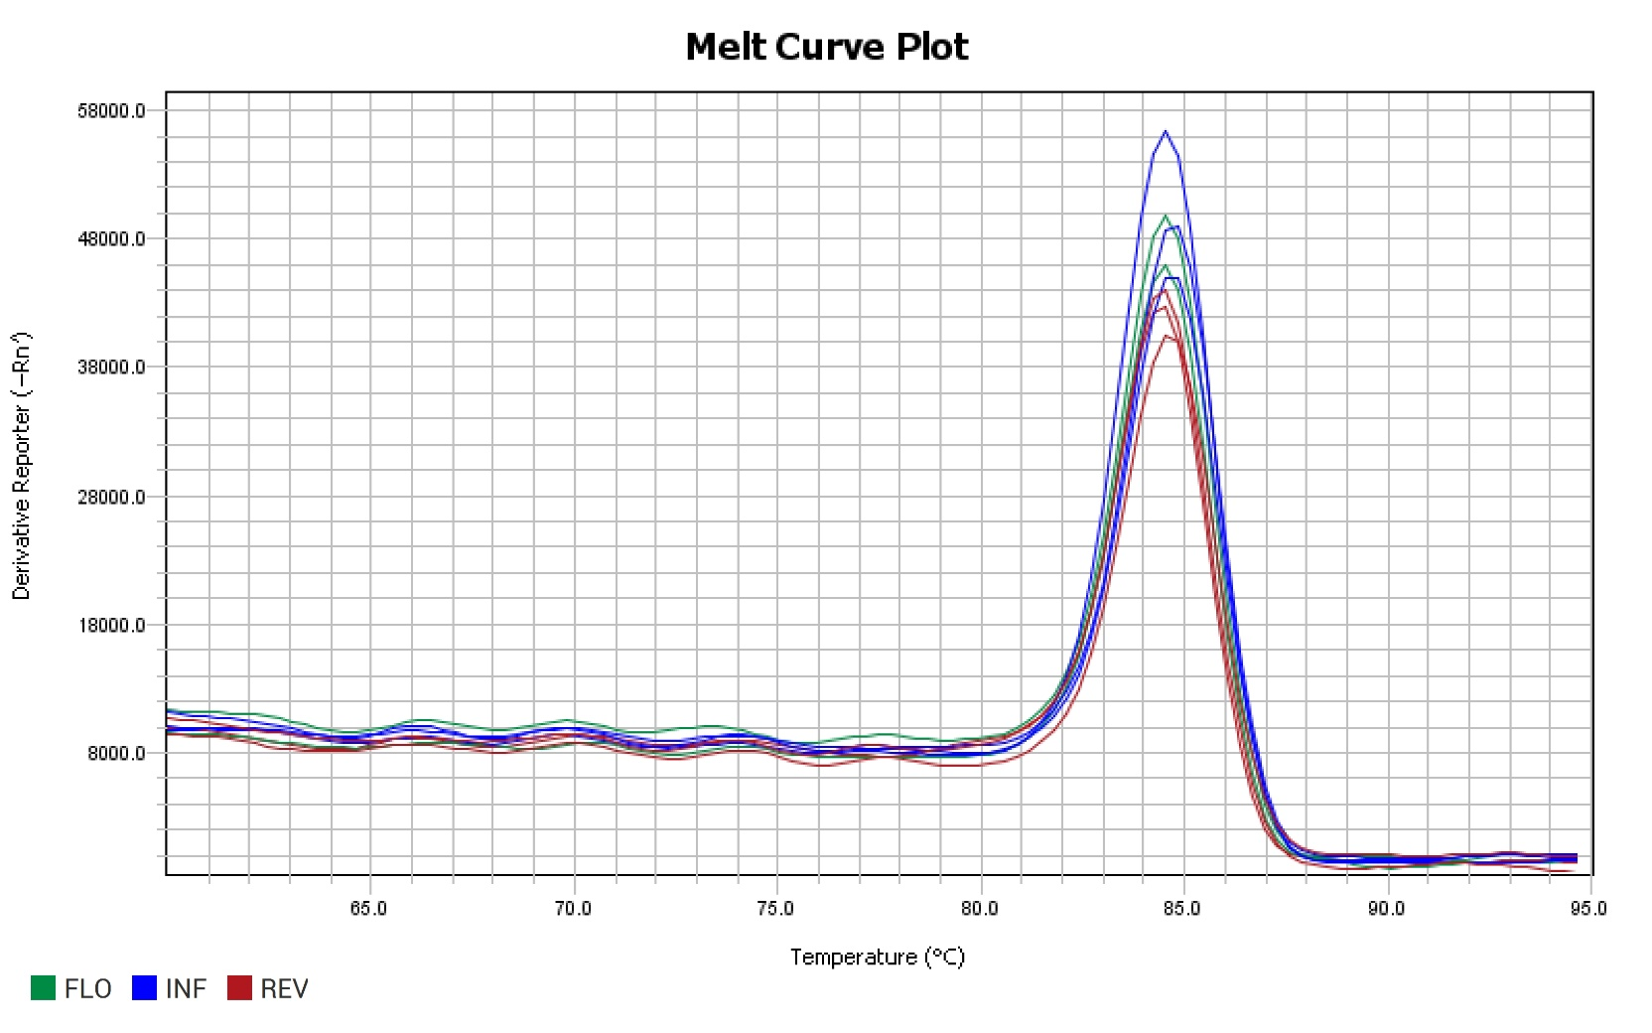
Gene: | Pavir.2KG439000 | PCR Efficiency: | 104.44% | Melt Peak: | 84.598

Slide 5
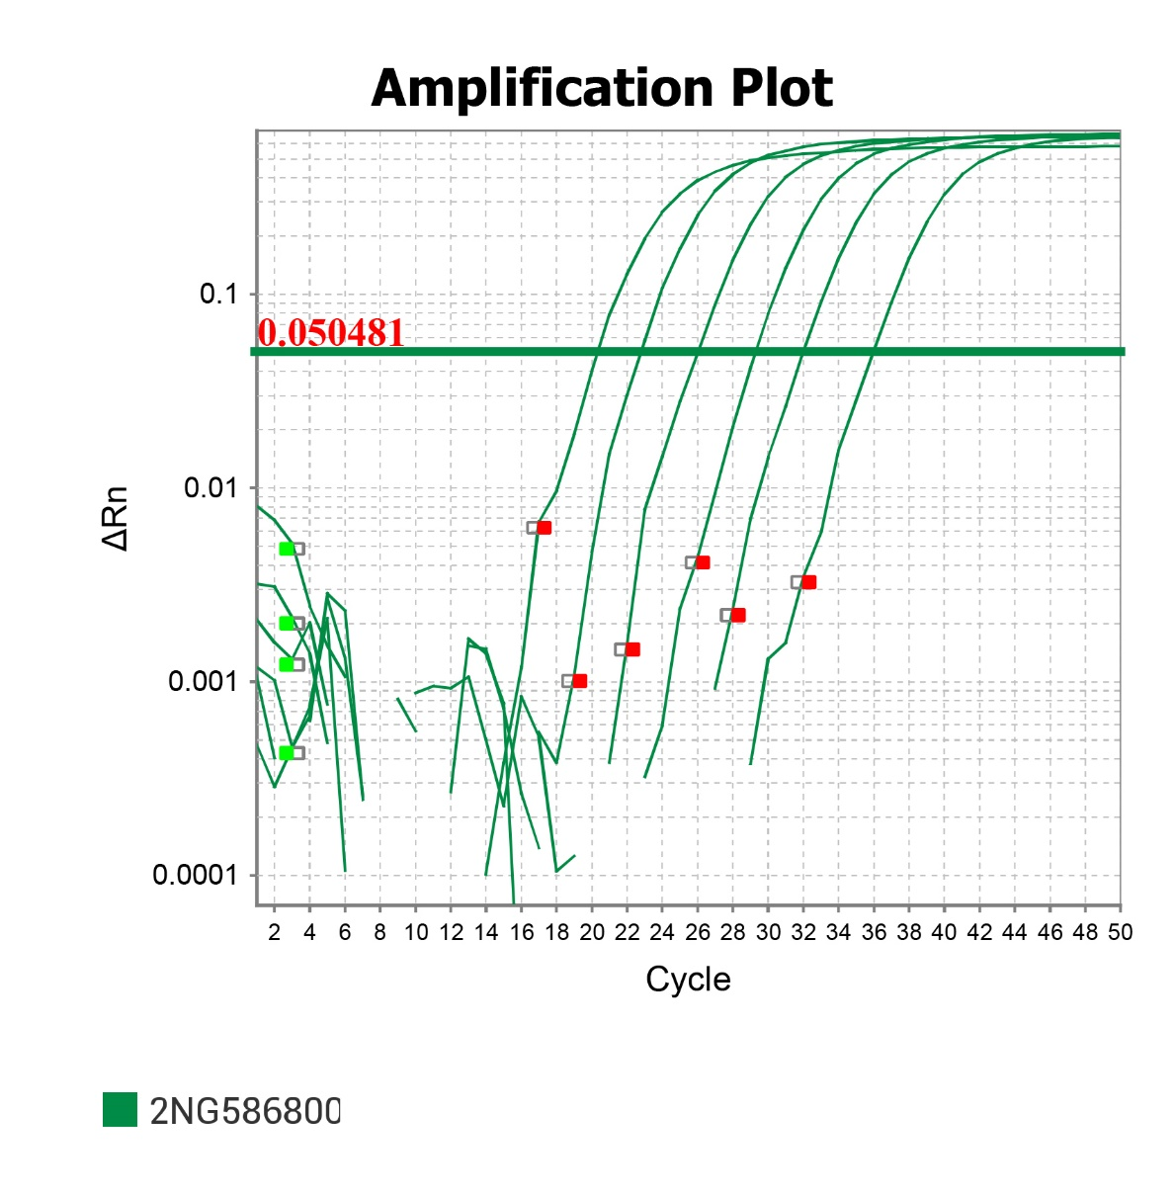
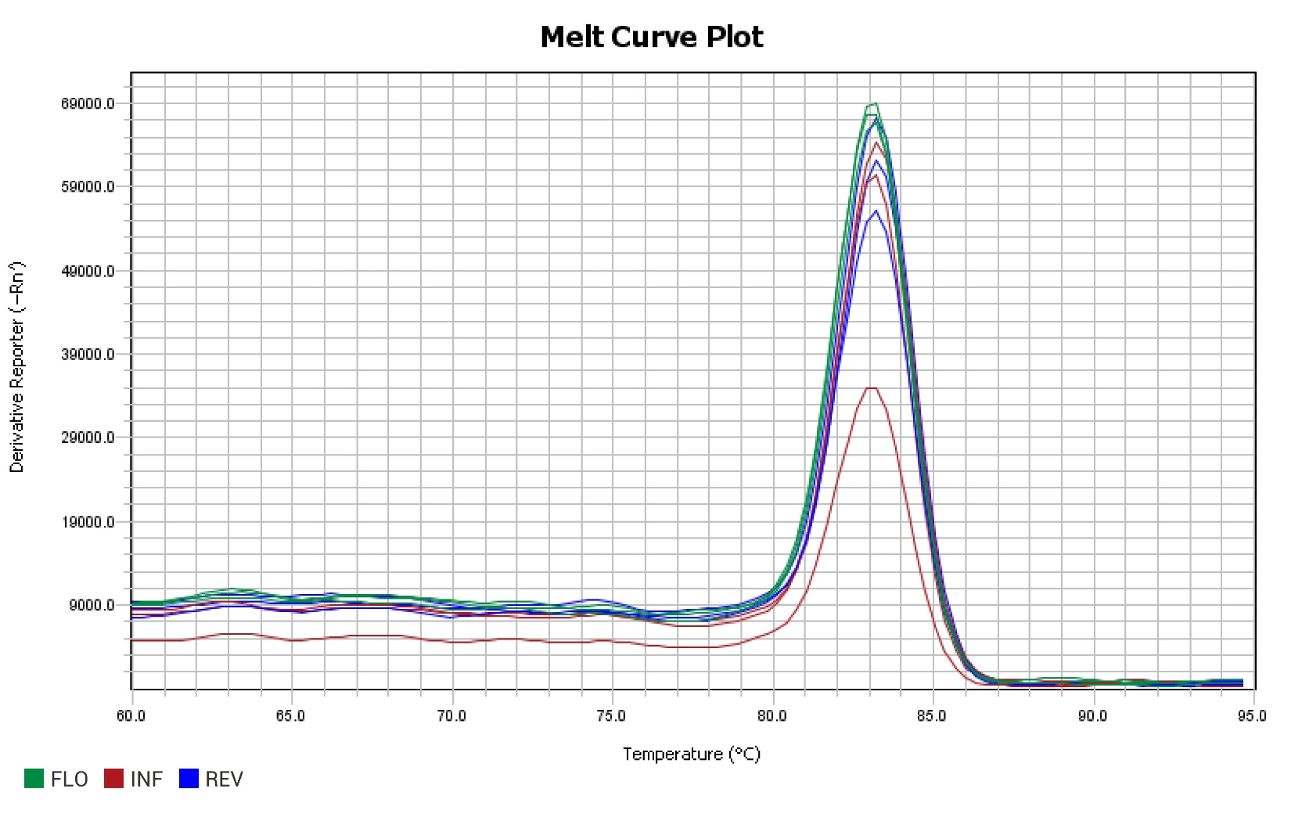
Gene: | Pavir.2NG586800 | PCR Efficiency: | 104.44% | Melt Peak: | 83.206

Slide 6
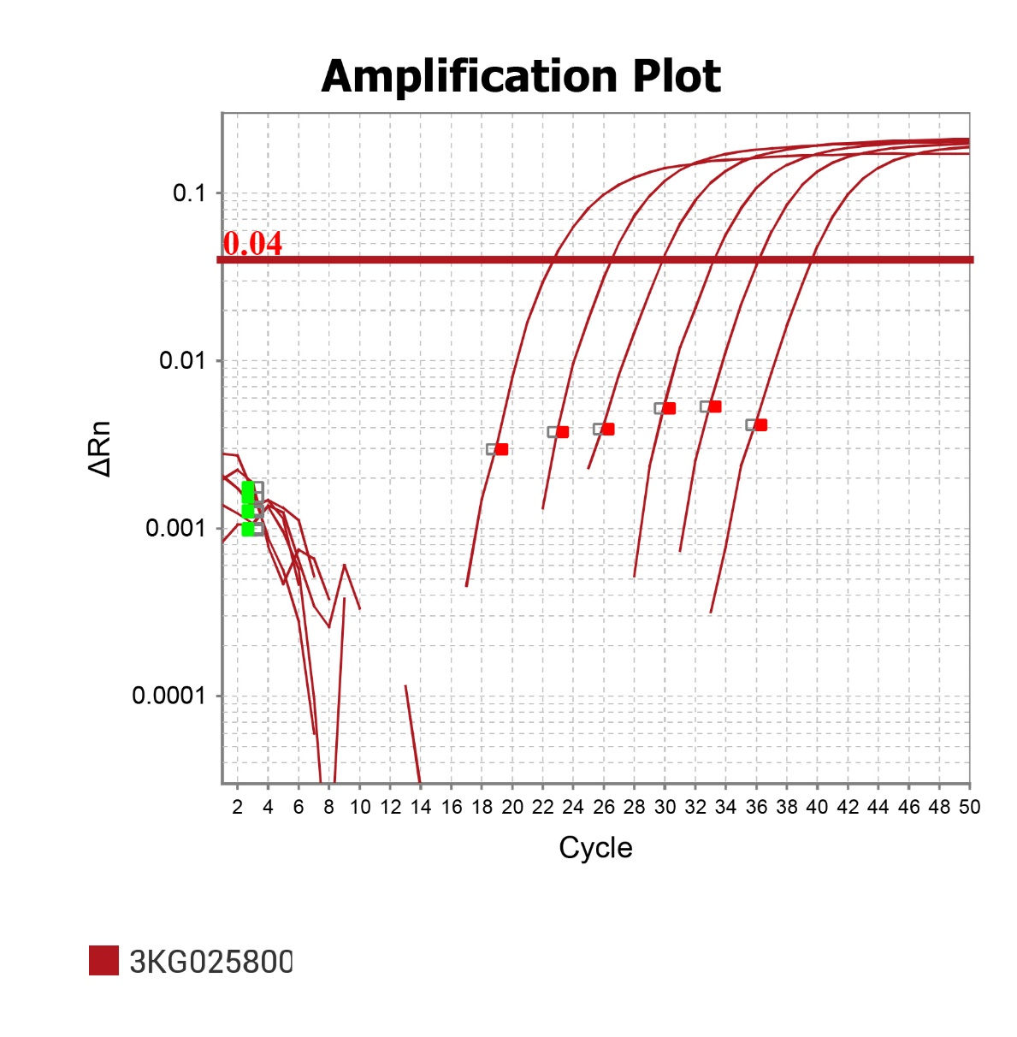
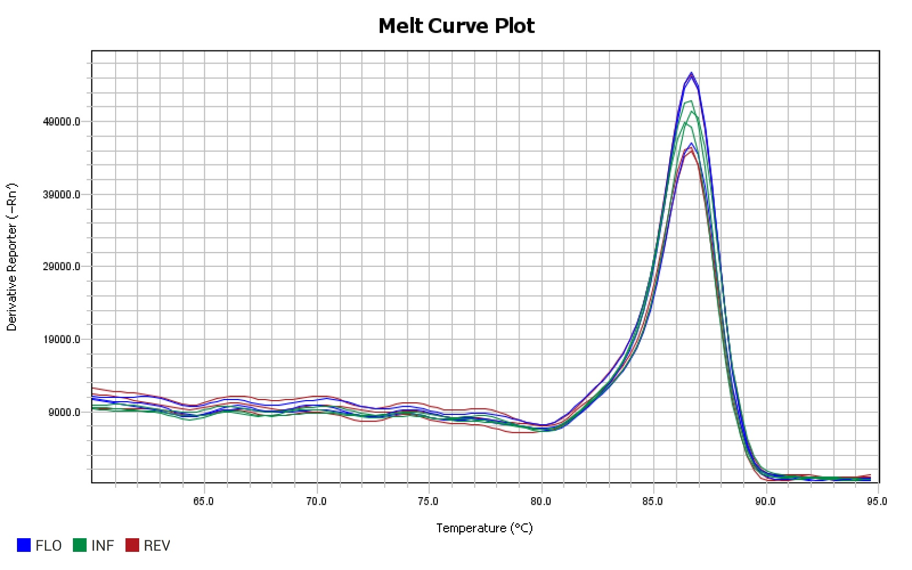
Gene: | Pavir.3KG025800 | PCR Efficiency: | 99.65% | Melt Peak: | 86.373

Slide 7
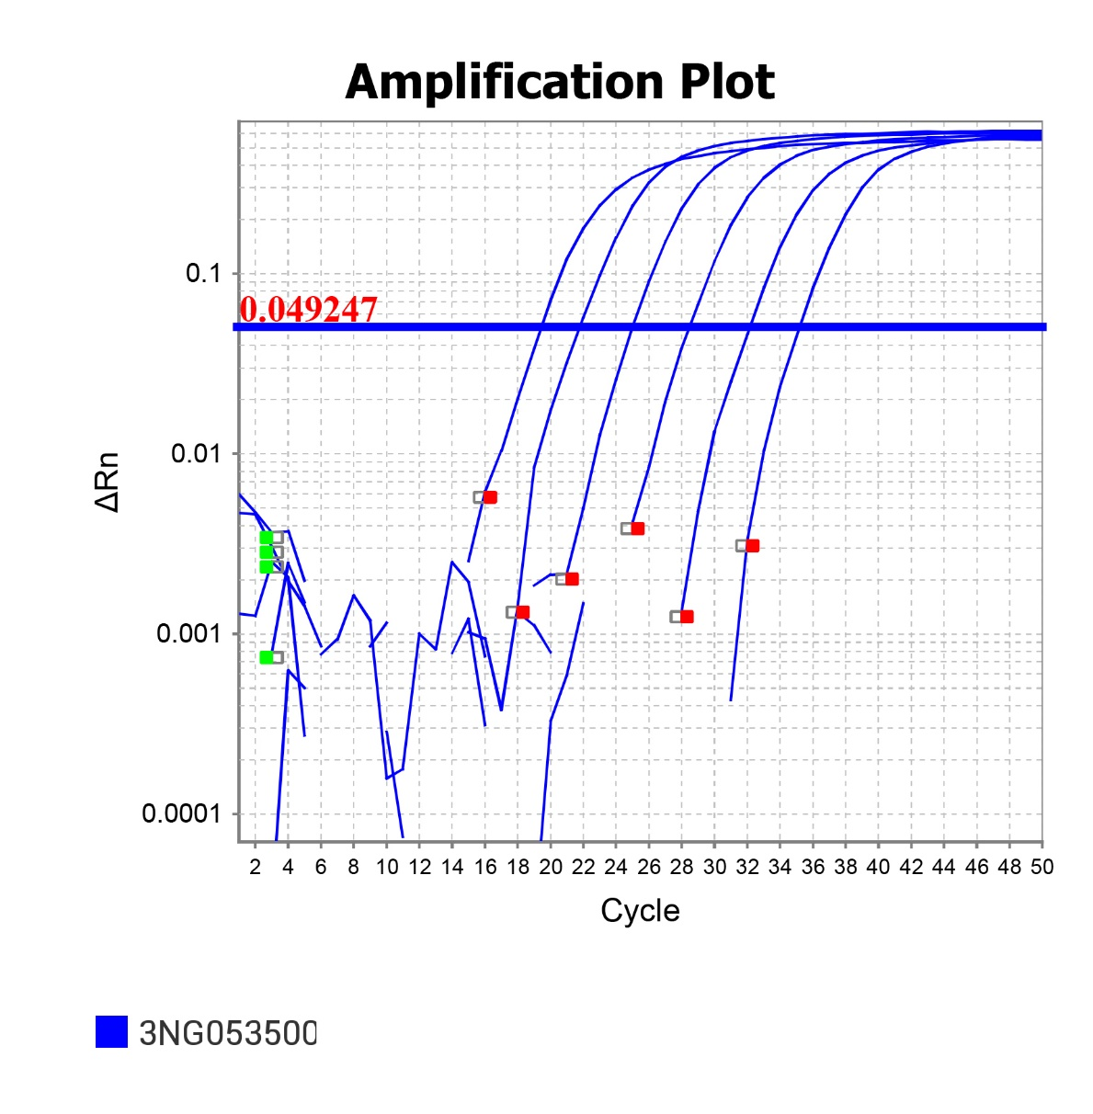
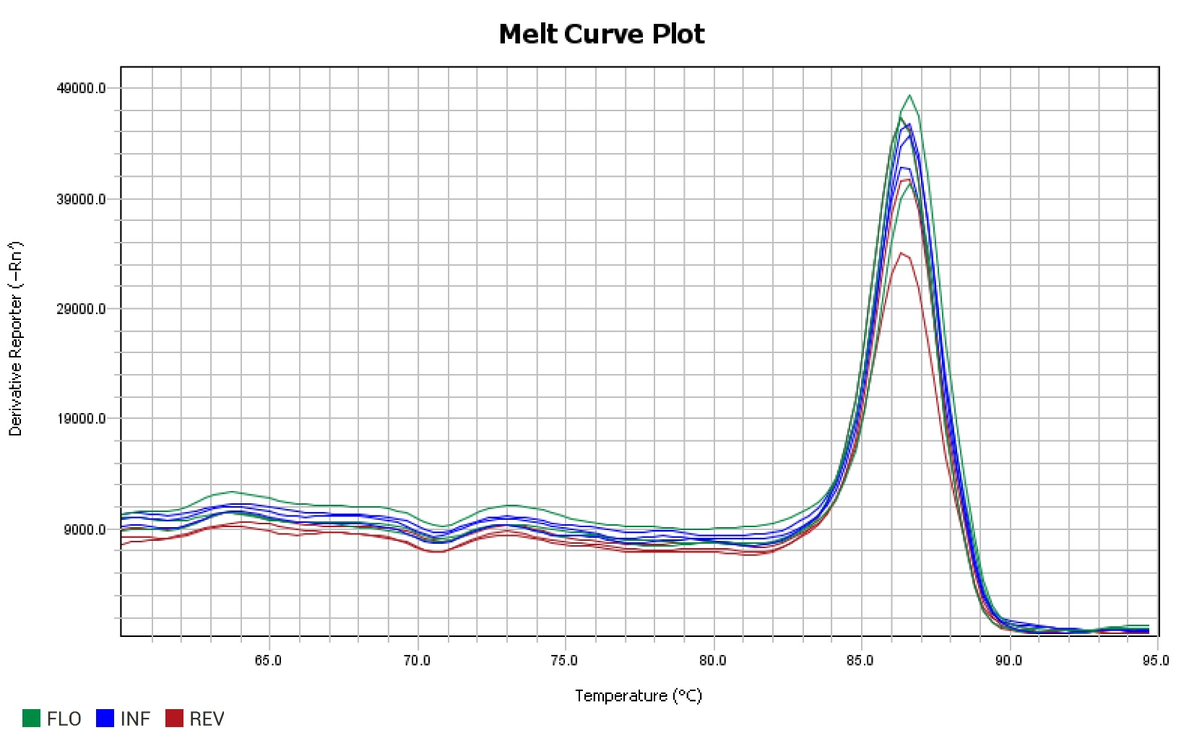
Gene: | Pavir.3NG053500 | PCR Efficiency: | 101.80% | Melt Peak: | 86.614

Slide 8
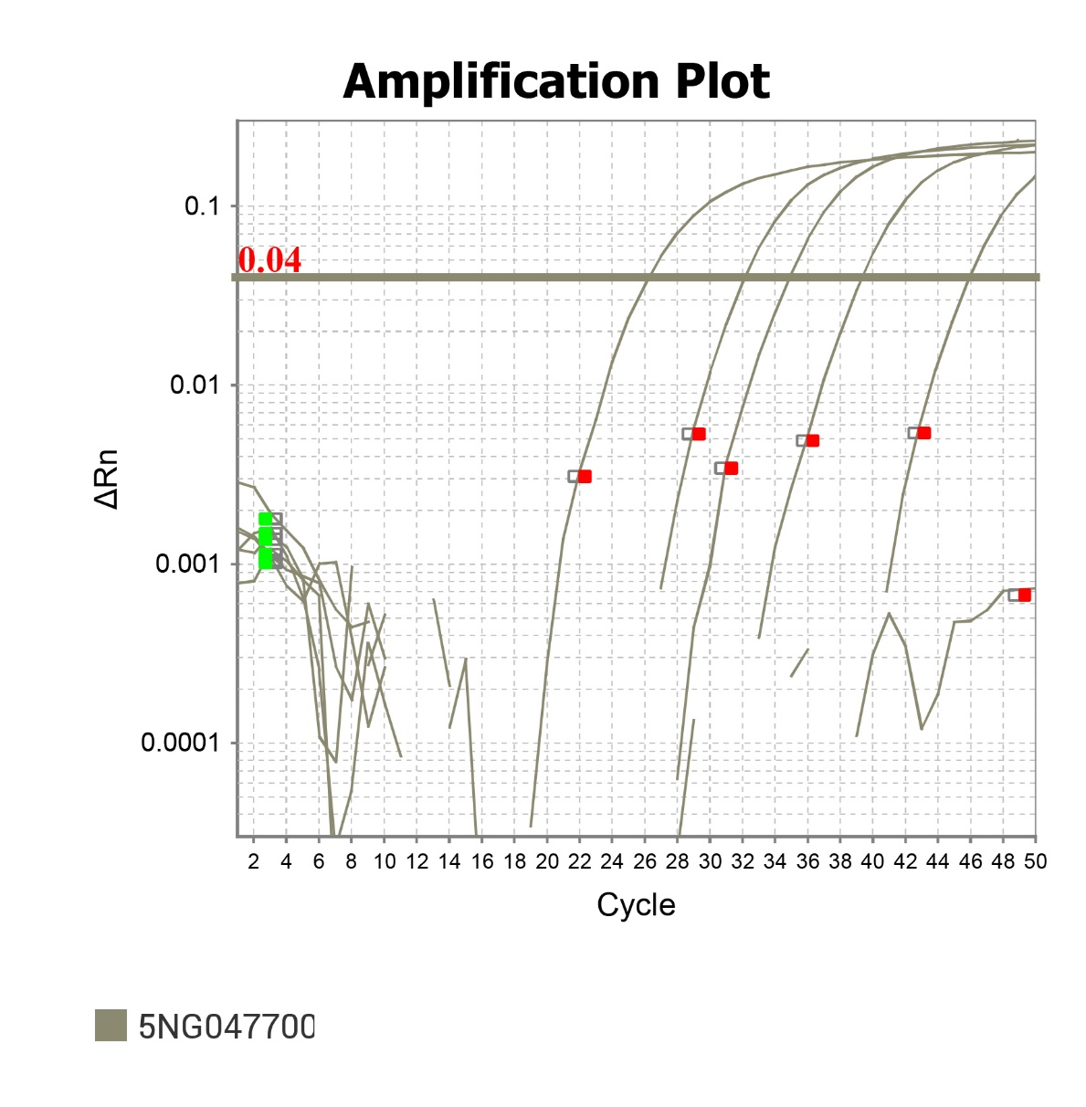
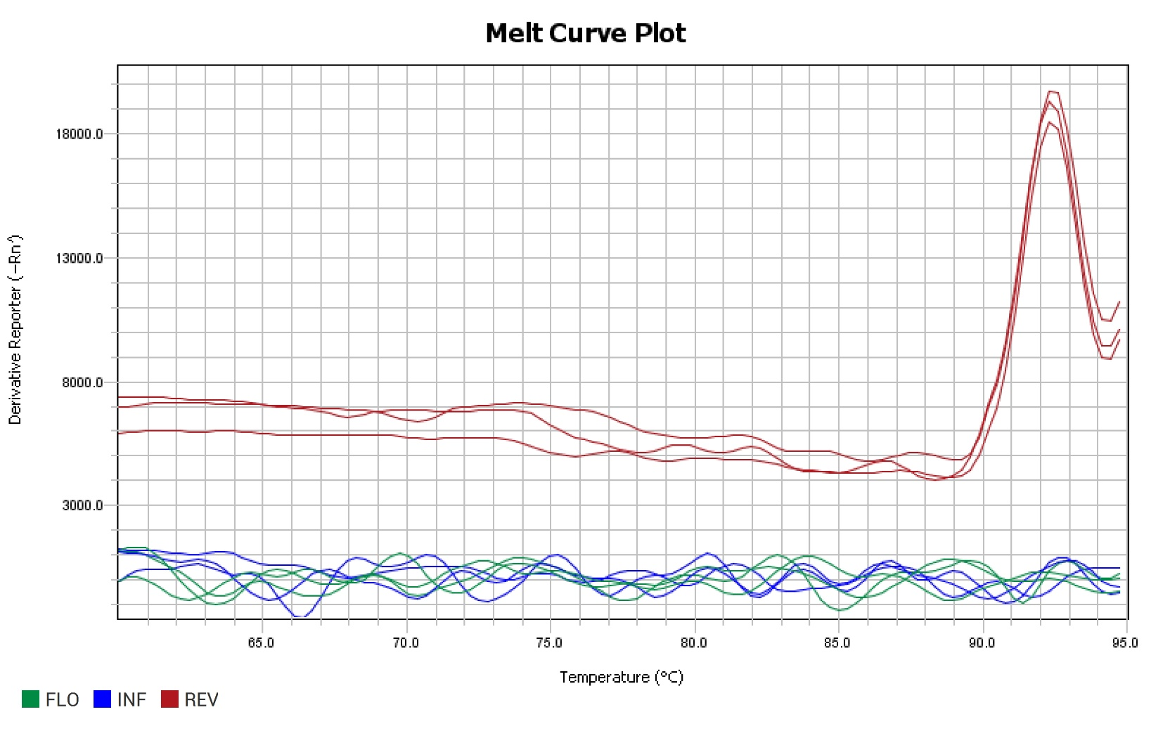
Gene: | Pavir.5NG047700 | PCR Efficiency: | 81.98% | Melt Peak: | 92.339

Slide 9
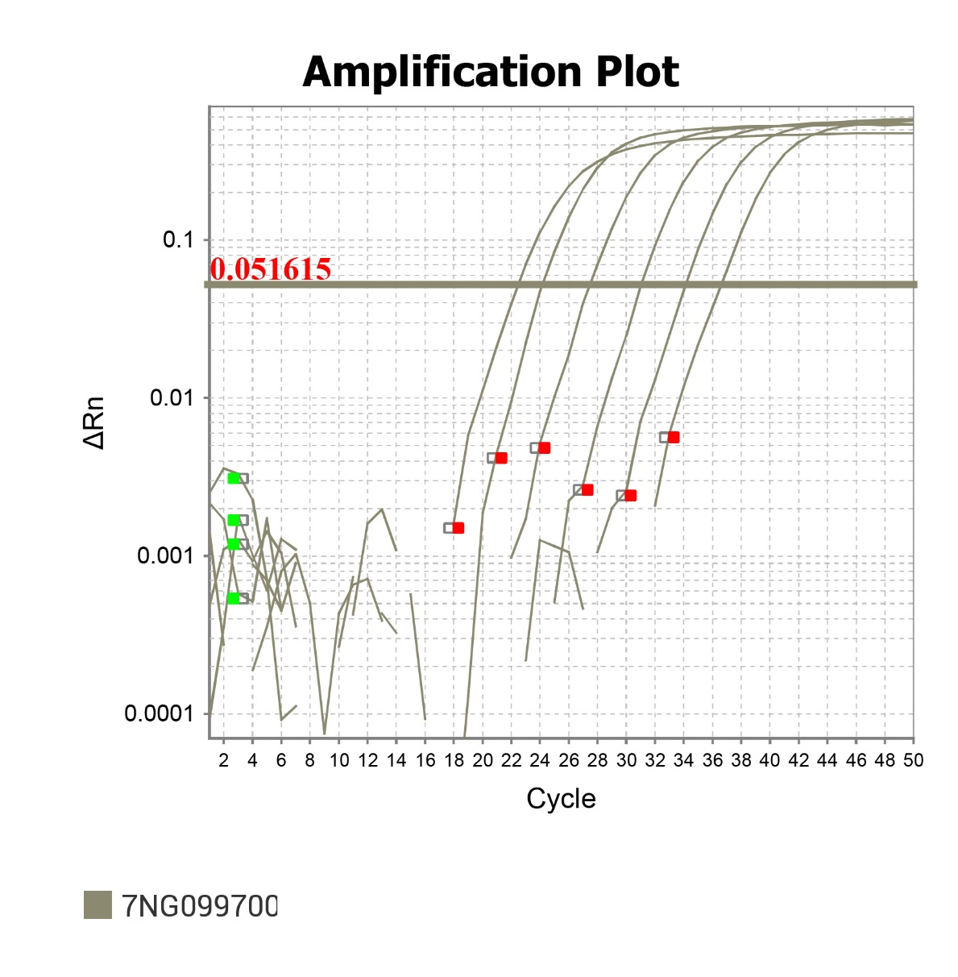
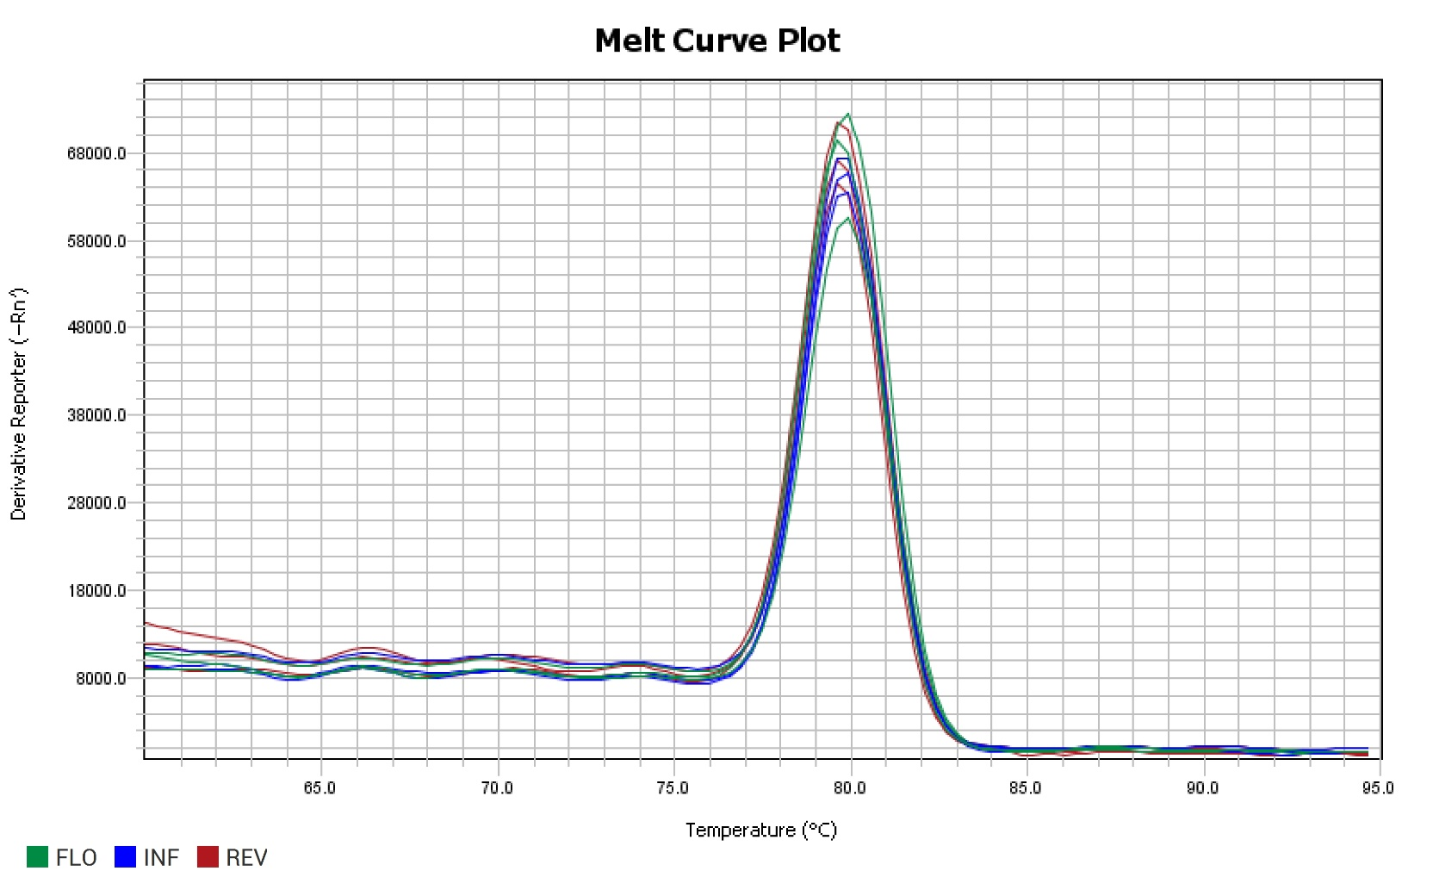
Gene: | Pavir.7NG099700 | PCR Efficiency: | 108.28% | Melt Peak: | 79.756

Slide 10
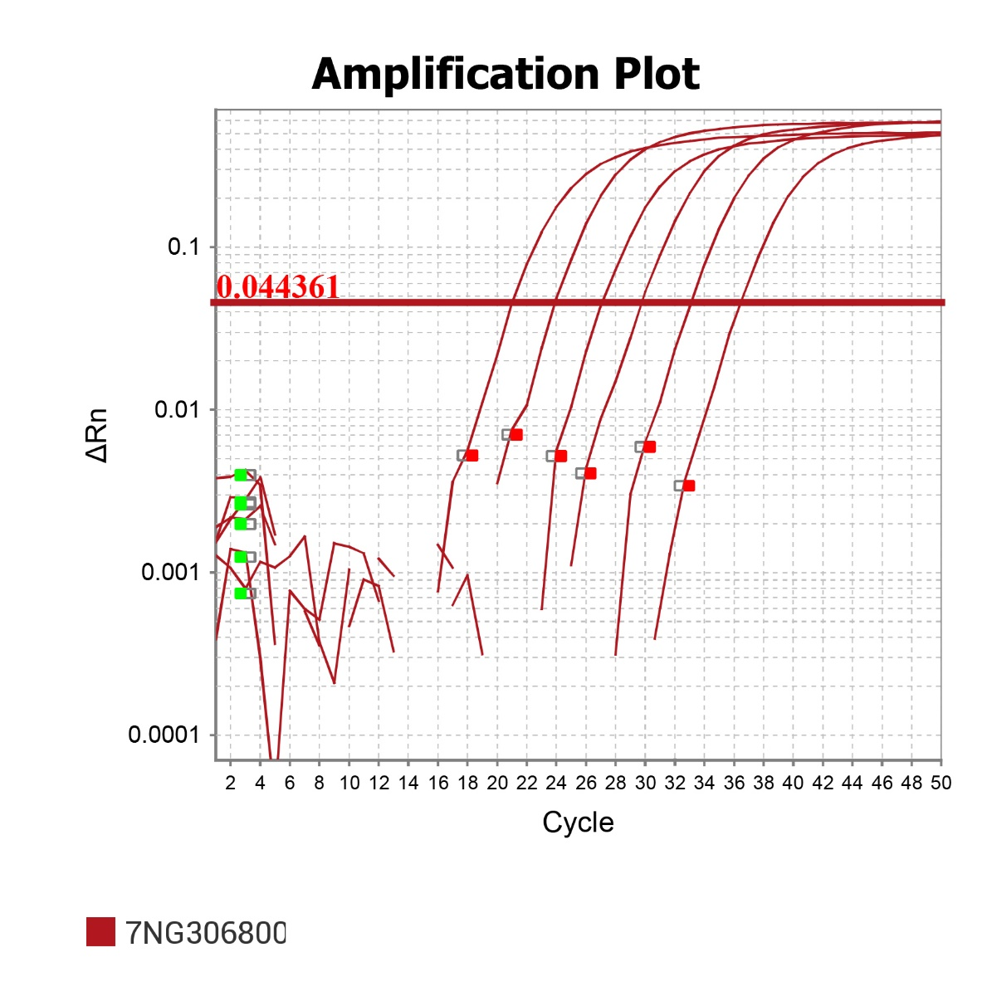
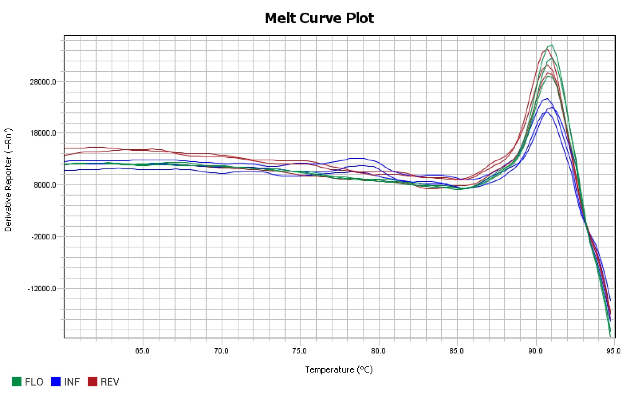
Gene: | Pavir.7NG306800 | PCR Efficiency: | 106.44% | Melt Peak: | 90.673

Slide 11
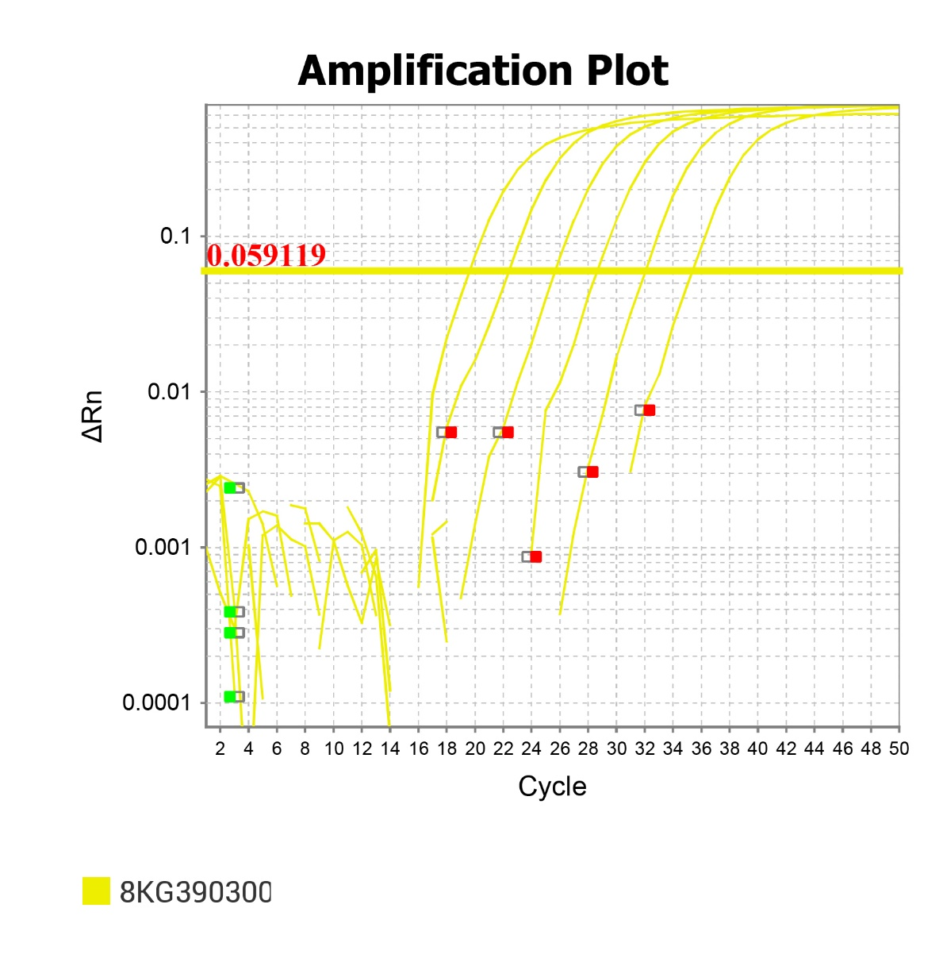
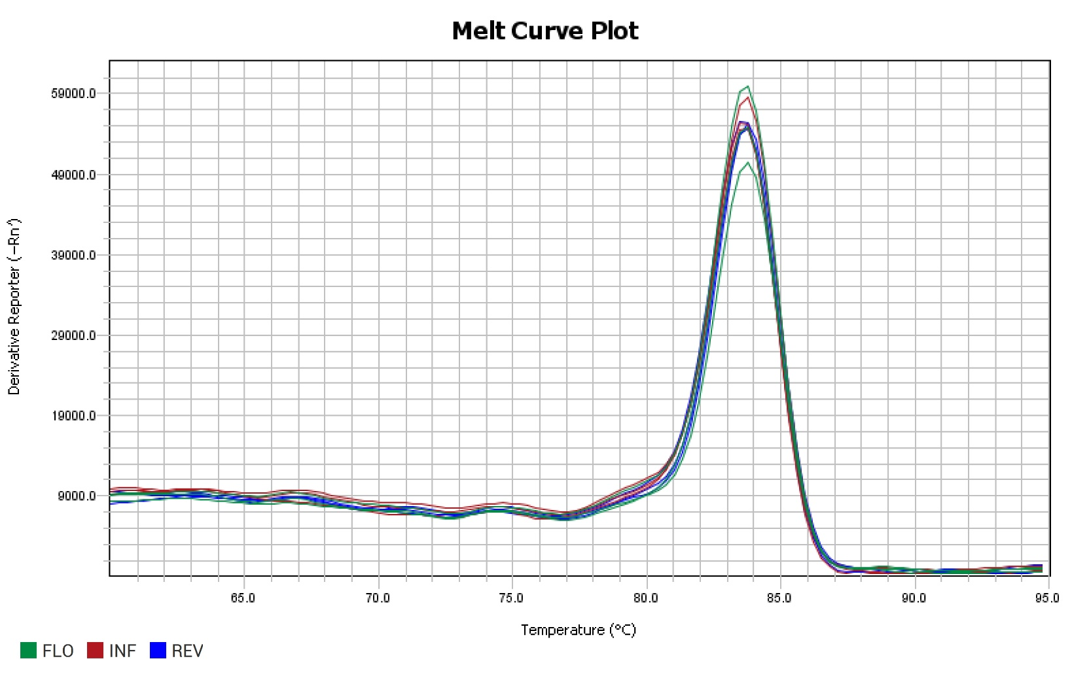
Gene: | Pavir.8KG390300 | PCR Efficiency: | 103.47% | Melt Peak: | 83.829

Slide 12
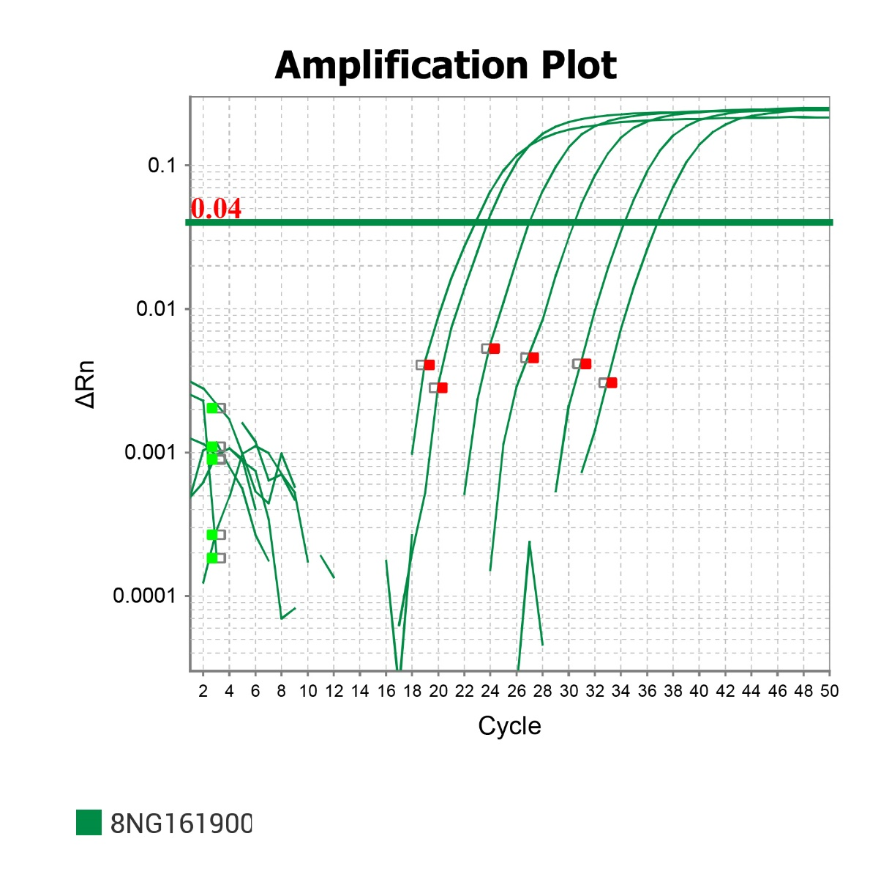
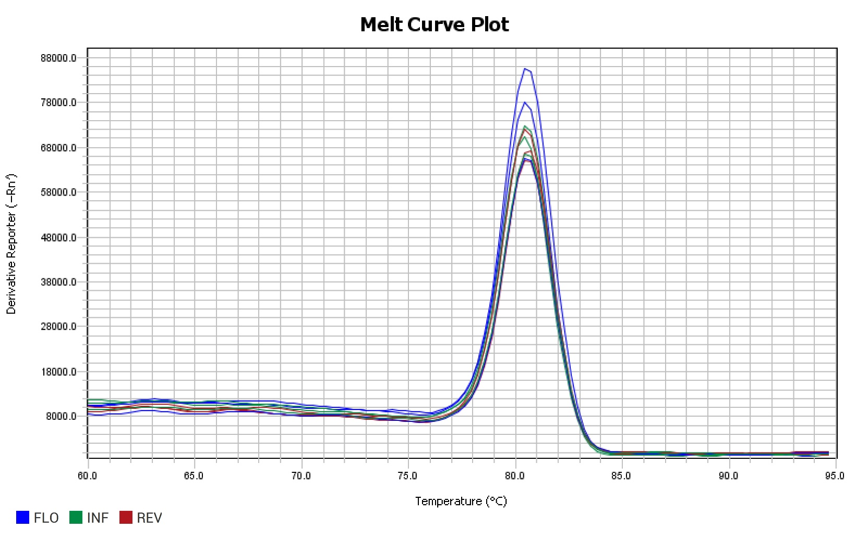
Gene: | Pavir.8NG161900 | PCR Efficiency: | 107.95% | Melt Peak: | 80.919

Slide 13
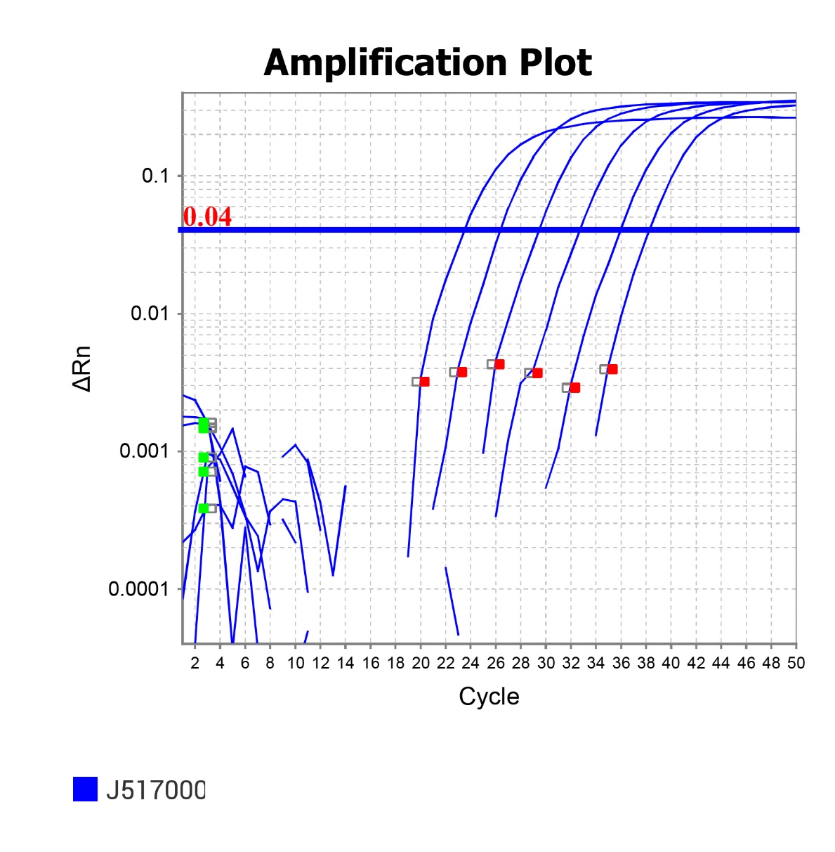
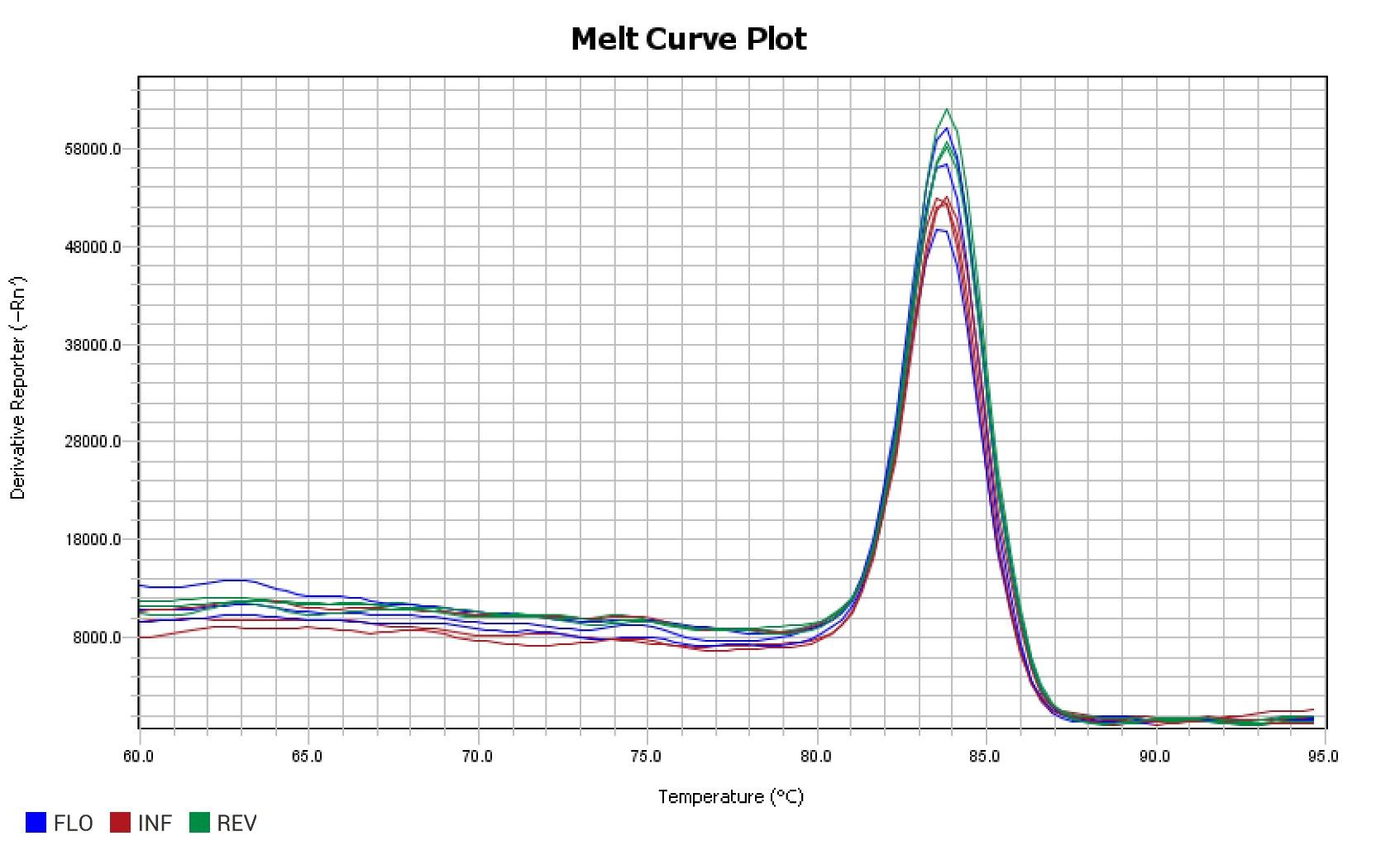
Gene: | Pavir.J517000 | PCR Efficiency: | 106.94% | Melt Peak: | 83.725

