Slide 1
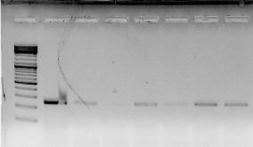
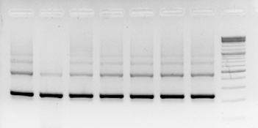
Cui et al., Figure 1B
OsDIRP1
OsUbiquitin
callus
stems
seedlings
flowers
callus
stems
roots
seedlings
flowers
leaves
panicles
leaves
roots
panicles

Slide 2
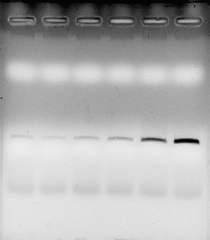
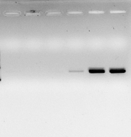
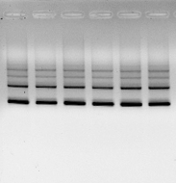
Cui et al., Figure 1C, Drought
OsDIRP1
OsRab16b
OsUbiquitin
Drought
Drought
Drought
0 15 30 60 120 240 (h)
0 15 30 60 120 240 (h)
0 15 30 60 120 240 (h)

Slide 3
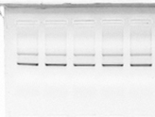
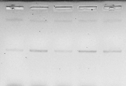
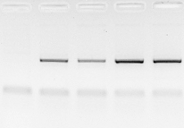
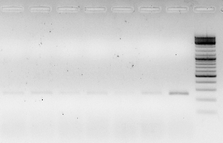
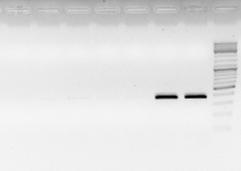
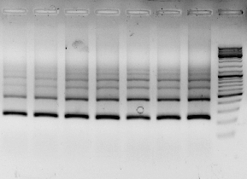
Cui et al., Figure 1C, ABA
OsUbiquitin
OsDIRP1
OsRab16b
ABA (100 µM)
ABA (100 µM)
ABA (100 µM)
0 3 6 12 24 (h)
0 3 6 12 24 (h)
0 3 6 12 24 (h)
Cui et al., Figure 1C, Salt
OsDIRP1
OsRab16b
OsUbiquitin
Mock
NaCl (300 mM)
Mock
NaCl (300 mM)
Mock
NaCl (300 mM)
0 1 4 8 1 4 8 (h)
0 1 4 8 1 4 8 (h)
0 1 4 8 1 4 8 (h)

Slide 4

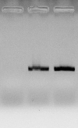
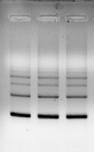
Cui et al. Fig. 1
Cui et al., Figure 1C, Cold
OsDIRP1
OsDREB1A
OsUbiquitin
Cold (4℃)
Cold (4℃)
Cold (4℃)
0 12 24 (h)
0 12 24 (h)
0 12 24 (h)

Slide 5
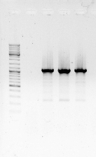
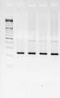
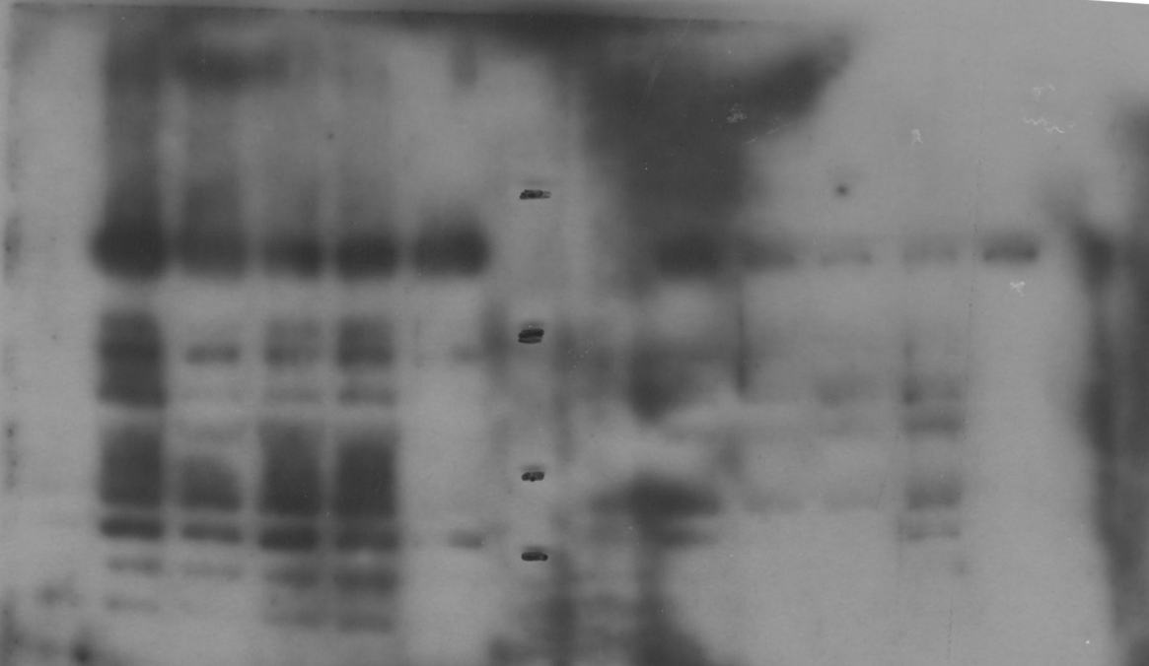
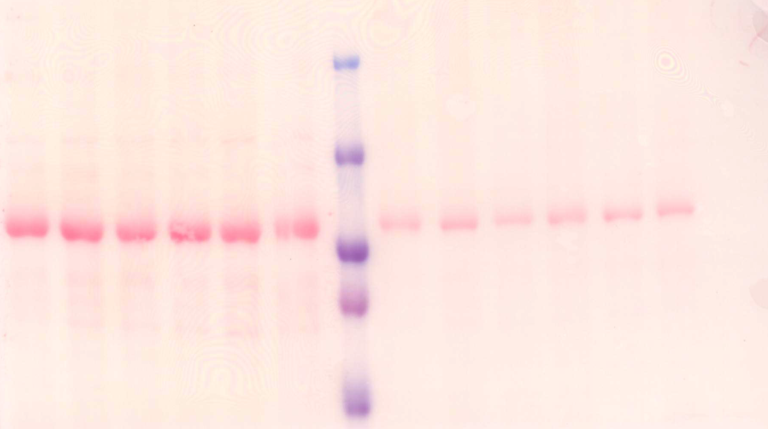
Cui et al., Figure 2C, RT-PCR
Cui et al., Figure 2D, immunoblot
OsDIRP1
OsUbiquitin
Ubi:OsDIRP1-sGFP
Ubi:OsDIRP1-sGFP
WT #1 #2 #3
WT #1 #2 #3
Ubi:OsDIRP1-sGFP
Ubi:OsDIRP1-sGFP
WT #1 #2 #3 #4 #5
WT #1 #2 #3 #4 #5
100 kDa
50 kDa
anti-GFP
Rubisco

Slide 6
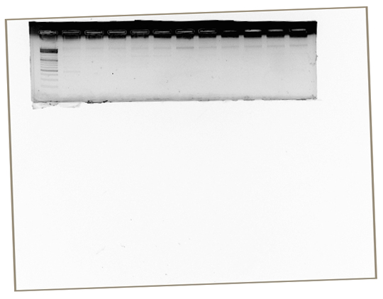
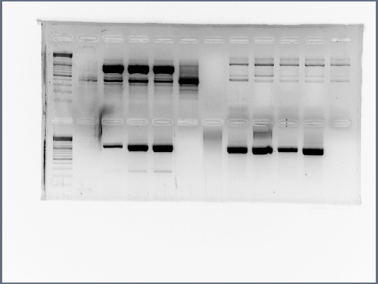
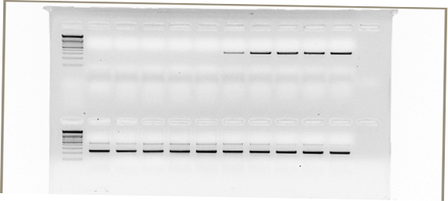
Cui et al., Figure 2E, RT-PCR
Normal condition
Drought condition (4 h)
Ubi:RNAi-OsDIRP1
Ubi:RNAi-OsDIRP1
WT #1 #2 #3
WT #1 #2 #3
OsDIRP1
OsUbiquitin

