Slide 1
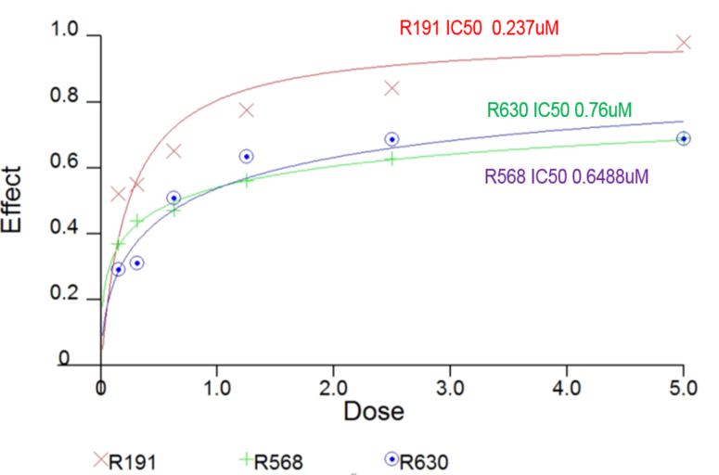
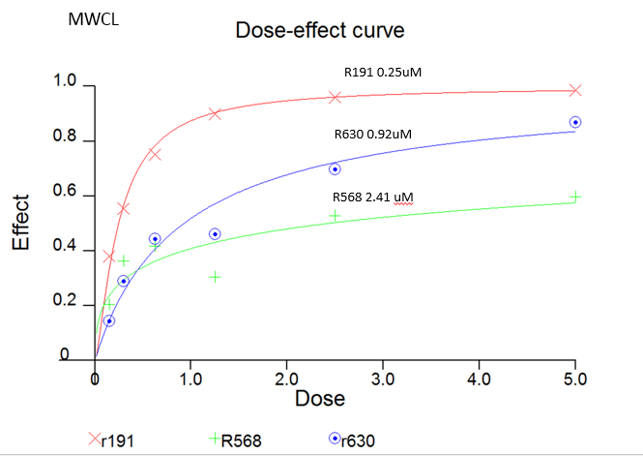
Supplementary Figure 1
BCWM.1
MWCL-1
Notes:
#27: Alignment of letters has been improved.

Slide 2
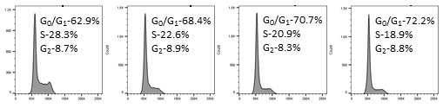
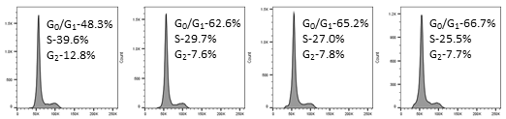
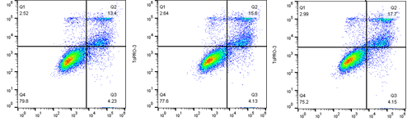
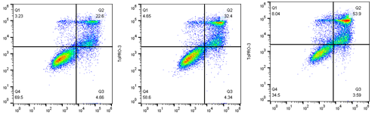
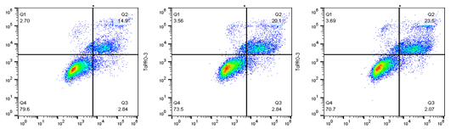
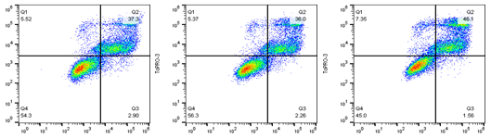
Supplementary Figure 2
A
B
MWCL-1
0 µM
0.15 µM
0.3 µM
0.6 µM
Count
BCWM.1
DAPI
0 µM 0.15 µM 0.3 µM 0.6 µM 1.25 µM 2.50 µM
ToPRO-3
MWCL-1-Apoptosis-24h
BCWM.1-Apoptosis-24h
Annexin-V

Slide 3
Supplementary Figure 3

Slide 4
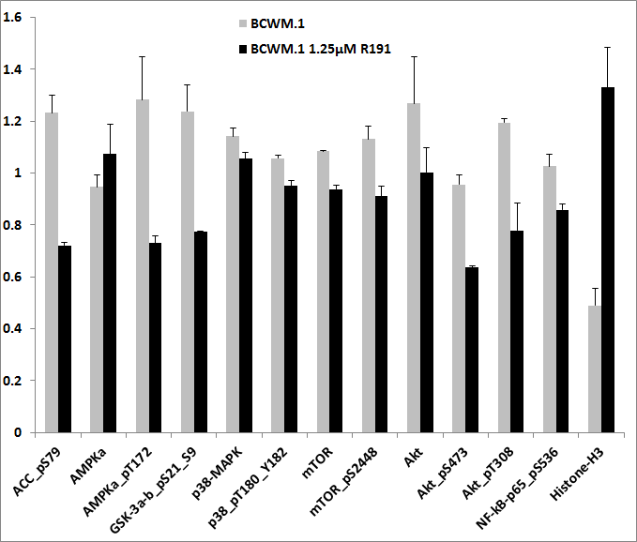
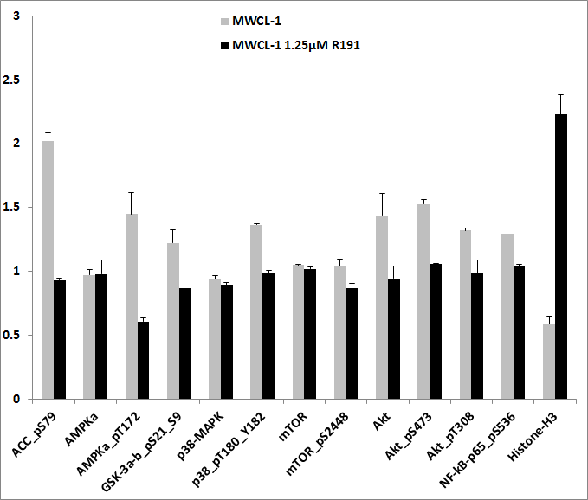
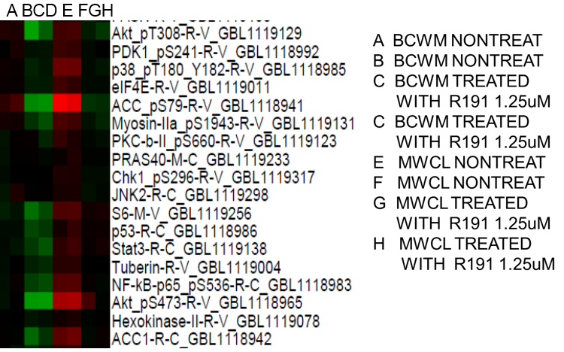
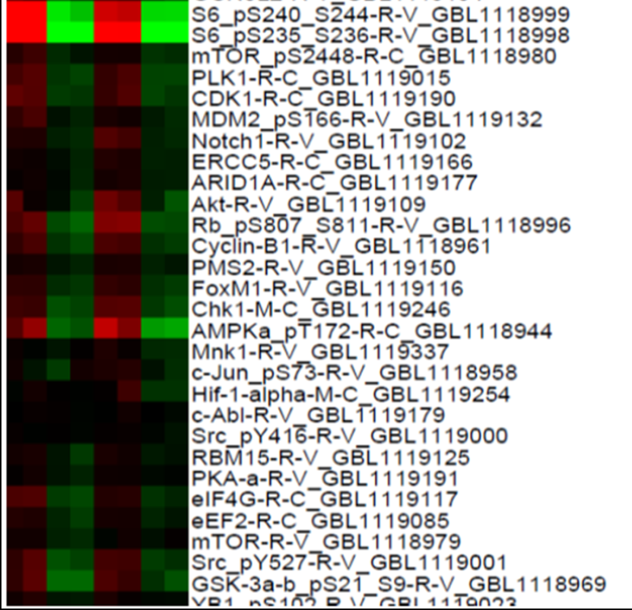
Supplementary Figure 4
A
B
*
*
*
*
*
*
*
*
*
Normalized Linear Values
*
*
*
*
*
*
*
*
*
*
*
AB C D E F G H
A
B
C
D
E
F
G
H
Notes:
#28: Data have been re-plotted and significance labels were added.

Slide 5
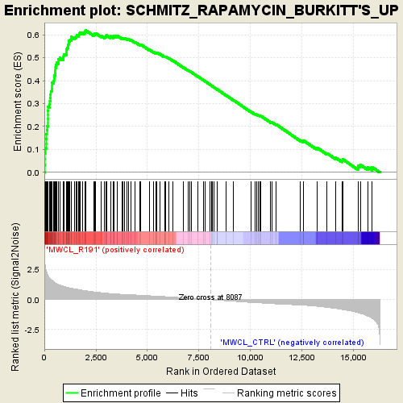
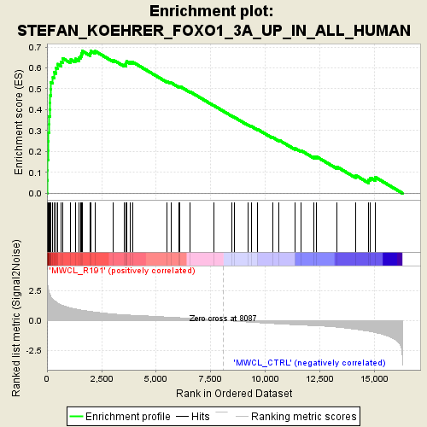
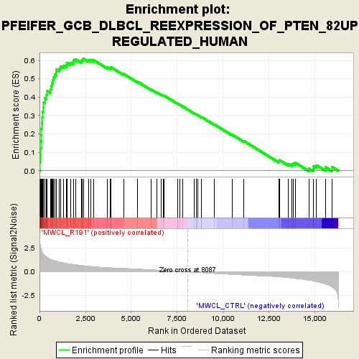
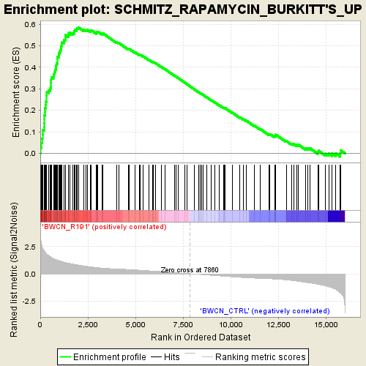
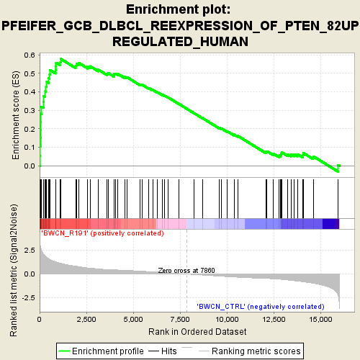
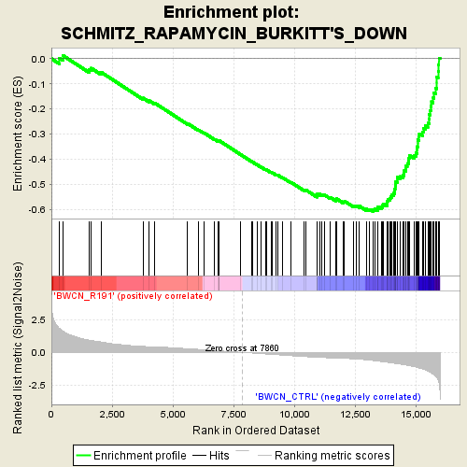
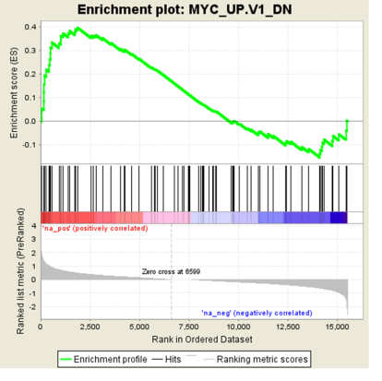
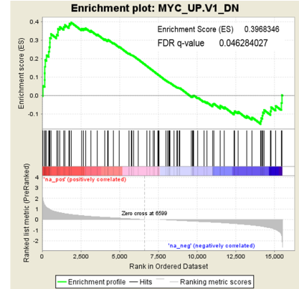
Supplementary Figure 5
A
B
BCWM.1
MWCL-1
BCWM.1 MWCL-1
Notes:
#28: Data have been re-plotted and significance labels were added.

Slide 6
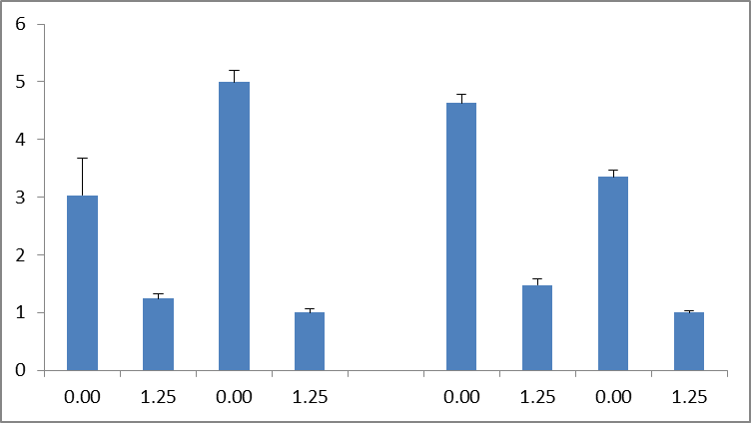
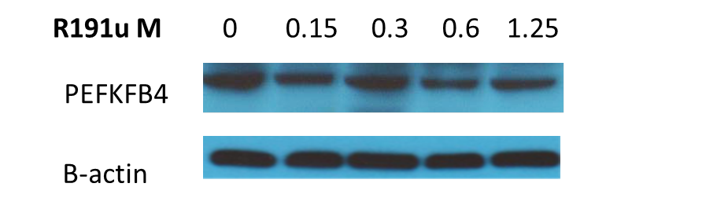
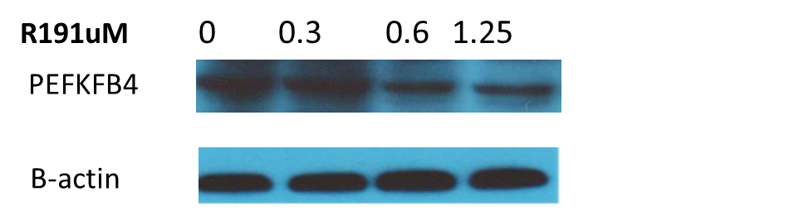
Supplementary Figure 6
A
B
BCWM.1
MWCL-1
6
5
4
3
2
1
0
***
***
***
***
Fold Change
R191 [μM]
*** p-Value ≤ 0.0005
BCWM.1
MWCL-1
R191 [μM] 0 0.15 0.3 0.6 1.25
0 0.3 0.6 1.25
PFKFB4
β-actin
Notes:
#28: Data have been re-plotted and significance labels were added.

Slide 7
Supplementary Figure 7
A
B
*
*
*
*
*
*P≤0.01
*
*
*
*P≤0.01
*
Notes:
#12: xBP1 label was fixed in panel A
#13: Significance labels were added to panels A, B and figure legend has been adjusted accordingly.

Slide 8
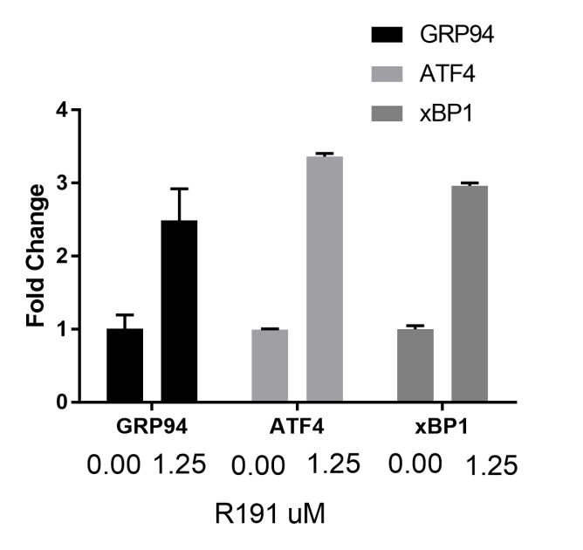


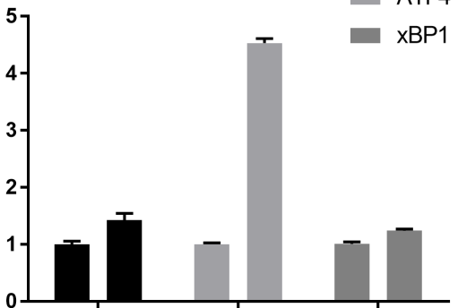
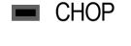


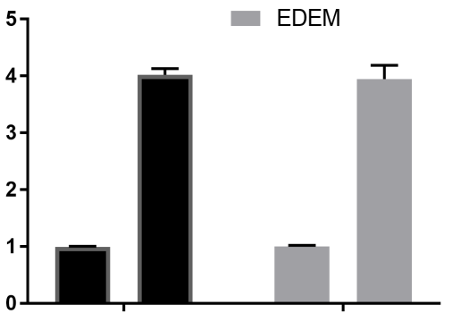
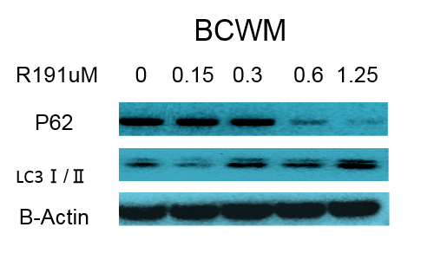
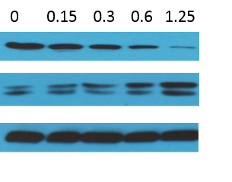
Supplementary Figure 8
A
B
BCWM.1
MWCL-1
GRP94
ATF4
XBP1
GRP94
ATF4
XBP1
*
***
***
***
Fold Change
Fold Change
*
**
R191 [μM]
R191 [μM]
CHOP
EDEM
CHOP
EDEM
***
***
**
Fold Change
**
Fold Change
R191 [μM]
R191 [μM]
R191 [μM] 0 0.15 0.3 0.6 1.25
0 0.15 0.3 0.6 1.25
p62
LC3 I/II
β-actin
Notes:
#12: xBP1 label was fixed in panel A
#13: Significance labels were added to panels A, B and figure legend has been adjusted accordingly.

Slide 9
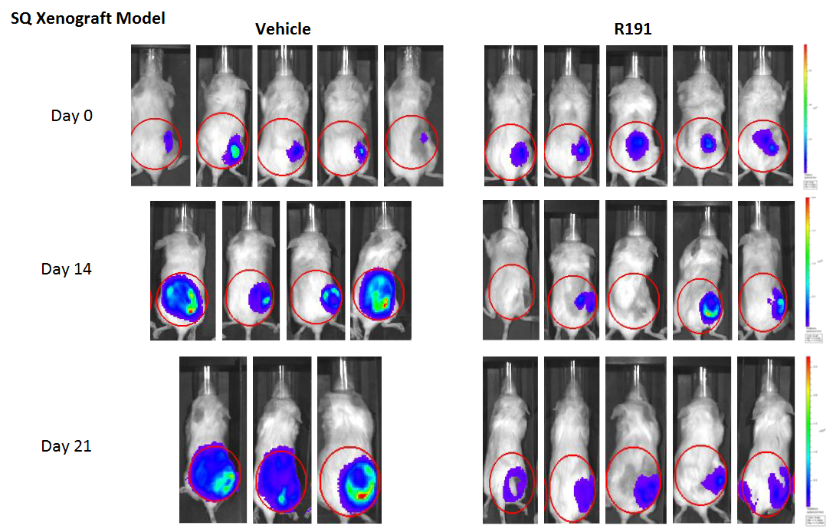
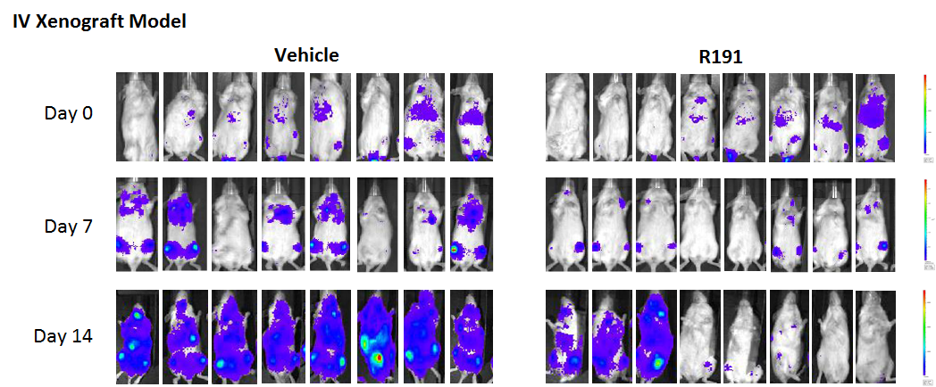
Supplementary Figure 9
A
B
C
SC Xenograft Model
IV Xenograft Model
IV Xenograft SC Xenograft
Notes:
Xenograft labels have been changed.

Slide 10
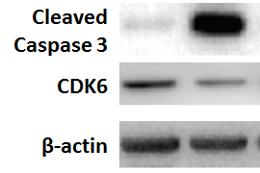
Supplementary Figure 10
Control
R191
Control
R191
SC Xenograft Tumors
Notes:
Xenograft labels have been changed.

