Slide 1
Supplementary Figure 1
Assay Optimization
Outcome
6 compounds tested in 12 cell lines; 11-point concentration response; 1:3 dilution; ATPlite reagent
2 controls
Primary Screening
Drug library of 7914 compounds in 12 cell lines; 5-point concentration response; 1:5 dilution;
48 hour incubation with compounds;
ATPlite reagent
256 hit compounds
205 compounds confirmed in at least one cell line
Secondary Screening
256 compound hit confirmation with 11-point dose response in triplicate; 1:3 dilution; 48 hour incubation with compounds; ATPlite reagent
Independent HEK 293T toxicity confirmation
7/8 compounds confirmed toxic to HEK239T
Hit confirmation with 11-point dose response in triplicate; 1:3 dilution; CellTiter Glo reagent

Slide 2
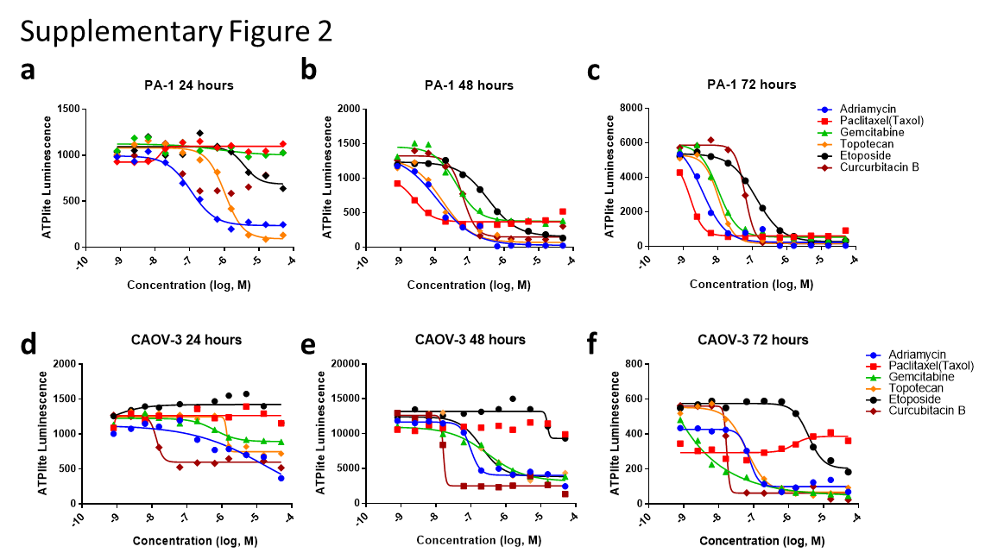

Slide 3
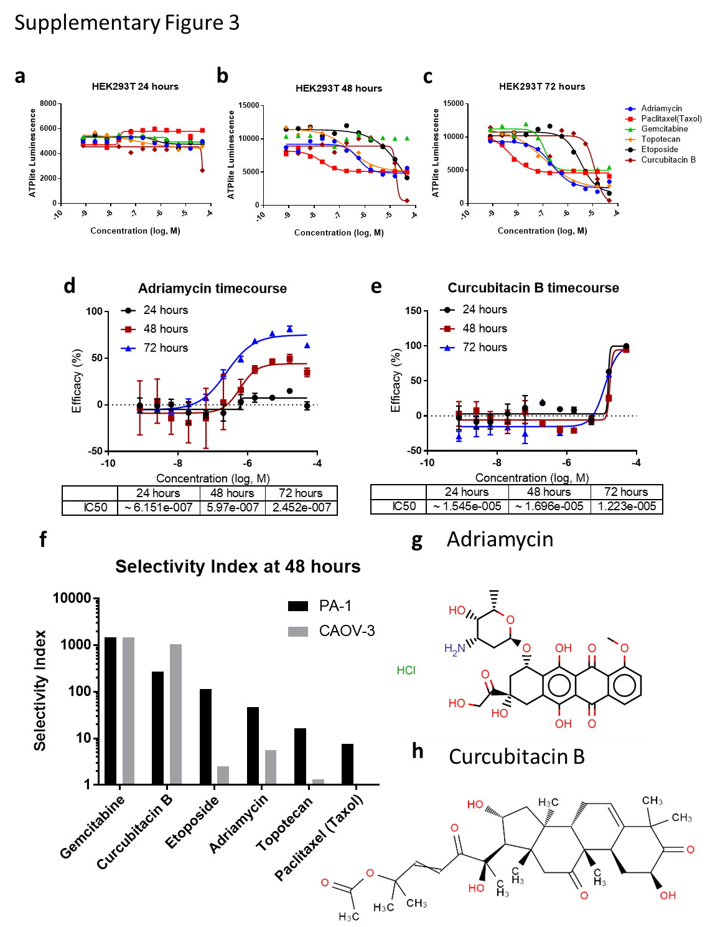

Slide 4
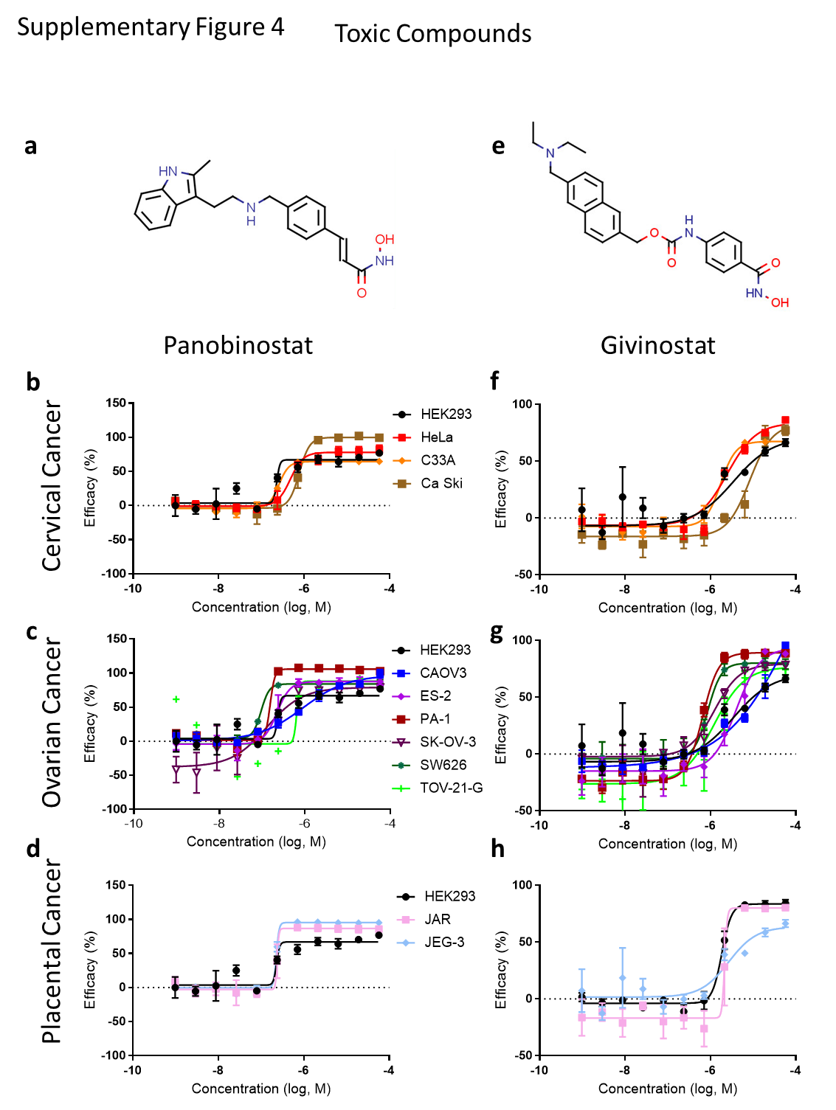

Slide 5
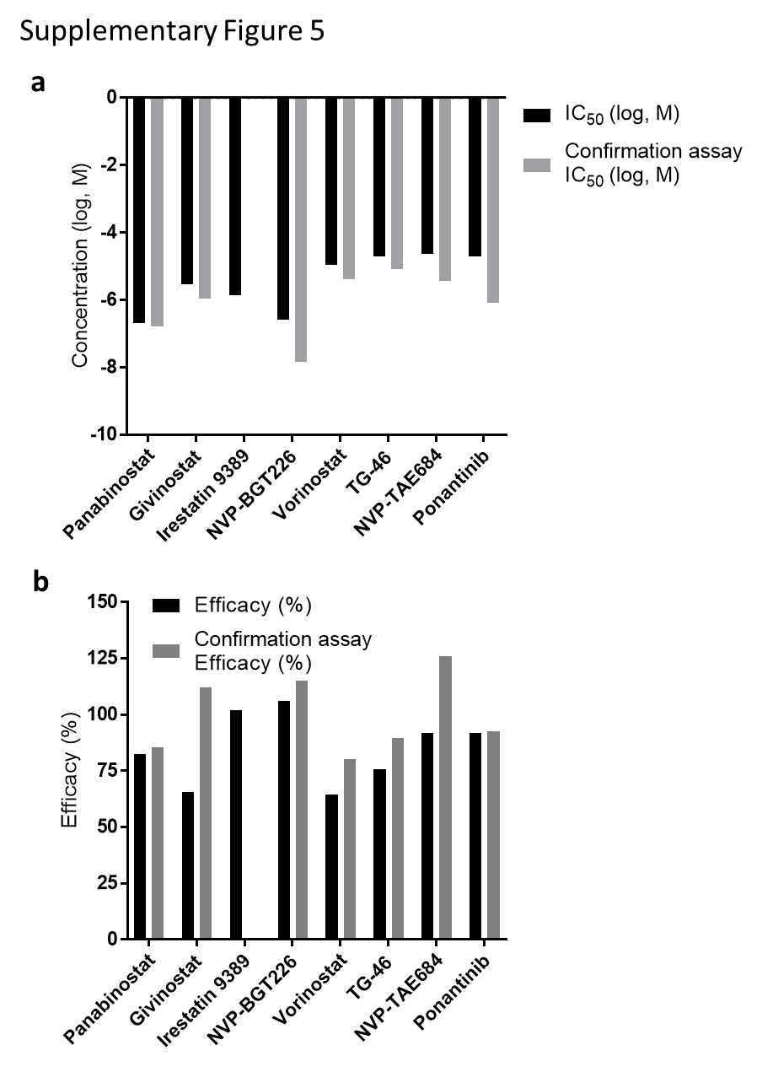

Slide 6
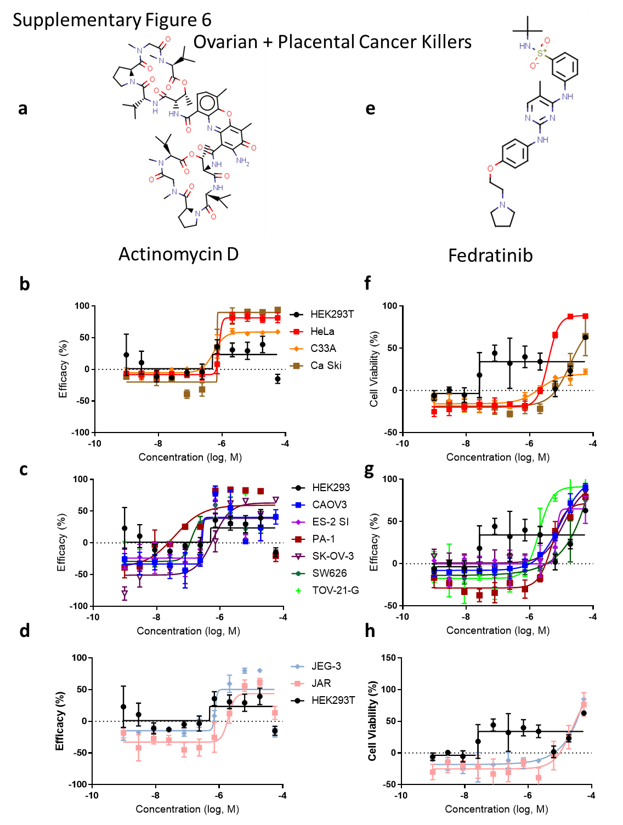

Slide 7
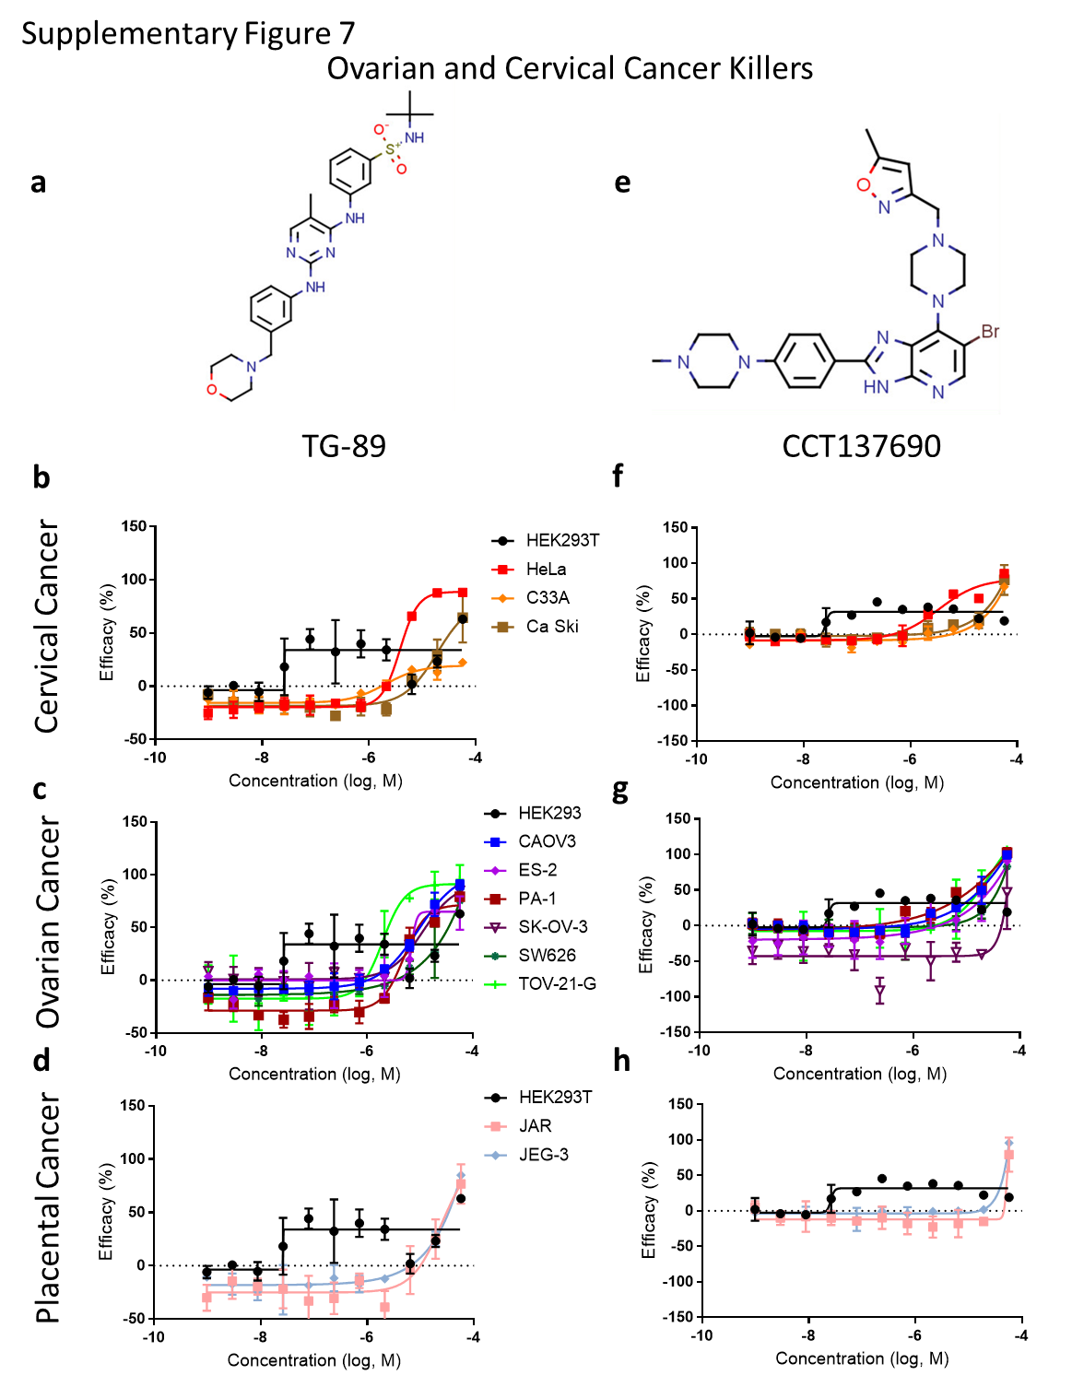

Slide 8
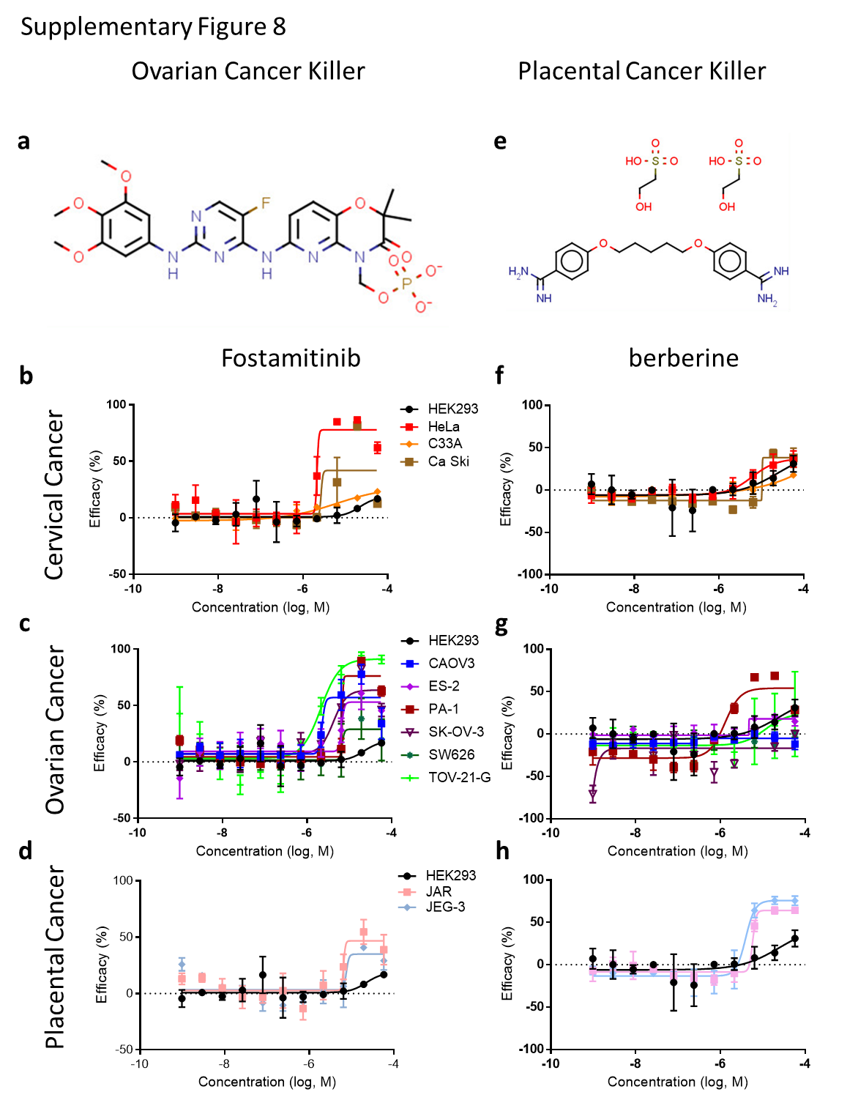

Slide 9
