Slide 1
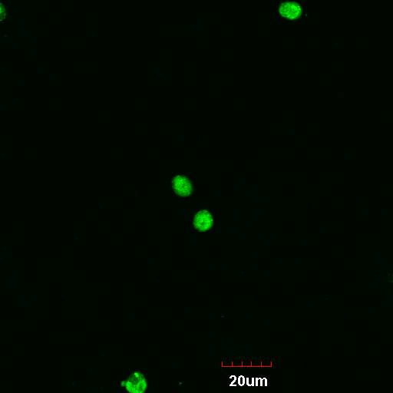
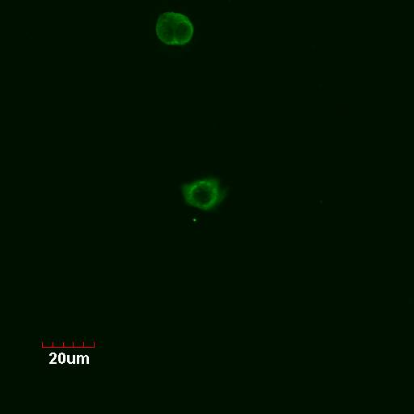
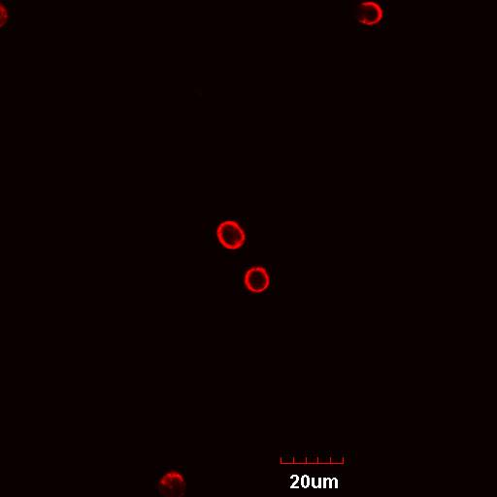
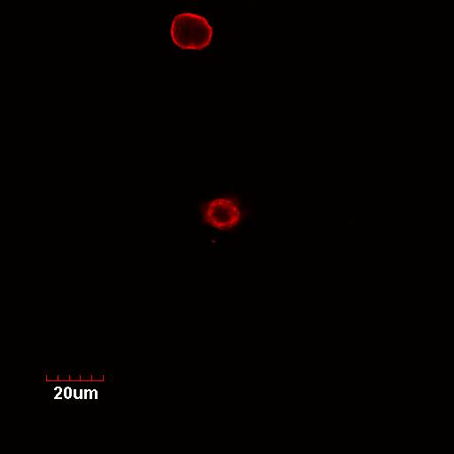
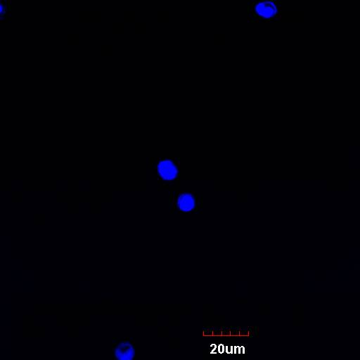
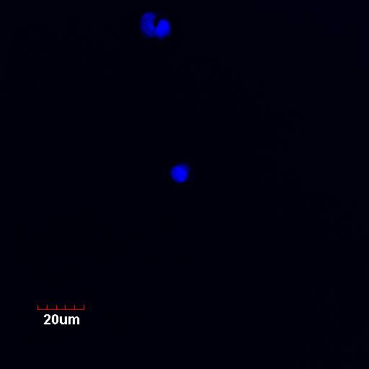
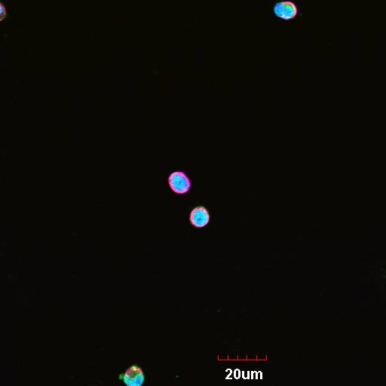
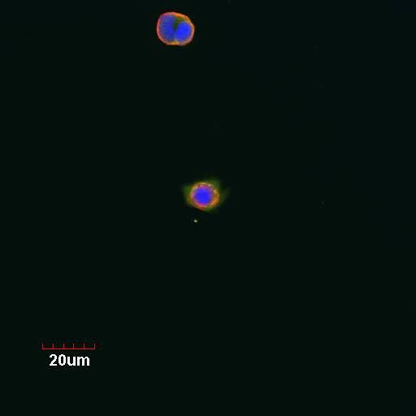
A
CTL
CHF
Epac1
Vimentin
TO-PRO-3
Merge
20 μM
B
C
Online Figure 1

Slide 2
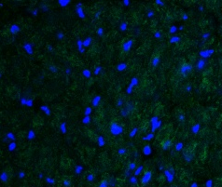
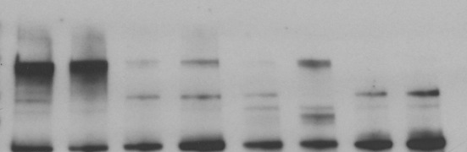
A
CTL
CHF
Epac1
TO-PRO-3
Merge
50 μm
B
CTL
CHF
CTL
CHF
kDa
250
150
100
75
Epac1
(~104 kDa)
Atrial
Ventricle
Online Figure 2

Slide 3
A
B
C
D
Online Figure 3

Slide 4
A
B
Days | 0 | 1 | 2 | 4 | 5 | 10 | 14
MI + Veh-corn oil | 10 | 10 | 10 | 9 | 8 | 8 | 8
MI + ESI-09 | 14 | 13 | 13 | 9 | 8 | 8 | 8
Days | 0 | 2 | 3 | 4 | 5 | 10 | 14
MI + Veh-saline | 9 | 8 | 8 | 6 | 5 | 5 | 5
MI + Sp-8-pCPT | 17 | 16 | 13 | 13 | 11 | 11 | 11
Groups
(no. of surviving mice)
Groups
(no. of surviving mice)
C
D
Online Figure 4

Slide 5
A
B
C
D
E
F
G
H
I
MI + Veh-corn oil
MI + Veh-saline
Online Figure 5

Slide 6
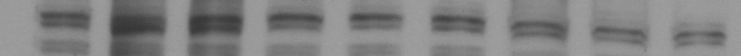
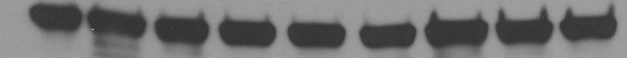
A
Sham MI + Veh MI + ESI-09
104 kDa
Epac1
36 kDa
GAPDH
B
Online Figure 6

Slide 7
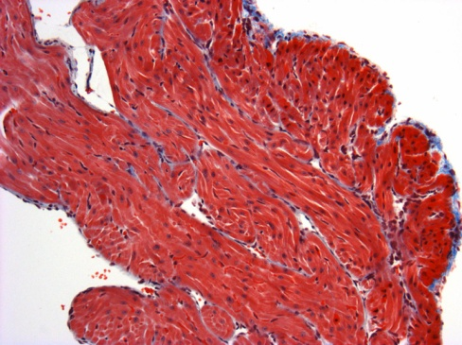
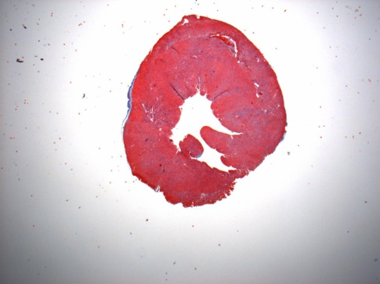
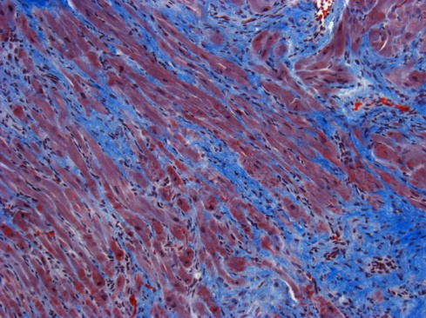
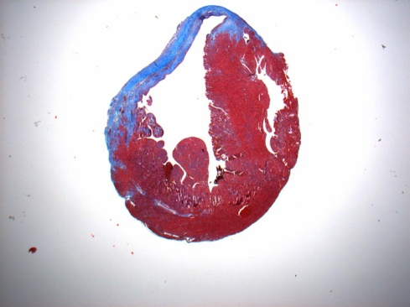
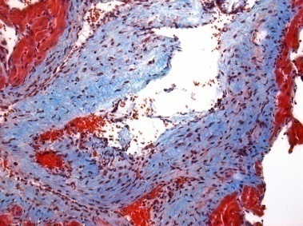
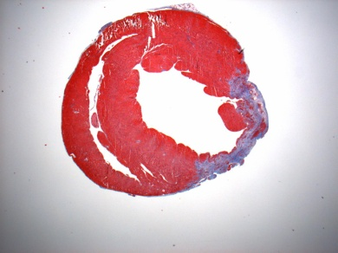
A
Atrial sections
Ventricular sections
Sham
MI + Veh
MI + ESI-09
0.2 mm
1 mm
B
C
Online Figure 7

Slide 8
A
B
C
D
E
F
G
H
I
Sham
MI + Veh
MI + ESI-09
Online Figure 8

Slide 9
TGFβR
TGFβ1
SIS3
P
Cardiac fibroblast
P
Smad3
Salbutamol
Smad3
ISO
β2-AR
ICI-118551
ESI-09
8-pCPT
Epac1
cAMP
CHF, MI
AC
8Br-cAMP
Collagen
α-AR
NE
Online Figure 9
Phenylephrine
Prazosin

