Slide 1
Tuning recombinant protein expression to match secretion capacity
Additional file 1
Luminita Gabriela Horga^{1*}, Samantha Halliwell^{1*}, Tania Selas Castiñeiras², Chris Wyre², Cristina F.R.O. Matos², Daniela S. Yovcheva², Ross Kent¹, Rosa Morra¹, Steven G. Williams², Daniel C. Smith², Neil Dixon¹
¹Manchester Institute of Biotechnology, School of Chemistry, University of Manchester, Manchester, UK M1 7DN. ²Cobra Biologics Ltd, Keele, UK, ST5 5SP
*These authors contributed equally
Corresponding author:
neil.dixon@manchester.ac.uk

Slide 2
Tuning recombinant protein expression to match secretion capacity
Additional file 1
Table S1 3
Table S2 4
Table S3 5
Table S4 6
Table S5 7
Table S6 8
Figure S1 9
Figure S2 10
Figure S3 11
Figure S4 12
Figure S5 13
Figure S6 14
Figure S7 15
Figure S8 16
Figure S9 17
Figure S10 18
Figure S11 19
Figure S12 20
Figure S13 21

Slide 3
Table S1
 |  | Max (IP) | IPTG (I) | Uninduced (UI) | IP/I | IP/UI
BL21 (IL3) | 14h, 30°C, TB | 19,912 | 815 | 84 | 24 | 237
 | 3h, 37°C, LB | 11,756 | 326 | 29 | 36 | 404
BL21 (LV2) | 14h, 30°C, TB | 28,478 | 668 | 23 | 43 | 1243
 | 3h, 37°C, LB | 9,307 | 292 | 14 | 32 | 643
K12 (LV2) | 14h, 30°C, TB | 12,464 | 344 | 18 | 36 | 684
 | 3h, 37°C, LB | 5,117 | 99 | 27 | 52 | 191
BL21 (DE3) | 14h, 30°C, TB | 31,373 | 13474 | 1083 | 2 | 29
 | 3h, 37°C, LB | 21,779 | 6,649 | 234 | 3 | 93
Notes:
Table S1. Performance of the different strains to express recombinant eGFP under riboswitch control. Gene expression was monitored and expressed as relative fluorescence units (RFU) over optical cell density (OD). Measured in the absence of inducer (UI), with IPTG induction only (I) and with both100µM IPTG and 400µM PPDA induction (IP). The highest gene expression value (max) at IP induction conditions was recorded in the table.

Slide 4
Table S2
SP | Variant | Nucleotide Sequence
DsbA | E1 | ATGAAAAAGATCTGGCTGGCACTGGCAGGTCTGGTTCTGGCATTTAGCGCAAGCGCC
yBGL2 | H1 | ATGCGCTTTAGTACGACACTGGCGACGGCCGCAACGGCCCTCTTCTTCACGGCGAGTCAGGTAAGCGCG
Piii | E5 | ATGAAGAAGCTACTATTCGCCATTCCGCTGGTTGTTCCGTTTTATAGCCATAGCGCC
PelB | A5 | ATGAAATATCTGCTTCCGACCGCTGCTGCTGGTCTGCTGCTCCTCGCTGCCCAGCCGGCGATGGCC
Notes:
Table S2. Nucleotide composition of the signal peptide mutant variants. Green indicates unchanged nucleotide, while blue indicated modified nucleotides.

Slide 5
Supplementary Table S3
mg/g DCW |  | Sample | Max (IP) | IPTG (I) | Uninduced (UI) | IP/I | Secretion(%) | EC50 (µM) | DRLR | OD600 at UI | OD600 at Max (IP)
DsbA E1 | scFvβ | Media | 0.9 ± 0.6 | 0.0 ± 0.0 | 0.0 ± 0.0 | - | n/a | 17 ± 7 | 58 | 13 ± 0.3 | 11 ± 0.3
 |  | Periplasm | 6.7 ± 1.8 | 1.2 ± 0.1 | 0.0 ± 0.0 | 5 | n/a | 6 ± 2 | 78
 |  | Spheroplast | 1.7 ± 0.5 | 0.1 ± 0.1 | 0.0 ± 0.0 | 27 | n/a | 32 ± 4 | 22
 |  | Secreted | 7.6 ± 1.9 | 1.2 ± 0.1 | 0.0 ± 0.0 | 6 | 81 | 7 ± 2 | 76
 |  | Total | 9.4 ± 2.0 | 1.3 ± 0.1 | 0.0 ± 0.0 | 7 | n/a | 10 ± 2 | 107
 | scFvT | Media | 2.4 ± 0.5 | 0.1 ± 0.0 | 0.0 ± 0.0 | 20 | n/a | nf | 263 | 11 ± 1.8 | 12 ± 0.8
 |  | Periplasm | 7.4 ± 1.8 | 1.3 ± 0.8 | 0.6 ± 0.1 | 6 | n/a | 7 ± 1 | 1,712
 |  | Spheroplast | 5.7 ± 1.9 | 0.3 ± 0.1 | 0.0 ± 0.0 | 23 | n/a | 41 ± 2 | 46
 |  | Secreted | 9.8 ± 1.8 | 1.4 ± 0.8 | 0.6 ± 0.1 | 7 | 63 | 35 ± 9 | 9,179
 |  | Total | 15.5 ± 2.6 | 1.7 ± 0.8 | 0.6 ± 0.1 | 9 | n/a | 40 ± 8 | 940
 | scFvH | Media | 0.0 ± 0.0 | 0.0 ± 0.0 | 0.0 ± 0.0 | - | n/a | nf | nf | 14 ± 0.8 | 8 ± 0.0
 |  | Periplasm | 1.8 ± 1.1 | 0.5 ± 0.1 | 0.0 ± 0.0 | 4 | n/a | nf | nf
 |  | Spheroplast | 3.1 ± 0.4 | 0.5 ± 0.2 | 0.0 ± 0.0 | 6 | n/a | 6 ± 0 | 96
 |  | Secreted | 1.8 ± 1.1 | 0.5 ± 0.1 | 0.0 ± 0.0 | 4 | 37 | nf | nf
 |  | Total | 4.9 ± 1.2 | 1.0 ± 0.3 | 0.0 ± 0.0 | 5 | n/a | 3 ± 1 | 1,443
Piii E5 | scFvβ | Media | 0.7 ± 0.4 | 0.0 ± 0.0 | 0.0 ± 0.0 | - | n/a | nf | 5 | 12 ± 0.8 | 10 ± 0.5
 |  | Periplasm | 4.9 ± 0.3 | 0.6 ± 0.2 | 0.0 ± 0.0 | 8 | n/a | 11 ± 7 | 57
 |  | Spheroplast | 23.4 ± 7.9 | 2.1 ± 1.1 | 0.0 ± 0.0 | 11 | n/a | 42 ± 21 | 373
 |  | Secreted | 5.6 ± 0.5 | 0.6 ± 0.2 | 0.0 ± 0.0 | 13 | 19 | 9 ± 6 | 40
 |  | Total | 29.0 ± 7.9 | 2.7 ± 1.1 | 0.0 ± 0.0 | 11 | n/a | 23 ± 6 | 159
 | scFvT | Media | 8.3 ± 3.4 | 0.5 ± 0.3 | 0.0 ± 0.0 | 17 | n/a | nf | nf | 11 ± 1.6 | 7 ± 1.3
 |  | Periplasm | 4.5 ± 4.2 | 10.0 ± 1.0 | 0.8 ± 0.6 | 0 | n/a | nf | nf
 |  | Spheroplast | 125.2 ± 5.7 | 3.4 ± 1.8 | 0.6 ± 0.8 | 37 | n/a | nf | nf
 |  | Secreted | 12.8 ± 5.4 | 10.5 ± 1.0 | 0.8 ± 0.6 | 1 | 9 | nf | nf
 |  | Total | 138.0 ± 7.8 | 13.9 ± 2.1 | 1.4 ± 1.0 | 10 | n/a | nf | nf
 | scFvH | Media | 0.0 ± 0.0 | 0.0 ± 0.0 | 0.0 ± 0.0 | - | n/a | nf | nf | 14 ± 0.8 | 11 ± 0.0
 |  | Periplasm | 1.7 ± 0.6 | 0.7 ± 0.7 | 0.0 ± 0.0 | 2 | n/a | nf | nf
 |  | Spheroplast | 5.8 ± 1.5 | 0.2 ± 0.1 | 0.0 ± 0.0 | 26 | n/a | 33 ± 13 | 487
 |  | Secreted | 1.7 ± 0.6 | 0.7 ± 0.7 | 0.0 ± 0.0 | 2 | 23 | nf | nf
 |  | Total | 7.5 ± 1.6 | 1.0 ± 0.7 | 0.0 ± 0.0 | 8 | n/a | 40 ± 27 | 313
Note: nf = not-fittable; n/a –not-applicable
Notes:
Table S3. Performance of the pDEST for different scFv expression and secretion. Gene expression was quantified by western blot analysis using purified protein standard. Protein levels were calculated in the absence of inducer (UI), with IPTG induction only (I) and with both IPTG and PPDA induction (IP). A summary of the highest protein levels (max), minimal protein levels and basal levels is represented in the table. The highest protein levels were seen with both IPTG and PPDA induction, while the lowest were seen in the absence of inducer. No basal expression was observed in the BL21(LV2) strains, within the western blot detection limit.

Slide 6
Supplementary Table S4
 | mg/g DCW | Max (IP) | IPTG (I) | Pre-induction | IP/I | IP/UI | Secretion (%)
DsbA E1 | Media | 3 ± 1 | 0 ± 0 | 0 | 49 | ≥ 307 | -
 | Periplasm | 9 ± 4 | 1 ± 1 | 0 | 7 | ≥ 940 | -
 | Spheroplast | 20 ± 9 | 0 ± 0 | 0 | 160 | ≥ 3,021 | -
 | Secreted | 12 ± 3 | 1 ± 1 | 0 | 9 | ≥ 1,247 | 29
 | Total | 43 ± 11 | 2 ± 1 | 0 | 27 | ≥ 4,267 | -
Piii E5 | Media | 4 ± 1 | 0 ± 0 | 0 | 47 | ≥ 411 | -
 | Periplasm | 10 ± 1 | 2 ± 0 | 0 | 4 | ≥ 971 | -
 | Spheroplast | 37 ± 6 | 0 ± 0 | 0 | 76 | ≥ 3,729 | -
 | Secreted | 14 ± 2 | 2 ± 1 | 0 | 6 | ≥ 1,382 | 27
 | Total | 51 ± 6 | 3 ± 1 | 0 | 17 | ≥ 5,111 | -
 | mg/L | Max (IP) | IPTG (I) | Pre-induction | IP/I | IP/UI | Secretion (%)
DsbA E1 | Media | 61 ± 15 | 1 ± 2 | 0 | 43 | ≥ 6,095 | -
 | Periplasm | 187 ± 70 | 31 ± 14 | 0 | 6 | ≥ 18,688 | -
 | Spheroplast | 612 ± 158 | 4 ± 3 | 0 | 146 | ≥ 61,150 | -
 | Secreted | 248 ± 65 | 32 ± 13 | 0 | 8 | ≥ 24,783 | 29
 | Total | 859 ± 199 | 36 ± 16 | 0 | 24 | ≥ 85,933 | -
Piii E5 | Media | 80 ± 12 | 2 ± 2 | 0 | 42 | ≥ 8,017 | -
 | Periplasm | 189 ± 18 | 53 ± 14 | 0 | 4 | ≥ 18,930 | -
 | Spheroplast | 727 ± 123 | 11 ± 9 | 0 | 68 | ≥ 72,690 | -
 | Secreted | 269 ± 29 | 55 ± 14 | 0 | 5 | ≥ 26,947 | 27
 | Total | 996 ± 117 | 66 ± 22 | 0 | 15 | ≥ 99,638 | -
Notes:
Table S4. Trial 1 - Performance of pDEST with DsbA E1 and Piii E5 for scFvβ expression and secretion in fed-batch fermentation (trial 1) at 4hrs post-induction. Protein production was quantified after western blot analysis using a known protein standard as mg per g dry cell weight (mg/g DCW) and mg per L (mg/L). Protein levels were calculated in the absence of inducer (UI), with IPTG induction only (I) and with both IPTG and PPDA induction (IP). A summary of the highest protein levels (max), minimal protein levels and basal levels is represented in the table. The highest protein levels were seen with both IPTG and PPDA induction, while the lowest were seen in the absence of inducer. No basal expression was observed in the BL21(LV2) strains prior to induction, within the western blot detection limit (50pg scFv, 0.01 mg/L at biomass OD 10). Induction control max over pre-induction (IP/UI) was calculated relative to the lower western blot detection limit.

Slide 7
Supplementary Table S5
DsbA E1 | mg/g DCW | Max (IP) | 20 IP | Pre-induction | Max IP/20 IP | IP/UI | Secretion (%)
scFvβ | Media | 0 ± 0 | 0 ± 0 | 0 | 11 | ≥ 12 | -
 | Periplasm | 11 ± 2 | 3 ± 1 | 0 | 3 | ≥ 1,087 | -
 | Spheroplast | 7 ± 0 | 0 ± 0 | 0 | 17 | ≥ 687 | -
 | Secreted | 11 ± 2 | 3 ± 1 | 0 | 3 | ≥ 1,099 | 62
 | Total | 17 ± 2 | 3 ± 1 | 0 | 5 | ≥ 1,786 | -
scFvT | Media | 0 ± 0 | 0 ± 0 | 0 | 20 | ≥ 29 | -
 | Periplasm | 6 ± 1 | 1 ± 0 | 0 | 4 | ≥ 574 | -
 | Spheroplast | 5 ± 1 | 1 ± 0 | 0 | 48 | ≥ 520 | -
 | Secreted | 6 ± 1 | 1 ± 0 | 0 | 4 | ≥ 603 | 54
 | Total | 11 ± 0 | 1 ± 0 | 0 | 7 | ≥ 1,123 | -
DsbA E1 | mg/L | Max (IP) | 20 IP | Pre-induction | Max IP/20 IP | IP/UI | Secretion (%)
scFvβ | Media | 4 ± 2 | 0 ± 0 | 0 | 10 | ≥ 385 | -
 | Periplasm | 348 ± 61 | 125 ± 29 | 0 | 3 | ≥ 34,848 | -
 | Spheroplast | 220 ± 2 | 15 ± 1 | 0 | 15 | ≥ 22,016 | -
 | Secreted | 352 ± 73 | 125 ± 35 | 0 | 3 | ≥ 35,234 | 62
 | Total | 572 ± 72 | 140 ± 36 | 0 | 4 | ≥ 57,250 | -
scFvT | Media | 10 ± 2 | 1 ± 1 | 0 | 18 | ≥ 998 | -
 | Periplasm | 200 ± 33 | 60 ± 9 | 0 | 3 | ≥ 20,023 | -
 | Spheroplast | 181 ± 25 | 4 ± 3 | 0 | 42 | ≥ 18,132 | -
 | Secreted | 210 ± 34 | 60 ± 10 | 0 | 3 | ≥ 21,020 | 54
 | Total | 392 ± 10 | 64 ± 8 | 0 | 6 | ≥ 39,152 | -
Notes:
Table S5. Trial 2 - Performance of pDEST with DsbA E1 for scFvβ and scFvT expression and secretion in fed-batch fermentation (trial 2) at 4hrs post-induction. Protein production was quantified after western blot analysis using a known protein standard as mg per g dry cell weight (mg/g DCW) and mg per L (mg/L). Protein levels were calculated in the absence of inducer (UI), with IPTG induction only (I) and with both IPTG and PPDA induction (IP). A summary of the highest protein levels (max), minimal protein levels and basal levels is represented in the table. The highest protein levels were seen with both IPTG and PPDA induction, while the lowest were seen in the absence of inducer. No basal expression was observed in the BL21(LV2) strains prior to induction, within the western blot detection limit (50pg scFv, 0.01 mg/L at biomass OD 10). Induction control max over pre-induction (IP/UI) was calculated relative to the lower western blot detection limit.

Slide 8
Supplementary Table S6
DsbA E1 | mg/g DCW | Max (IP) | 20 IP | Pre-induction | Max IP/20 IP | IP/UI | Secretion (%)
scFvβ | Media | 1 ± 0 | 0 ± 0 | 0 | 40 | ≥ 93 | -
 | Periplasm | 6 ± 1 | 2 ± 0 | 0 | 4 | ≥ 635 | -
 | Spheroplast | 7 ± 0 | 1 ± 0 | 0 | 7 | ≥ 652 | -
 | Secreted | 7 ± 1 | 2 ± 0 | 0 | 5 | ≥ 727 | 53
 | Total | 14 ± 1 | 3 ± 0 | 0 | 5 | ≥ 1,379 | -
scFvT | Media | 1 ± 0 | 0 ± 0 | 0 | 43 | ≥ 139 | -
 | Periplasm | 6 ± 1 | 1 ± 0 | 0 | 9 | ≥ 569 | -
 | Spheroplast | 6 ± 1 | 1 ± 1 | 0 | 8 | ≥ 640 | -
 | Secreted | 7 ± 1 | 1 ± 0 | 0 | 10 | ≥ 708 | 53
 | Total | 13 ± 1 | 1 ± 1 | 0 | 9 | ≥ 1,348 | -
DsbA E1 | mg/L | Max (IP) | 20 IP | Pre-induction | Max IP/20 IP | IP/UI | Secretion (%)
scFvβ | Media | 29 ± 4 | 1 ± 1 | 0 | 37 | ≥ 2,937 | -
 | Periplasm | 201 ± 23 | 55 ± 12 | 0 | 4 | ≥ 20,077 | -
 | Spheroplast | 206 ± 15 | 32 ± 4 | 0 | 6 | ≥ 20,630 | -
 | Secreted | 230 ± 28 | 56 ± 16 | 0 | 4 | ≥ 23,013 | 53
 | Total | 436 ± 41 | 88 ± 15 | 0 | 5 | ≥ 43,644 | -
scFvT | Media | 43 ± 14 | 1 ± 1 | 0 | 37 | ≥ 4,303 | -
 | Periplasm | 176 ± 24 | 24 ± 6 | 0 | 7 | ≥ 17,600 | -
 | Spheroplast | 198 ± 32 | 28 ± 21 | 0 | 7 | ≥ 19,807 | -
 | Secreted | 219 ± 38 | 25 ± 6 | 0 | 9 | ≥ 21,904 | 53
 | Total | 417 ± 33 | 54 ± 24 | 0 | 8 | ≥ 41,711 | -
Notes:
Table S6. Trial 2 - Performance of pDEST with DsbA E1 for scFvβ and scFvT expression and secretion in fed-batch fermentation (trial 2) at 6hrs post-induction. Protein production was quantified after western blot analysis using a known protein standard as mg per g dry cell weight (mg/g DCW) and mg per L (mg/L). Protein levels were calculated in the absence of inducer (UI), with IPTG induction only (I) and with both IPTG and PPDA induction (IP). A summary of the highest protein levels (max), minimal protein levels and basal levels is represented in the table. The highest protein levels were seen with both IPTG and PPDA induction, while the lowest were seen in the absence of inducer. No basal expression was observed in the BL21(LV2) strains prior to induction, within the western blot detection limit (50pg scFv, 0.01 mg/L at biomass OD 10). Induction control max over pre-induction (IP/UI) was calculated relative to the lower western blot detection limit.

Slide 9
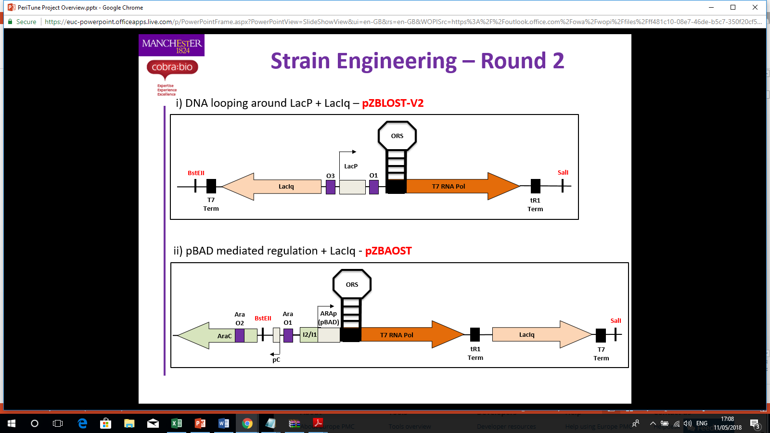
Supplementary Figure S1
Notes:
Figure S1. Schematic representation of the BL21 (LV2) strain

Slide 10
Supplementary Figure S2
Notes:
Figure S2. Expression analysis with different strains for relative for relative fluorescent units (RFU) normalized to cell density (OD600) under different inducer concentrations at 30° C, 14 h post induction.

Slide 11
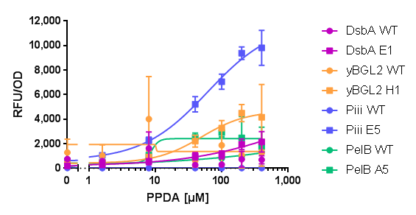
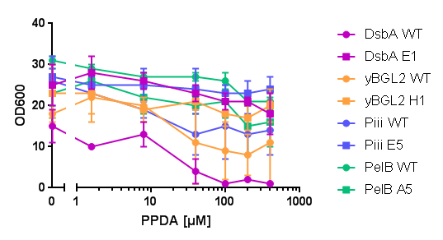
Supplementary Figure S3
a
b
Notes:
Figure S3. Titratability and cell density of the selected codon-optimised and WT constructs. (a) Dose response curves for relative fluorescent units (RFU) normalized to cell density (OD600) and (b) optical cell density (OD600) under different inducer concentrations at 30°C, 20 h post induction.

Slide 12
Supplementary Figure S4
b
a
c
Notes:
Figure S4. Performance of scFvβ expression with DsbA E1 and Piii E5 in Bl21(LV2)-pDEST versus BL21(DE3)-pET28 without the riboswitch control (NO ORS). (a) Cell density (OD600) at different inducer concentrations at 30°C, 14 h post induction. (b) per cell yield in mg per g dry cell weight (mg/g DCW) and (c) titres (mg/L) of scFvβ in the media (M), periplasm (PP) and spheroplast (SP) fractions quantified from western blot analysis against a known scFvβ standard.

Slide 13
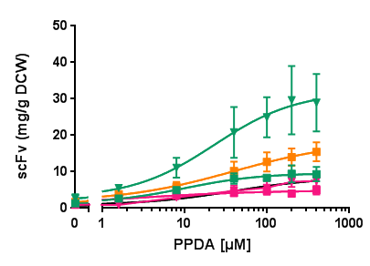
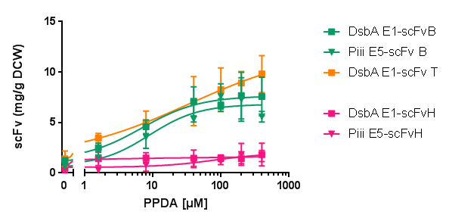
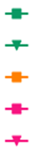
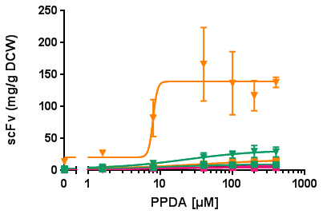
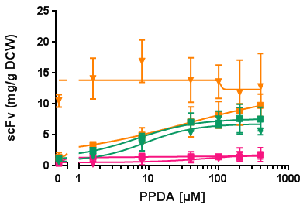
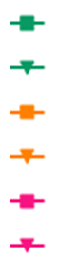
Supplementary Figure S5
a
Total protein
b
Secreted protein
DsbA E1-scFvβ
Piii E5-scFvβ
DsbA E1-scFvT
DsbA E1-scFvH
Piii E5-scFvH
c
Total protein
d
Secreted protein
DsbA E1-scFvβ
Piii E5-scFvβ
DsbA E1-scFvT
Piii E5-scFvT
DsbA E1-scFvH
Piii E5-scFvH
Notes:
Figure S5. Titratability of the productivity per cell in mg per g dry cell weight (mg/g DCW) of the different signal peptide-scFv constructs at different inducer concentrations at 30° C, 14 h post induction. Dose-response curves for total expressed protein (a) and (c) and data for secreted protein (b) and (d).

Slide 14
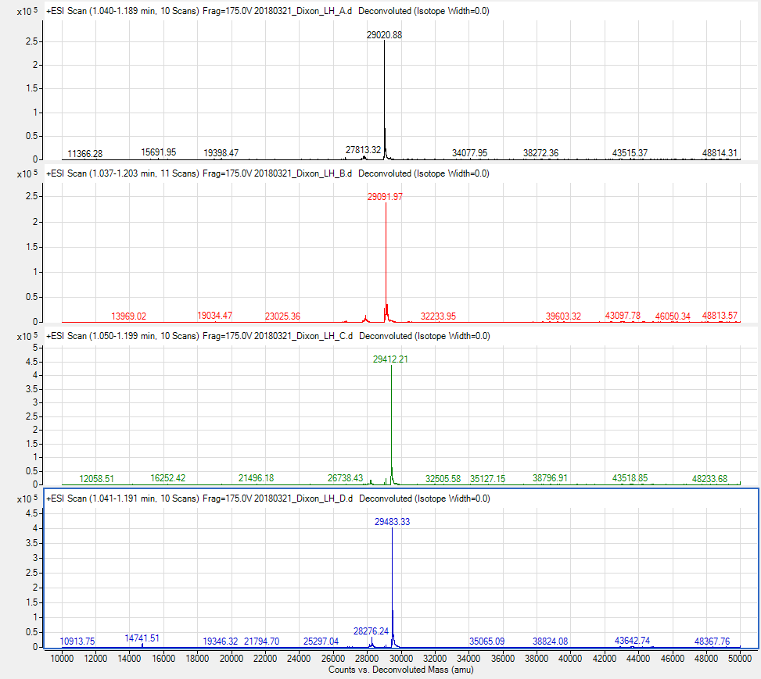
Supplementary Figure S6
a
DsbA E1-scFvβ
b
Piii E5-scFvβ
c
DsbA E1-scFvT
d
Piii E5-scFvT
Notes:
Figure S6. Intact mass spectrometry analysis scFvβ (a-b) and scFvT (c-d) protein purified from the periplasmic fraction of shake flask pDEST expression of the DsbA E1 (a) and (c) and Piii E5 (b) and (d) signal peptides at highest inducer concentration at 30°C, 14 h post induction.

Slide 15
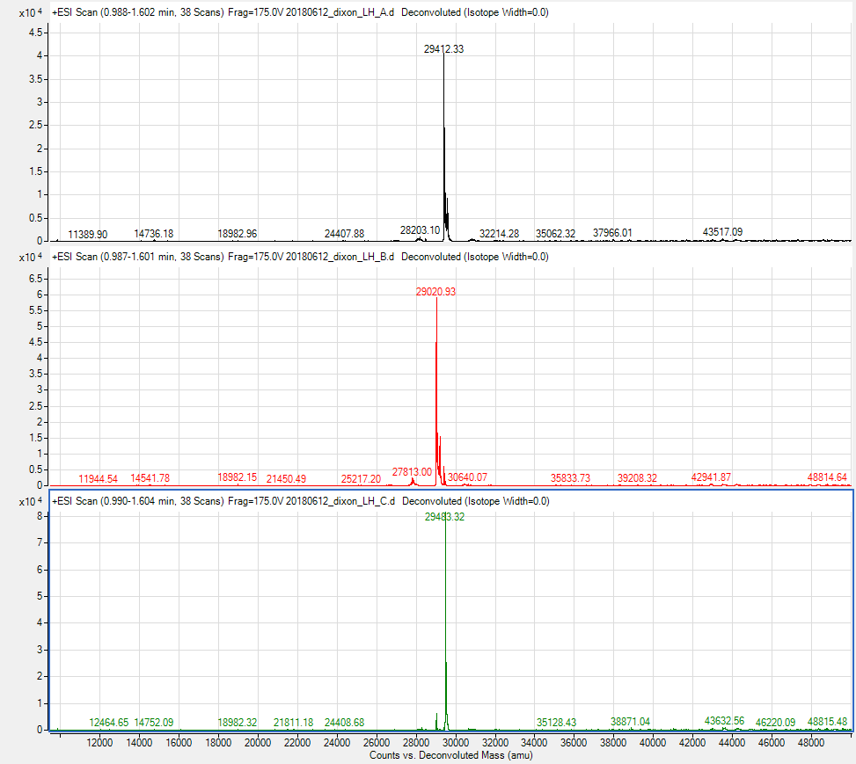

Supplementary Figure S7
a
Piii E5-scFvT
b
DsbA E1-scFv$β$
c
DsbA E1-scFvT
Notes:
Figure S7. Intact mass spectrometry analysis scFv protein purified from the media fraction of shake flask (a), and periplasm fraction of fed-batch fermentation (b-c), pDEST expression of the DsbA E1 (b) and (c) and Piii E5 (a) signal peptides. The shake flask media sample used was from highest inducer concentration at 30°C, 14 h post induction. The fed-batch fermentation periplasm samples were from Trial 2 at highest inducer concentration at 30°C, 6hrs post-induction.

Slide 16
Supplementary Figure S8
Notes:
Figure S8. SEC-MALS analysis of the purified scFv proteins to be used as standard curve for quantification of the protein production.

Slide 17
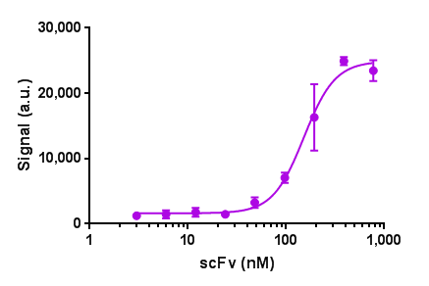
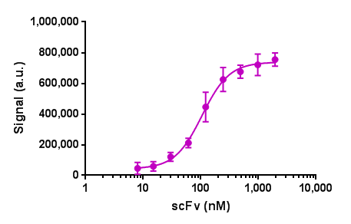
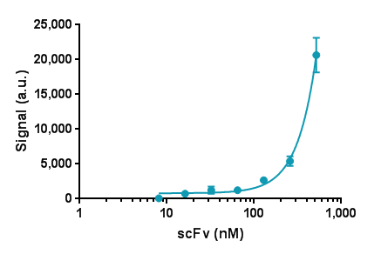
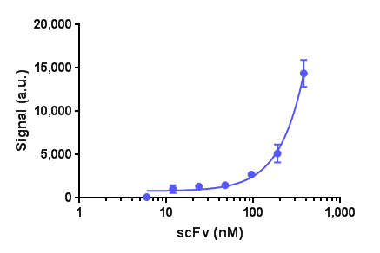
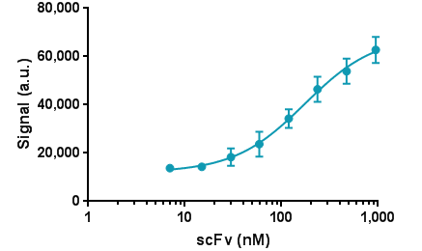
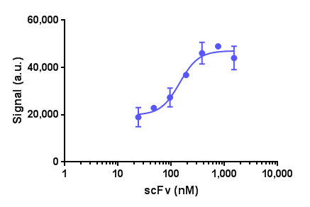
Supplementary Figure S9
a
pDEST - DsbA E1
(shake flask)
b
pDEST - Piii E5
(shake flask)
EC50=152±12
EC50=113±27
c
pDEST - DsbA E1-scFvH
(shake flask)
d
pDEST - Piii E5-scFvH
(shake flask)
EC50=207±43
EC50=656±313
e
pDEST - DsbA E1
(fermentation)
f
pDEST - Piii E5
(fermentation)
EC50=175±19
EC50=144±26
Notes:
Figure S9. Analysis of scFvβ binding to β-Galactosidase substrate. The scFvβ was isolated from the periplasmic fraction of the pDEST shake flask (a) and (b) and fermentation (c) and (d) expression. The data was plotted as dose-response curve, with triangle sign indicating the EC50 value.

Slide 18


Supplementary Figure S10
15
7.5
3.7
1.8
0.9
0.5
0.2
0.1
0.06
β-galactosidase
ΒSA (bovine serum albumin)
Notes:
Figure S10. Dot blot for assessing scFvβ binding to β-Galactosidase and BSA (-control). The scFvβ was isolated from the periplasmic fraction of the pDEST shake flask and fermentation expression.

Slide 19
Supplementary Figure S11
a
Trial 1 FBF
b
Trial 2 FBF
Notes:
Figure S11. Cell viability as colony forming unit per ml (CFU/mL) for the last time points in the fed-batch fermentation for Trial 1 (a), Trial 2 (b). The different signal peptide-scFv constructs were induced with constant IPTG (100µM) and different PPDA concentrations (0, 4, 20, 40, 200, 400µM).

Slide 20


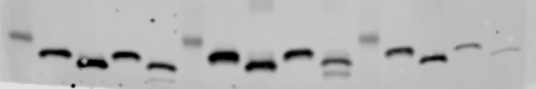
Supplementary Figure S12
DsbA E1-scFvβ
DsbA E1-scFvT
(kDa)
(kDa)
PP
SP
PP
SP
35 -
35 -
DsbA E1-scFvβ
DsbA E1-scFvT
PP
PP
(kDa)
+
-
(kDa)
+
-
DTT
DTT
35 -
35 -
Notes:
Figure S12. Western blot analysis cellular fractions from the fed-batch fermentation Trial 2. The periplasm (PP) and spheroplast (SP) samples from 4h induction, the same periplasm fractions were also assessed for the disulfide bond formation under reducing and non-reducing conditions, with (+) or without (-) DTT.

Slide 21
Supplementary Figure S13
a
b
c
d
Notes:
Figure S13. Performance of different signal peptide-scFv pDEST expression from fed-batch fermentation. Inducer concentrations (IPTG/PPDA) plotted as expression per cell (yield) in mg per g dry cell weight (mg/g DCW) (a) and (b) and expression per volume (titre) (mg/L) (c) and (d). The samples were processed in technical triplicates from Trial 2 fermentation, using the 4h and 6h post-induction samples and scFvβ or scFvT from the media (M), periplasm (PP) and spheroplast (SP) fractions were quantified using western blot analysis from a known scFv standard.

