Slide 1
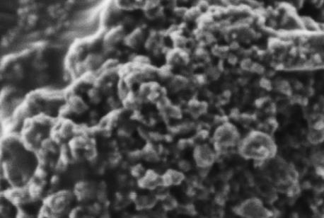
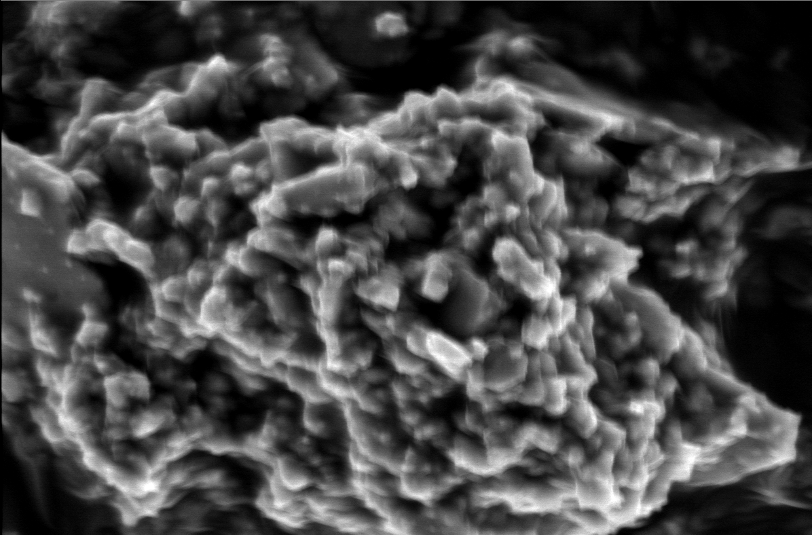
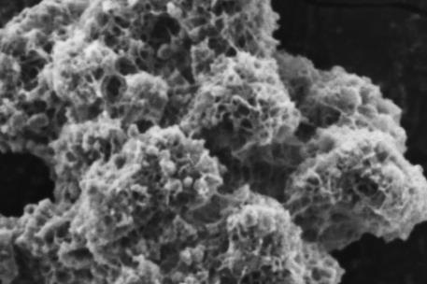
(f)
(c)
(e)
(b)
(d)
(a)
Fig. 1

Slide 2
Si-O in Q² sites
Si-O in SiO₄
Si-O-Si
deformation vibrations
(c)
O-H
C-O
(b)
(a)
Fig. 2

Slide 3
Fig. 3

Slide 4
(a)
(b)
Fig. 4

Slide 5
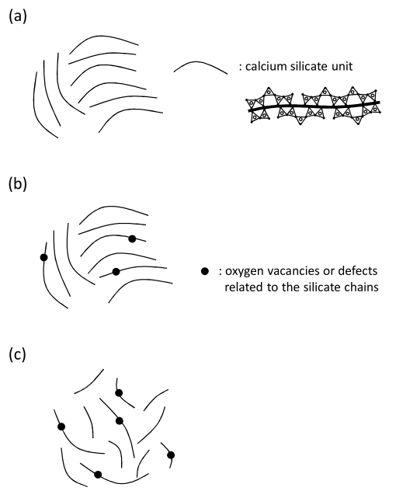
Supporting information Fig. 1
Fig SI-1. Schematic illustrations for structure of samples (a) before and after milling treatment with (b) 1-propanol and (c) acetone.

