Slide 1
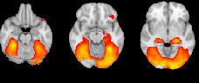
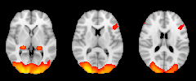


Figure S2. Non-cannabis cue vs. fixation. The non-cannabis vs. fixation contrast elicited increased brain activation across 11 clusters. MNI z coordinates are indicated to the left of each slice.
-21
-13
-5
-13
-5
-21
-13
-5
3
11
19
3
11
19
27
35
43
L
27
35
43
3
11
R
19
L
27
35
43
R
L
Notes:
Cope3 neutral vs fixation

