Slide 1
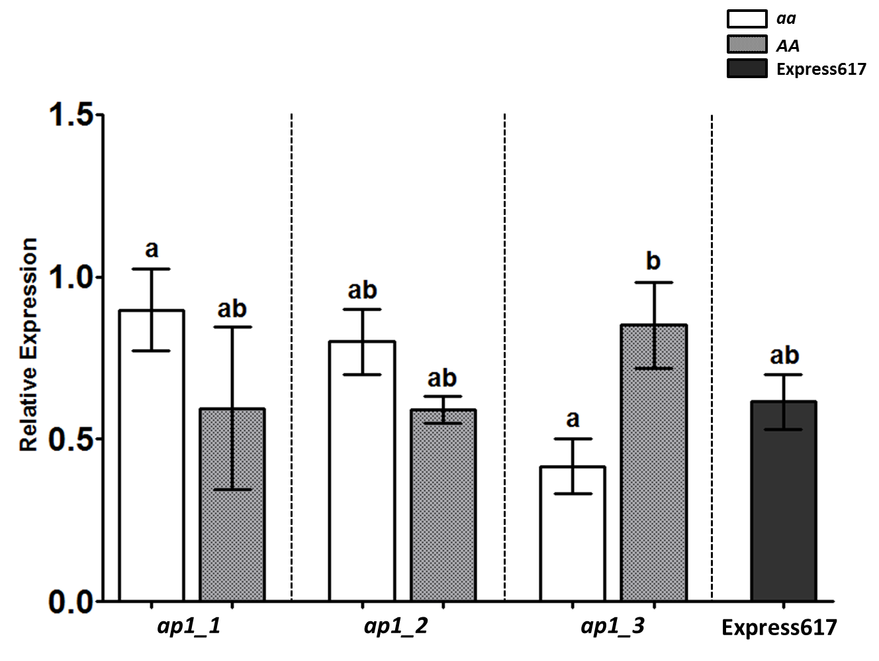
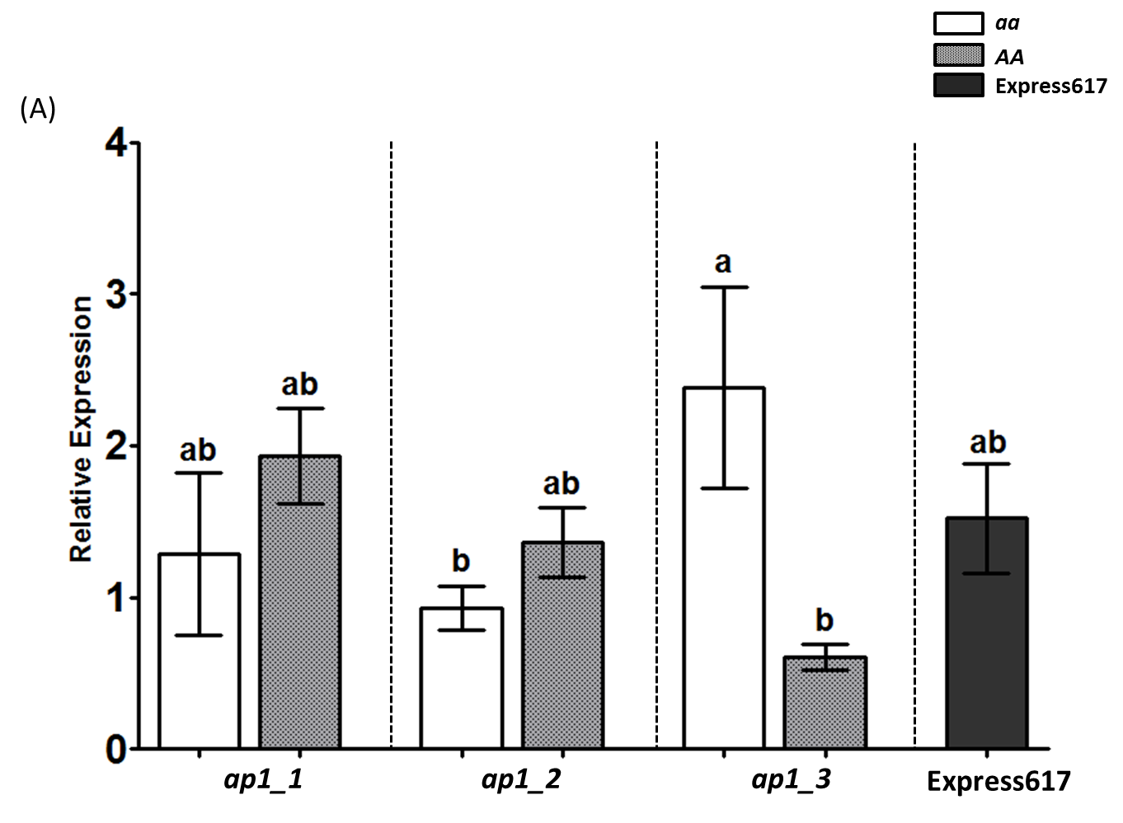
Supplementary Figure 2
(A)
(B)
Bna.AP1 joint expression
Bna.AP1 (Bna.AP1.A02) paralog specific expression
Mutant families
Mutant families

