Slide 1
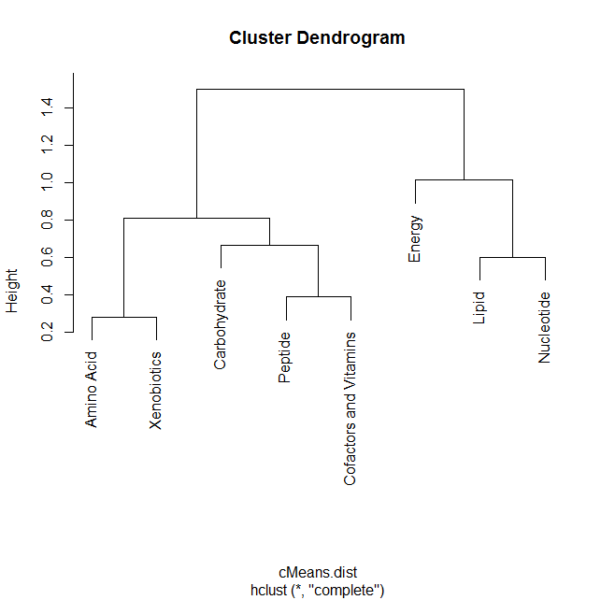
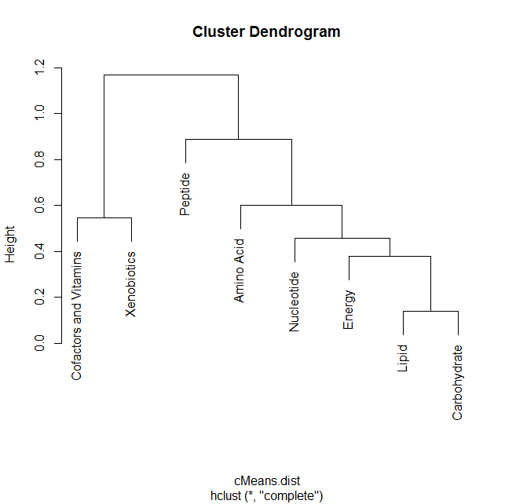
Figure S1 : Dendrograms showing pathway clusters in regard as to whether metabolites increased or decreased versus their matched T-0 controls: (A) early time points and (B) late time points.
A)
B)

