Slide 1
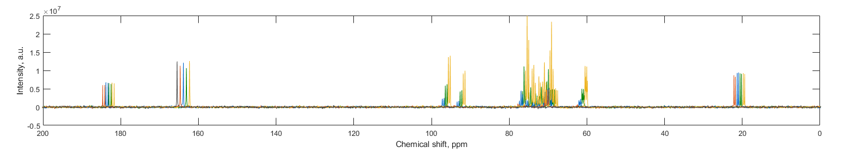
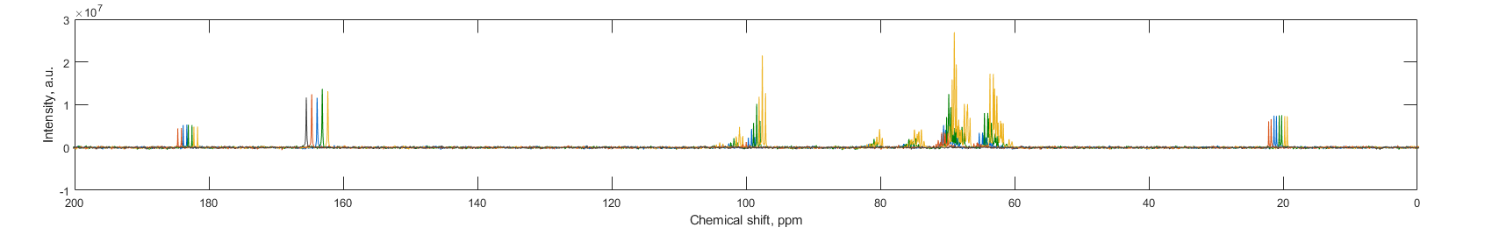
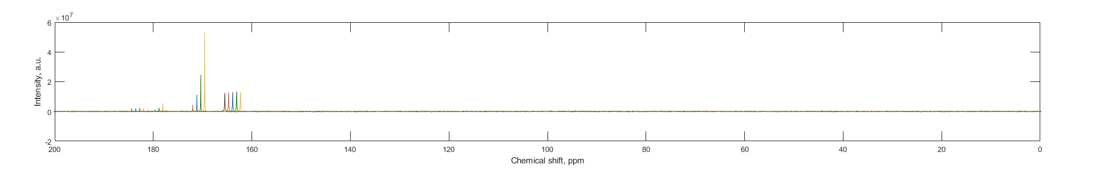
Figure S10
a)
Glucose
S
U
L₃
L₁
b)
Fructose
S
U
L₃
L₁
c)
Pyruvate
S
H
U
L₁
Notes:
Remaining examples
Pyruvate = DN0604
Glucose = DN0650
Fructose = DN0645

