Slide 1
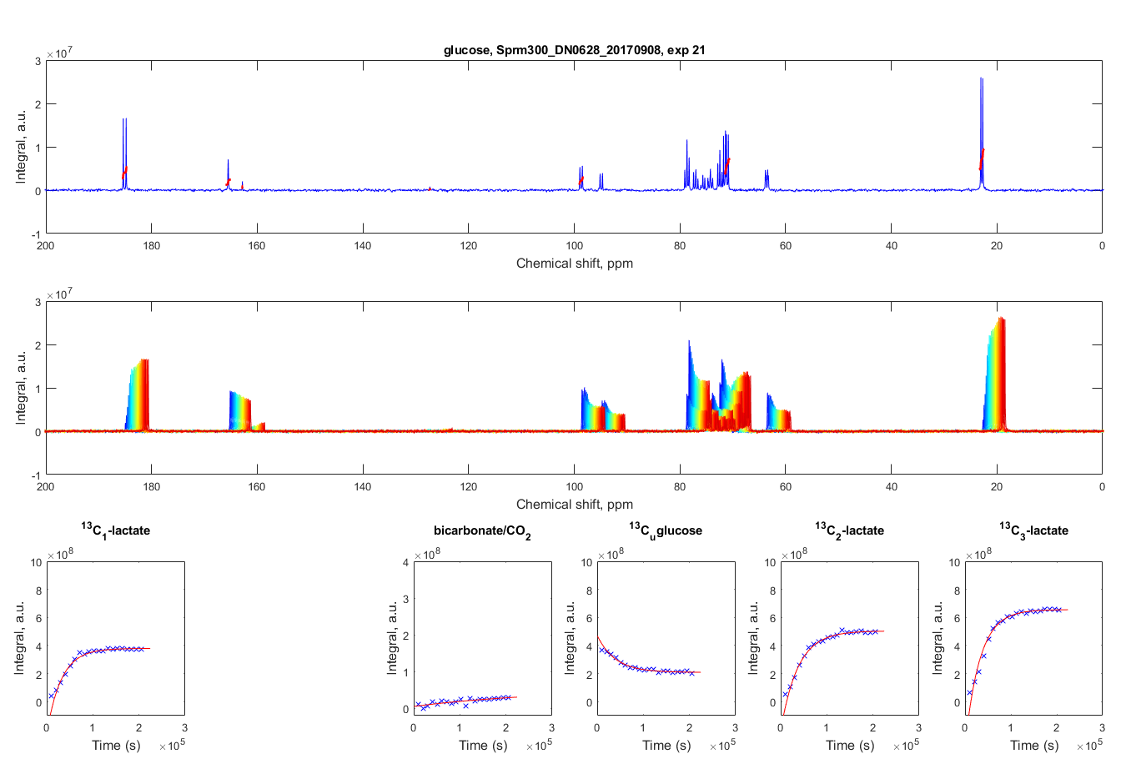
a)
Glucose rates spectra
S
L₃
L₁
Intensity, a.u.
U
S
L₂
S
B
C
b)
Time, h
Intensity, a.u.
0
58
c)

