Slide 1
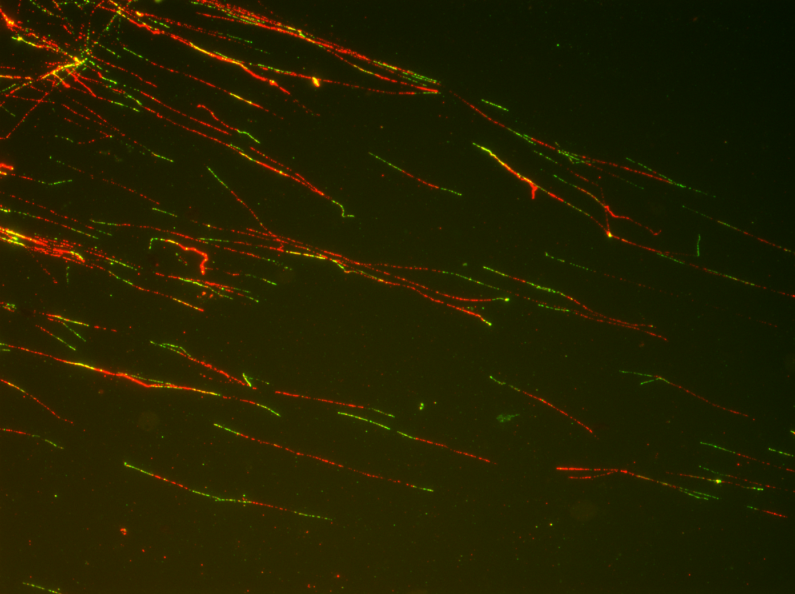
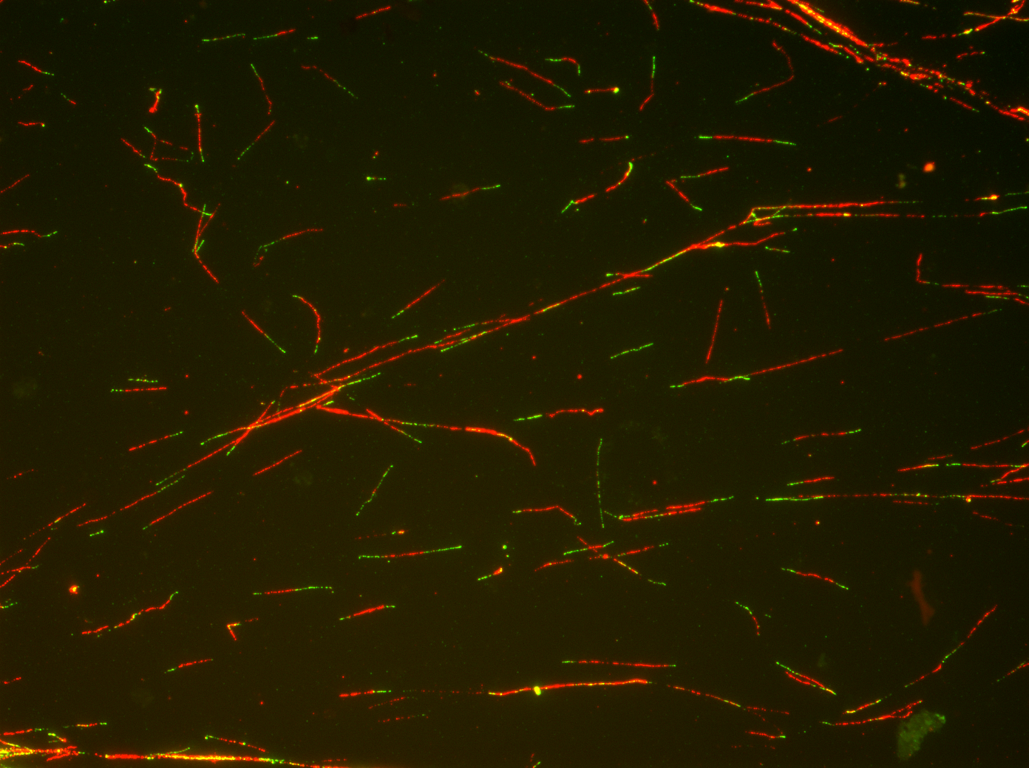
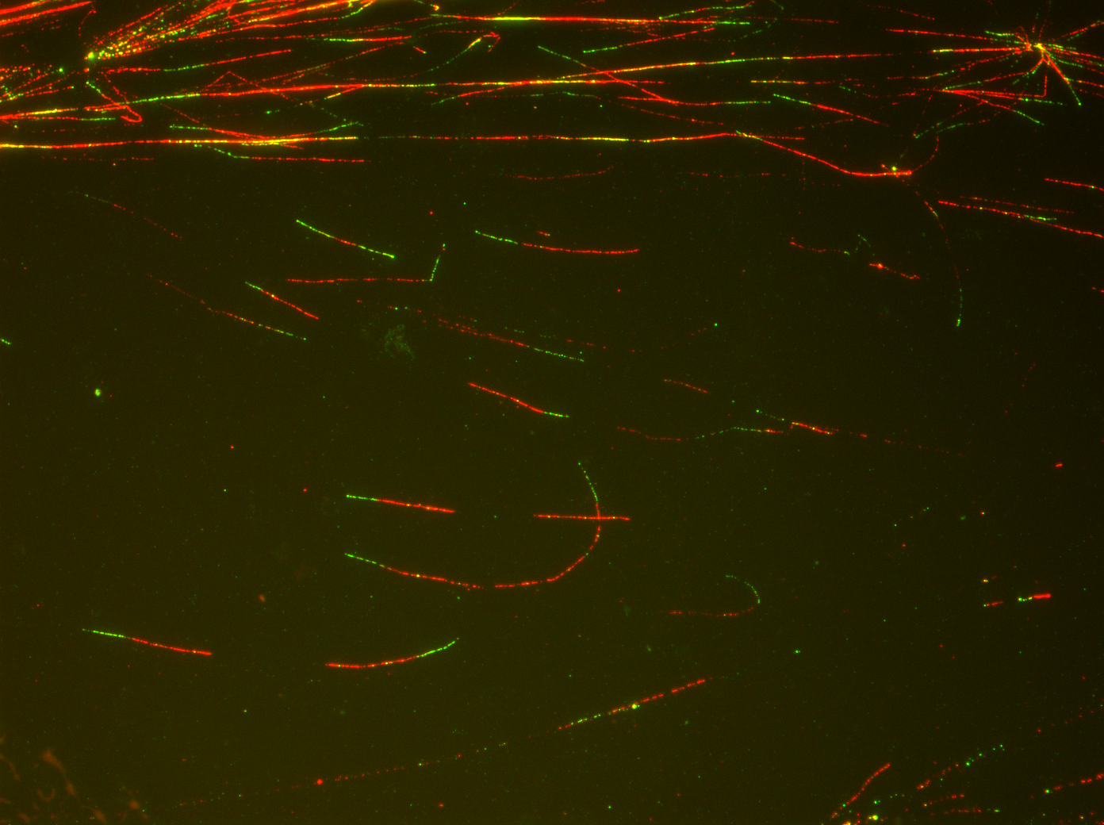
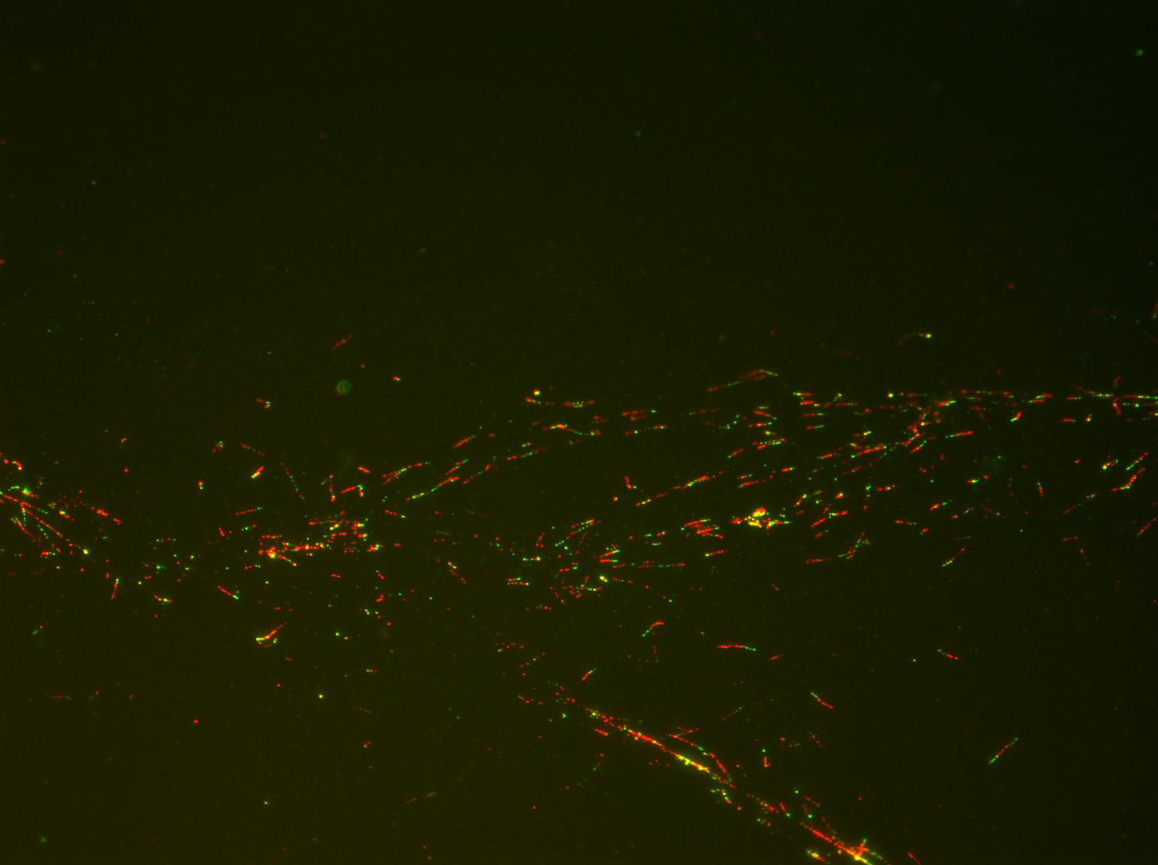
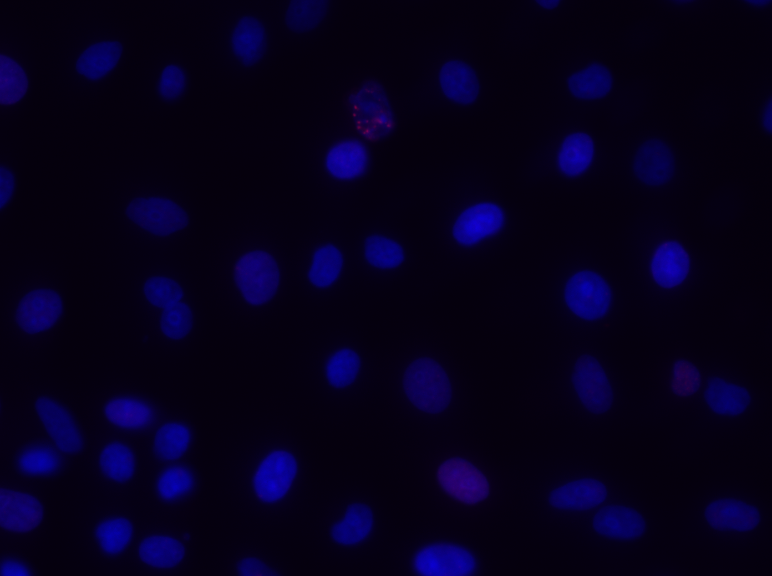
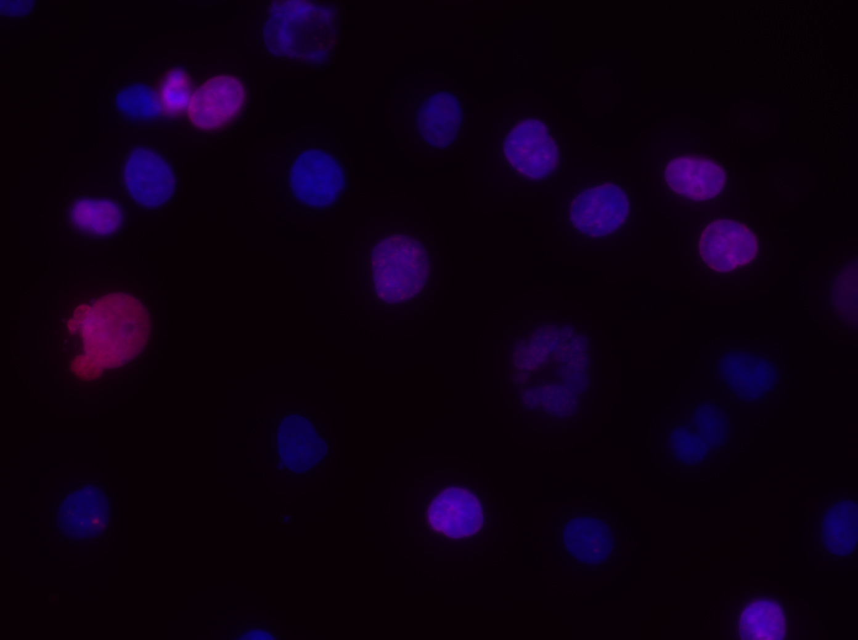
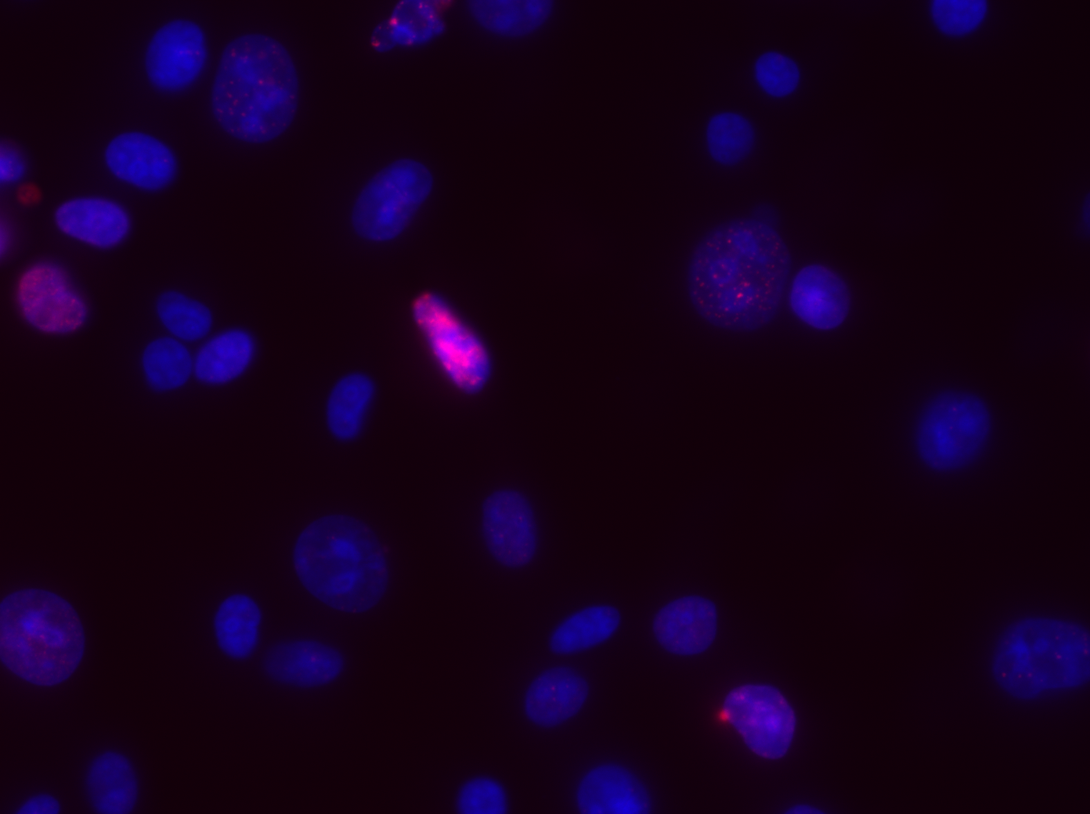
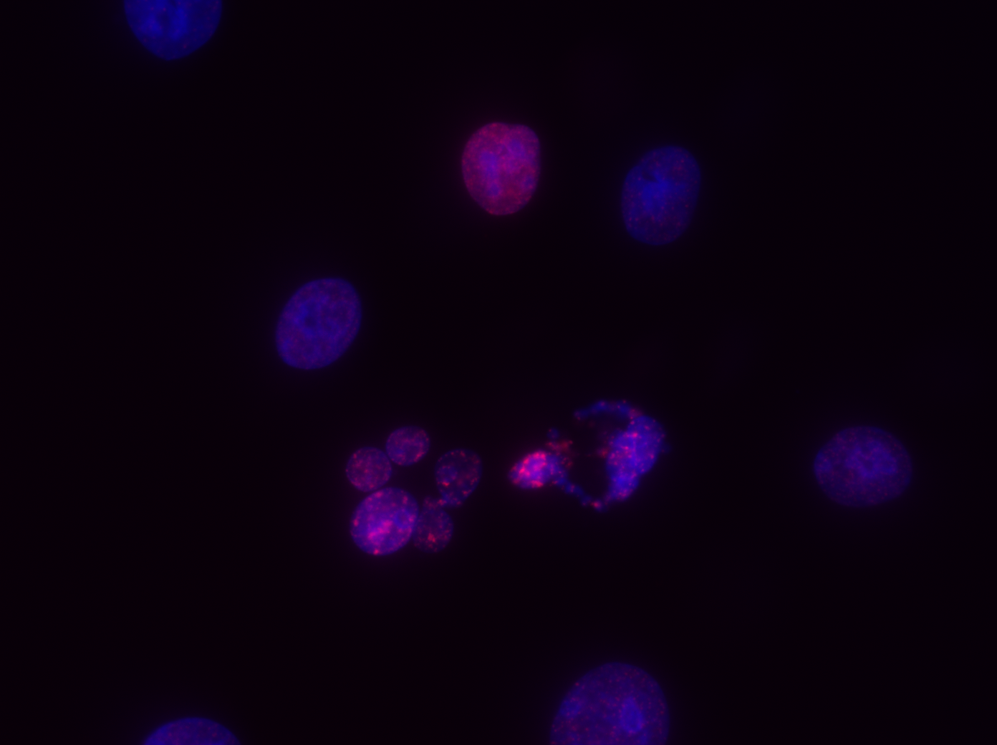
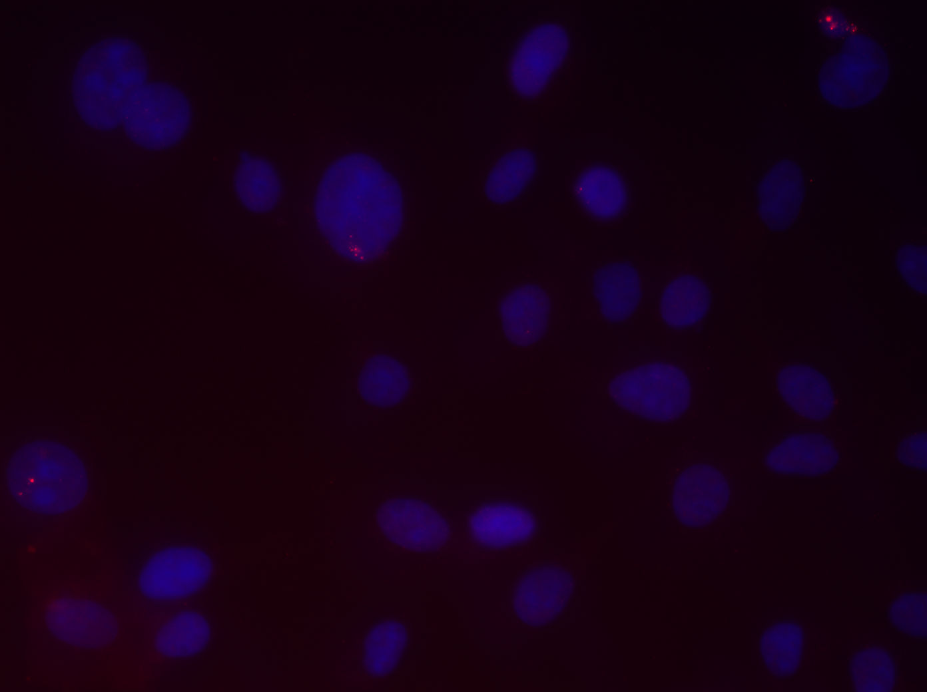
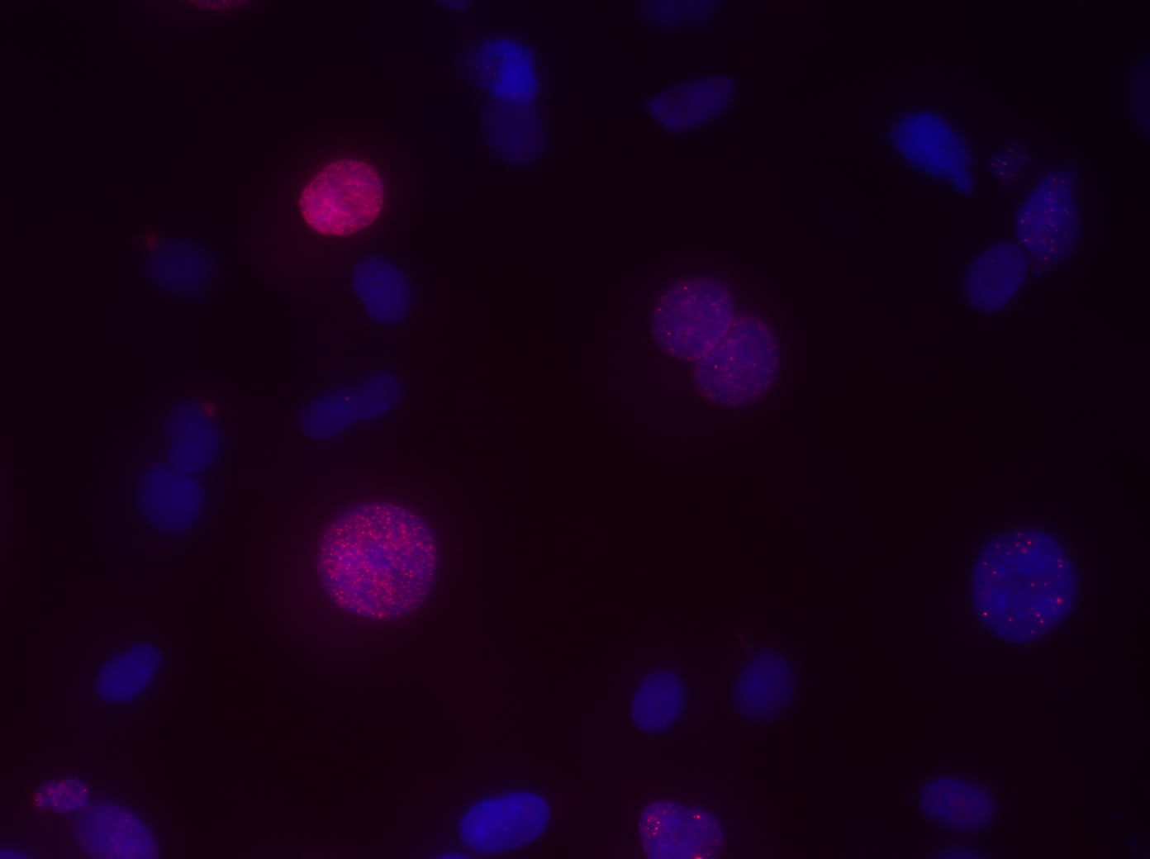
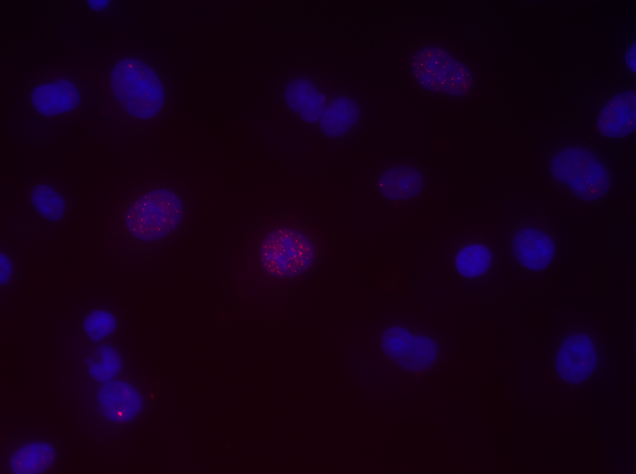
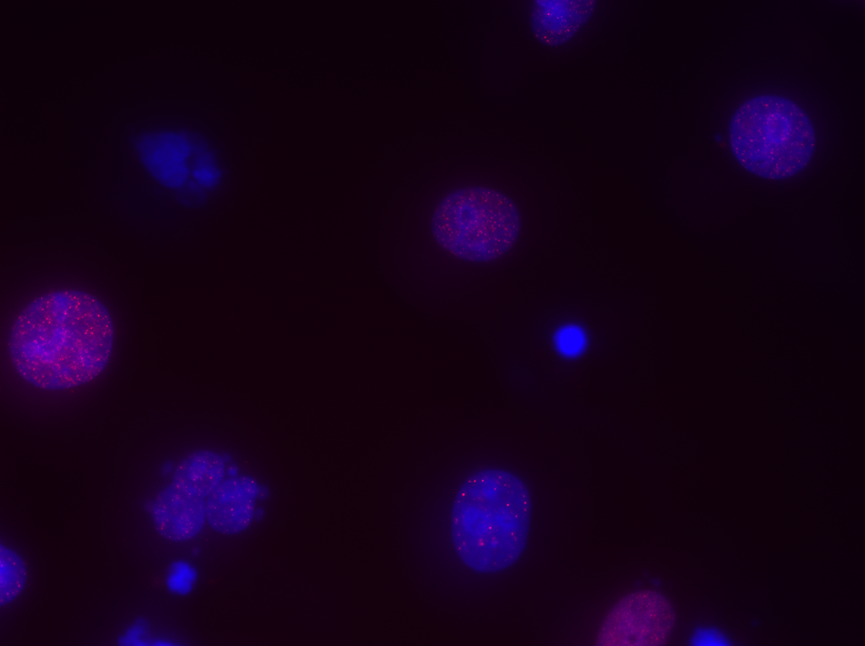
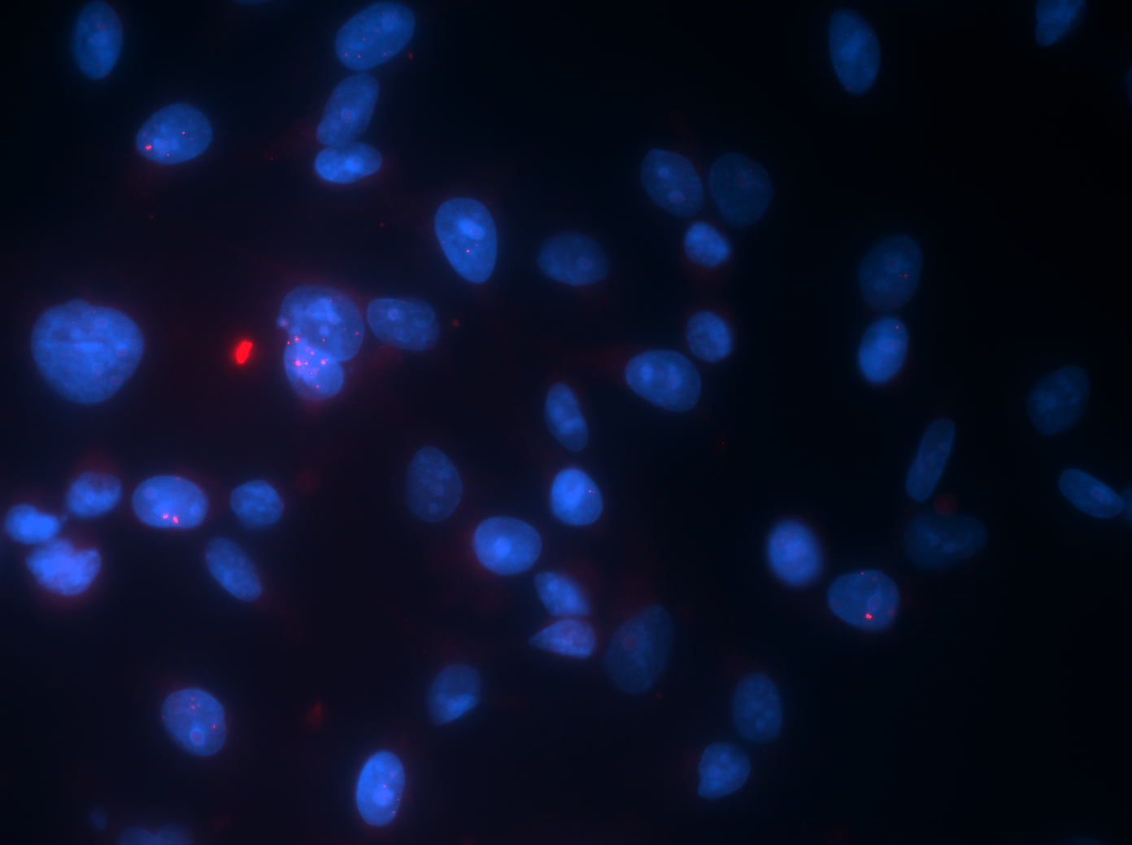
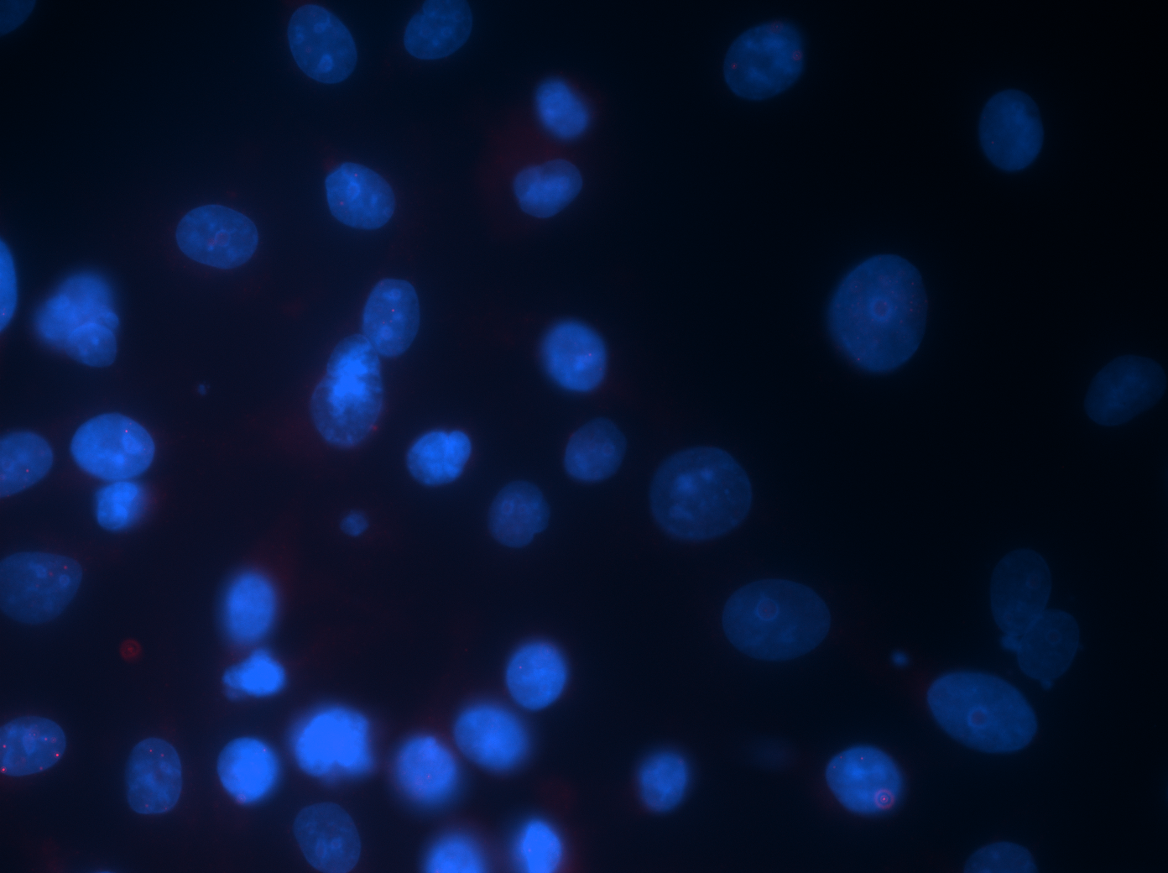
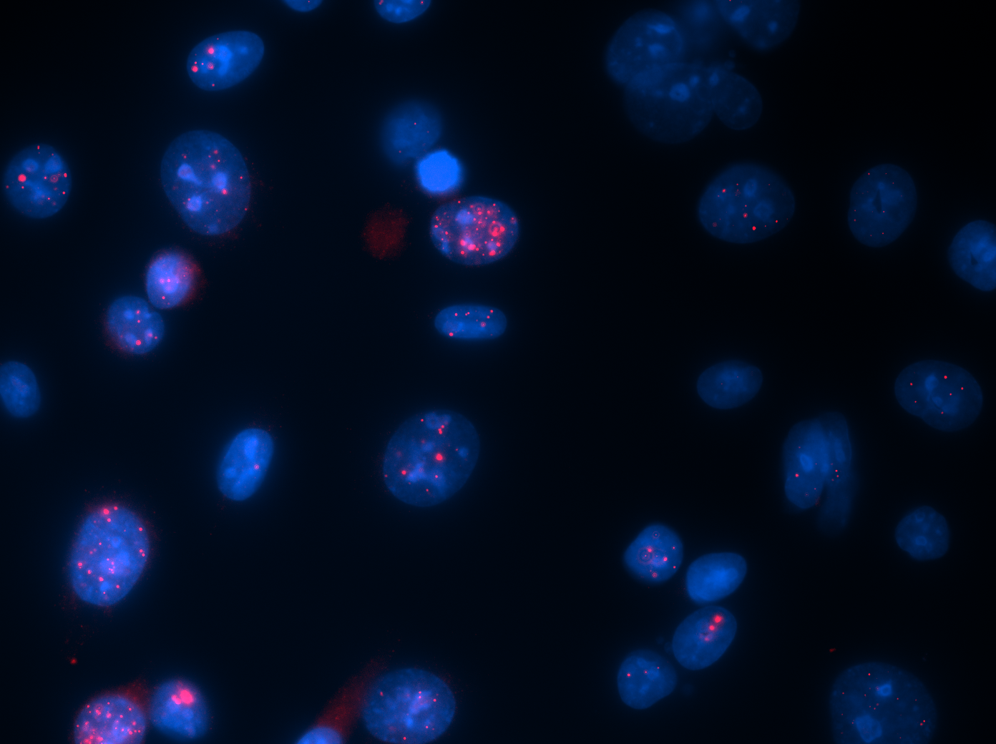
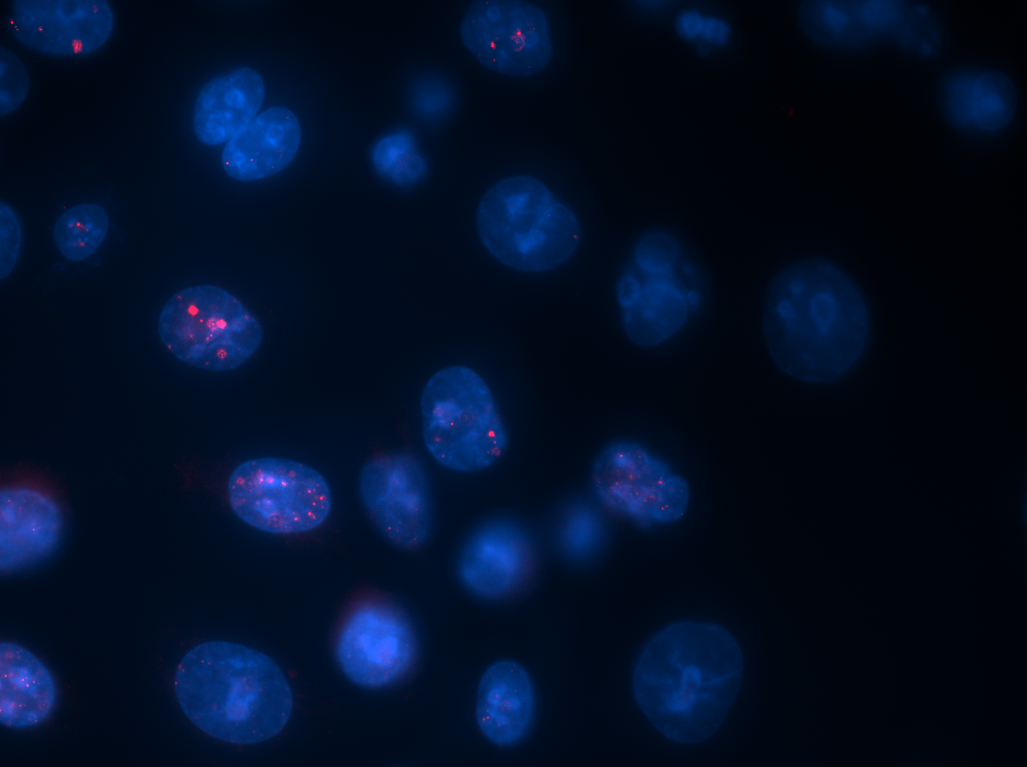
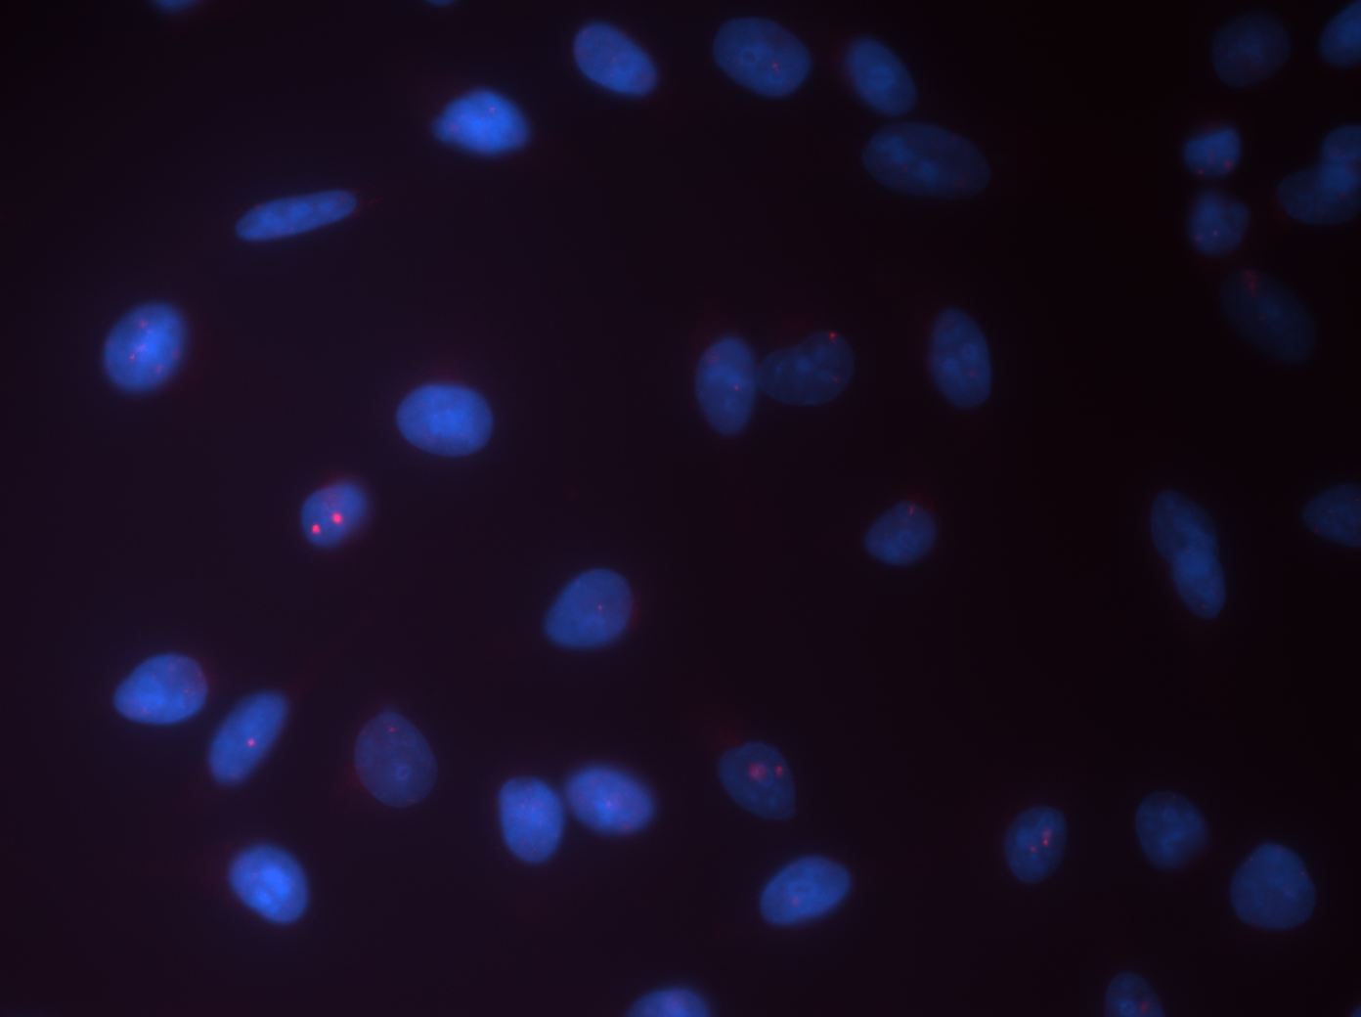
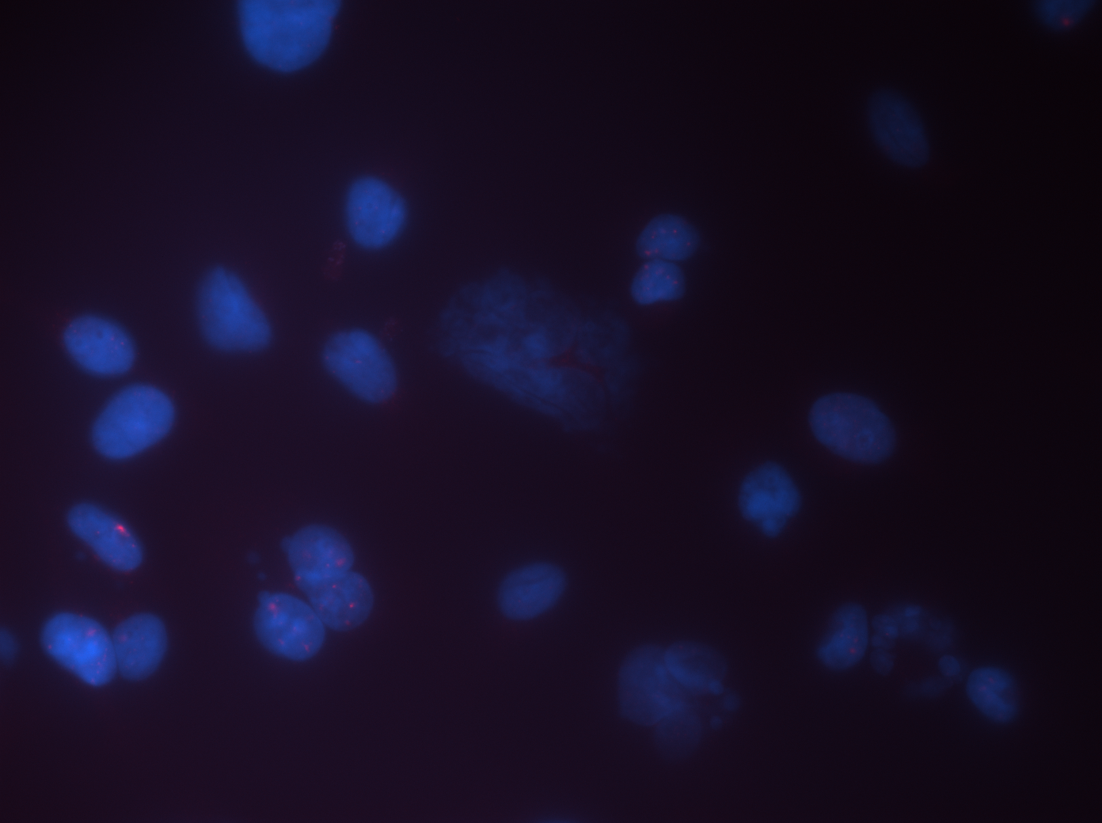
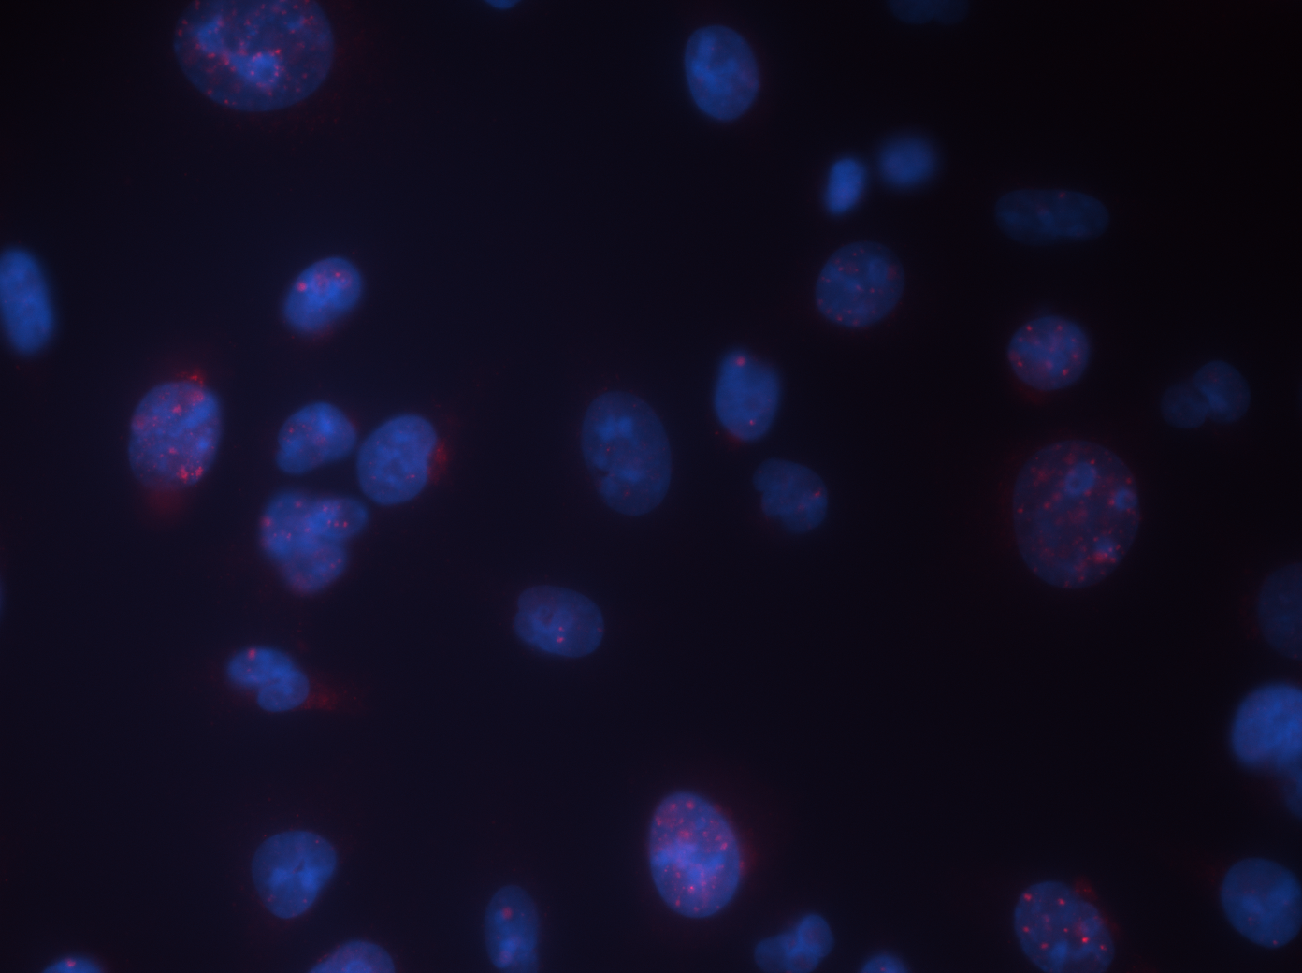
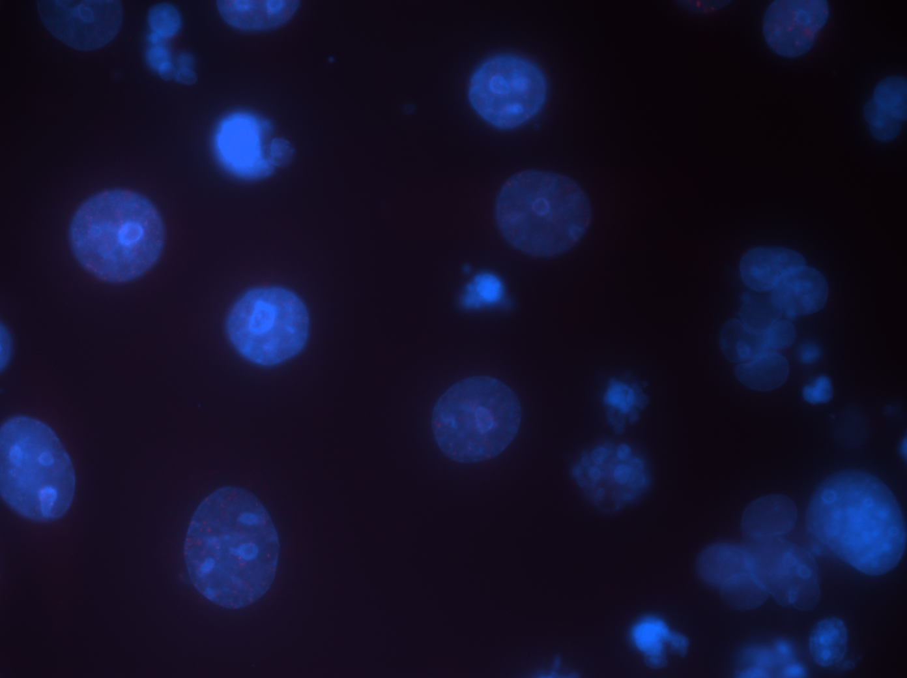
A
CNL
AZD
Cyclin E
Cyclin E + AZD
50μm
B
 | CNL | AZD | Cyclin E | Cyclin E + AZD
Number of fiber | 194 | 238 | 192 | 274
Median (kb/min) | 0.56 | 0.29 | 0.46 | 0.10
25% percentile (kb/min) | 0.47 | 0.23 | 0.22 | 0.07
75% percentile (kb/min) | 0.70 | 0.35 | 0.60 | 0.15
Mean (kb/min) | 0.59 | 0.29 | 0.43 | 0.15
C
CNL
AZD
Cyclin E
Cyclin E + AZD
γH2AX
RPA
RAD51
53BP1
50μm

Slide 2
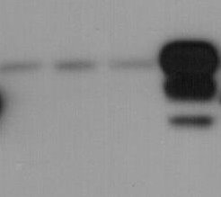
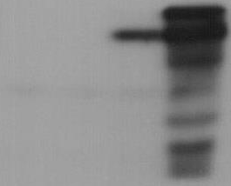
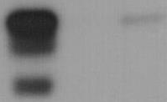






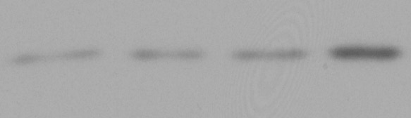


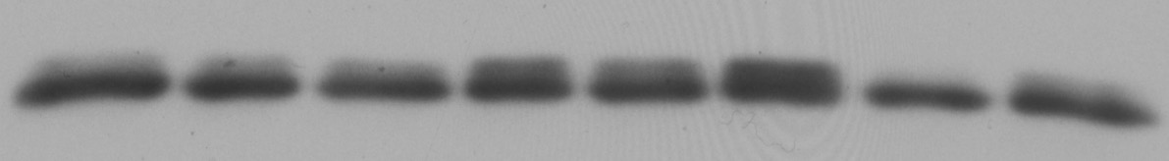
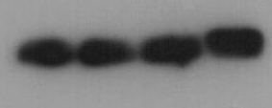

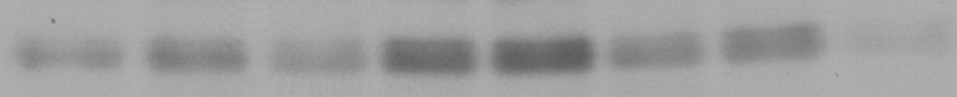







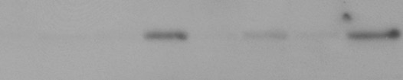

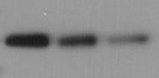



D
76NE6
MDA231
HCC1806
Vector
Cyclin E
Vector
Cyclin E
shCyclin E
DOX
-
+
-
+
-
+
-
+
Scr.
#1 #2
cyclin E
pCDK2
(T160)
CDK2
pCDK1
(Y15)
CDK1
pCHK1
(S345)
CHK1
ATR
Wee1
Actin
Supplementary Figure 7. Cyclin E overexpression induces DNA replication stress, sensitizing cells to AZD1775. (A) Representative images of DNA tracts pulse-labeled with IdU and CIdU from control cells (CNL), cells treated with 48 hours of 1 µM AZD1775 (AZD), cells with 48-hour induction of cyclin E by 10 ng/mL doxycycline (cyclin E), and cells with both cyclin E induction and AZD1775 treatment for 48 hours (cyclin E + AZD) in MDA231 cyclin E-inducible cells. Scale bar, 50 µm. (B) The supporting statistics of ongoing forks as shown in fig.2B. (C) Representative images of γH2AX, RPA, RAD51, and 53BP1 foci in control cells (CNL), cells treated with 48 hours of 1 μM AZD1775 (AZD), cells with 48-hour induction of cyclin E by 10 ng/mL doxycycline (cyclin E), and cells with both cyclin E induction and AZD1775 treatment for 48 hours (cyclin E + AZD) in MDA231 cyclin E-inducible cells. The areas inside the white box are shown in fig.2C. Scale bar, 50 µm. (D) 76NE6 inducible cells (left) and MDA231 inducible cells (middle) cultured with (+) or without (-) of 10 ng/mL doxycycline for 24 hours and HCC1806 cells with scrambled shRNA (Scr.) or cyclin E shRNA knockdown (shCyclin E #1 and #2) (right) were subjected to immunoblot with the indicated antibodies.

Slide 3
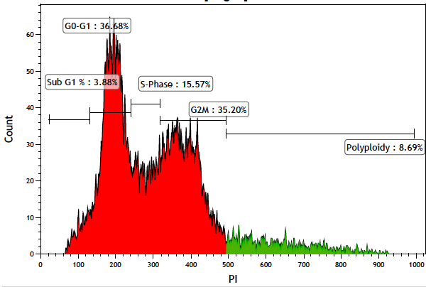
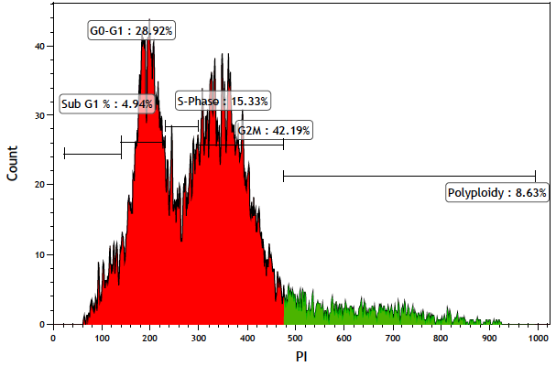
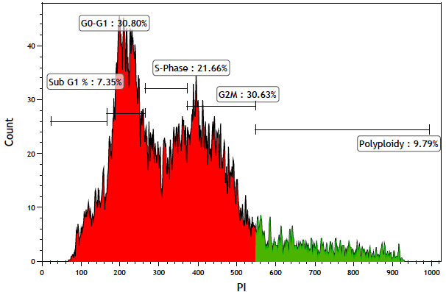
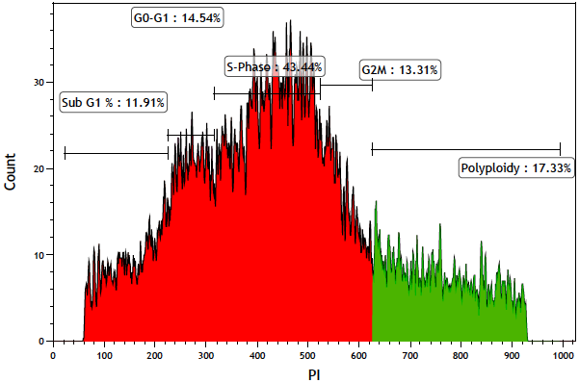
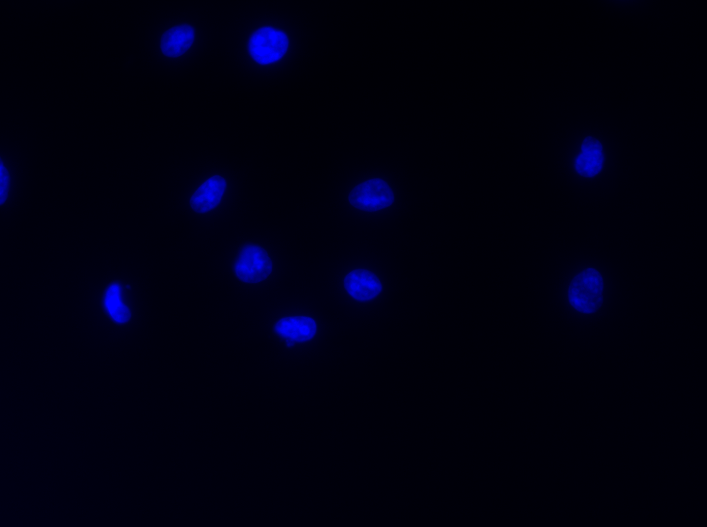
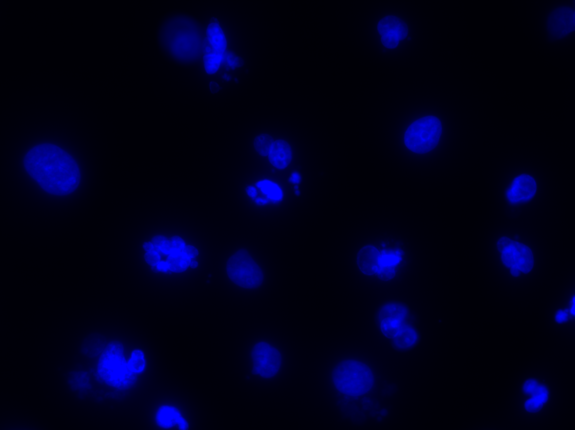
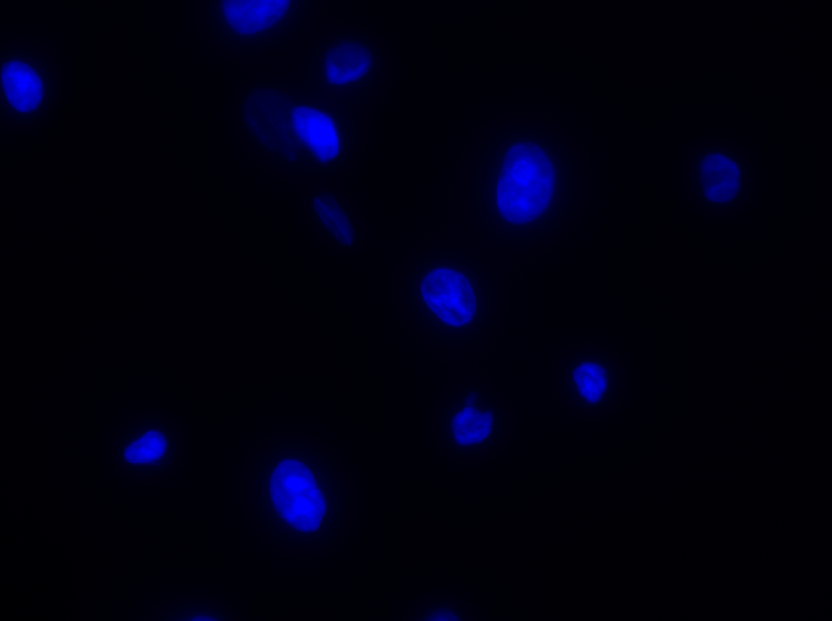
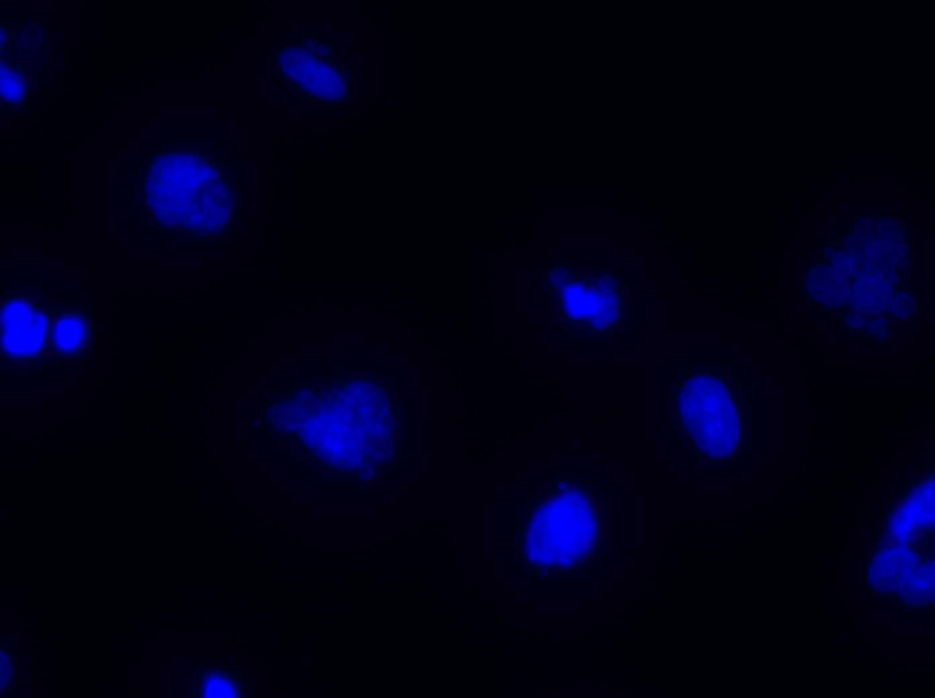
A
76NE6 cyclin E
CNL
AZD
Cyclin E
Cyclin E + AZD
Cell counts
PI staining
*
***
***
***
Cell population
**
**
CNL
AZD
Cyclin E
Cyclin E + AZD
B
MDA231 cyclin E
CNL
AZD
Cyclin E
Cyclin E + AZD
50μm
Supplementary Figure 8. Cyclin E overexpression and Wee1 kinase inhibition increase polyploidy population and abnormal nuclei. (A) The representative histogram images (top) and the cell-cycle analysis with flow cytometry (bottom) in control cells (CNL), cells treated with 48 hours of 1 µM AZD1775 (AZD), cells with 48-hour induction of cyclin E by 10 ng/mL doxycycline (cyclin E), and cells with both cyclin E induction and AZD1775 treatment for 48 hours (cyclin E + AZD) in 76NE6 cyclin E-inducible cells. Green in the histogram indicates polyploidy. (B) Representative images of 4',6-diamidino-2-phenylindole (DAPI) staining in control cells (CNL), cells treated with 48 hours of 1 µM AZD1775 (AZD), cells with 48-hour induction of cyclin E by 10 ng/mL doxycycline (cyclin E), and cells with both cyclin E induction and AZD1775 treatment for 48 hours (cyclin E + AZD) in MDA231 cyclin E-inducible cells. The areas inside the white box are shown in fig.2G. Scale bar, 50 µm. A two-tailed unpaired t-test was used to compare two groups. Error bars represent standard error of the mean. *, p<0.05; **, p<0.01; ***, p<0.001; ****, p<0.0001.

