Slide 1
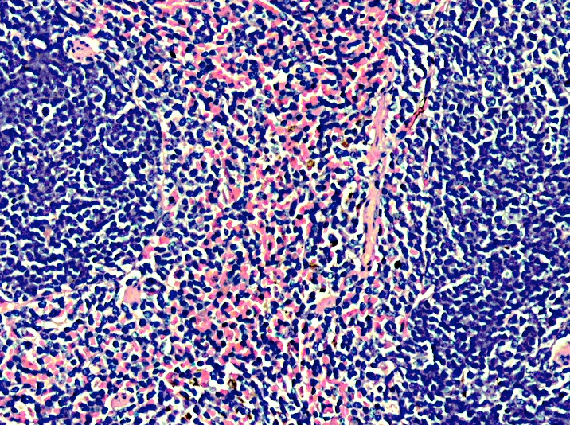
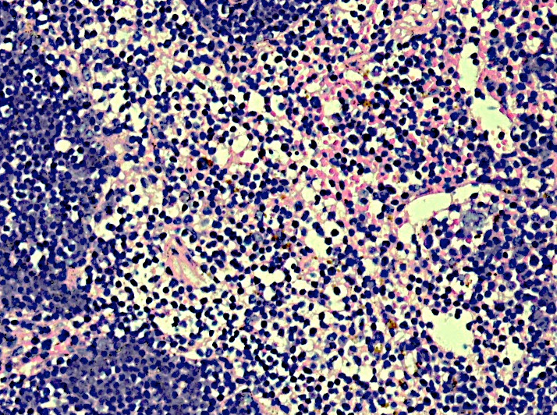
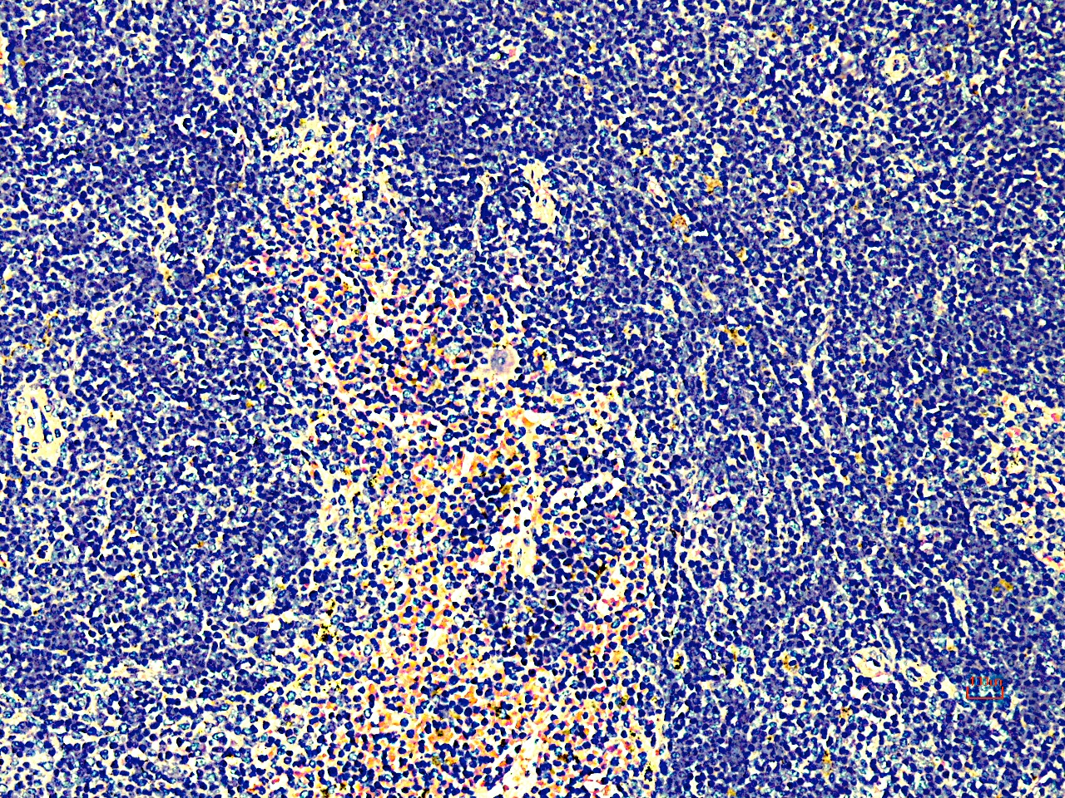
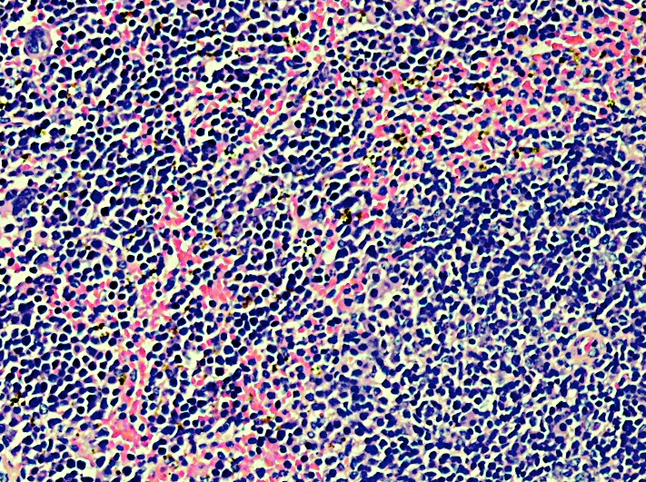
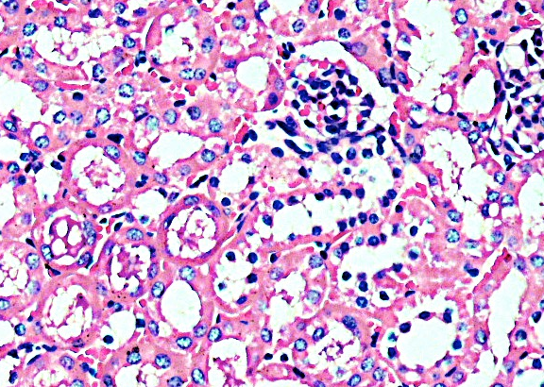
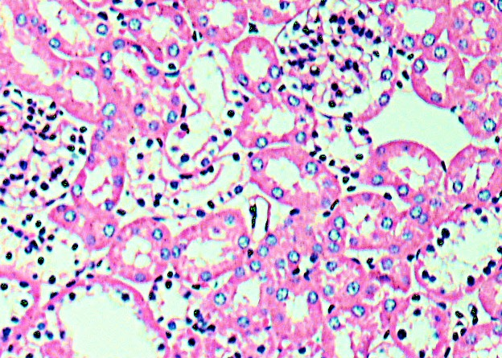
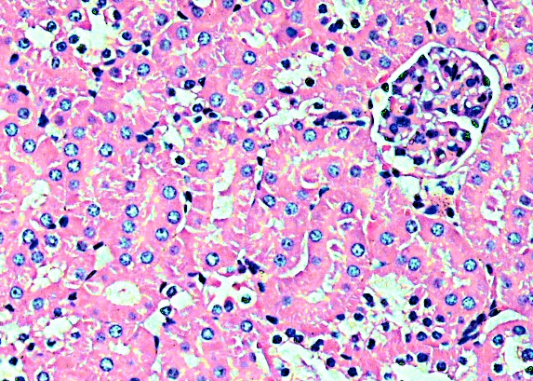
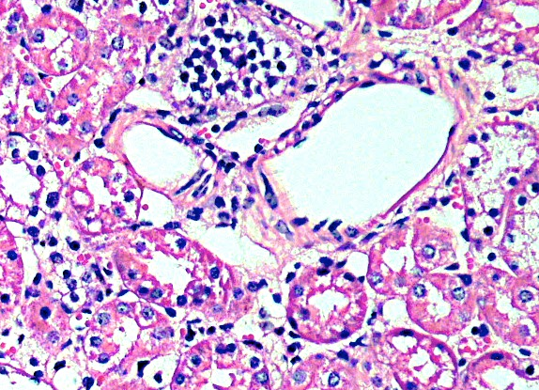
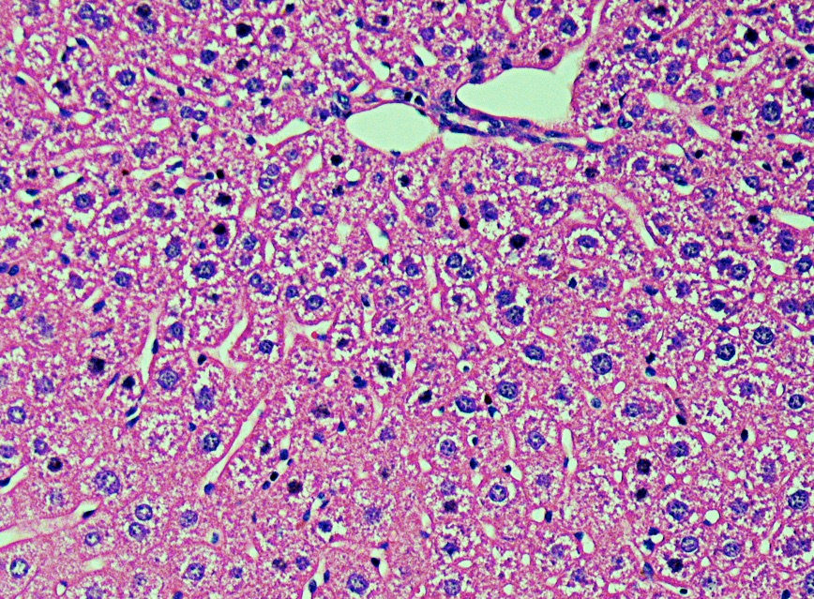
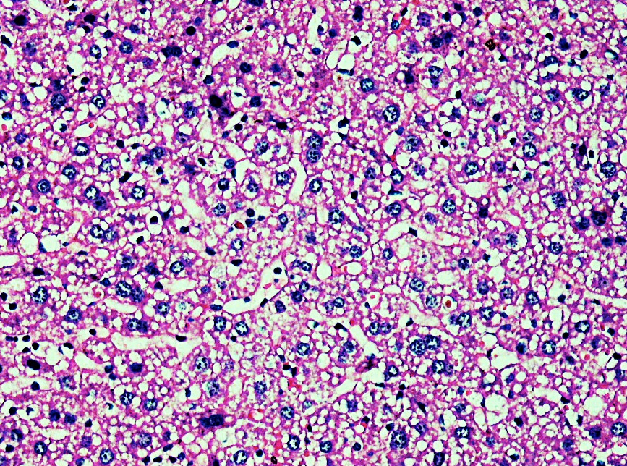
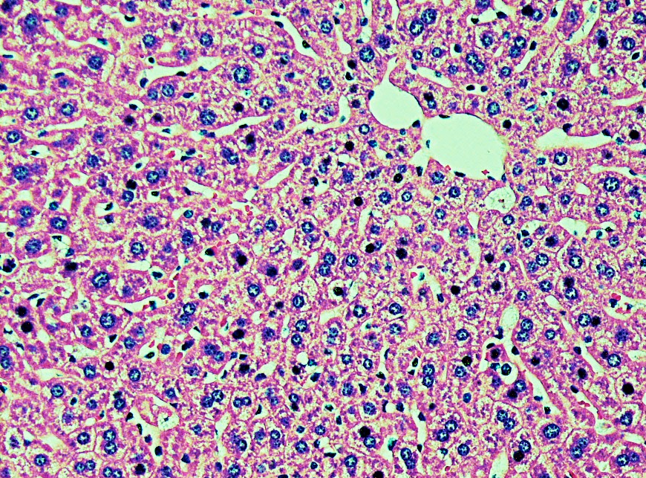
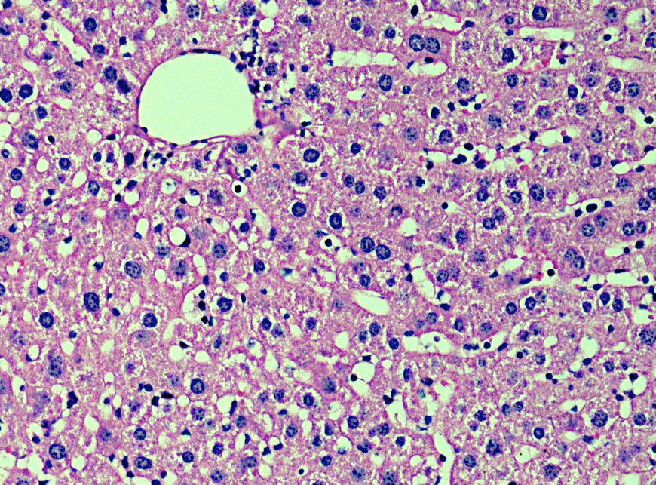
Fig. 1
A B
25 μm
25 μm
C D
25 μm
25 μm
E F
Liver Kidney Spleen
25 μm
25 μm
G H
25 μm
25μm
I J
25 μm
25 μm
K L
25 μm
25 μm

Slide 2
Fig. 2
G-CSF
MIP-1α
(pg/ml)
*
*
(pg/ml)
*
*
*
*
*
*
*
16 24 32 16 24 32 16 24 32 32* ICV 16 24 32 16 24 32 16 24 32 32* ICV
Wild Type MPS IIIA
G1 G2
Wild Type MPS IIIA G1 G2
MCP-1
IL-1α
(pg/ml)
*
*
*
(pg/ml)
*
*
*
*
*
16 24 32 16 24 32 16 24 32 32* ICV 16 24 32 16 24 32 16 24 32 32* ICV
Wild Type MPS IIIA
G1 G2
Wild Type MPS IIIA G1 G2
Plasma Pro-inflammatory cytokines: Interleukin 1-α and β (IL-1α and β, macrophage chemoattractant protein-1 (MCP-1), macrophage inflammatory protein-1α (MIP-1α) and granulocyte colony stimulating factor (G-CSF) were measured in the plasma of wild type, untreated and PPS-treated MPS IIIA mice at various intervals post-treatment. MPS IIIA mice were treated weekly with 25 mg/kg of PPS SQ beginning at 1 week of age for 32 weeks. PPS significantly reduced all inflammatory cytokines in the MPS IIIA mice.
N = 10 animal/group. * P < 0.01

Slide 3
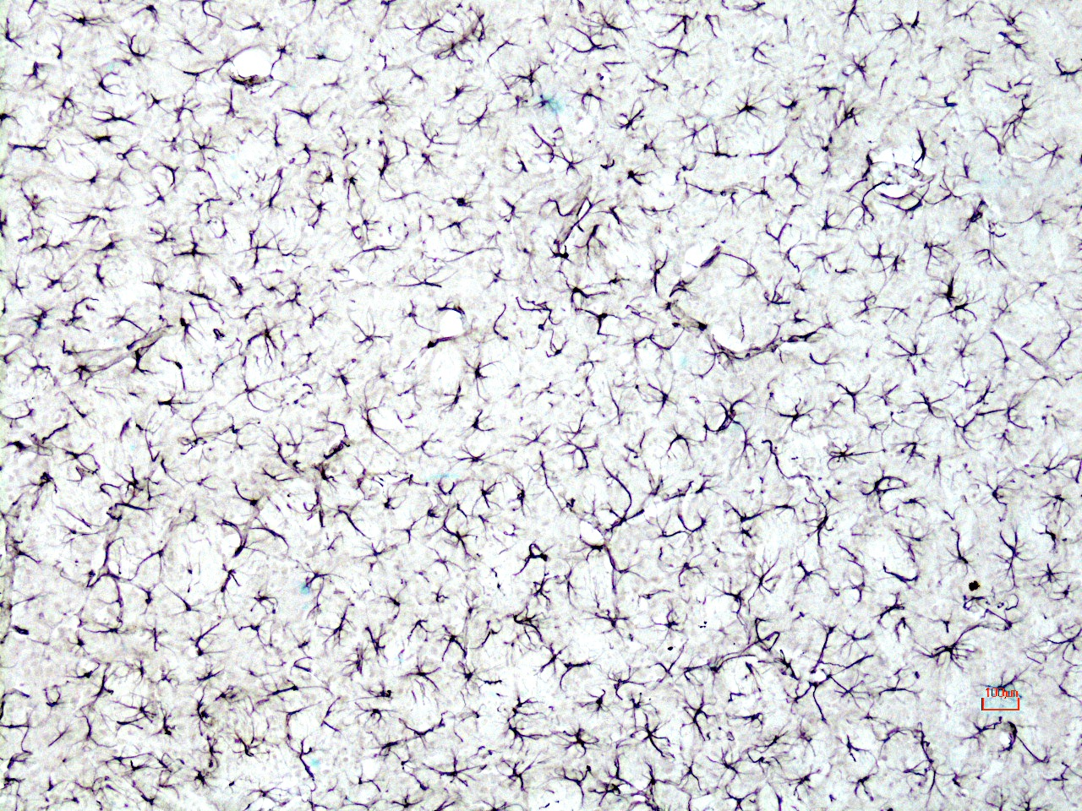
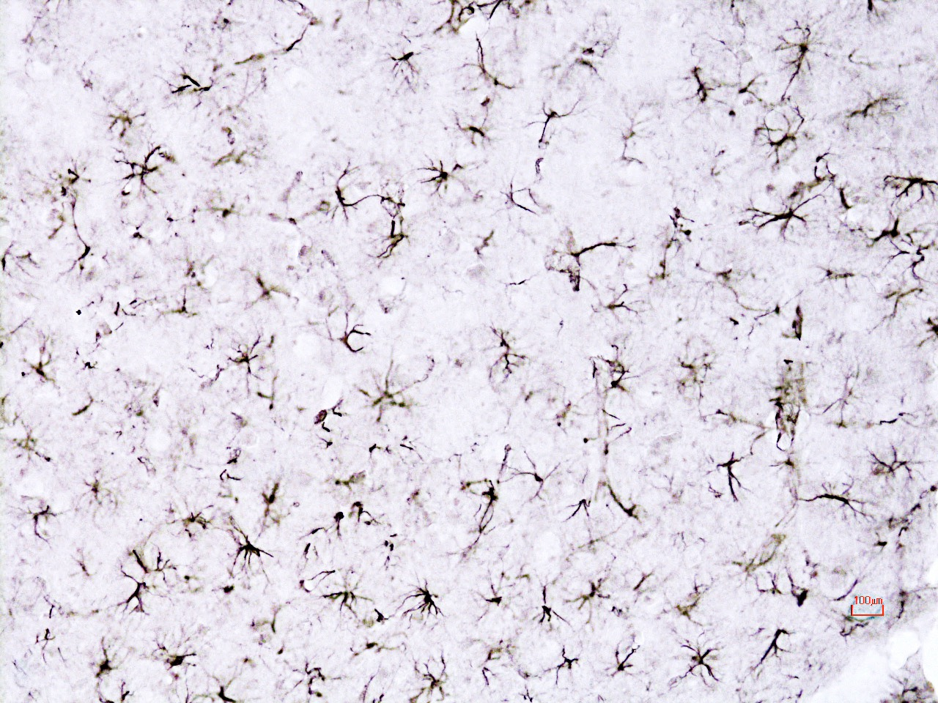
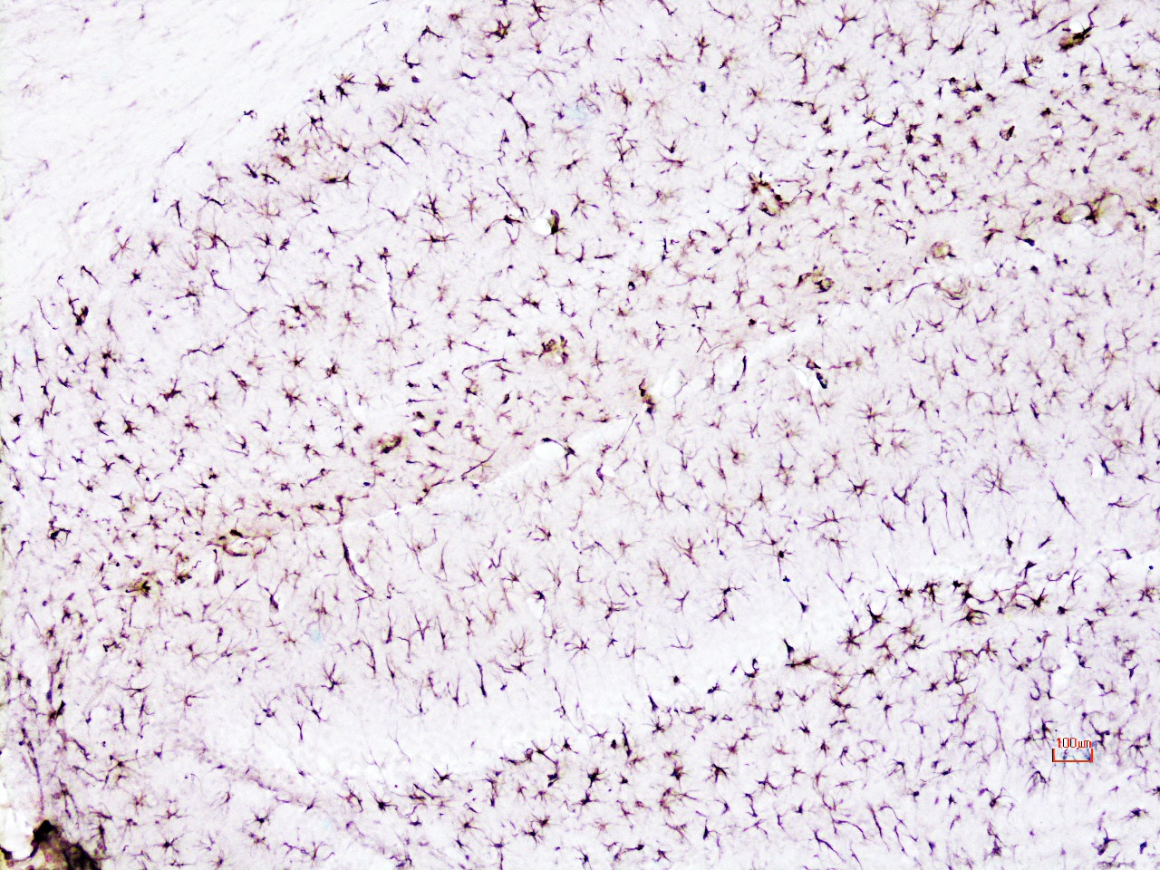
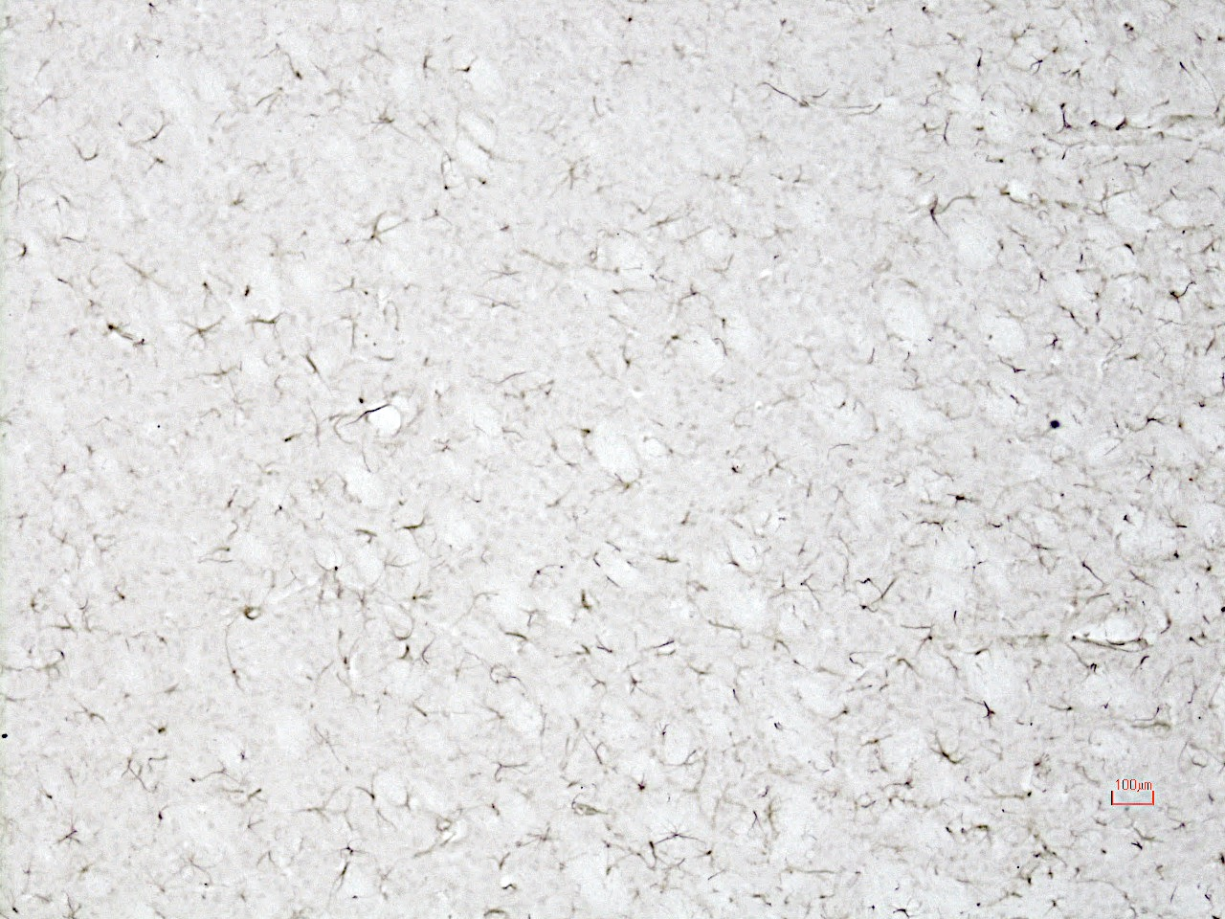
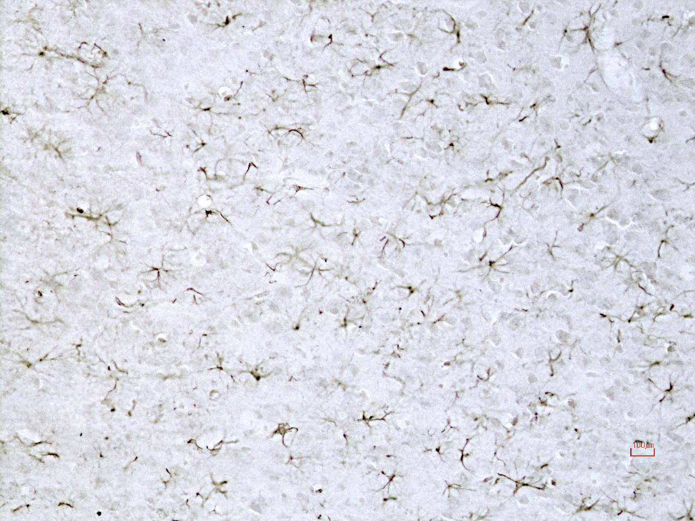
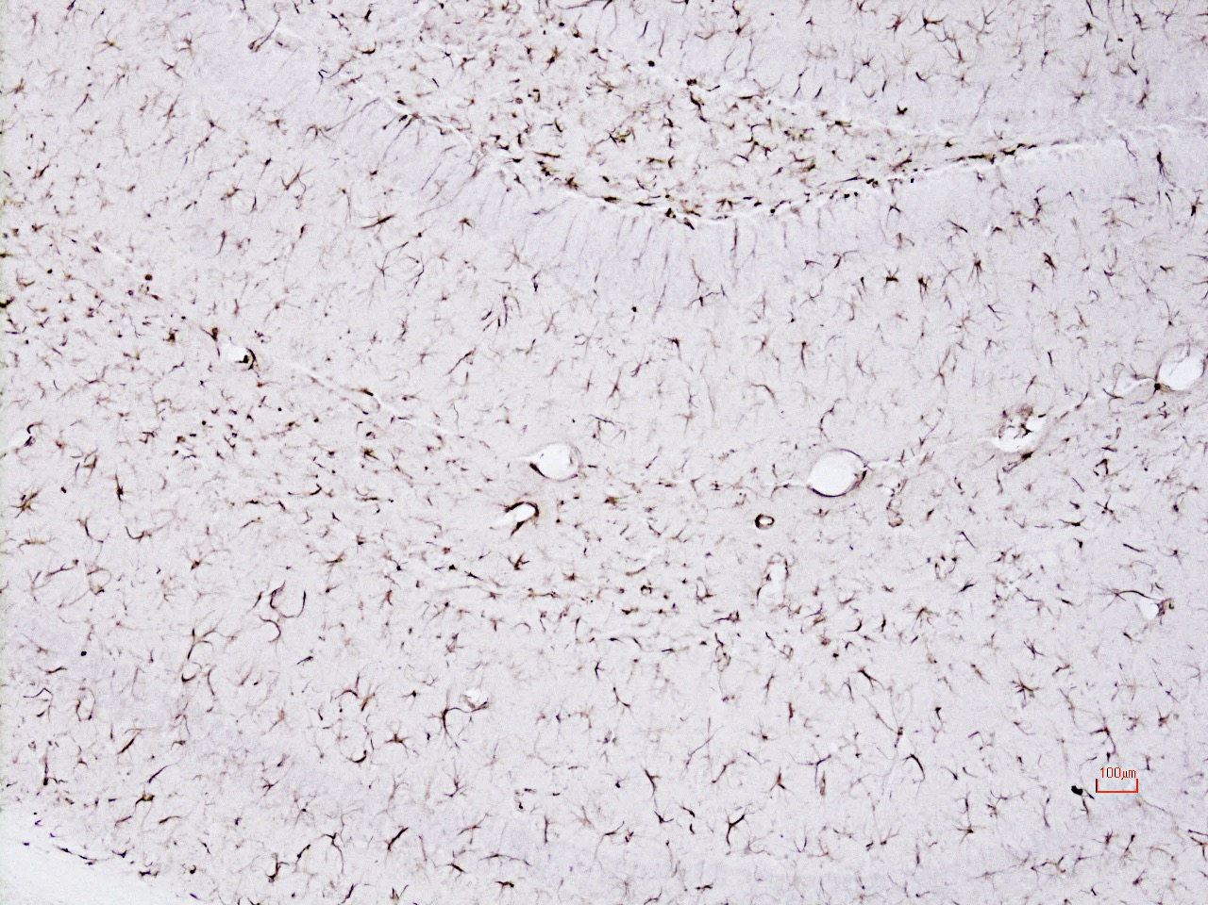
Fig. 3
Thalamus Cortex Hippocampus
A B C
MPS IIIA
GFAP
100 μm
100 μm
100 μm
D E F
Group 1
100 μm
100 μm
100 μm

Slide 4
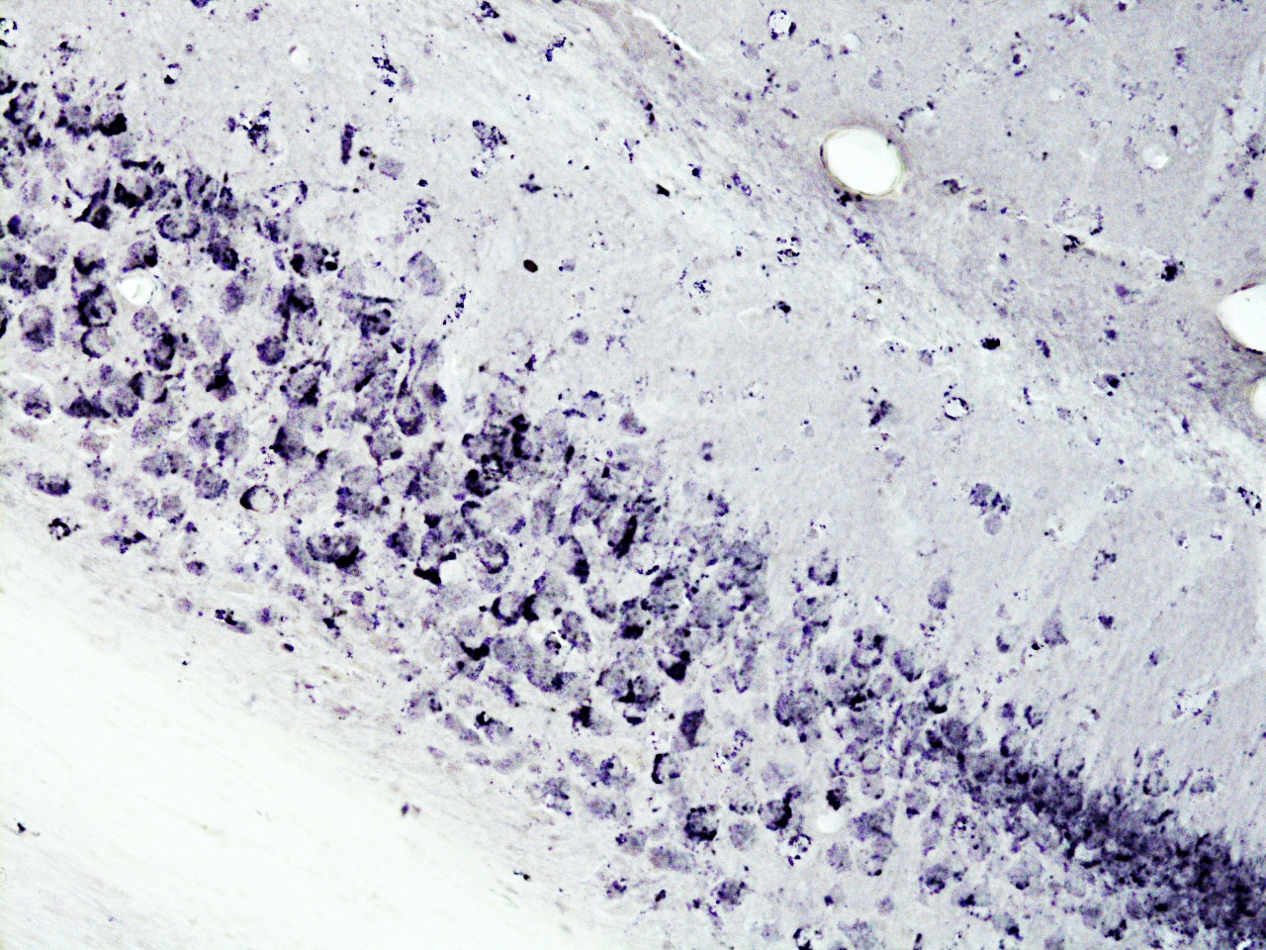
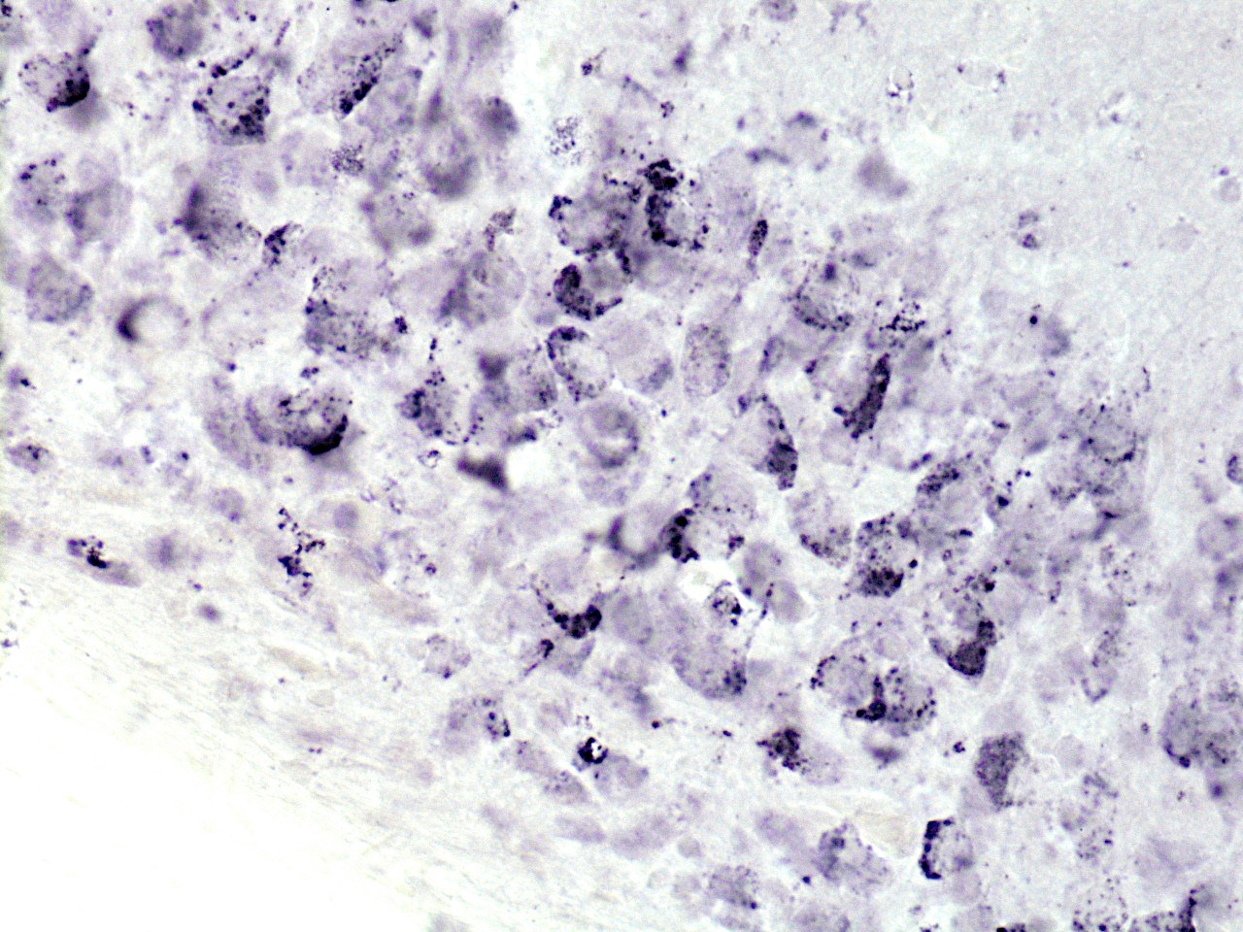
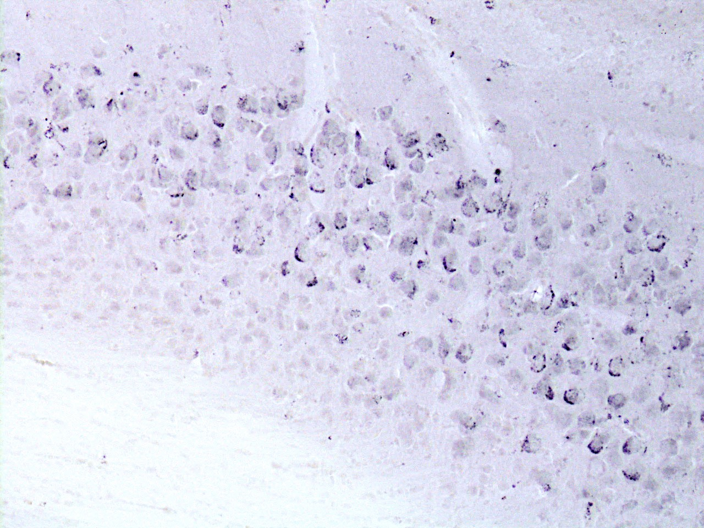
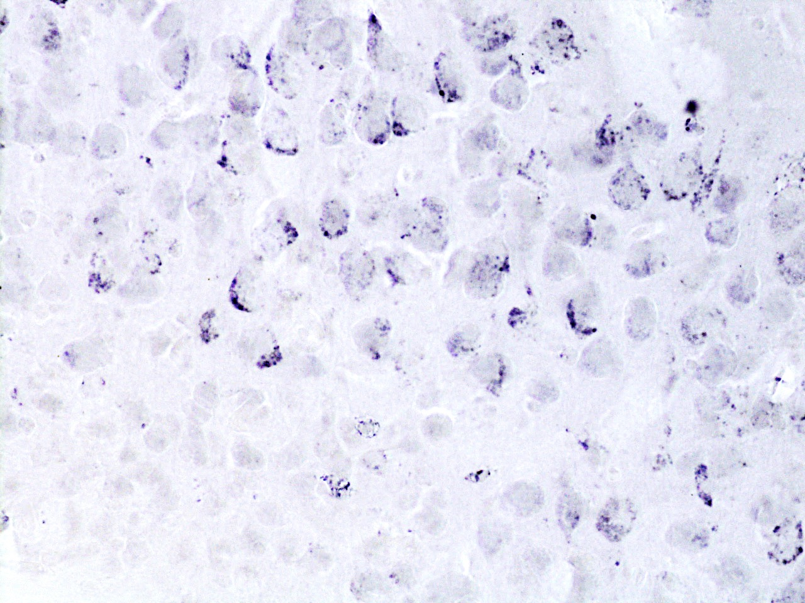
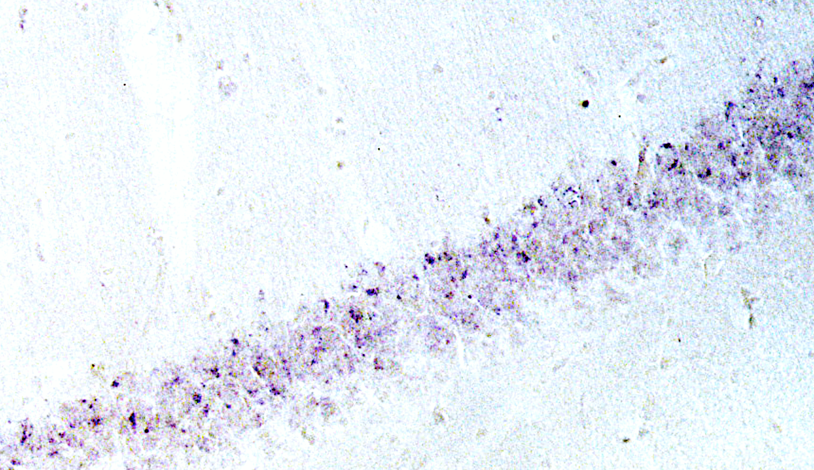
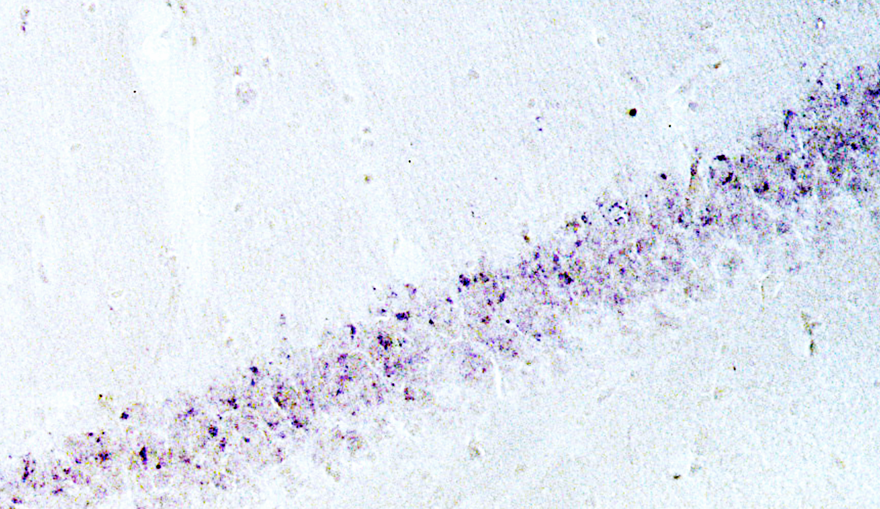
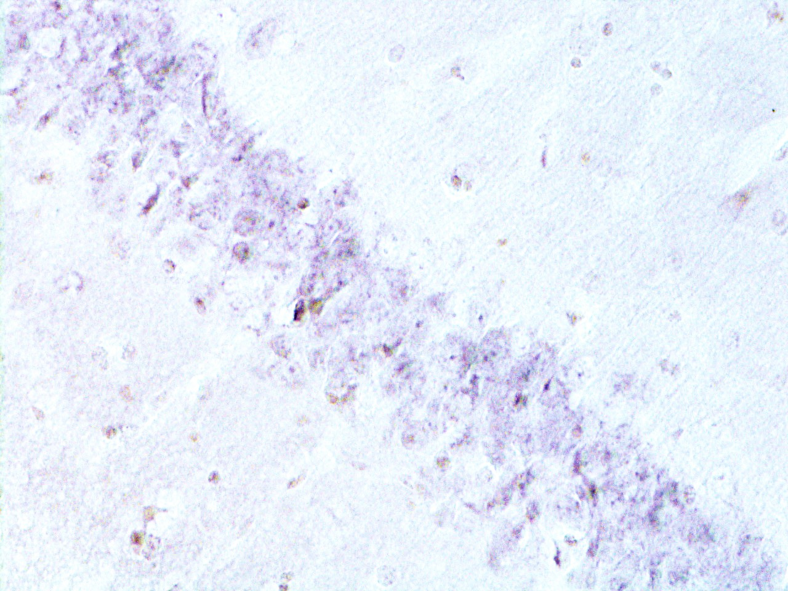
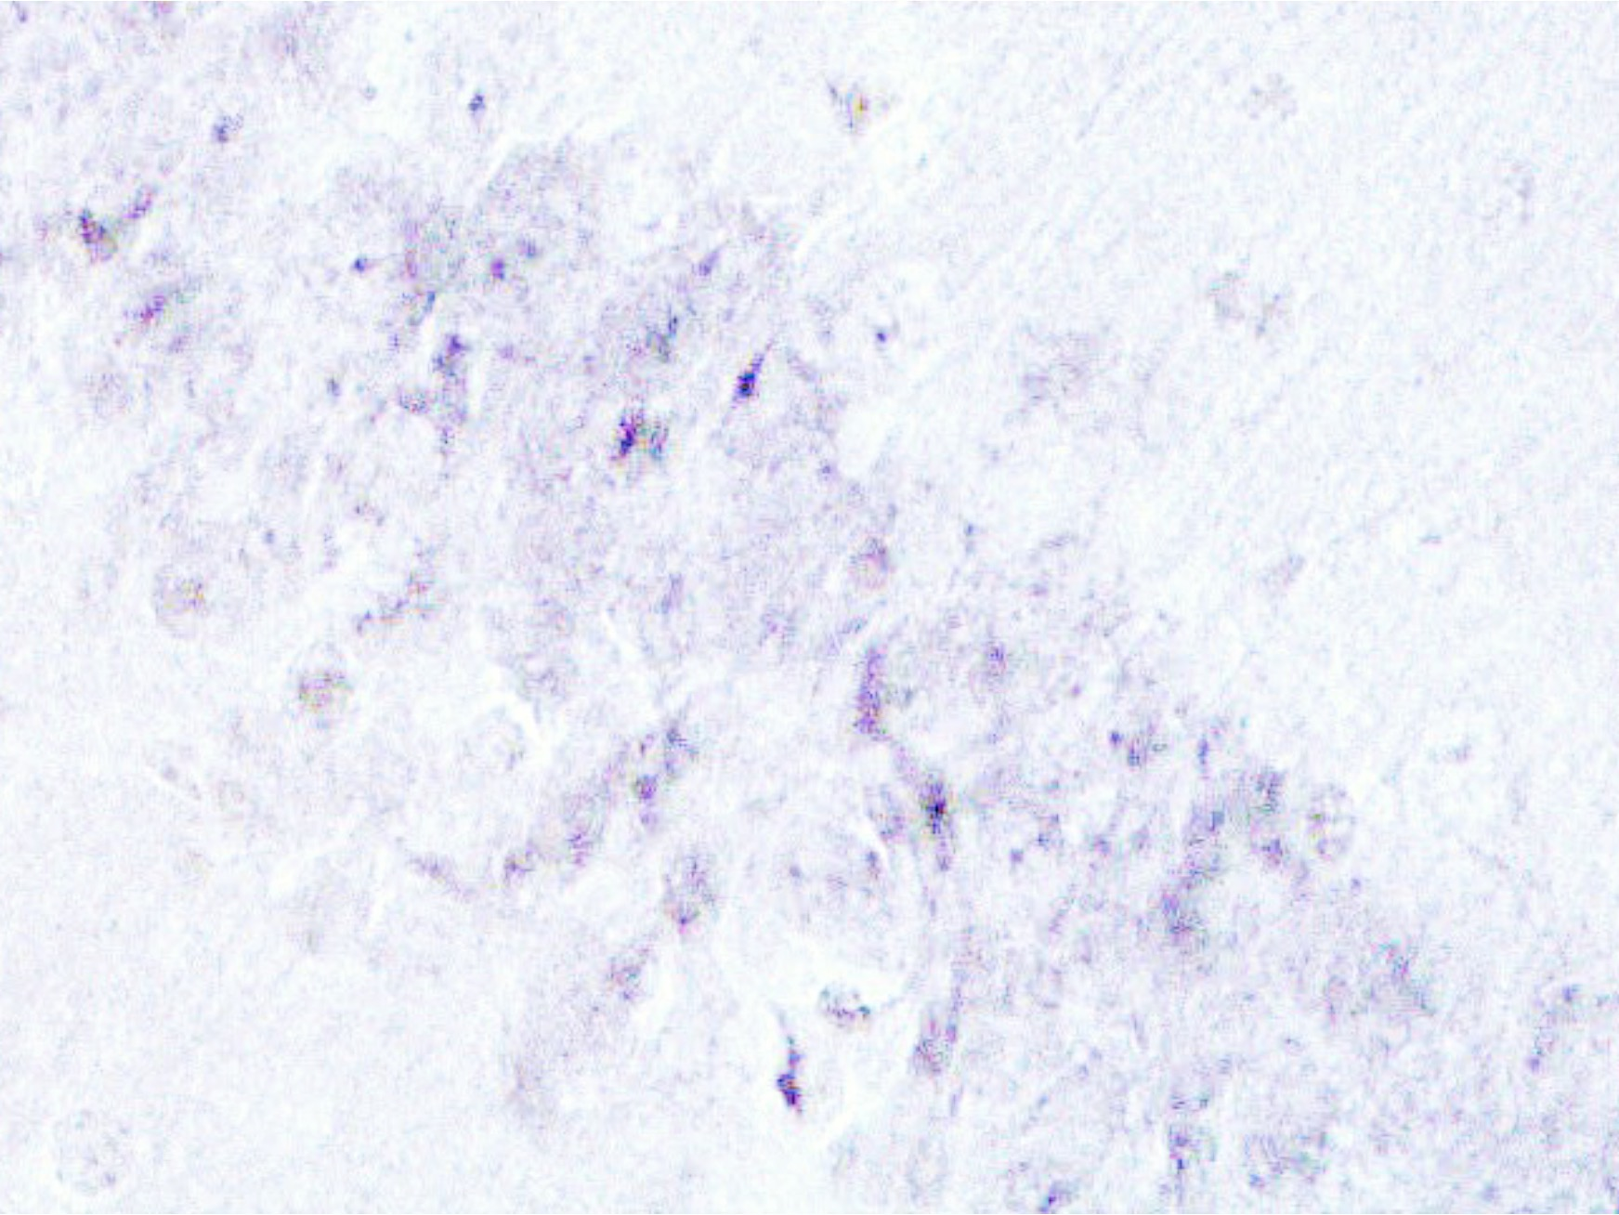
Fig. 4
A B
MPS IIIA ( 32 weeks)
100 μm
50 μm
C D
Group 1
100 μm
50 μm
E F
MPS IIIA (16 weeks)
100 μm
50 μm
G H
ICV PPS
100 μm
50 μm

Slide 5
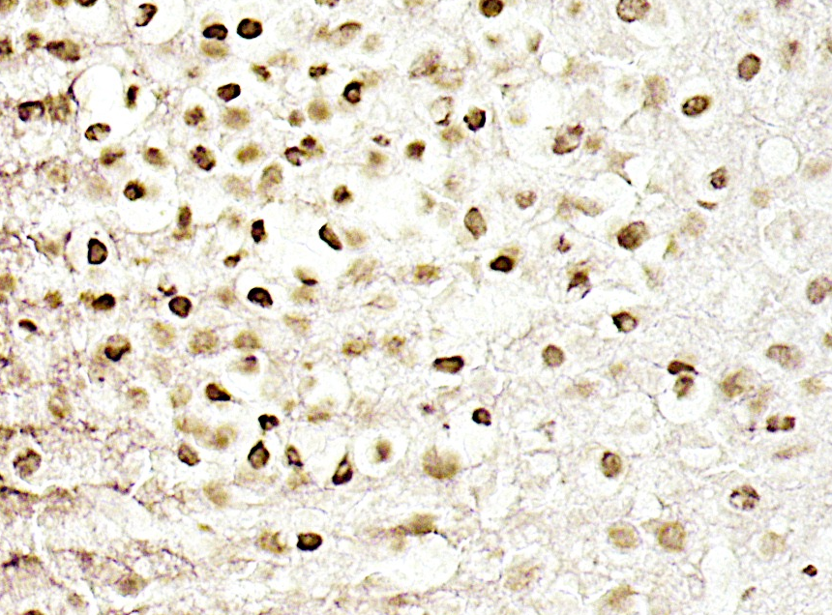
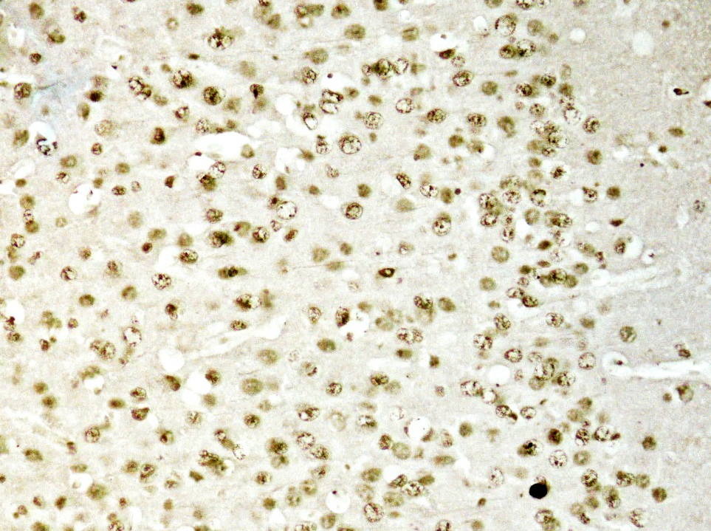
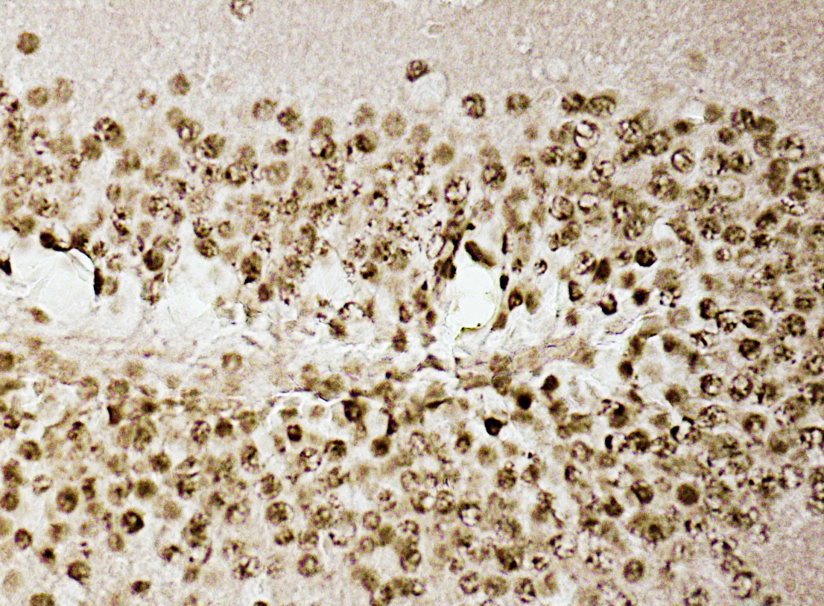
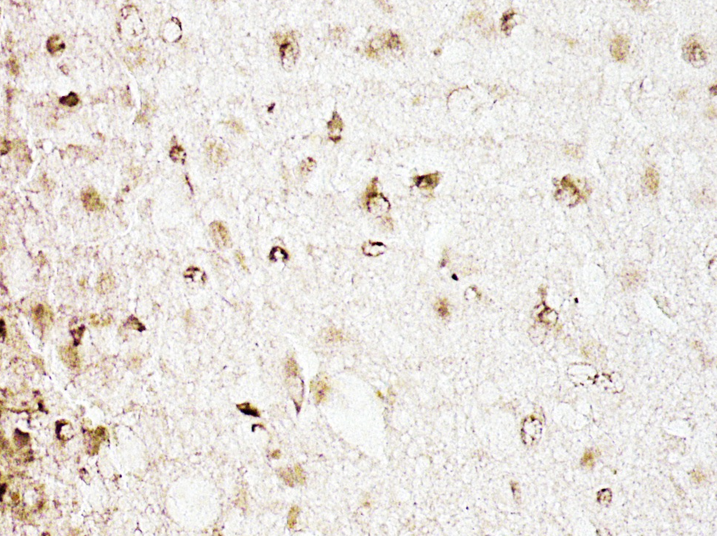
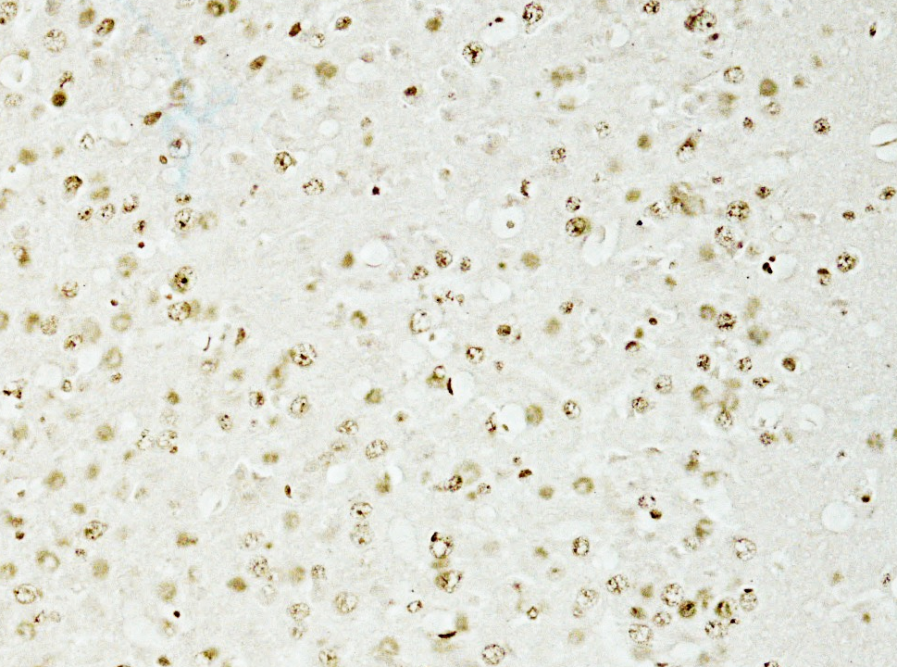
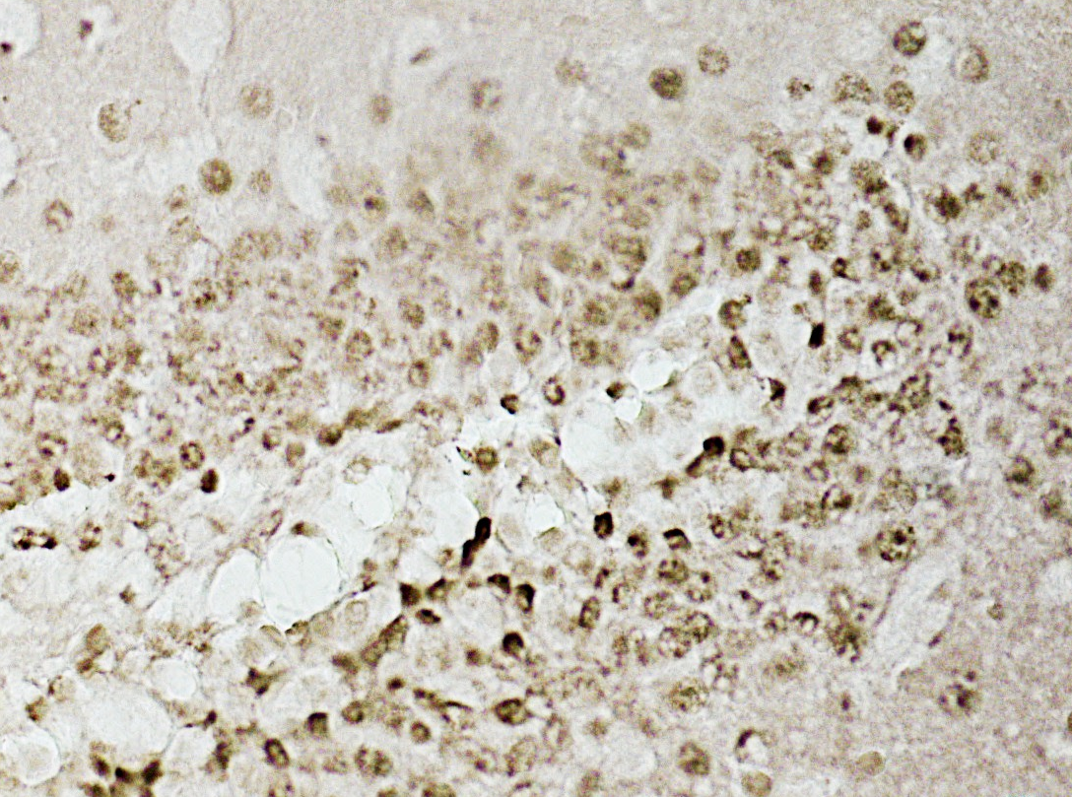
Fig. 5
Cortex Thalamus Hippocampus
A B C
Group 1 MPS IIIA
50 μm
50 μm
50 μm
D E F
50 μm
50 μm
50 μm

Slide 6
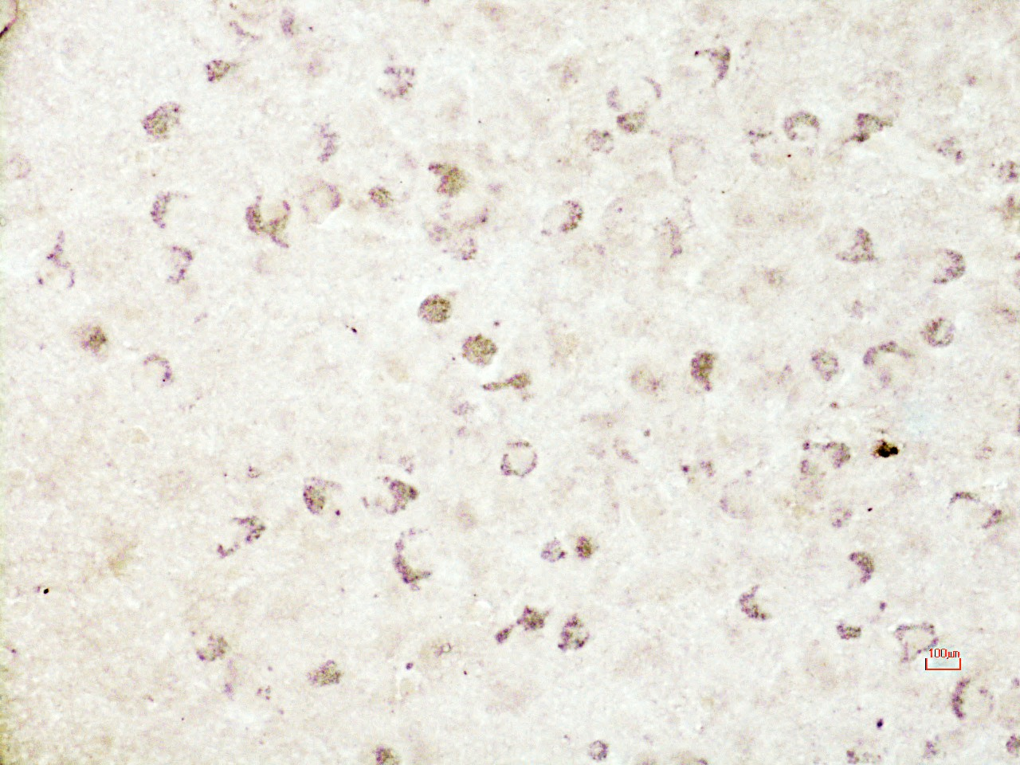
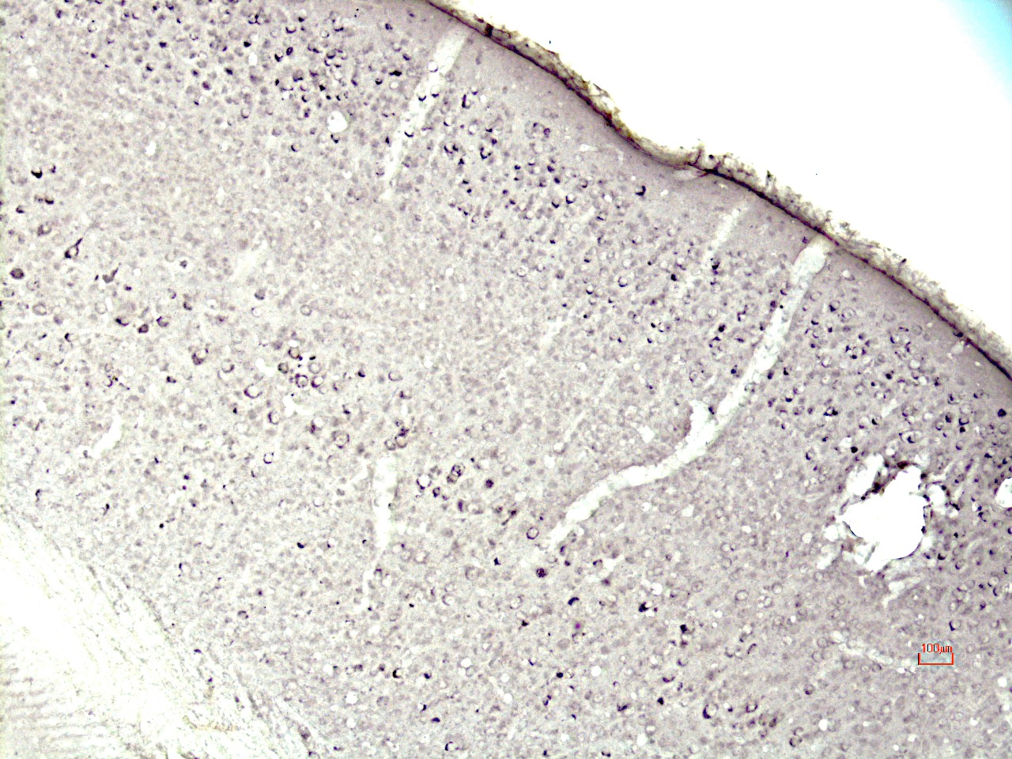
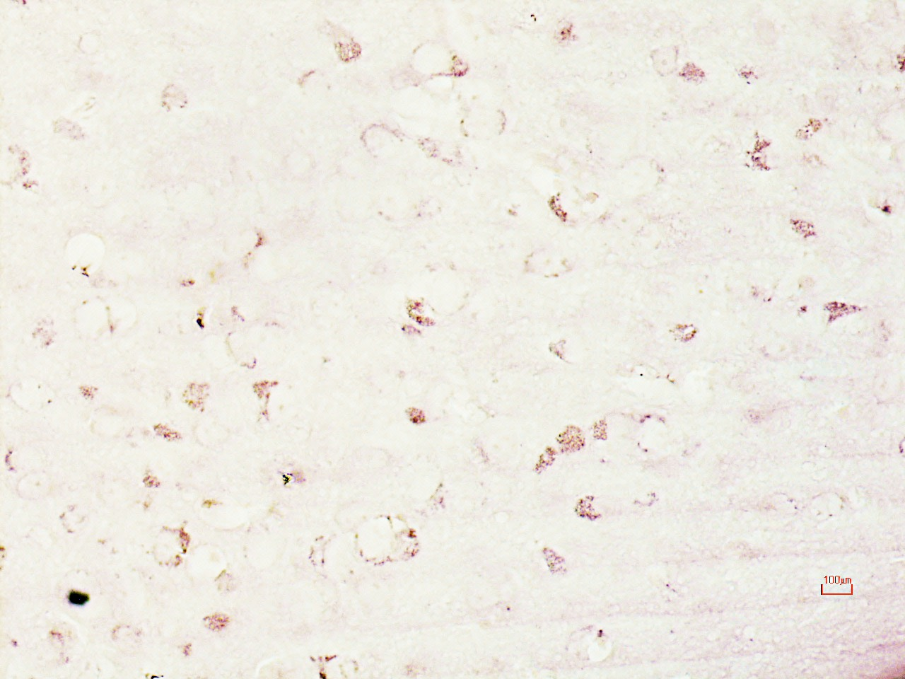
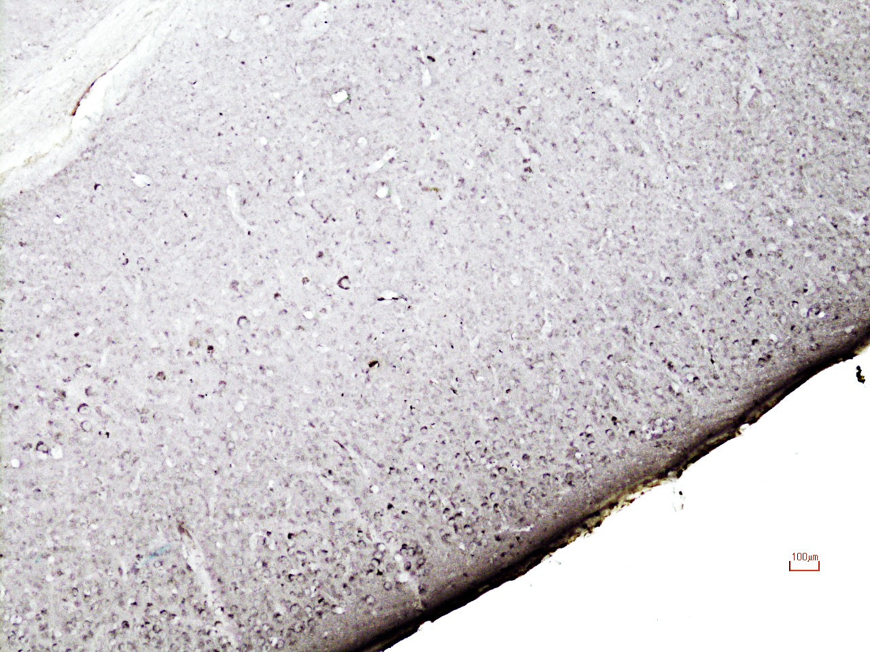
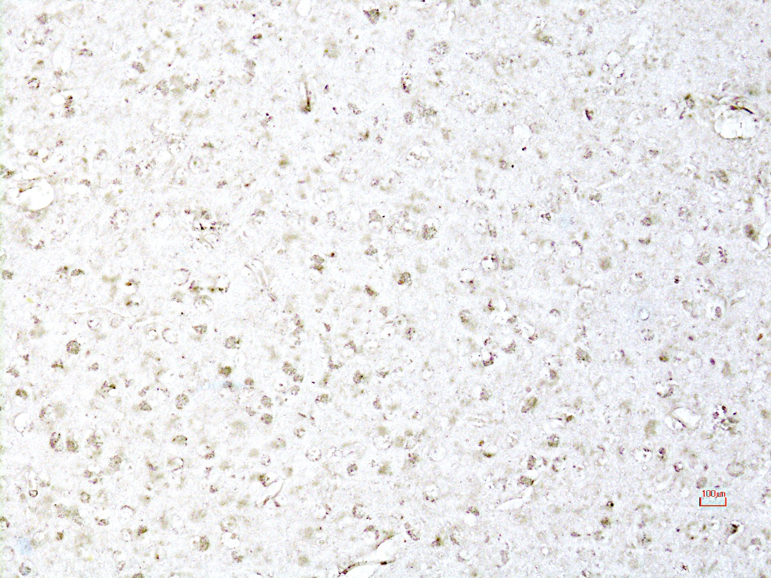
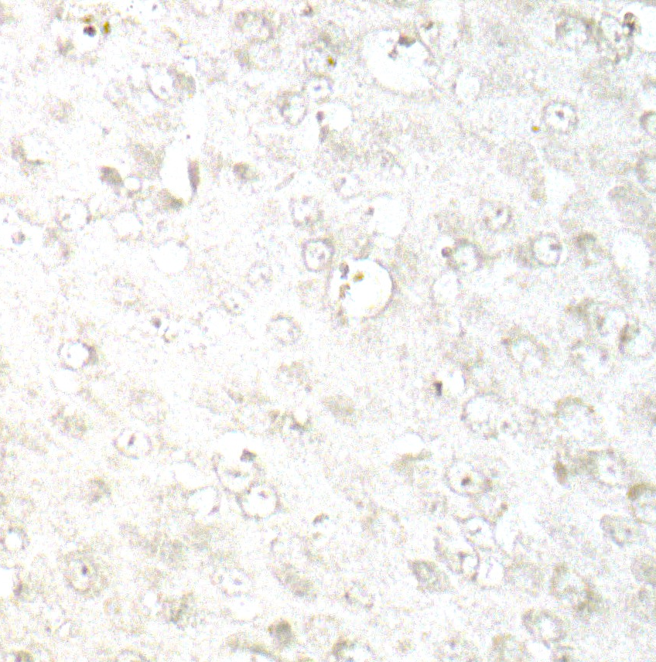
Fig. 6
Amygdala Cortex
A B
MPS IIIA
50 μm
100 μm
C D
Group 1
50μm
100 μm
E F
Amygdala
50 μm
50 μm
MPS IIIA ICV PPS

Slide 7
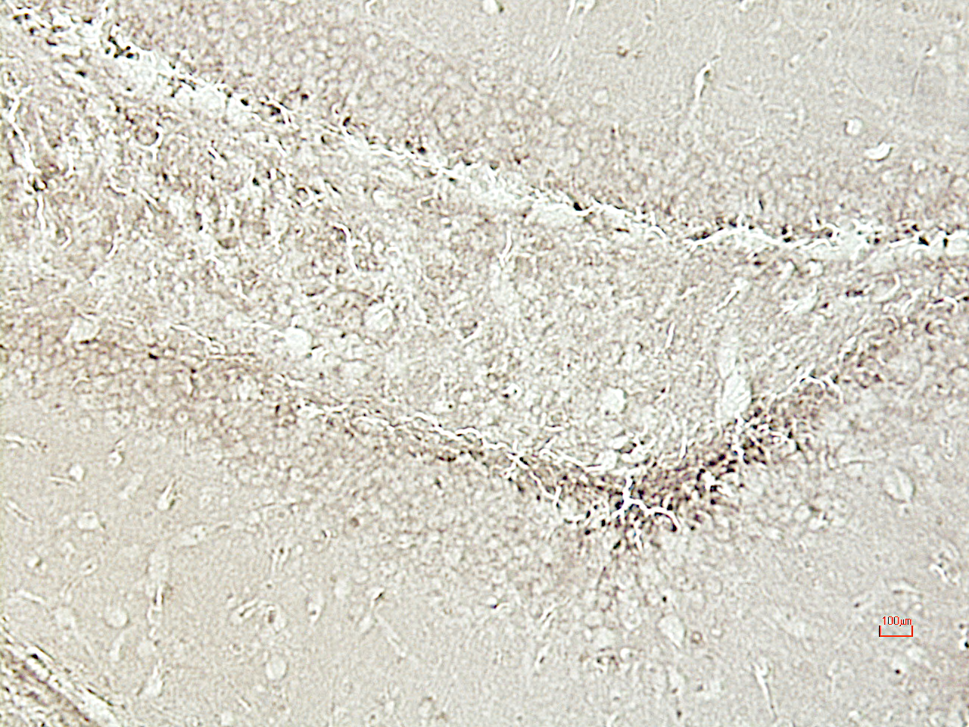
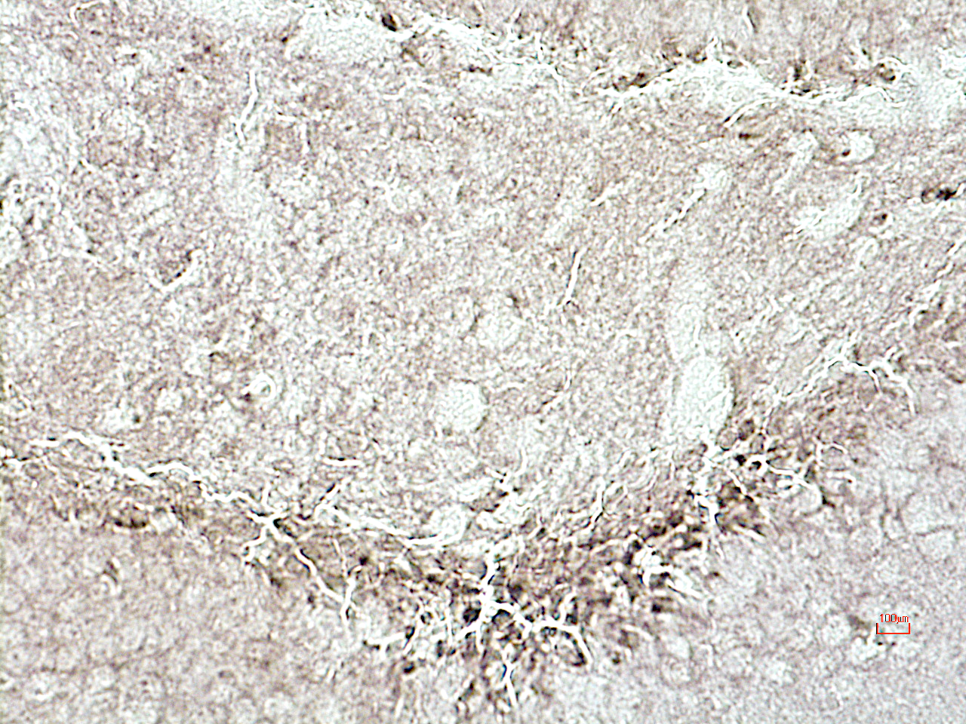
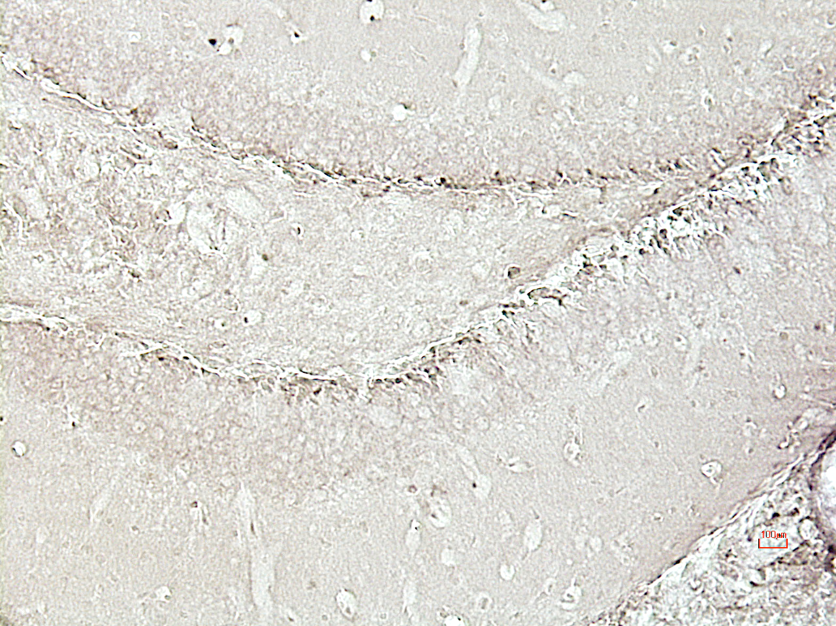
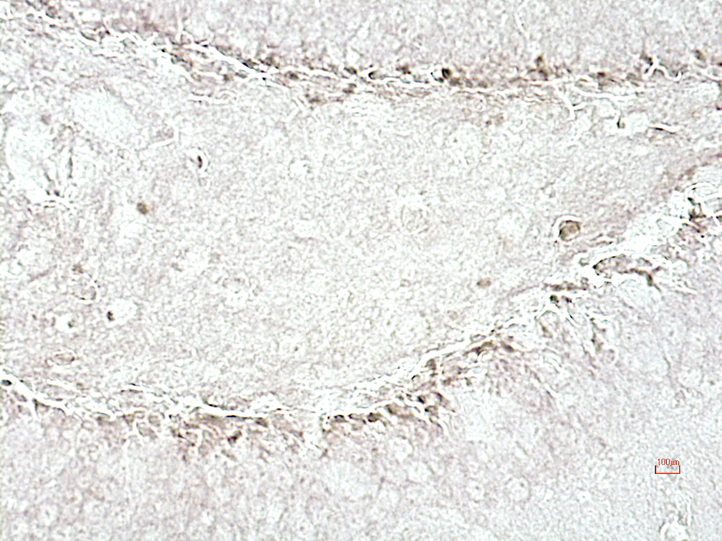
Fig. 7
A B
Group 1 MPS IIIA
100 μm
50 μm
C D
100 μm
50 μm

Slide 8
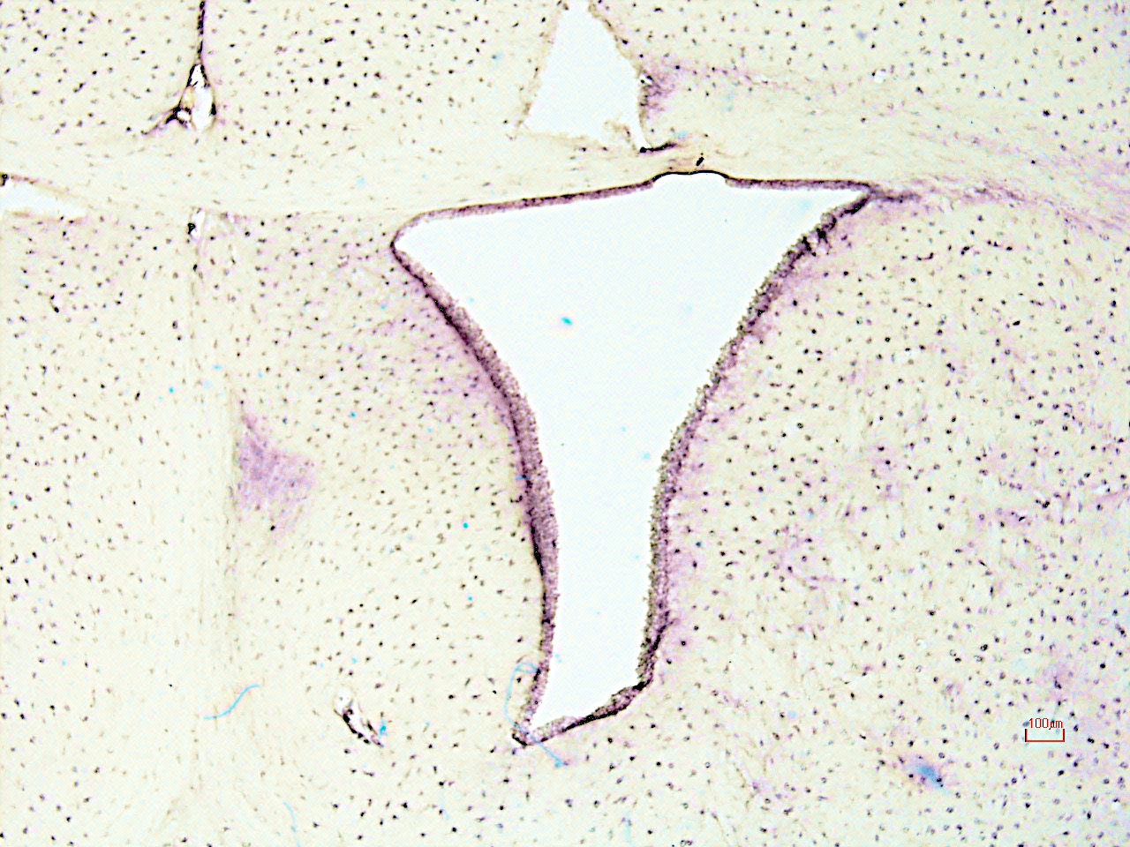
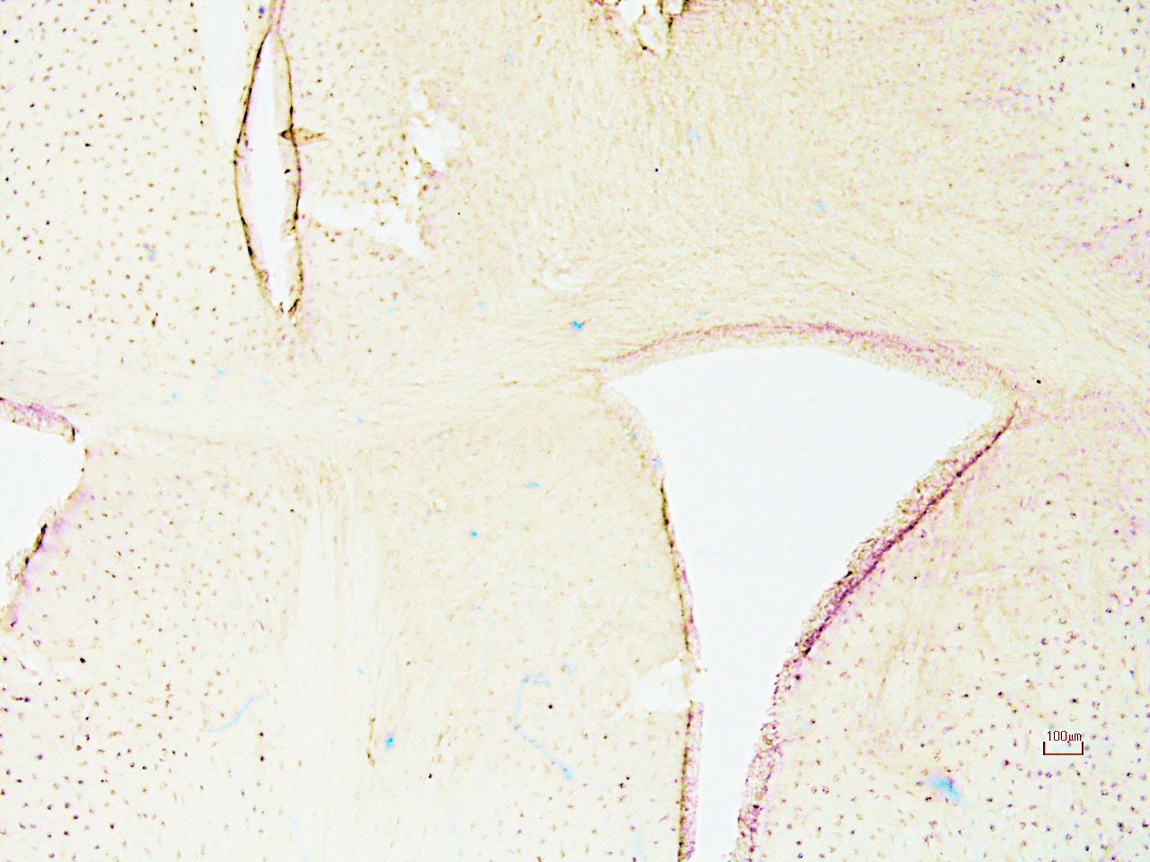
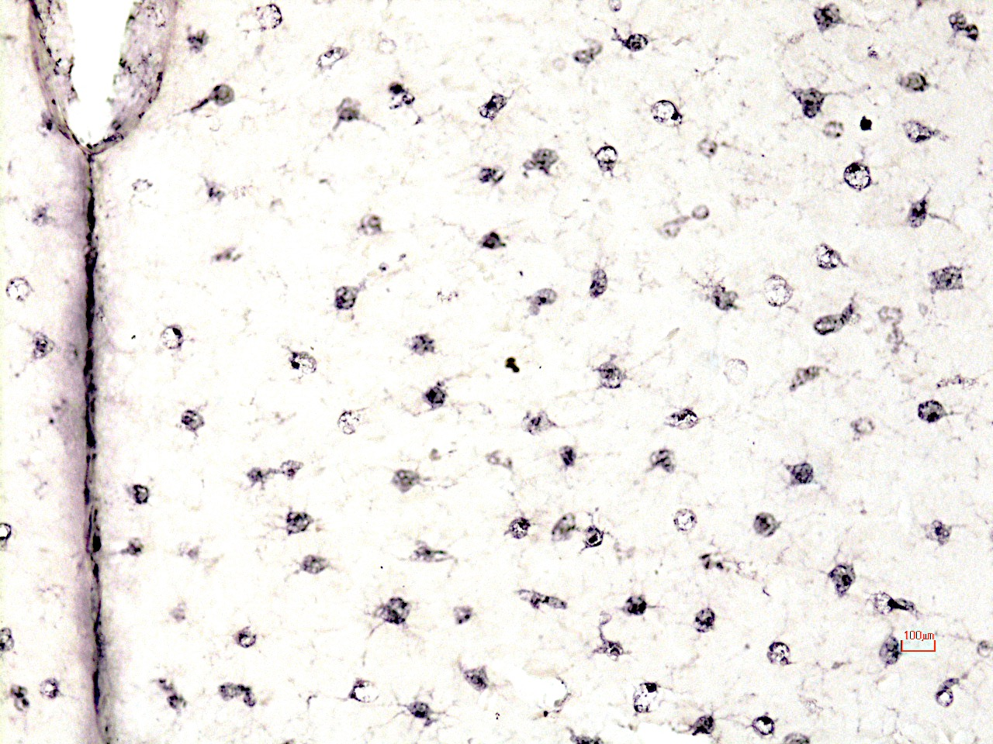
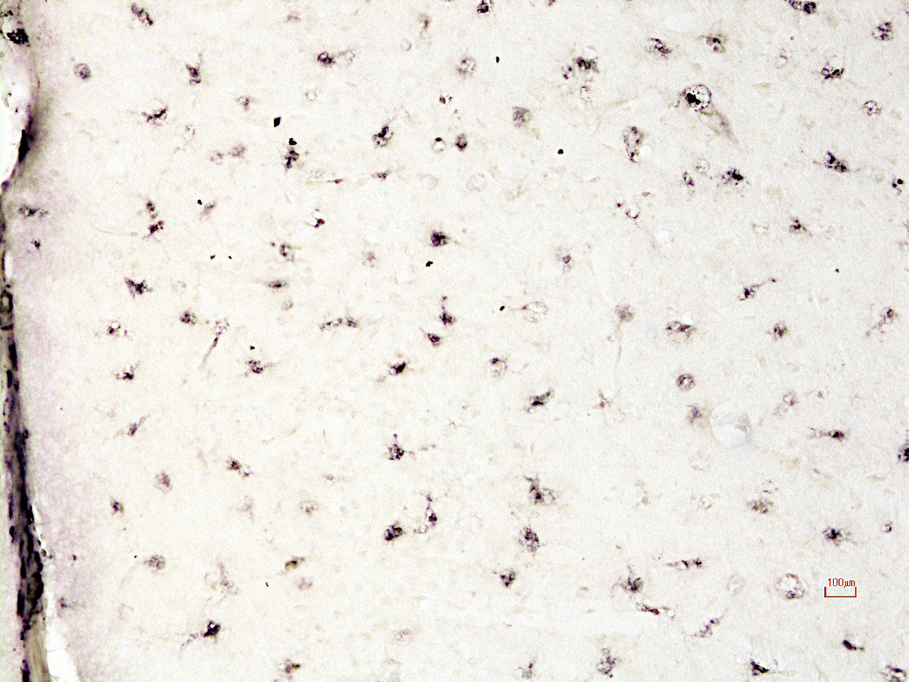
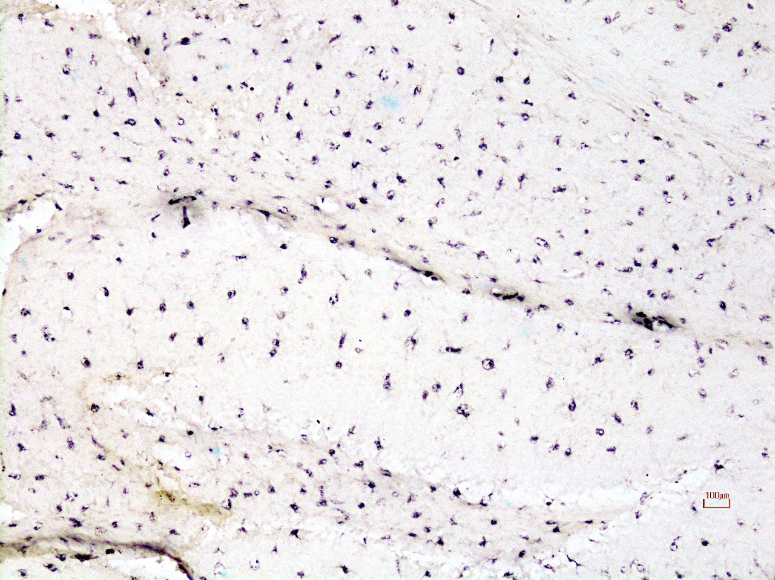
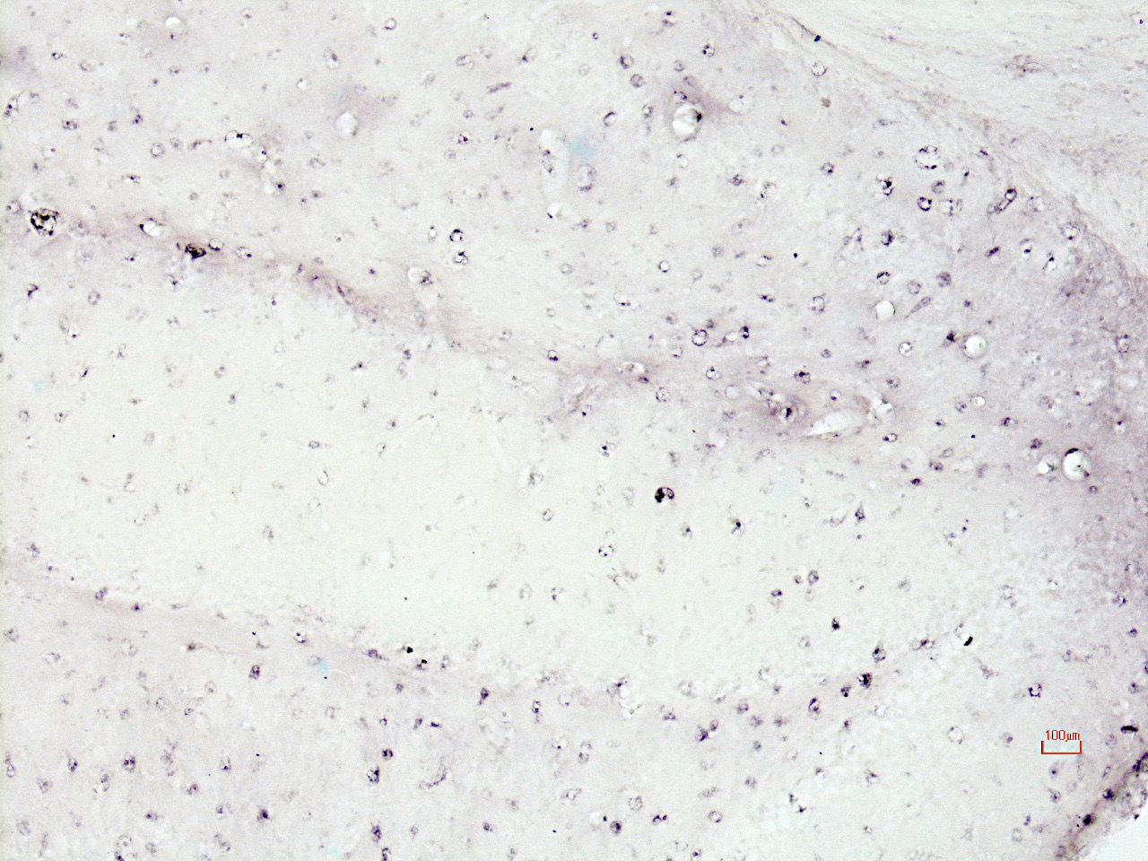
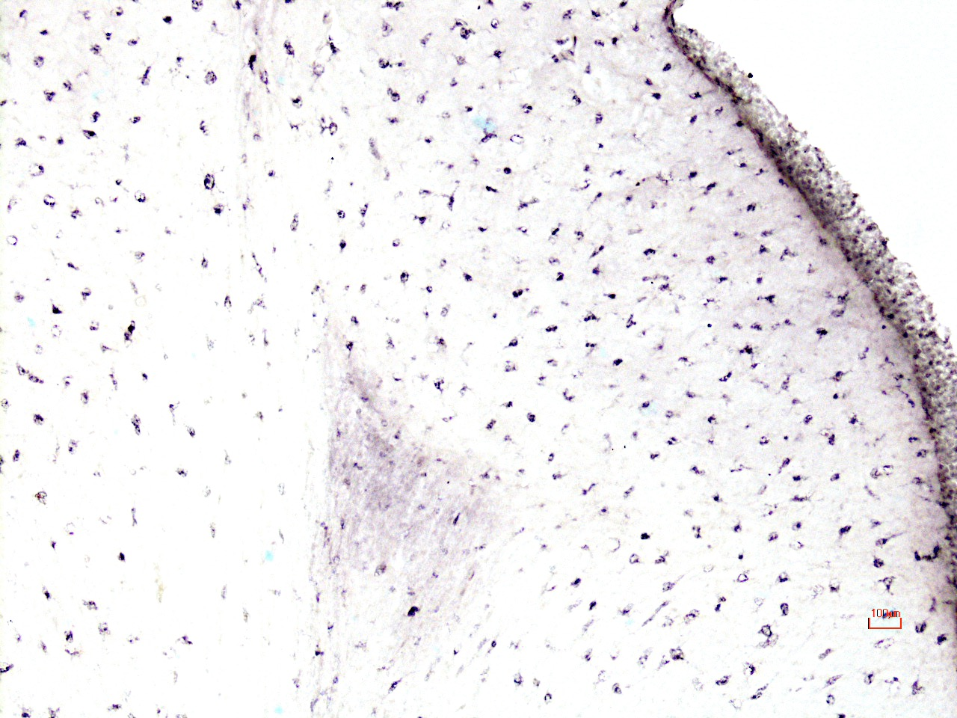
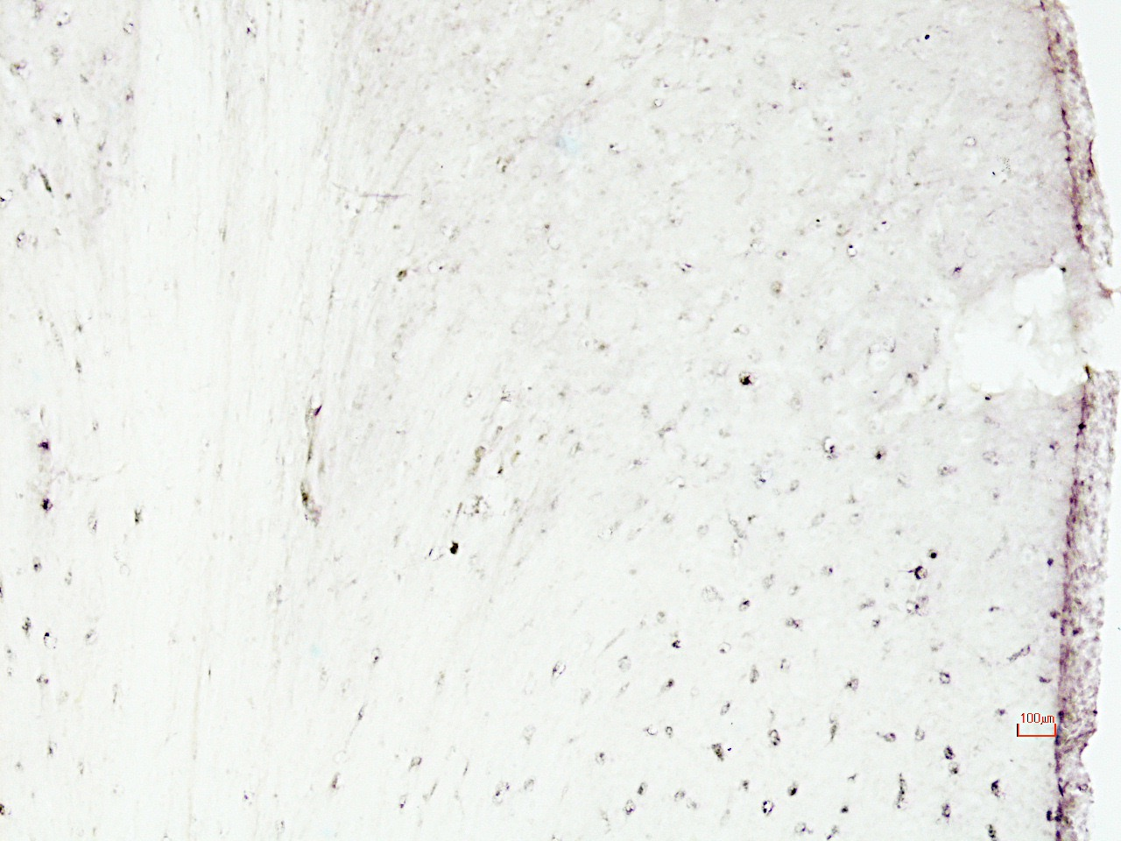
Fig. 8
Ventricle Cortex Hippocampus Lateral Septum
A B C D
E F G H
ICV PPS MPS IIIA
100 μm
100 μm
100 μm
100 μm
100 μm
100 μm
100 μm
100 μm

Slide 9
Fig. 9
A.
B.
Limp-2
% Reduction Compared To MPS IIIA
GFAP
HS
GM3
P-Tau
Cortex
Hippocampus
Thalamus
Cortex
Thalamus
Hippocampus
Amygdala
Cortex
Hippocampus
Hippocampus
% Reduction Compared To MPS IIIA
GM3
Limp-2
IL-B4
Ventricle
Cortex
Hippocampus
Lateral Septum
Amygdala
Hippocampus

Slide 10
Fig. 10
A.
B.
Marbles Buried In 30 Min
*
Wild Type MPS IIIA G1
Learning Testing
*

Slide 11
Tissue Vacuolization Scoring
S. 1
 | Wild Type | Untreated | Group 1 | Group 2
Spleen | 0 | 4.56+/-0.53 | 1.67+/-0.50* | 1.89+/-0.33*
Kidney | 0 | 3.78+/-0.44 | 1.33+/-0.50* | 2.11+/-0.33*
Liver | 0 | 4.67+/-0.50 | 1.11+/-0.33* | 1.67+/-0.44*

Slide 12
S. 2
μg GAG/mg Tissue
*
*
WT Un G1 G2 WT Un G1 G2 WT Un G1 G2
Liver Kidney Spleen

