Slide 1
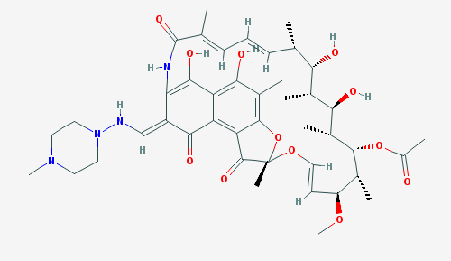
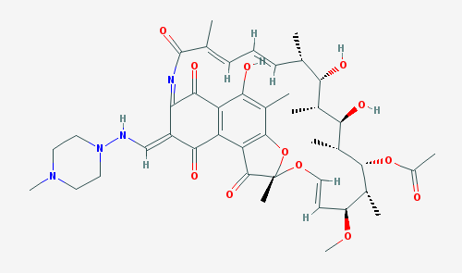
RIFAMPIN
RIFAMPIN
QUINONE
Auto-oxidation
Reduction
Supplemental Figure S1. Chemical structures of rifampin and rifampin quinone.
Rifampin auto-oxidizes to form rifampin quinone.

