Slide 1
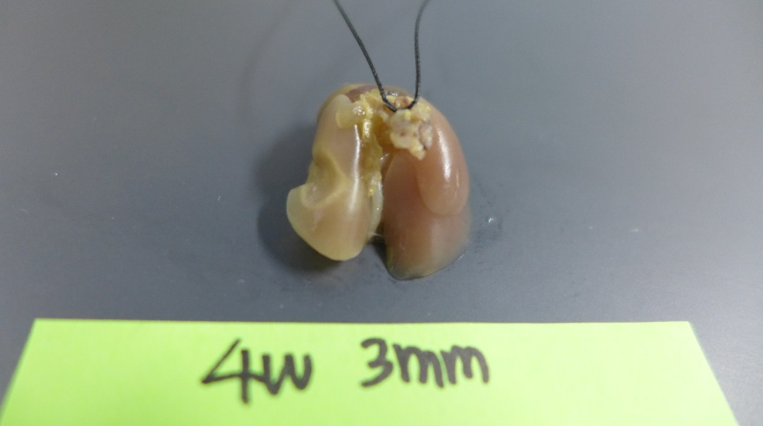
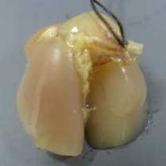
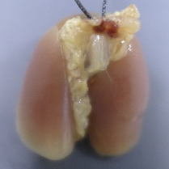
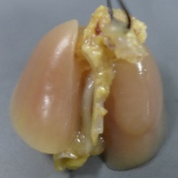
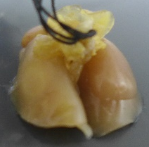
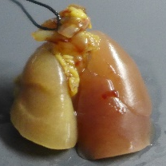
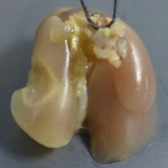
Supplementary Fig S1
A
B
1W
2W
4W
Neighboring
Control
Focal
90 Gy

Slide 2
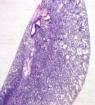
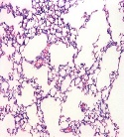
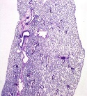
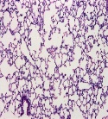
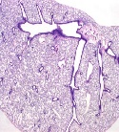
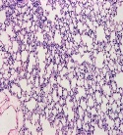
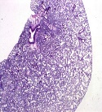
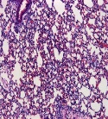
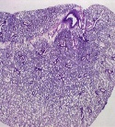
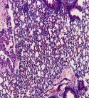
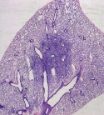
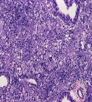
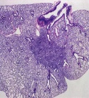
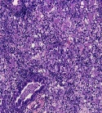
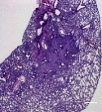
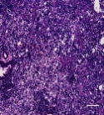
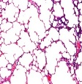
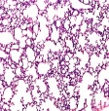
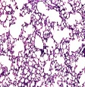
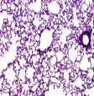
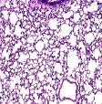
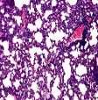
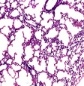
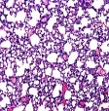
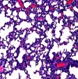
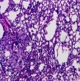
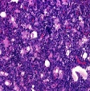
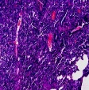
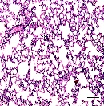
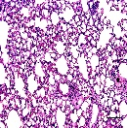
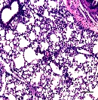
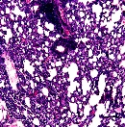
Supplementary Fig S2
A
90 Gy (weeks)
1
2
3
4
Con
H&E
IR
x100
20 Gy (months)
B
0.5
1
3
6
9
12
Con
H&E
Irradiated
Non
-irradiated
x100

Slide 3
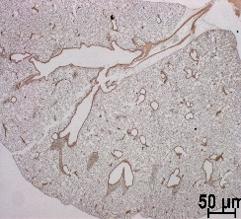
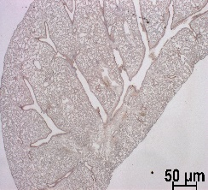
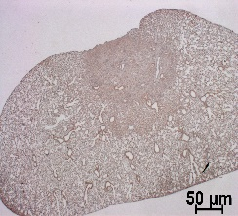
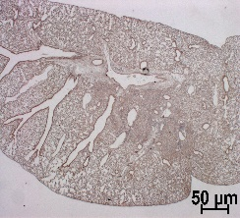
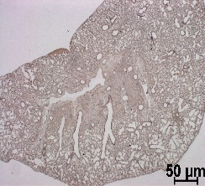
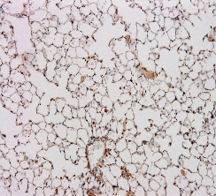
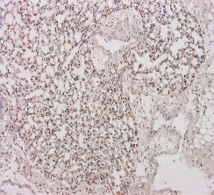
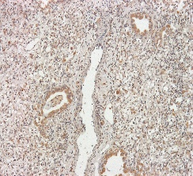
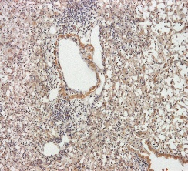
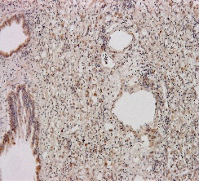
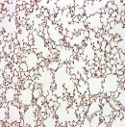














Supplementary Fig S2
90 Gy (weeks)
C
Con
1
2
3
4
X1.25
Hydroxyproline
x100
20 Gy (months)
D
1
3
6
9
12
Con
Hydroxyproline
Irradiated
Non
-irradiated
x100

Slide 4
Supplementary Fig S3
FN1
90 Gy |  |  | 20 Gy
Focal | 1W | 3.24 | Ir- radiation | 3M | 1.85
 | 2W | 5.6 |  | 6M | 1.92
 | 3W | 3.67 |  | 9M | 2.45
 | 4W | 5.91 |  | 12M | 2.13
Neighbor | 1W | 1.5 | Non- irradiation | 3M | 1.10
 | 2W | 2.77 |  | 6M | 0.82
 | 3W | 1.38 |  | 9M | 0.98
 | 4W | 3.99 |  | 12M | 1.10
TWIST1
90 Gy |  |  | 20 Gy
Focal | 1W | 1.47 | Ir- radiation | 3M | 1.39
 | 2W | 5.75 |  | 6M | 2.04
 | 3W | 5.13 |  | 9M | 1.06
 | 4W | 5.15 |  | 12M | 0.59
Neighbor | 1W | 1.03 | Non- irradiation | 3M | 0.68
 | 2W | 2.86 |  | 6M | 0.70
 | 3W | 3.59 |  | 9M | 0.74
 | 4W | 2.66 |  | 12M | 1.01
IL13
90 Gy |  |  | 20 Gy
Focal | 1W | 1.00 | Ir- radiation | 3M | 6.06
 | 2W | 7.27 |  | 6M | 1.19
 | 3W | 2.96 |  | 9M | 4.42
 | 4W | 1.83 |  | 12M | 3.89
Neighbor | 1W | 0.92 | Non- irradiation | 3M | 9.84
 | 2W | 1.15 |  | 6M | 2.55
 | 3W | 1.04 |  | 9M | 1.49
 | 4W | 0.86 |  | 12M | 1.19
MMP2
90 Gy |  |  | 20 Gy
Focal | 1W | 1.62 | Ir- radiation | 3M | 1.67
 | 2W | 2.92 |  | 6M | 1.41
 | 3W | 1.69 |  | 9M | 1.79
 | 4W | 3.71 |  | 12M | 1.34
Neighbor | 1W | 1.42 | Non-irradiation | 3M | 1.44
 | 2W | 2.4 |  | 6M | 0.81
 | 3W | 1.48 |  | 9M | 1.12
 | 4W | 4.07 |  | 12M | 0.96
IL1B
90 Gy |  |  | 20 Gy
Focal | 1W | 2.21 | Ir- radiation | 3M | 0.79
 | 2W | 10.03 |  | 6M | 1.50
 | 3W | 1.31 |  | 9M | 0.71
 | 4W | 3.81 |  | 12M | 0.63
Neighbor | 1W | 1.91 | Non- irradiation | 3M | 0.74
 | 2W | 2.08 |  | 6M | 1.14
 | 3W | 1.14 |  | 9M | 0.36
 | 4W | 2.45 |  | 12M | 0.36
MMP12
90 Gy |  |  | 20 Gy
Focal | 1W | 2.76 | Ir- Radiation | 3M | 4.65
 | 2W | 26.53 |  | 6M | 2.49
 | 3W | 20.77 |  | 9M | 21.56
 | 4W | 20.07 |  | 12M | 9.75
Neighbor | 1W | 1.1 | Non- irradiation | 3M | 4.91
 | 2W | 6.49 |  | 6M | 0.91
 | 3W | 7.83 |  | 9M | 7.25
 | 4W | 3.71 |  | 12M | 1.28
IL6
90 Gy |  |  | 20 Gy
Focal | 1W | 18.13 | Ir- radiation | 3M | 5.37
 | 2W | 26.38 |  | 6M | 13.19
 | 3W | 8.34 |  | 9M | 13.47
 | 4W | 14.54 |  | 12M | 5.79
Neighbor | 1W | 1.87 | Non- irradiation | 3M | 4.12
 | 2W | 5.35 |  | 6M | 7.7
 | 3W | 8.95 |  | 9M | 4.91
 | 4W | 4.7 |  | 12M | 0.62

Slide 5
Supplementary Fig S4
A
90 Gy
 | Irradiation |  |  |  | Non-irradiation
gene | 1W | 2W | 3W | 4W | 1W | 2W | 3W | 4W
TGFB1 | 1.46 | 1.85 | 2.00 | 1.53 | 1.21 | 0.80 | 1.30 | 1.44
TGFB2 | 1.57 | 1.31 | 1.26 | 1.32 | 1.44 | 1.06 | 0.97 | 1.57
TGFB3 | 0.95 | 0.87 | 0.87 | 1.39 | 0.96 | 0.64 | 0.70 | 1.70
TGFBR1 | 1.08 | 3.34 | 2.21 | 2.21 | 1.12 | 1.61 | 1.27 | 1.84
TGFBR2 | 1.28 | 1.68 | 1.48 | 1.57 | 1.18 | 1.50 | 1.17 | 1.34
TGFBR3 | 0.76 | 0.51 | 0.45 | 0.59 | 0.92 | 0.88 | 0.54 | 0.75
Smad1 | 1.18 | 1.80 | 1.68 | 1.57 | 1.04 | 1.49 | 1.33 | 1.03
Smad5 | 0.86 | 0.91 | 0.75 | 0.95 | 0.92 | 1.16 | 0.82 | 1.16
Smad2 | 1.15 | 2.10 | 1.28 | 1.21 | 1.00 | 1.65 | 1.08 | 1.18
Smad3 | 1.31 | 1.27 | 0.81 | 1.66 | 1.03 | 0.94 | 0.56 | 1.97
Smad4 | 0.76 | 1.05 | 1.22 | 1.09 | 0.82 | 1.33 | 0.96 | 1.06
Smad6 | 0.91 | 0.31 | 0.32 | 0.32 | 1.04 | 0.46 | 0.47 | 0.48
Smad7 | 0.94 | 0.85 | 0.58 | 0.49 | 0.98 | 0.97 | 0.64 | 0.52
20 Gy
 | Irradiation |  |  |  | Non-irradiation
gene | 3M | 6M | 9M | 12M | 3M | 6M | 9M | 12M
TGFB1 | 1.36 | 1.39 | 1.05 | 0.80 | 1.32 | 1.22 | 0.82 | 0.77
TGFB2 | 1.49 | 1.34 | 1.36 | 0.87 | 1.09 | 1.00 | 0.86 | 1.08
TGFB3 | 1.04 | 0.85 | 1.01 | 0.65 | 1.17 | 0.91 | 0.82 | 1.00
TGFBR1 | 1.39 | 1.40 | 1.36 | 1.05 | 1.29 | 1.14 | 0.96 | 1.00
TGFBR2 | 1.35 | 1.72 | 1.44 | 1.19 | 1.08 | 1.04 | 0.82 | 0.80
TGFBR3 | 0.91 | 0.93 | 0.96 | 0.83 | 1.05 | 0.90 | 0.52 | 1.02
Smad1 | 1.03 | 1.50 | 1.25 | 0.79 | 1.22 | 1.35 | 0.85 | 0.86
Smad5 | 1.12 | 0.82 | 1.07 | 0.88 | 1.15 | 0.83 | 0.76 | 1.05
Smad2 | 1.37 | 1.47 | 1.23 | 0.96 | 1.48 | 1.21 | 0.87 | 0.93
Smad3 | 1.02 | 0.78 | 1.17 | 1.07 | 1.35 | 0.70 | 0.66 | 1.08
Smad4 | 1.03 | 0.67 | 1.52 | 0.93 | 0.90 | 0.61 | 0.91 | 0.93
Smad6 | 0.90 | 0.48 | 0.73 | 0.51 | 0.89 | 0.72 | 0.61 | 0.97
Smad7 | 0.86 | 0.95 | 1.11 | 0.74 | 0.92 | 1.05 | 0.70 | 0.85
B
gtse1
90 Gy |  |  | 20 Gy
Focal | 1W | 14.73 | Irradiation | 3M | 5.85
 | 2W | 16.23 |  | 6M | 2.65
 | 3W | 4.87 |  | 9M | 2.97
 | 4W | 5.15 |  | 12M | 1.52
Neighbor | 1W | 3.78 | Non-irradiation | 3M | 4.81
 | 2W | 6.22 |  | 6M | 1.07
 | 3W | 3.57 |  | 9M | 1.31
 | 4W | 2.92 |  | 12M | 1.11
fgl1
90 Gy |  |  | 20 Gy
Focal | 1W | 2.11 | Irradiation | 3M | 5.04
 | 2W | 8.78 |  | 6M | 17.39
 | 3W | 4.81 |  | 9M | 10.30
 | 4W | 6.04 |  | 12M | 37.52
Neighbor | 1W | 0.71 | Non-irradiation | 3M | 3.97
 | 2W | 8.40 |  | 6M | 5.19
 | 3W | 6.16 |  | 9M | 4.48
 | 4W | 1.09 |  | 12M | 2.11

Slide 6
























Supplementary Fig S5
3
6
12
24
(hr)
-
+
-
+
-
+
-
+
B
A
(TGFβ)
Fibronectin
245
Con
gtse1
(siRNA)
Con
fgl1
(siRNA)
3
6
12
24
(hr)
Fold
1.0
1.6
1.0
1.7
1.0
1.3
1.0
1.0
-
+
-
+
(TGFβ)
-
+
-
+
(TGFβ)
-
+
-
+
35
245
245
-
+
-
+
(TGFβ)
Snail
Fibronetin
Fibronetin
gtse1
Fold
1.0
3.3
1.0
2.7
1.0
2.2
1.0
3.1
245
Fold
1.0
1.3
0.7
0.8
35
Fold
1.0
1.4
0.7
1.1
Fold
1.0
1.9
1.0
1.1
1.0
2.5
1.0
1.1
Zo-1
Snail
Snail
35
fgl1
Fold
1.0
2.3
1.0
1.6
1.0
0.6
1.0
0.6
25
Fold
1.0
2.4
1.1
1.9
135
Fold
1.0
1.5
0.8
1.7
Fold
1.0
2.0
1.0
1.2
1.0
1.1
1.0
1.0
Twist
GTSE1
FGL1
35
gapdh
Fold
1.0
1.3
1.0
1.1
1.0
1.0
1.0
0.9
135
Fold
1.0
1.9
0.8
0.5
35
Fold
1.0
1.4
0.7
1.1
GTSE1
GAPDH
GAPDH
35
Fold
1.0
2.0
1.0
1.4
1.0
0.7
1.0
1.0
35
FGL1
Fold
1.0
1.5
1.0
1.0
1.0
1.1
1.0
0.6
GAPDH
35
C
-
+
(TGFβ)
D
E
GTSE1
FGL1
-
+
-
+
si, Con
si,gtse1
si,fgl1
(TGF-β)
SiCon
(TGF-β)
0 hr
Fibronectin
sigtse1
x100
Gtse1/Fgl1
48 hr
x100
-
+
(TGFβ)
Relative Wound width
siCon
DAPI
*
*
sifgl1
Merge
x100
x100
(TGF-β / 48hr)

Slide 7
Supplementary Fig S6
Cell Death (%)
TGF-β
-
+
-
+
TGF-β
-
+
-
+
Gtse1 SiRNA
-
-
+
+
Fgl1 SiRNA
-
-
+
+
Cell Death (%)
IR
-
+
-
+
IR
-
+
-
+
Gtse1 SiRNA
-
-
+
+
Fgl1 SiRNA
-
-
+
+

Slide 8




















Supplementary Fig S7
GTSE1
GTSE1
ki67
DAPI
Merged
Detailed
Con
2W
N
IR
F
90 Gy
Con
4W
N
IR
F
x100
x200

