Slide 1
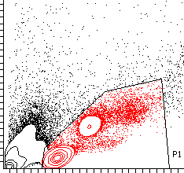
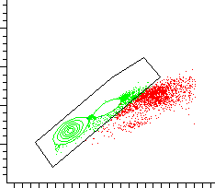
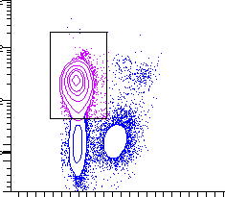
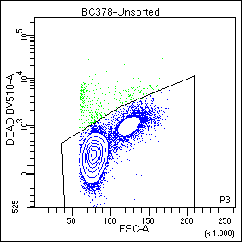
SSC-A
FSC-H
Singlets
FSC-A
FSC-A
T cells
Live cells
CD3
Live/Dead
FSC-A
FSC-A

