Slide 1
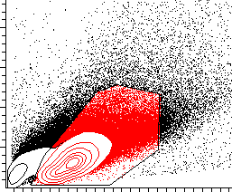
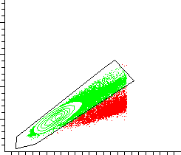
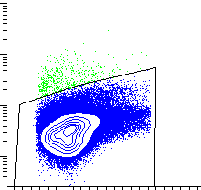
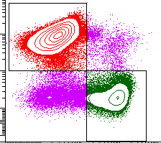
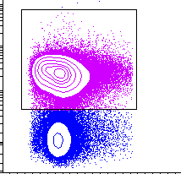
SSC-A
FSC-H
Singlets
Live/Dead
Live cells
FSC-A
FSC-A
FSC-A
CD4+ T cells
T cells
CD4
CD3
CD8+ T cells
CD8
FSC-A

