Slide 1
Figure S1
B
C
A
D
E
F

Slide 2
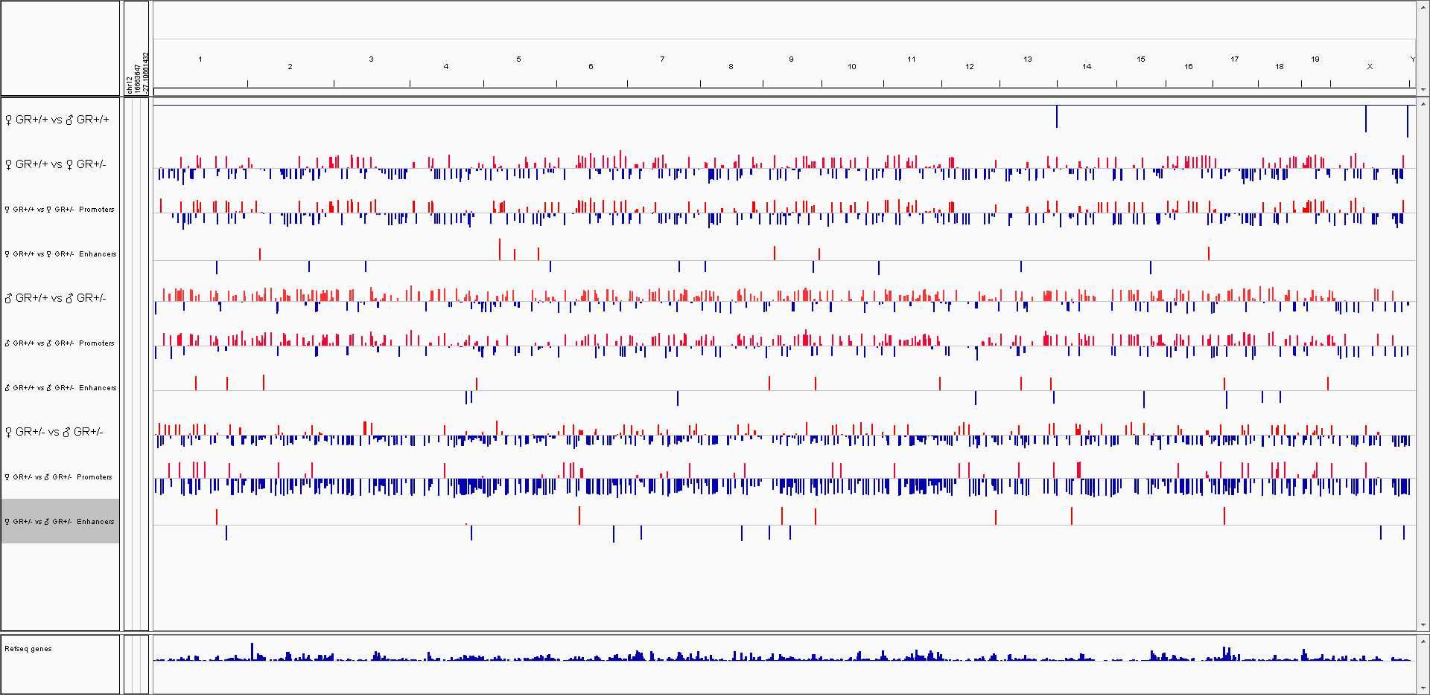
Figure S 2

Slide 3
Figure S3

Slide 4
Figure S4

