Slide 1
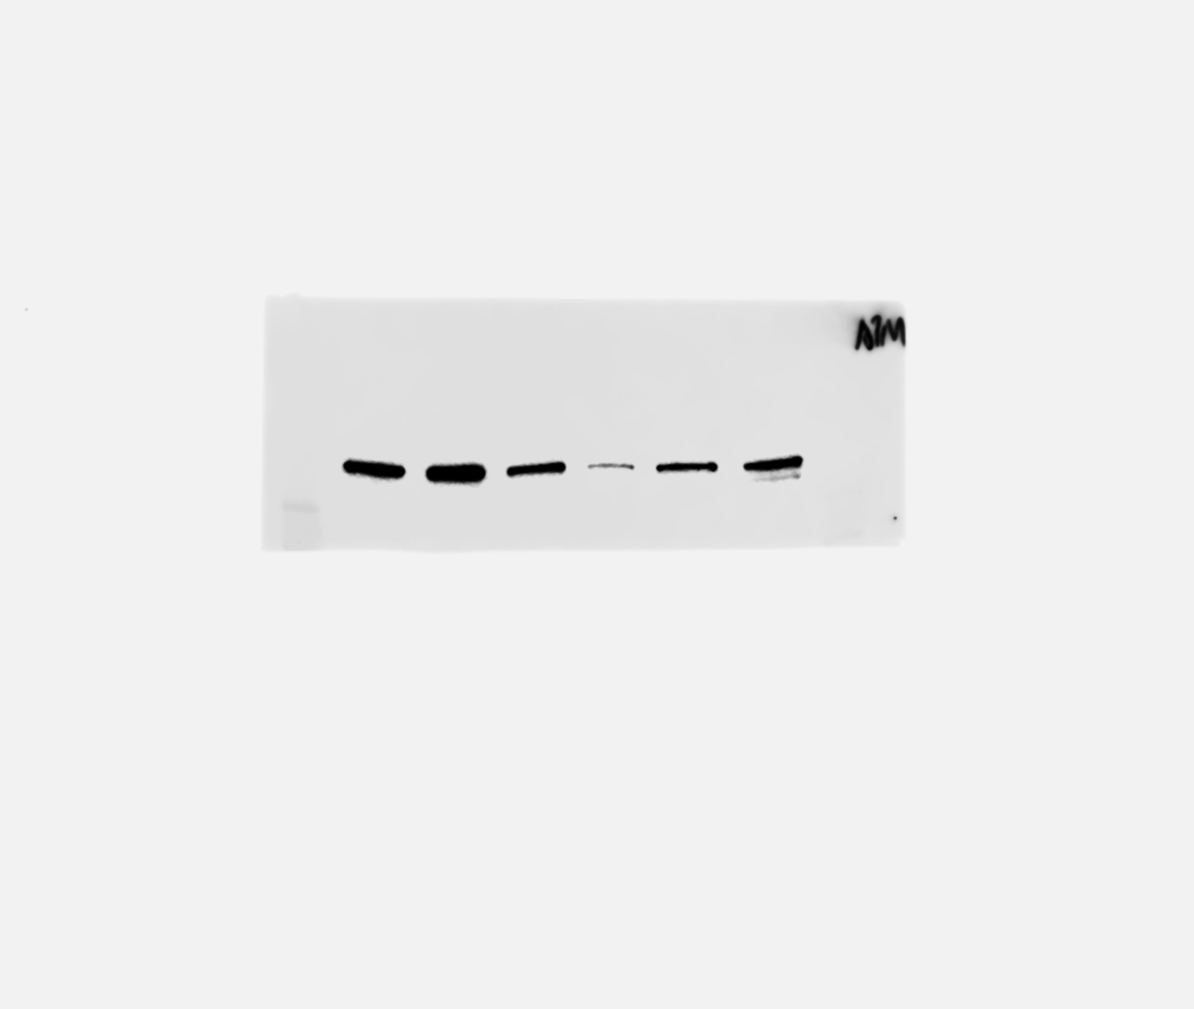
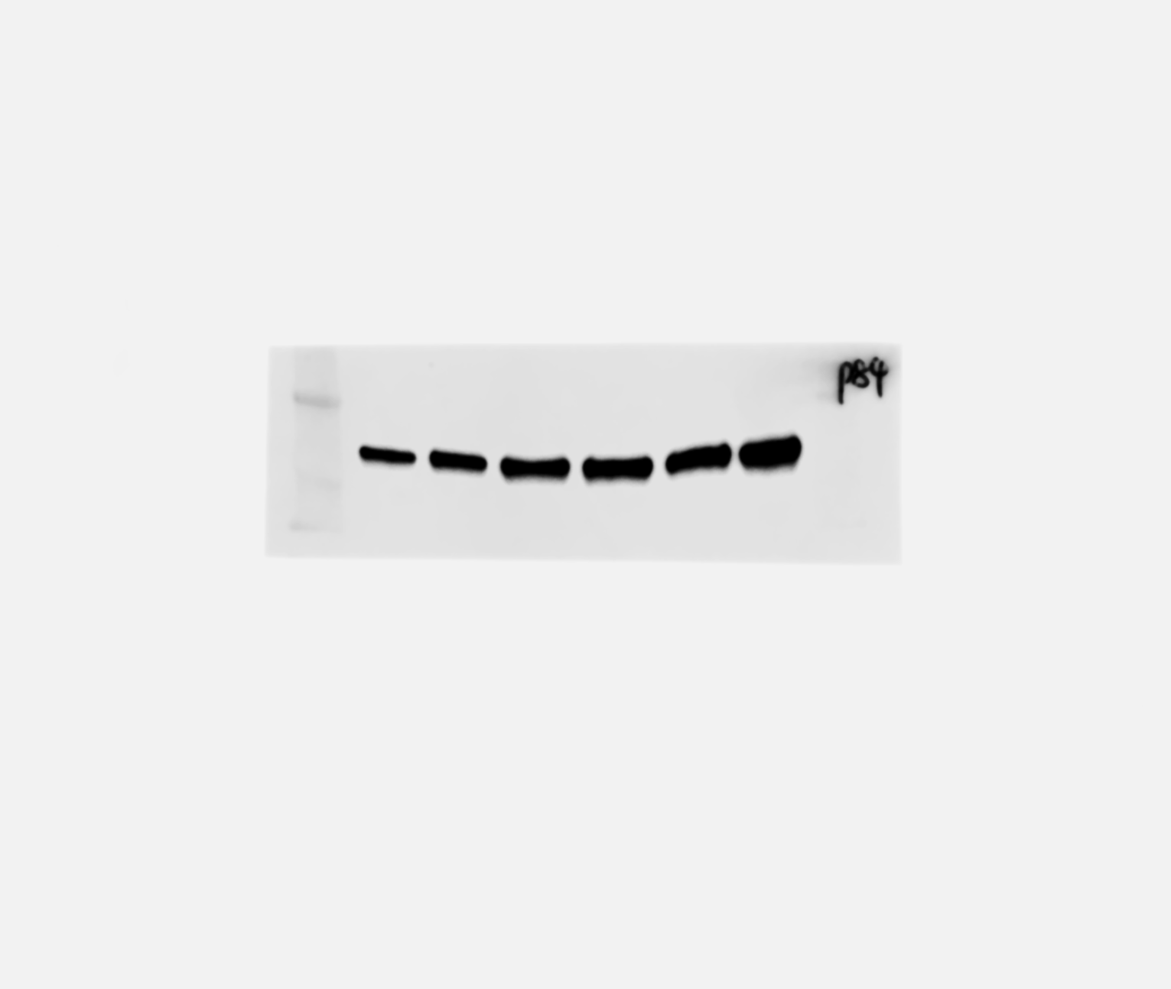
Fig.S1
A
RWPE-1
Vec
N-Myc
B
N-Myc
Vector N-Myc Vector N-Myc Vector N-Myc
AR
ATM
PSA
p84
NSE
RWPE-1
LNCaP
C4-2
CgA
GAPDH

