Slide 1
Supplementary Figure 1
Epac WT
Epac1-/-
Epac2-/-
Ponceau
Supplementary Figure 1. Representative Ponceau red staining of a nitrocellulose membrane demonstrating equal protein loading and used for normalization of a respective Western blot.

Slide 2
Supplementary Figure 2
A.
B.
5
*
Epac WT
20
4
Epac1-/-
*
Epac2-/-
15
3
Animal weight, g
Water intake, ml/24h
10
2
1
5
9
10
17
0
0
Supplementary Figure 2. (A) Summary graph comparing 24 h water intake of age matched Epac WT, Epac1 -/-, and Epac2 -/- mice placed in metabolic cages. (B) Summary graph of total weight of Epac WT, Epac1 -/-, and Epac2 -/- mice used for balance studies in metabolic cages. * – P < 0.05 versus Epac WT.

Slide 3
Supplementary Figure 3
Epac WT
70
Epac1-/-
Epac2-/-
60
*
*
50
Urine creatinine, mg/dL
40
30
8
9
10
20
Supplementary Figure 3. Summary graph comparing creatinine concentration in spot urine samples of Epac WT, Epac1 -/-, and Epac2 -/- mice. * – P < 0.05 versus Epac WT.

Slide 4
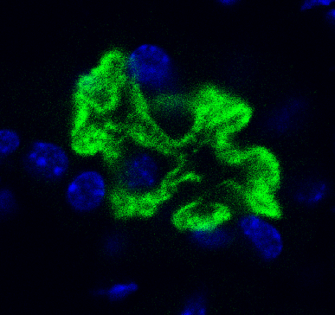
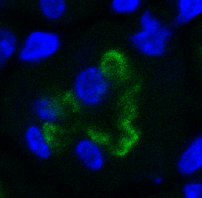
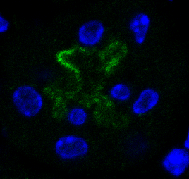
Anti-NHE-3
EpacWT
Epac1-/-
Epac2-/-
10 µm
Supplementary Figure 4. Representative micrograph of NHE-3 brush boarder staining in renal cortex of Epac WT, Epac1 -/-, and Epac2 -/- mice.

Slide 5
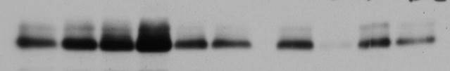
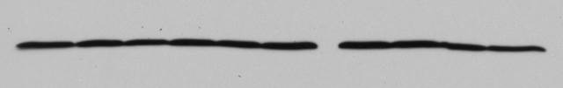
Supplementary Figure 5
A.
B.
Epac WT
Epac1-/-
1.4
Epac2-/-
Epac WT
Epac1 -/-
Epac2 -/-
1.2
1.0
*
56 kDa
NHERF1
0.8
Relative NHERF1 expression
0.6
0.4
43 kDa
β-actin
0.2
5
5
6
0.0
Supplementary Figure 5. (A) A representative Western blot of whole kidney lysates from Epac WT, Epac1 -/- and Epac2 -/- mice probed with anti-NHERF1 (upper) and β-actin (lower). (B) Summary graph comparing renal NHERF1 expression normalized to the respective intensity of β-actin.

