Slide 1
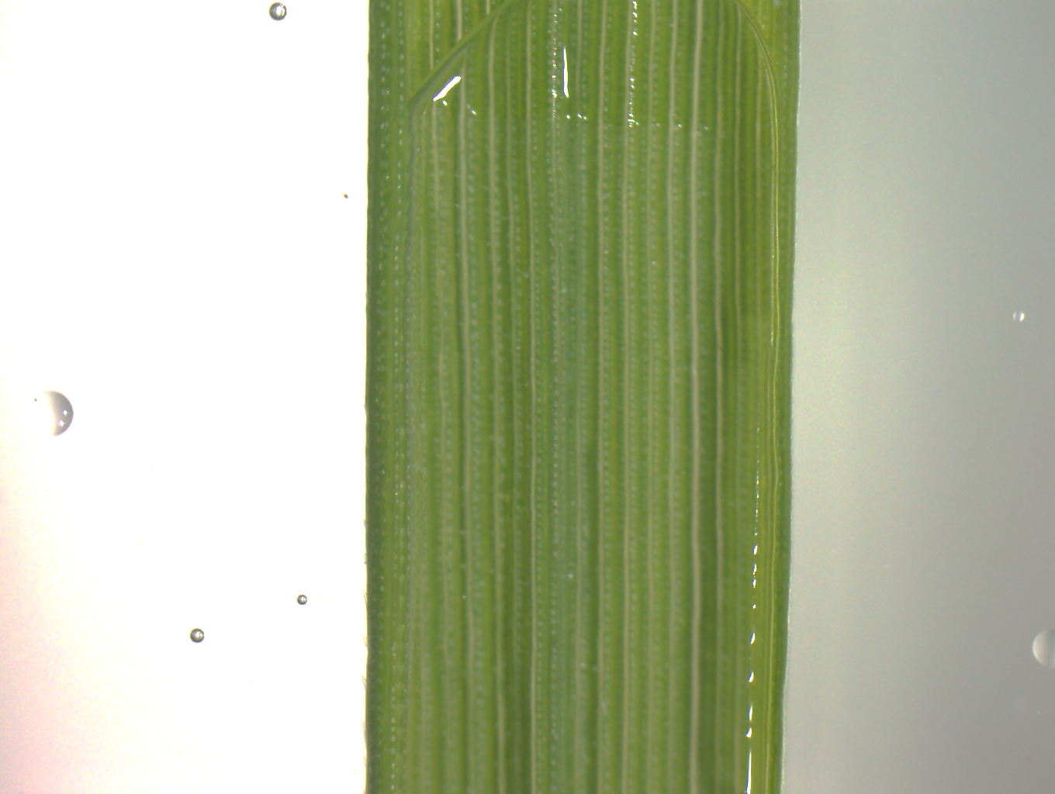
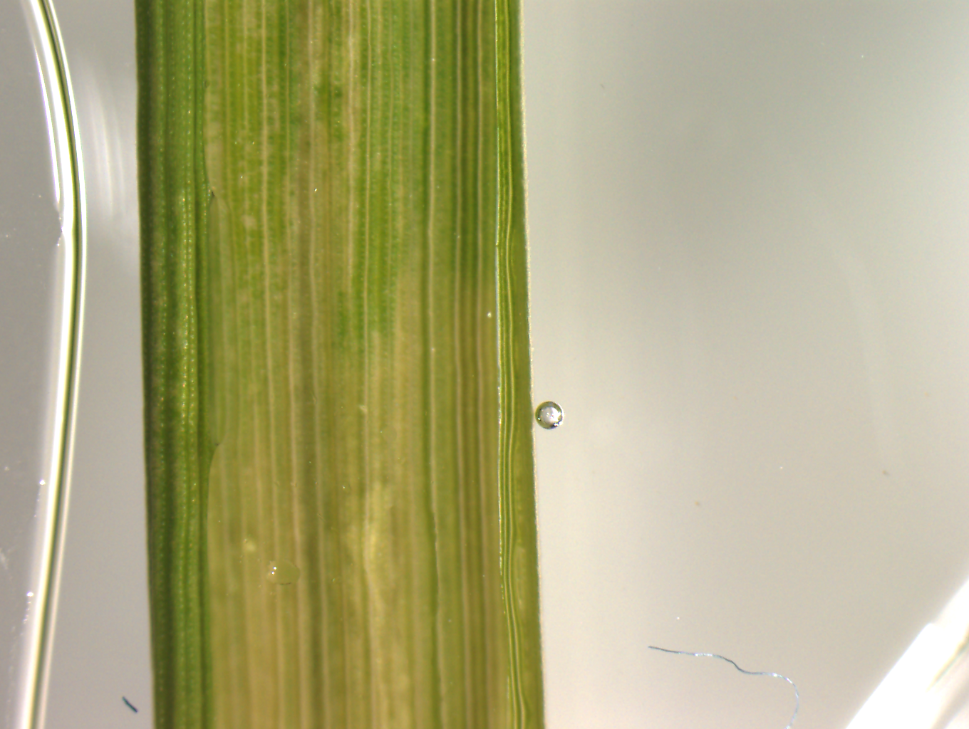
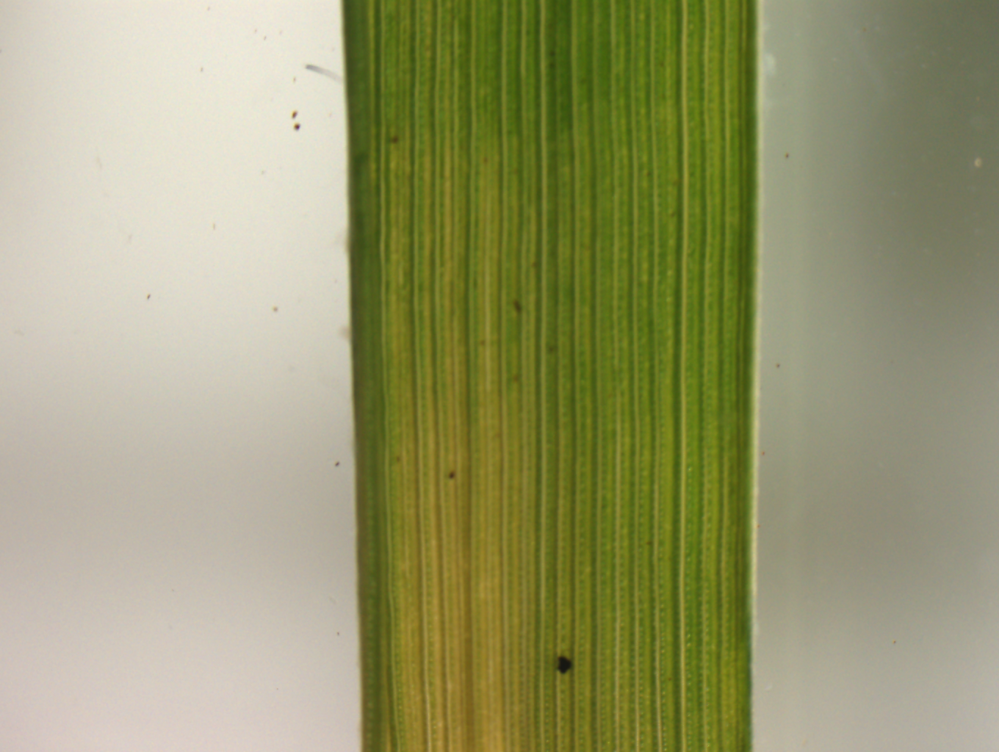
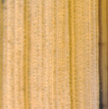
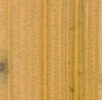
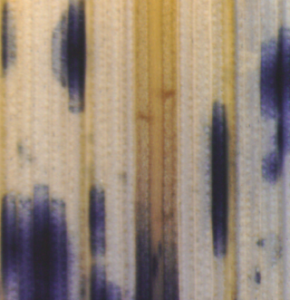
A
NB
dcl1a-IR
*
*
Chl a
Chl b
Mock
WT dcl1a-IR WT dcl1a-IR
NB
dcl1a-IR
Mock
MV
WT
MV
dcl1a-IR
WT dcl1a-IR WT dcl1a-IR
Mock
MV
B
WT
dcl1a-IR
WT (NB) + H₂O₂
Fig. S5. Effect of methyl viologen on chlorophylls and carotenoids, and detection of O₂^{•-} in dcl1a-IR plants. (A) Leaves of 3-week-old knock-down DCL11a (dcl1a-IR) and wild-type (Nipponbare) plants were treated with methyl viologen (MV) for 72 h. Right panels: quantification of chorophyls (Chla+Chlb) and carotenoids (Car) in mock-inoculated and MV-treated wild-type and dcl1a-IR plants. Data shown correspond to wild-type and dcl1a-IR plants (*, P ≤ 0.05 by ANOVA). (B) Detection of superoxide ion (O₂^{•-}) by nitroblue tetrazolium (NBT) staining in leaves of wild-type and dcl1a-IR plants. As a control, leaves were treated with H₂O₂ for 6 h. Bars = 250 µm.

