Slide 1
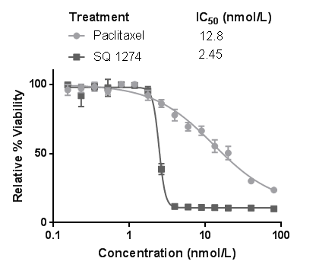
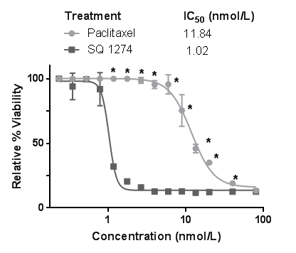






A
ES2
ARK4
SQ1274
SQ1274
B
Paclitaxel SQ1274
ES2
ARK4
-
-
+ -
- +
-
-
+
-
-
+
AXL
Gas6
Actin

Slide 2
S1. ES2 and ARK4 cells are more effectively treated with SQ1274 than paclitaxel. A) Results of XTT assay of relative cell viability in ES2 and ARK4 cells treated with increasing concentrations of paclitaxel and SQ1274 .Cell viability is reported relative to controls treated with vehicle. These assays were performed in triplicate and graphed with mean ± SD. *, P < 0.05 compared to controls. B) Western blot analysis of AXL and Gas6 expression in ES2 and ARK4 cell lines treated with vehicle (DMSO), 2 nM paclitaxel, or 2 nM SQ1274. B-Actin is shown as a loading control.

Slide 3
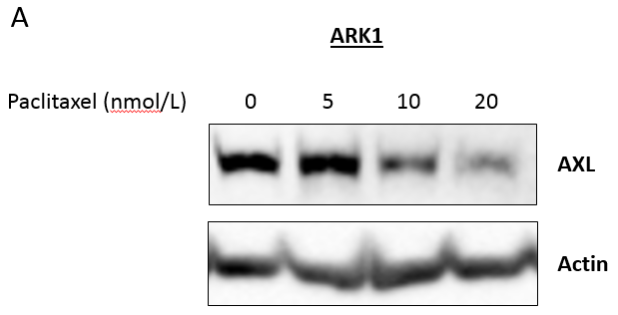
A

Slide 4
S2. Paclitaxel decreases AXL expression at higher concentrations. A) Western blot detection of AXL in ARK1 cells treated with increasing concentrations of paclitaxel. B-actin is shown as a loading control.

Slide 5
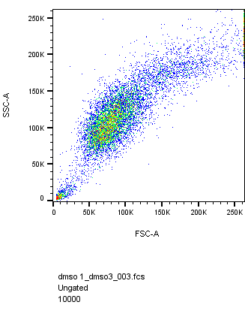
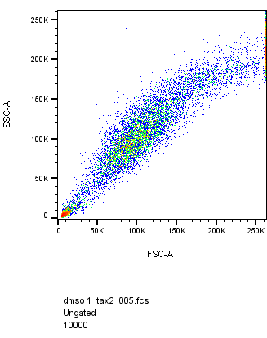
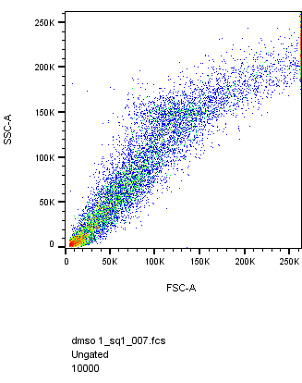
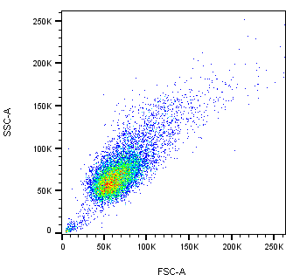
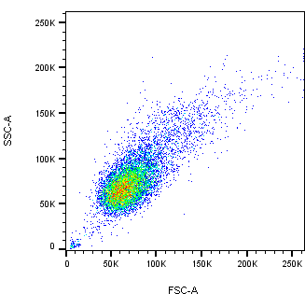
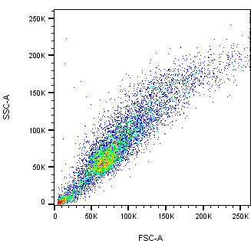
A
DMSO
Paclitaxel
SQ1274
ARK1
OVCAR8

Slide 6
S3. Cell-cycle flow dot plots. Representative cell- cycle flow dot plots of DMSO, paclitaxel, and SQ1274 treated A) ARK1 and B) OVCAR8 cells stained with PI. Along the Y-axis is the side scatter and along the X- axis is the forward scatter parameter.

Slide 7
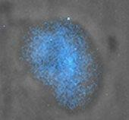
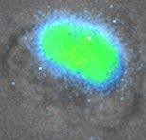
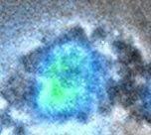
A
B
C
Normal Nucleus
Abnormal DNA Condensation
Nuclear Blebbing

Slide 8
S4. Images of DAPI stained cells. Examples of a A) normal nucleus, B) abnormal DNA condensation, and C) nuclear blebbing visualized by DAPI staining.

Slide 9
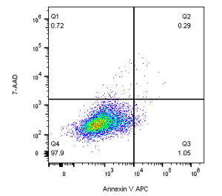
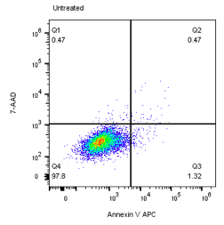
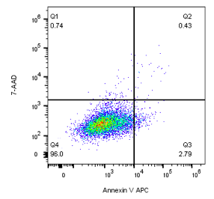
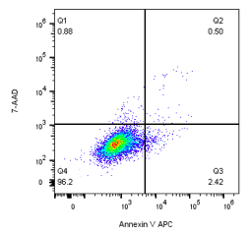
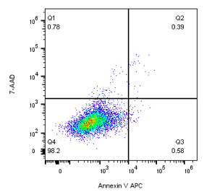
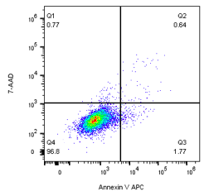
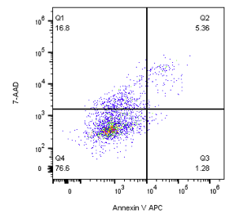
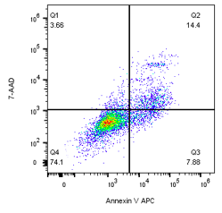
A
ARK1
B
OVCAR8
Untreated
DMSO
Paclitaxel
SQ1274

Slide 10
S5. Detection of apoptosis by flow cytometry. Representative dot plots of DMSO, paclitaxel, and SQ1274 treated A) ARK1 and B) OVCAR8 cells double stained with Annexin V/7-AAD. The percentages of viable cells (Annexin V-/7-AAD-, lower left quadrant), early apoptotic cells (Annexin V+/7-AAD-, lower right quadrant), late apoptotic/necrotic cells (Annexin V+/7-AAD+, upper right quadrant) and late necrotic (Annexin V-/7-AAD+, upper left quadrant) are indicated.

