Slide 1
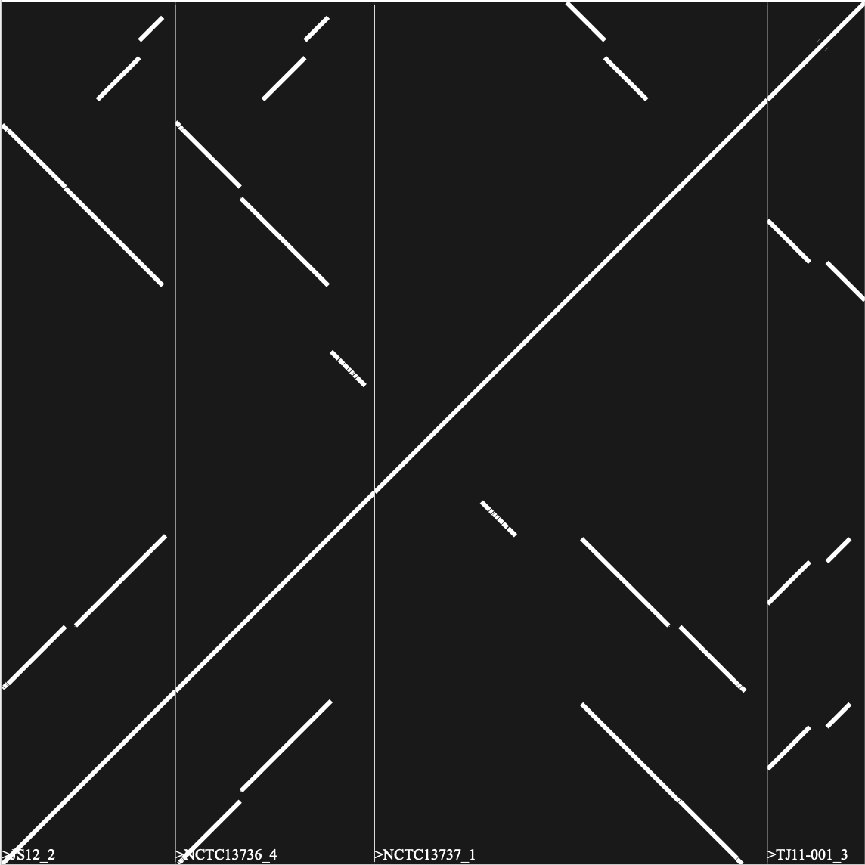
Supplementary Figure 1
A
1 | JS12_2
2 | NCTC13736_4
3 | NCTC13737_1
4 | TJ11-001_3
1
2
3
4

Slide 2
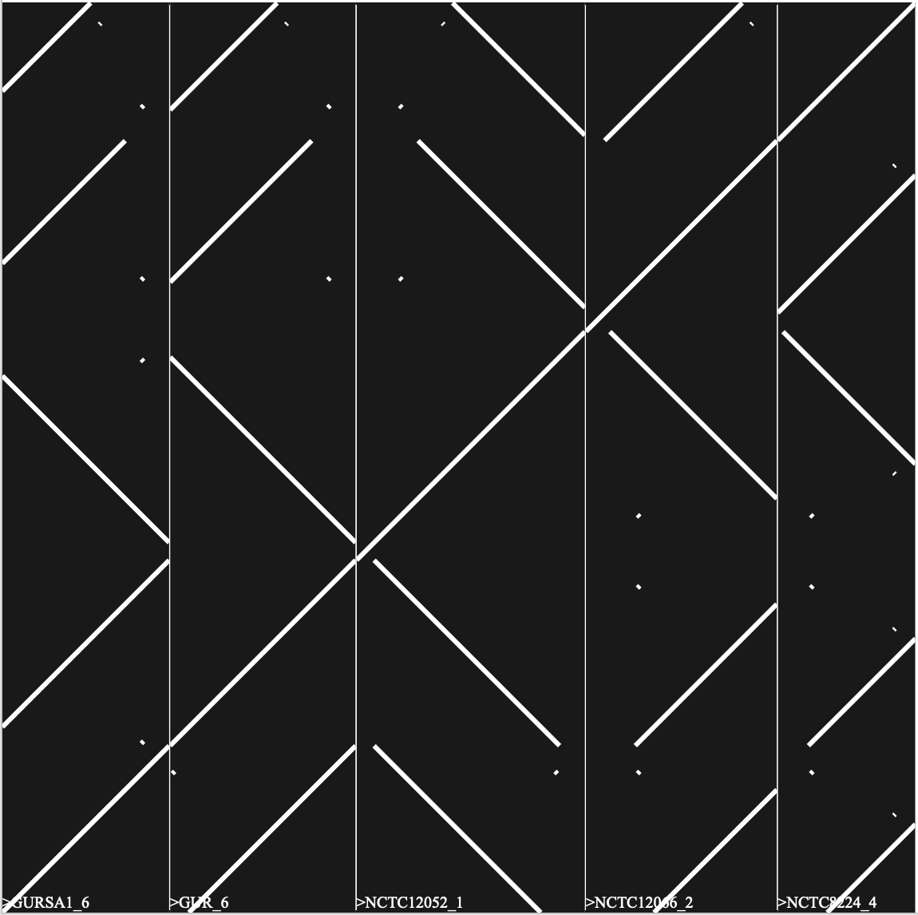
B
1 | GURSA1_6
2 | GUR_6
3 | NCTC12052_1
4 | NCTC12066_2
5 | NCTC8224_4
1
2
3
4
5

Slide 3
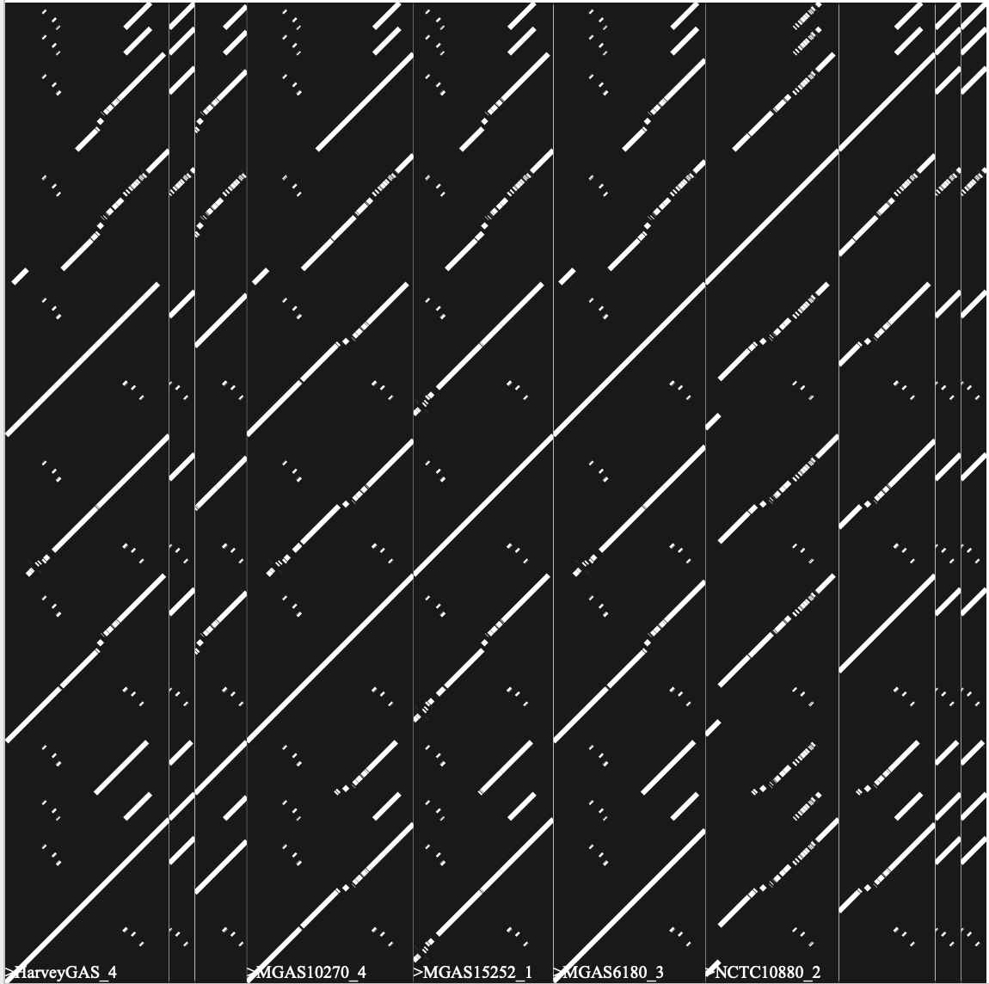
C
1 | HarveyGAS_4
2 | M28PF1_4
3 | MEW123_2
4 | MGAS10270_4
5 | MGAS15252_1
6 | MGAS6180_3
7 | NCTC10880_2
8 | NCTC8322_4
9 | STAB09014_3
10 | STAB10015_4
2
3
4
5
6
9
1
7
8
10

Slide 4
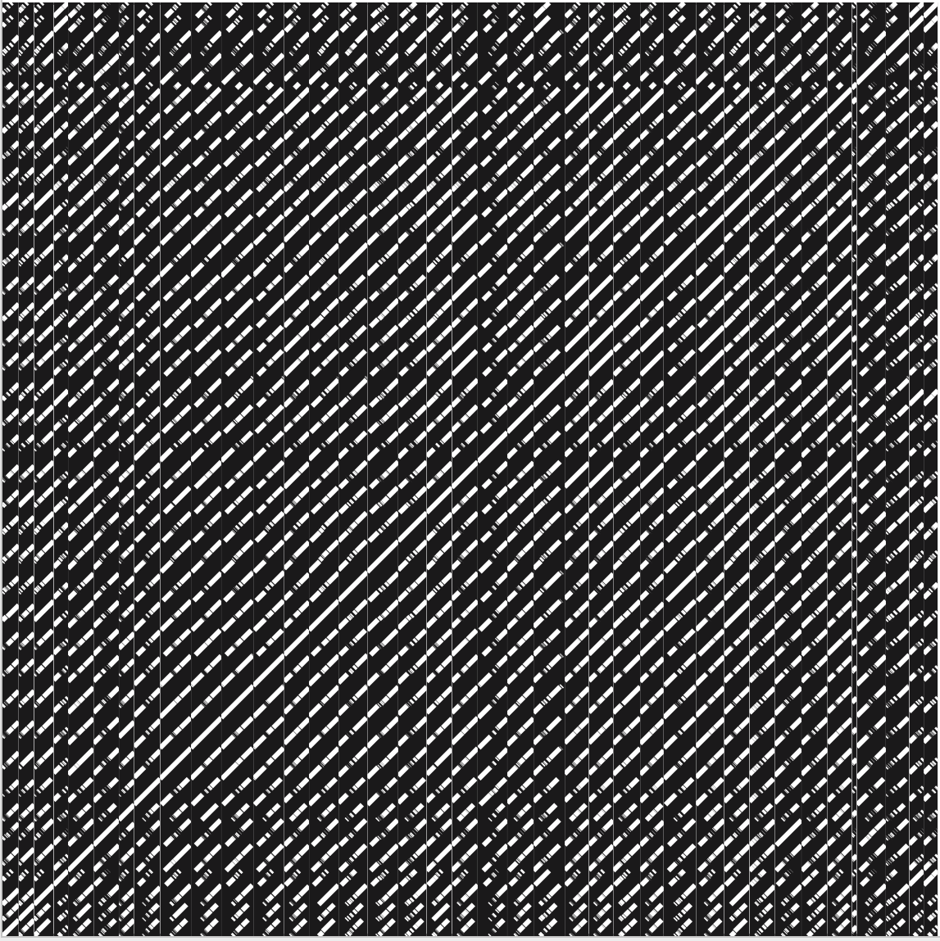
D
1 | AP53_5
2 | ATCC19615_4
3 | M1_SF370_4
4 | M28PF1_3
5 | MGAS10394_8
6 | MGAS10750_4
7 | MGAS1882_2
8 | Manfredo_5
9 | NCTC10874_2
10 | NCTC10877_2
11 | NCTC12044_2
12 | NCTC12045_2
13 | NCTC12046_3
14 | NCTC12058_2
15 | NCTC12062_3
16 | NCTC12066_3
17 | NCTC12069_3
18 | NCTC12696_4
19 | NCTC12840_4
20 | NCTC13737_2
21 | NCTC13738_4
22 | NCTC13742_4
23 | NCTC5163_5
24 | NCTC5164_5
25 | NCTC8224_5
26 | NCTC8225_5
27 | NCTC8231_2
28 | NCTC8304_3
29 | NCTC8314_4
30 | NCTC8324_5
31 | NCTC8326_4
32 | NCTC8328_4
33 | NCTC8332_5
34 | NGAS638_3
35 | NGAS979_2
36 | NS53_1
37 | STAB09014_2
38 | STAB10015_3
1
2
3
4
5
6
7
8
9
10
11
12
13
14
15
16
17
18
19
20
21
22
23
24
25
26
27
28
29
30
31
32
33
34
35
36
37
38

Slide 5
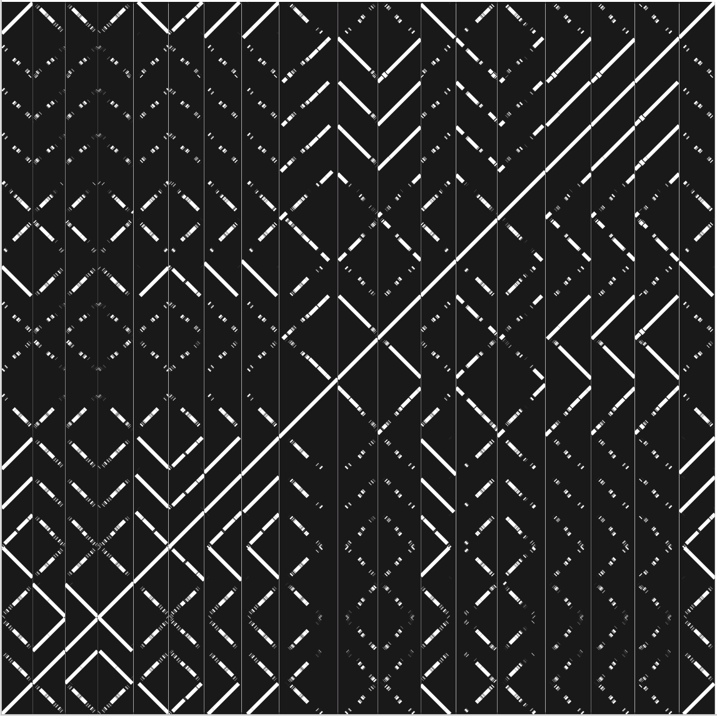
E
1 | HKU360_1
2 | HKU360_4
3 | HKU488_4
4 | HKUQMH11_1
5 | HKUQMH11_3
6 | M1_SF370_2
7 | MGAS9429_2
8 | NCTC10085_1
9 | NCTC12045_1
10 | NCTC13736_1
11 | NCTC13751_3
12 | NCTC8300_1
13 | NCTC8324_3
14 | NGAS979_1
15 | STAB090229_2
16 | STAB120304_3
17 | STAB14018_3
18 | TJ11-001_2
1
2
3
4
5
6
7
8
9
10
11
12
13
14
15
16
17
18

Slide 6
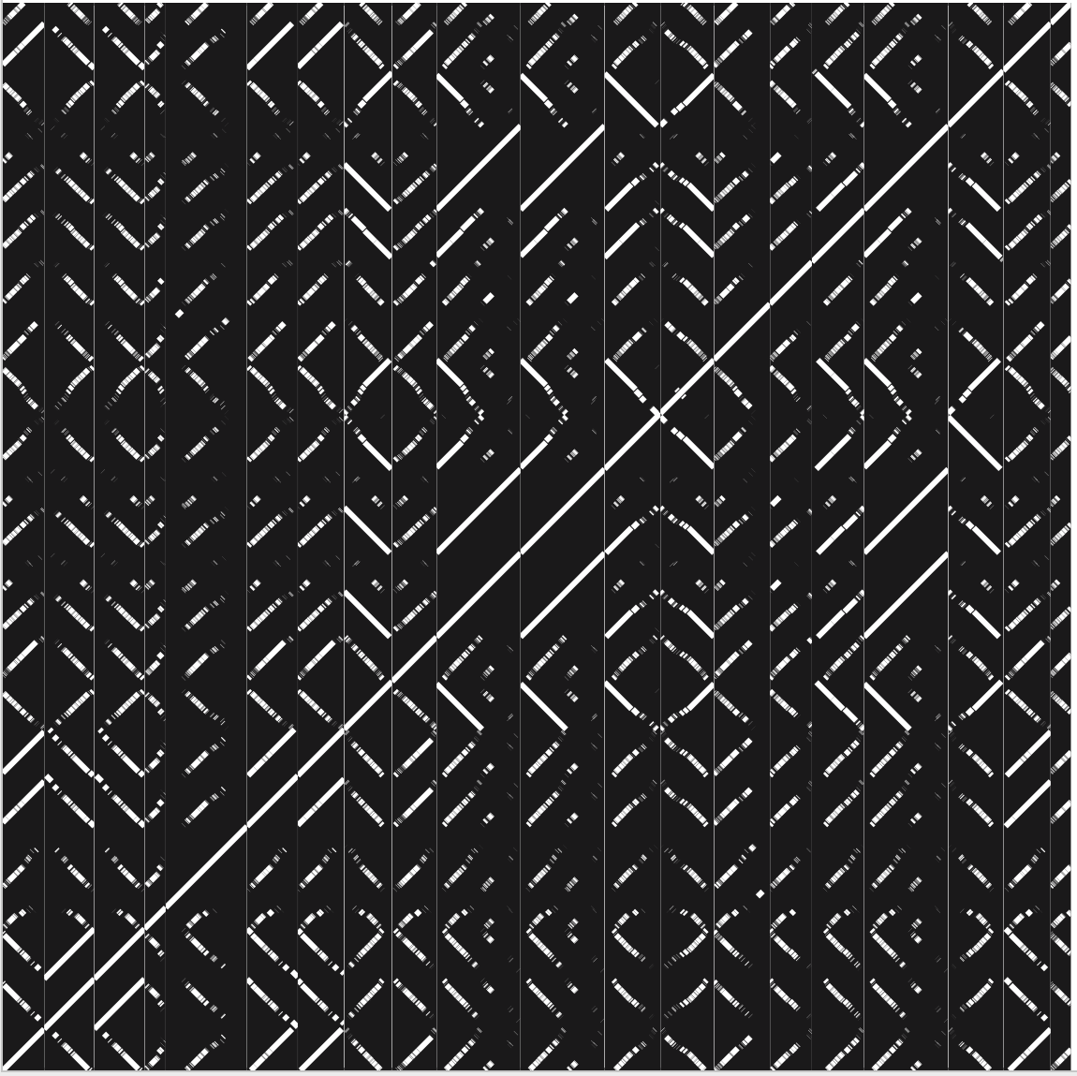
F
1 | ATCC19615_3
2 | GURSA1_1
3 | GUR_1
4 | MGAS10394_7
5 | NCTC12046_2
6 | NCTC12047_1
7 | NCTC12696_3
8 | NCTC12840_2
9 | NCTC13744_2
10 | NCTC5163_2
11 | NCTC5164_2
12 | NCTC8195_4
13 | NCTC8225_4
14 | NCTC8227_3
15 | NCTC8230_5
16 | NCTC8304_1
17 | NCTC8332_2
18 | NGAS743_2
19 | NZ131_3
20 | STAB13021_2
1
2
3
4
5
6
7
8
9
10
11
12
13
14
15
16
17
18
19
20

Slide 7
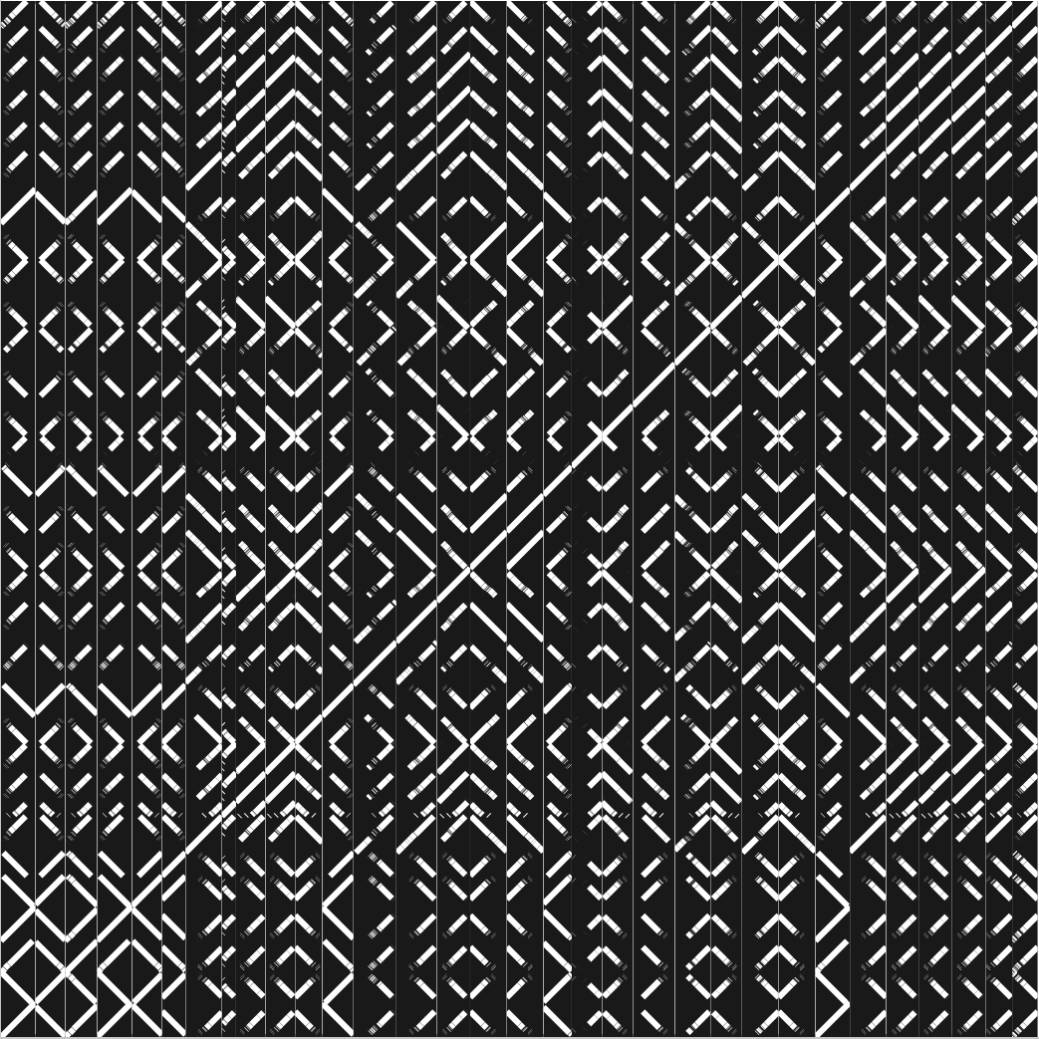
G
1 | 5448_3
2 | A20_1
3 | AP1_3
4 | FDAARGOS149_3
5 | HKU488_1
6 | M1_476_1
7 | M3-b_2
8 | MEW427_1
9 | MGAS10270_2
10 | MGAS10750_2
11 | MGAS315_5
12 | MGAS5005_1
13 | NCTC12048_1
14 | NCTC12840_1
15 | NCTC13751_2
16 | NCTC5163_4
17 | NCTC5164_4
18 | NCTC8198_3
19 | NCTC8314_1
20 | NCTC8314_3
21 | NCTC8322_3
22 | NCTC8324_2
23 | NCTC8326_2
24 | NCTC8328_2
25 | NCTC8332_4
26 | NCTC8370_2
27 | SSI-1_2
28 | STAB090229_1
29 | STAB120304_2
30 | STAB14018_2
31 | STAB902_2
32 | Streptococcus phage T12
1
2
3
4
5
6
7
8
9
10
11
12
13
14
15
16
17
18
1
2
3
4
5
6
7
8
9
10
11
12
13
14
15
16
17
18
19
20
21
22
23
24
25
26
27
28
29
30
31
32

Slide 8
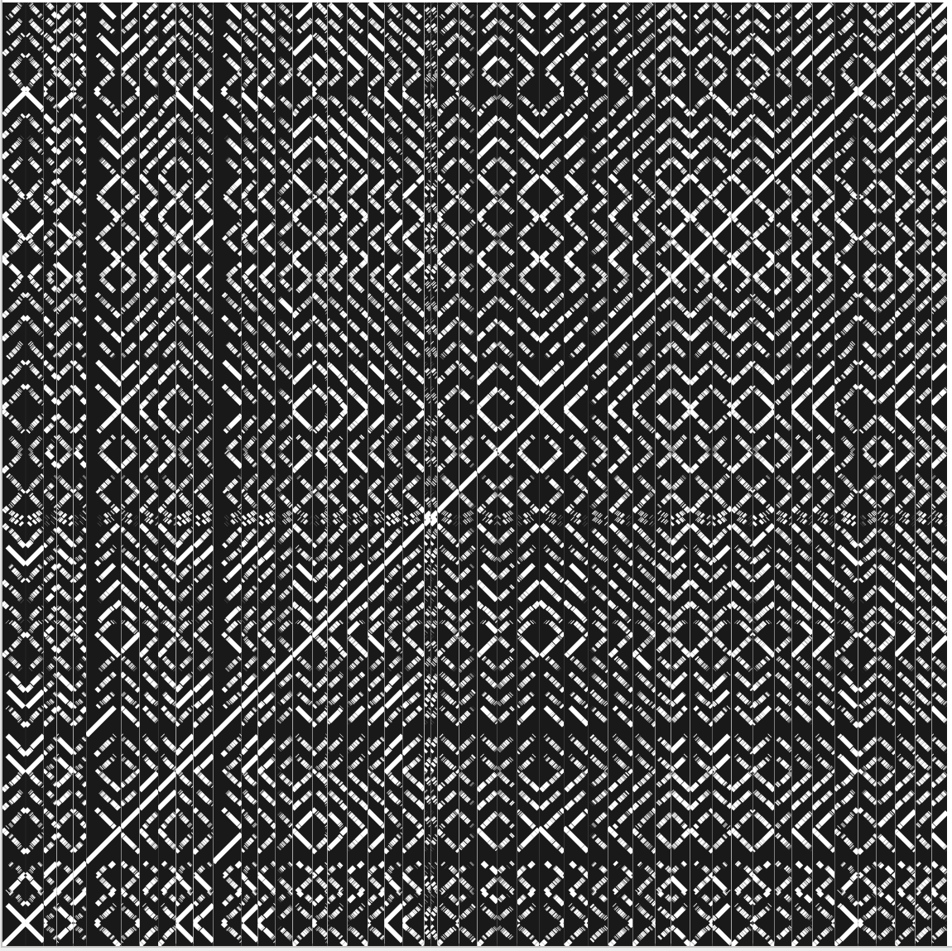
1 | 5448_2
2 | A20_2
3 | ALAB49_2
4 | AP1_2
5 | AP53_3
6 | D471_1
7 | FDAARGOS149_2
8 | GURSA1_3
9 | GUR_3
10 | HKU488_2
11 | HSC5_2
12 | JRS4_2
13 | M1_476_2
14 | M1_SF370_3
15 | M23ND_4
16 | M3-b_4
17 | MEW427_2
18 | MGAS10394_5
19 | MGAS10750_3
20 | MGAS315_3
21 | MGAS5005_2
22 | MGAS8232_4
23 | MTB313_2
24 | MTB314_2
25 | Manfredo_2
26 | NCTC10876_2
27 | NCTC10879_1
28 | NCTC12050_2
29 | NCTC12052_4
30 | NCTC12059_1
31 | NCTC12062_1
32 | NCTC13738_2
33 | NCTC13739_1
34 | NCTC4001_1
35 | NCTC8195_2
36 | NCTC8198_4
37 | NCTC8224_2
38 | NCTC8230_4
39 | NCTC8314_2
40 | NCTC8320_3
41 | NCTC8322_1
42 | NCTC8326_1
43 | NCTC8328_3
44 | NCTC8370_1
45 | NGAS322_2
46 | NGAS743_1
47 | SSI-1_4
48 | STAB13021_1
49 | STAB902_4
H
1
2
3
4
5
6
7
8
9
10
11
12
13
14
15
16
17
18
19
20
21
22
25
26
27
28
29
30
31
32
33
34
35
36
37
38
39
40
41
42
43
44
45
46
47
48
49
23
24

Slide 9
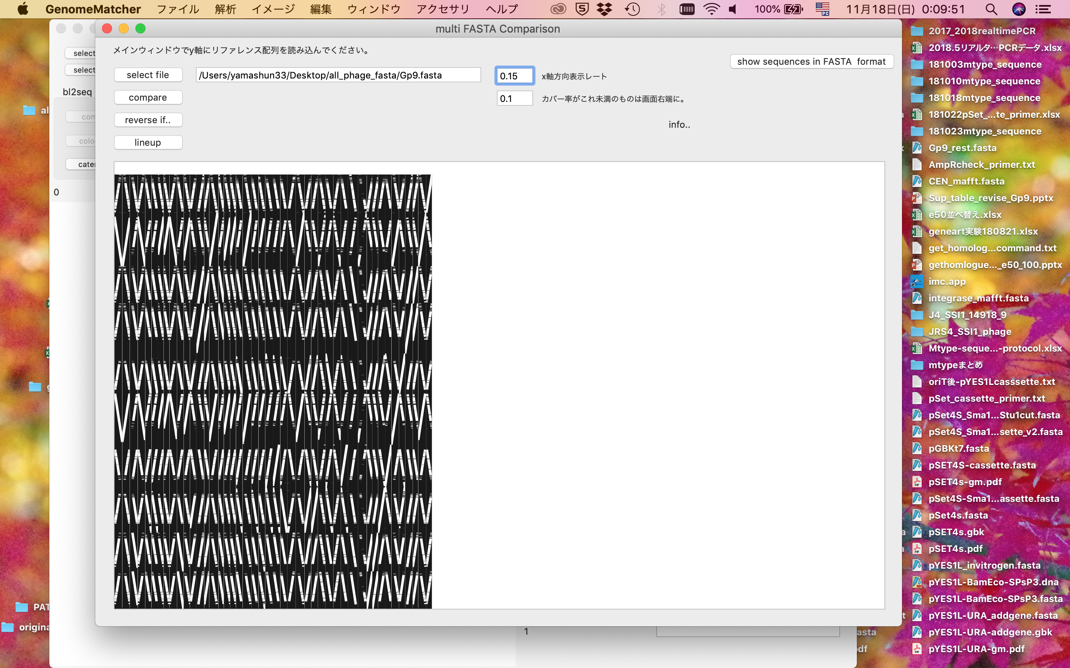
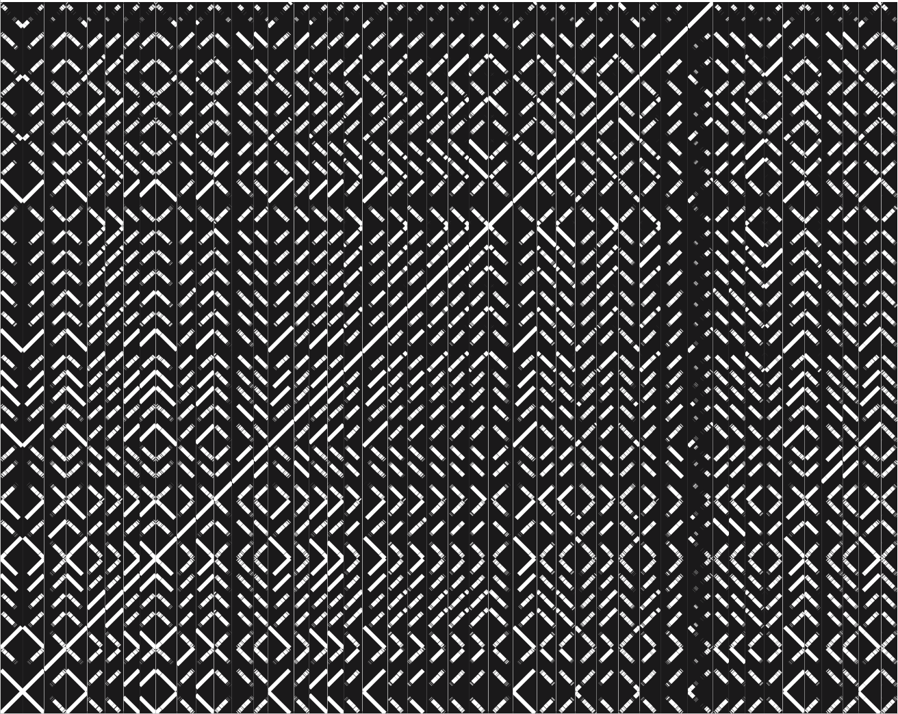
I
1 | 5448_1
2 | A20_3
3 | D471_3
4 | FDAARGOS149_1
5 | GURSA1_5
6 | GUR_5
7 | HKU360_3
8 | HKU488_3
9 | HKUQMH11_2
10 | JRS4_4
11 | M1_476_3
12 | M23ND_2
13 | M3-b_1
14 | MGAS10394_1
15 | MGAS2096_2
16 | MGAS315_6
17 | MGAS5005_3
18 | MGAS9429_3
19 | Manfredo_3
20 | NCTC10085_2
21 | NCTC10879_4
22 | NCTC12044_1
23 | NCTC12059_2
24 | NCTC12062_2
25 | NCTC12840_3
26 | NCTC13736_2
27 | NCTC13738_3
28 | NCTC5163_1
29 | NCTC5164_1
30 | NCTC8195_5
31 | NCTC8224_3
32 | NCTC8225_2
33 | NCTC8231_1
34 | NCTC8300_2
35 | NCTC8304_2
36 | NCTC8324_1
37 | NCTC8328_1
38 | NCTC8332_1
39 | NGAS596_1
40 | NGAS638_2
41 | NZ131_2
42 | SSI-1_1
43 | STAB902_1
44 | TJ11-001_5
45 | Streptococcus phage P9
1
2
3
4
5
6
7
8
9
10
11
12
13
14
15
16
17
18
19
20
21
22
23
24
25
26
27
28
29
30
31
32
33
34
35
36
37
38
39
40
41
42
43
44
45

Slide 10

J
1 | 7F7_1
2 | ALAB49_1
3 | HSC5_1
4 | HarveyGAS_1
5 | JS12_1
6 | M28PF1_2
7 | MEW123_1
8 | MGAS6180_1
9 | MGAS8232_3
10 | NCTC12064_2
11 | NCTC8320_2
12 | NCTC8324_4
13 | NGAS327_1
14 | NGAS638_1
15 | STAB09014_1
16 | STAB10015_1
17 | STAB1102_1
1
2
3
4
5
6
7
8
9
10
11
12
13
14
15
16
17

Slide 11

1 | 1E1_2
2 | AP1_5
3 | AP53_2
4 | ATCC19615_1
5 | HKU360_2
6 | M23ND_1
7 | M23ND_3
8 | M3-b_5
9 | MGAS10270_1
10 | MGAS10394_2
11 | MGAS10750_1
12 | MGAS1882_1
13 | MGAS315_2
14 | MGAS8232_2
15 | MGAS9429_1
16 | Manfredo_4
17 | NCTC10874_1
18 | NCTC10876_1
19 | NCTC10877_1
20 | NCTC10879_2
21 | NCTC12050_1
22 | NCTC12052_3
23 | NCTC12057_2
24 | NCTC12066_1
25 | NCTC12069_1
26 | NCTC12696_1
27 | NCTC13736_3
28 | NCTC13742_2
29 | NCTC13743_1
30 | NCTC13751_1
31 | NCTC4001_2
32 | NCTC5163_3
33 | NCTC5164_3
34 | NCTC8195_3
35 | NCTC8198_1
36 | NCTC8227_1
37 | NCTC8230_3
38 | NCTC8320_1
39 | NCTC8326_3
40 | NCTC8332_3
41 | NGAS322_1
42 | NGAS322_3
43 | SSI-1_5
44 | STAB120304_1
45 | STAB14018_1
46 | STAB901_1
47 | STAB902_5
48 | TJ11-001_4
K
1
2
3
4
5
6
7
8
9
10
11
12
13
14
15
16
17
18
19
20
21
22
23
24
25
26
27
28
29
30
31
32
33
34
35
36
37
38
39
40
41
42
43
44
45
46
47
48

Slide 12
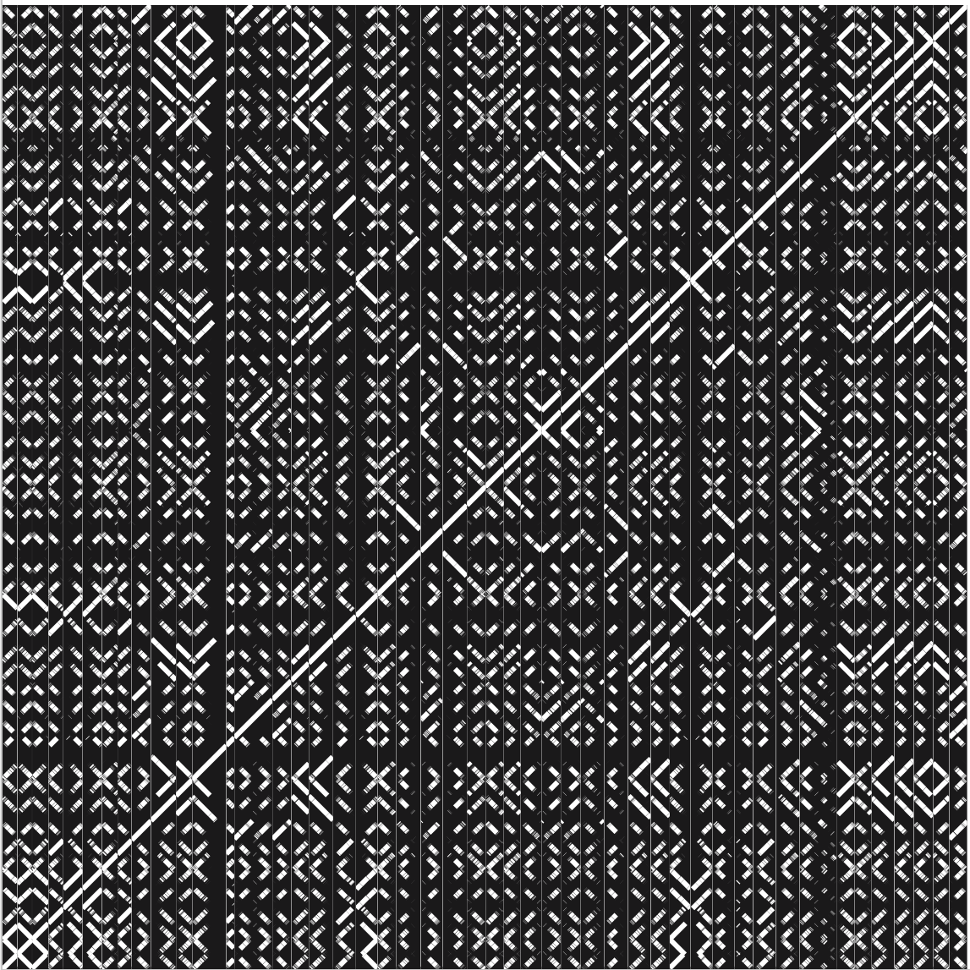
1 | ALAB49_3
2 | AP1_1
3 | AP53_4
4 | D471_2
5 | GURSA1_2
6 | GUR_2
7 | HSC5_3
8 | JRS4_3
9 | M1_SF370_1
10 | M28PF1_1
11 | M3-b_3
12 | MGAS10270_3
13 | MGAS10394_6
14 | MGAS11027_1
15 | MGAS2096_1
16 | MGAS315_4
17 | MGAS6180_2
18 | MGAS8232_5
19 | Manfredo_1
20 | NCTC10876_3
21 | NCTC10880_1
22 | NCTC12052_2
23 | NCTC12058_1
24 | NCTC12064_1
25 | NCTC12067_1
26 | NCTC12069_2
27 | NCTC13736_5
28 | NCTC13738_1
29 | NCTC13742_1
30 | NCTC13743_2
31 | NCTC13744_1
32 | NCTC13745_2
33 | NCTC13751_4
34 | NCTC8198_5
35 | NCTC8224_1
36 | NCTC8227_2
37 | NCTC8230_2
38 | NCTC8320_4
39 | NCTC8322_2
40 | NGAS743_3
41 | SSI-1_3
42 | STAB090229_3
43 | STAB10015_2
44 | STAB120304_4
45 | STAB14018_4
46 | STAB902_3
47 | TJ11-001_1
L
1
2
3
4
5
6
7
8
9
10
11
12
13
14
15
16
17
18
19
20
21
22
23
24
25
26
27
28
29
30
31
32
33
34
35
36
37
38
39
40
41
42
43
44
45
46
47

Slide 13
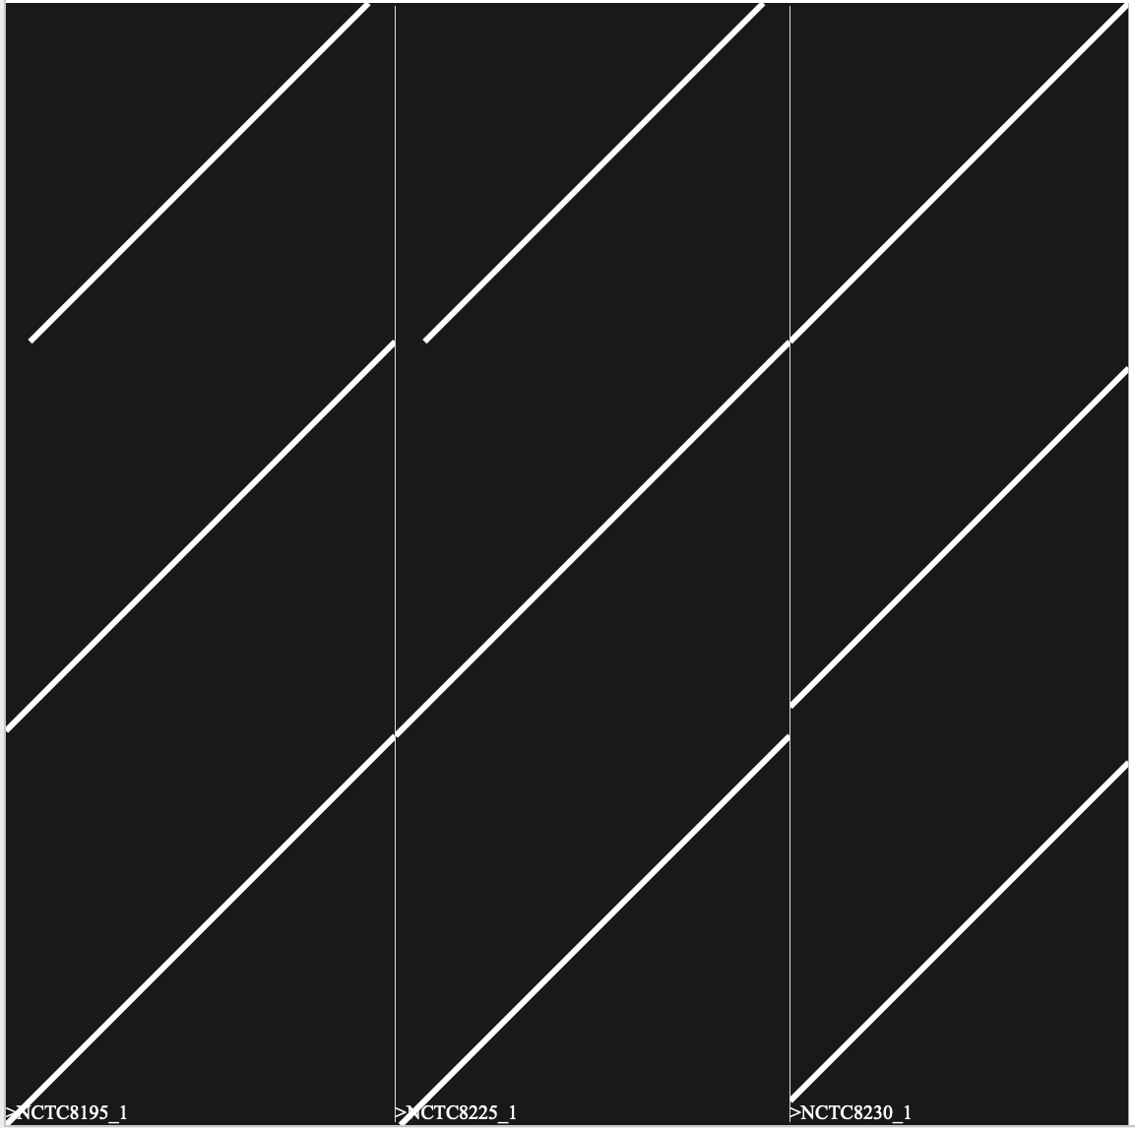
M
1 | NCTC8195_1
2 | NCTC8225_1
3 | NCTC8230_1
1
2
3

Slide 14
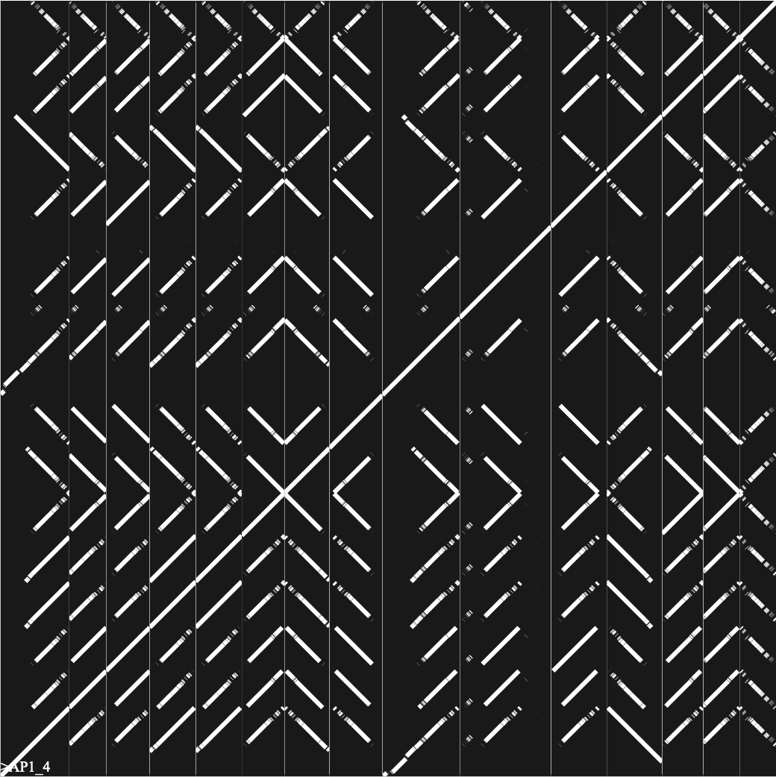
N
1 | AP1_4
2 | AP53_1
3 | ATCC19615_2
4 | GURSA1_4
5 | GUR_4
6 | M3-b_6
7 | MGAS315_1
8 | MGAS8232_1
9 | NCTC10879_3
10 | NCTC12046_1
11 | NCTC12696_2
12 | NCTC8198_2
13 | SSI-1_6
14 | STAB902_6
15 | Streptococcus phage phi3396
1
2
3
4
5
6
7
8
9
10
11
12
13
14
15

Slide 15
Supplementary Figure 2

