Slide 1
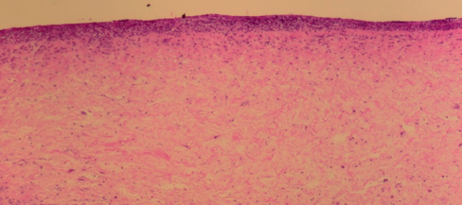
H&E
MT
A
B
CE
CE
Day 7
500µm
500µm
vCUT
C
D
*
vCUT
vCUT
Day 28
*
*
*
*
AW
AW
500µm
500µm
Figure S1

Slide 2
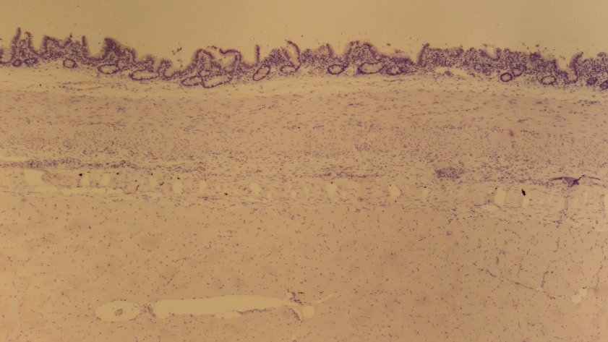
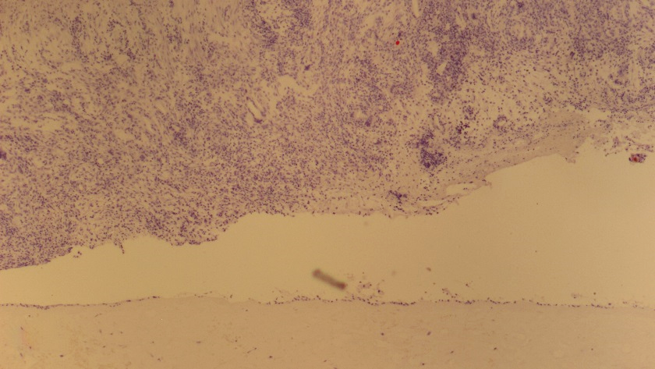
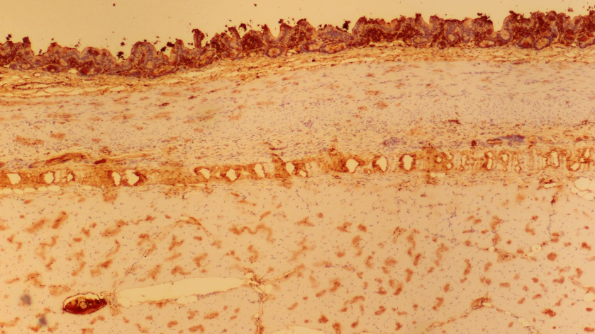
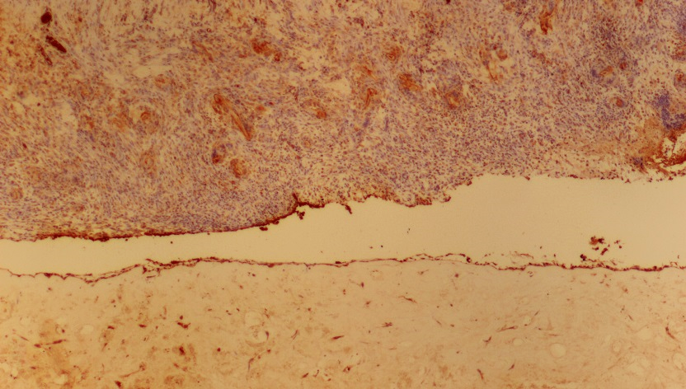
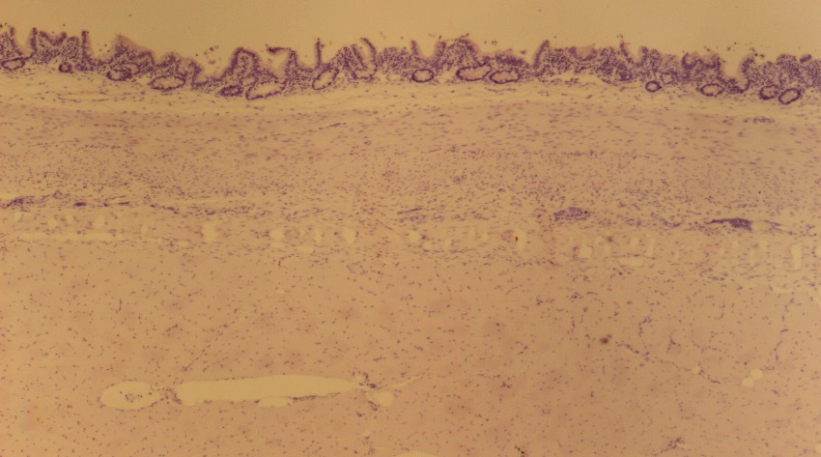
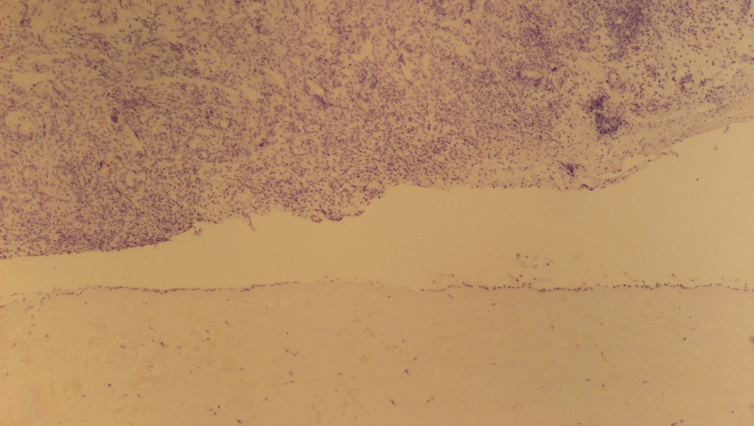
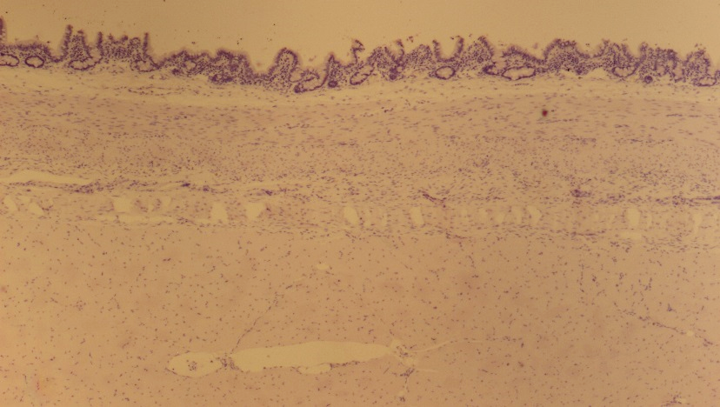
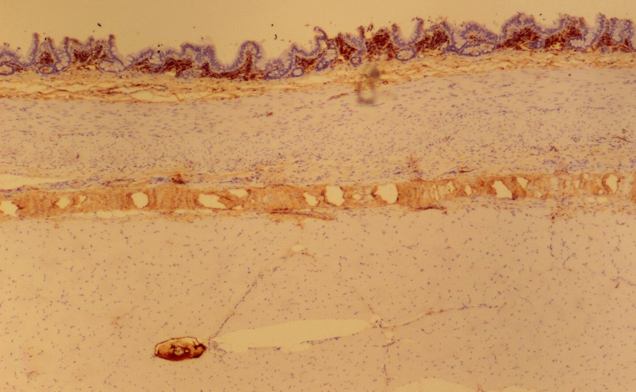
Control
Day 7
vCUT
A
B
CE
CE
CD68
AW
500µm
500µm
vCUT
C
D
iNOS
500µm
500µm
E
F
CD163
500µm
500µm
G
H
Negative control
500µm
CD68 & CD163
non-specific background
500µm
iNOS
non-specific background
Figure S2

Slide 3
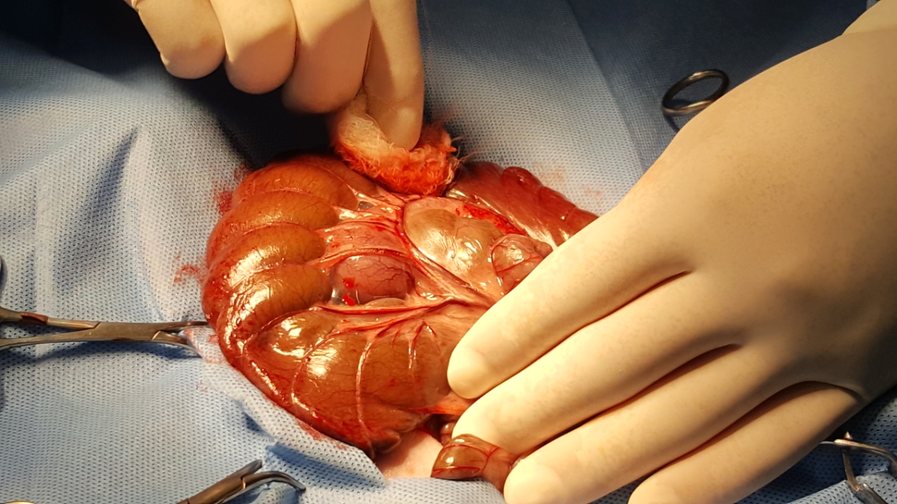
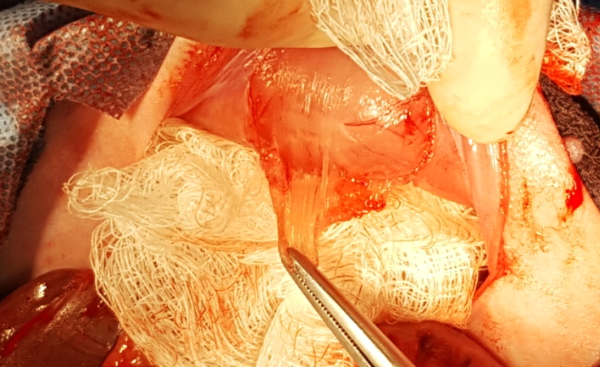
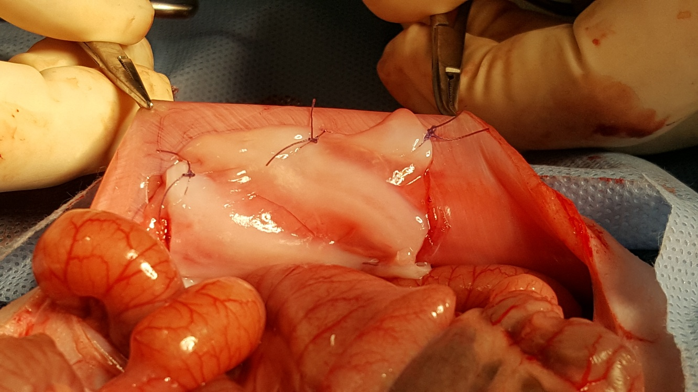
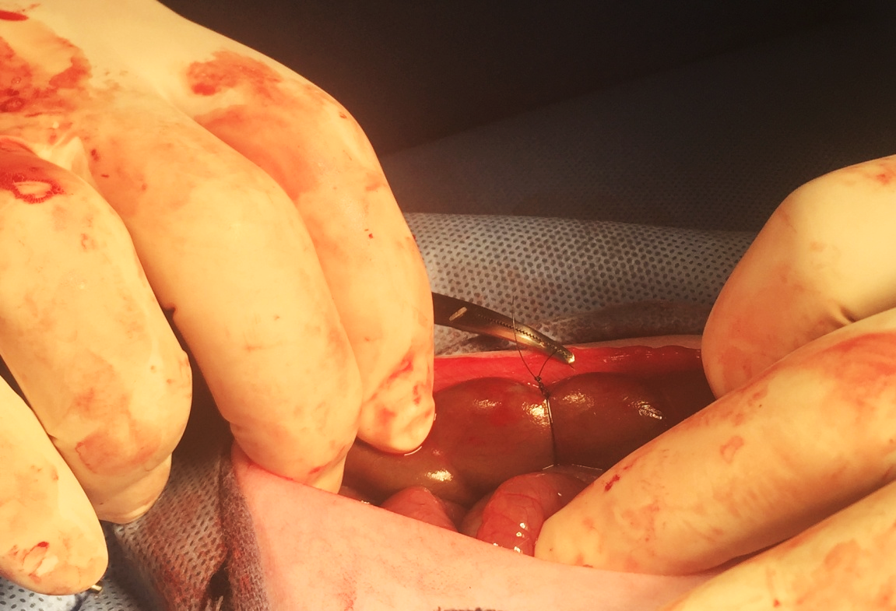
Table S1: Study Design
Experimental Group | Time points & number of animals |  |  | Treatment type (only one injury site per animal due to severity of the model)
 | Day 7 | Day 28 | Day 67
1 | 1 | 1 | 1 | Control
2 | 1 | 1 | 1 | vCUT
Surgical Procedure
A
Midline laparotomy was performed leading to exposure of the bowel and cecum
Cecum
Petechial hemorrhage on cecum was induced by abrasion (A)
B
Peritoneum and the abdominal transverse muscle were removed from the abdominal cavity (B)
Abdominal wall
Control (no barrier grafts) or vCUT
sutured to the abdominal wall (C)
C
vCUT
Cecum
Abdominal wall
Cecum was sutured to the abdominal wall; only one injury site per animal was created (D)
D
Suture
Gross examination and sample collection for histological analysis at days 7, 28, and 67 post surgery
Cecum
Figure S3

Slide 4
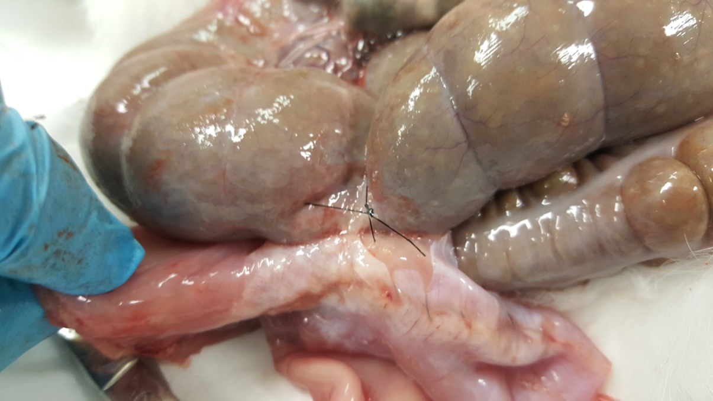
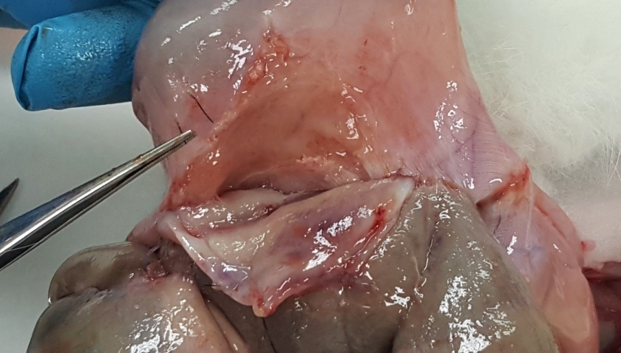
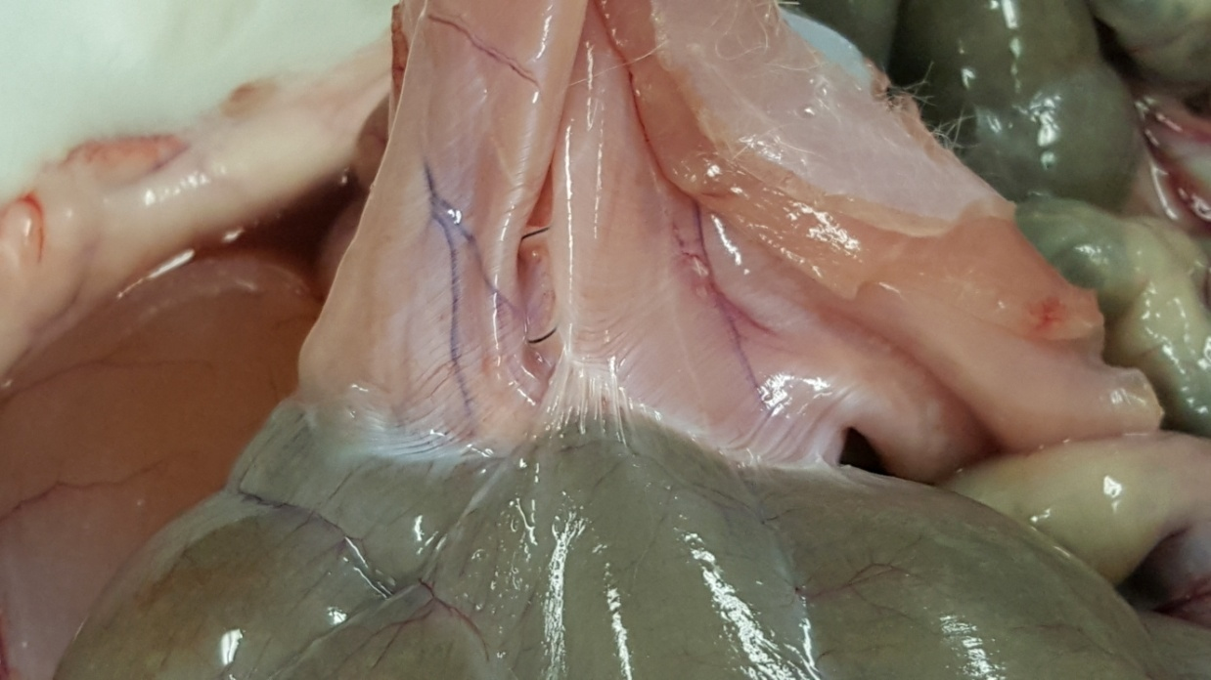
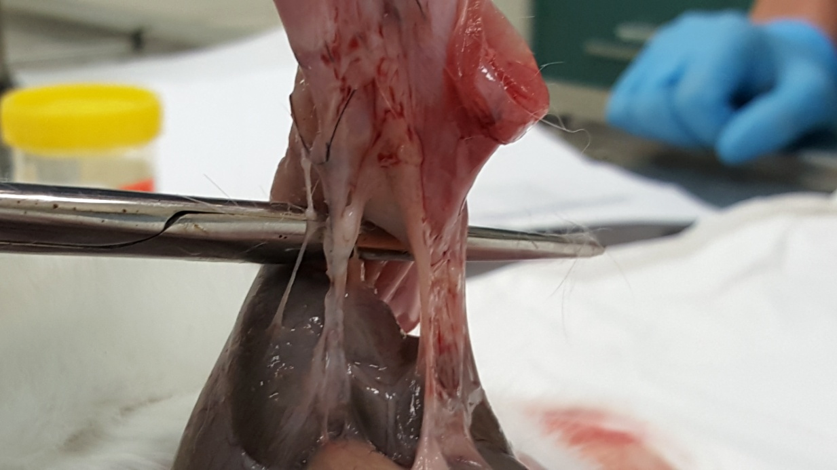
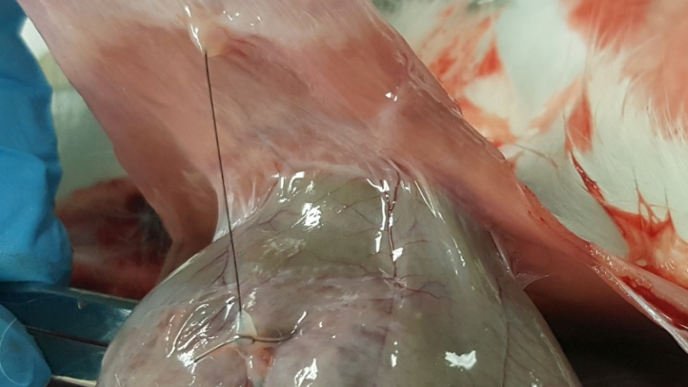
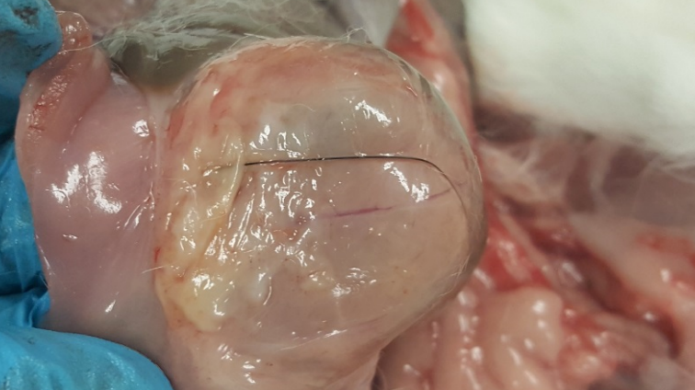
Control
vCUT
A
B
Abdominal wall
Cecum
Day 7
vCUT
Suture
Adhesion
Cecum
Abdominal wall
C
D
Adhesion
Abdominal wall
Day 28
vCUT
Cecum
Abdominal wall
E
Abdominal wall
F
Adhesion
Suture
vCUT
Day 67
Abdominal wall
Cecum
Table S2: Peritoneal adhesion scoring in a rabbit model with cecum sutured to the abdominal wall
Parameters | Score at day 28
 | Control | vCUT
Adhesion between wall and cecum (gross evaluation) | 4 | 0
Fibrosis (histological evaluation) | 2 | 2*
Inflammation (histological evaluation) | 2 | 3*
Grading scale: 0= normal; 1= minimal; 2= mild; 3= moderate; 4= severe
*Areas between abdominal wall and vCUT with no adhesion to cecum
Figure S4

