Slide 1
Supplementary table 1. Custom 48 gene panel used for mutation analysis
ABL1 | FGFR3 | NOTCH1
AKT1 | FLT3 | NPM1
ALK | GNA11 | NRAS
APC | GNAQ | PDFRA
ATM | GNAS | PIK3CA
BRAF | HNF1A | PTEN
CDH1 | HRAS | PTPN11
CDKN2A | IDH1 | RB1
CSF1R | JAK2 | RET
CTNNB1 | JAK3 | SMAD4
EGFR | KDR | SMARCB1
ERBB2 | KIT | SMO
ERBB4 | KRAS | SRC
FBBXW7 | MET | STK11
FGFR1 | MLH1 | TP53
FGFR2 | MPL | VHL

Slide 2
Supplementary table 2. Characteristics of lesions originating from patients with multiple polyps. Lesions were assumed to develop independently based on differing morphology, colonic location, size, histopathology and/or growth. The copy number alterations of the polyps confirmed this assumption.
Patient | Sample ID | Morphology | Location | Endoscopy size | Histopathology | Dysplasia | Volumetric change | Total # CNA | 8q gain | 13q gain | 20q gain | 8p loss | 15q loss | 17p loss | 18q loss | Total # CAE
10284 | 6 | pedunculated | proximal | 8 | TVA | LGD | -11.67 | excl. | excl. | excl. | excl. | excl. | excl. | excl. | excl. | excl.
10284 | 7 | flat | distal | 8 | TA | LGD | 14.9 | n.d. | n.d. | n.d. | n.d. | n.d. | n.d. | n.d. | n.d. | n.d.
10375 | 9 | sessile | proximal | 10 | TVA | LGD | 97.02 | 4 | Yes | Yes | No | No | No | No | No | 2
10375 | 8 | sessile | proximal | 5 | TA | LGD | -2.92 | 0 | No | No | No | No | No | No | No | 0
10482 | 15 | pedunculated | distal | 10 | TA | LGD | 11.92 | 1 | No | Yes | No | No | No | No | No | 1
10482 | 14 | sessile | distal | 7 | TA | LGD | -18.53 | 0 | No | No | No | No | No | No | No | 0
10916 | 16 | pedunculated | distal | 7 | TA | LGD | 12.65 | 0 | No | No | No | No | No | No | No | 0
10916 | 17 | pedunculated | distal | 15 | TA | LGD | 70.51 | 0 | No | No | No | No | No | No | No | 0
11130 | 19 | sessile | proximal | 5 | TA | LGD | -32.97 | 1 | No | No | No | No | No | No | No | 0
11130 | 18 | sessile | proximal | 8 | TA | LGD | -34.41 | 0 | No | No | No | No | No | No | No | 0
11177 | 23 | sessile | proximal | 7 | TA | LGD | 61.26 | 0 | No | No | No | No | No | No | No | 0
11177 | 22 | sessile | proximal | 7 | TA | LGD | 23.7 | 0 | No | No | No | No | No | No | No | 0
11177 | 21 | pedunculated | proximal | 9 | TA | LGD | -27.52 | 0 | No | No | No | No | No | No | No | 0
11430 | 24 | sessile | proximal | 6 | TA | LGD | -34.51 | 0 | No | No | No | No | No | No | No | 0
11430 | 25 | pedunculated | proximal | 9 | TA | LGD | 227.46 | 0 | No | No | No | No | No | No | No | 0
11574 | 64 | sessile | proximal | 6 | TA | LGD | 19 | excl. | excl. | excl. | excl. | excl. | excl. | excl. | excl. | excl.
11574 | 26 | pedunculated | proximal | 12 | TA | LGD | 33.59 | excl. | excl. | excl. | excl. | excl. | excl. | excl. | excl. | excl.
11574 | 27 | pedunculated | proximal | 15 | TVA | LGD | 88.21 | 0 | No | No | No | No | No | No | No | 0
12070 | 39 | flat | proximal | 10 | TA | LGD | 123.08 | 0 | No | No | No | No | No | No | No | 0
12070 | 36 | flat | proximal | 5 | TA | LGD | -14.51 | 0 | No | No | No | No | No | No | No | 0
12070 | 37 | sessile | proximal | 10 | TA | LGD | -0.57 | 6 | No | Yes | Yes | No | No | Yes | No | 3
12070 | 38 | flat | distal | 7 | TA | LGD | 93.09 | 1 | No | Yes | No | No | No | No | No | 1
12359 | 42 | pedunculated | distal | 4 | TA | LGD | -47.18 | 0 | No | No | No | No | No | No | No | 0
12359 | 43 | sessile | distal | 5 | TA | LGD | -31.58 | 0 | No | No | No | No | No | No | No | 0
12444 | 45 | sessile | proximal | 4 | TA | LGD | -48.23 | n.d. | n.d. | n.d. | n.d. | n.d. | n.d. | n.d. | n.d. | n.d.
12444 | 66 | flat | distal | 3 | HP | none | 288.83 | 0 | No | No | No | No | No | No | No | 0
12444 | 46 | pedunculated | distal | 6 | TA | LGD | 17.83 | 2 | No | Yes | Yes | No | No | No | No | 2
12671 | 52 | sessile | proximal | 7 | TA | LGD | 137.29 | 0 | No | No | No | No | No | No | No | 0
12671 | 53 | sessile | proximal | 7 | TA | LGD | 174.07 | 0 | No | No | No | No | No | No | No | 0
12671 | 51 | pedunculated | proximal | 8 | TA | LGD | 43.23 | 4 | Yes | Yes | No | No | No | No | No | 2
12820 | 67 | sessile | distal | 5 | HP | none | 23.88 | n.d. | n.d. | n.d. | n.d. | n.d. | n.d. | n.d. | n.d. | n.d.
12820 | 60 | sessile | distal | 8 | SSP | none | 64.32 | 0 | No | No | No | No | No | No | No | 0
CAE = cancer associated events, CNA = copy number alterations, excl. = exclusion, LGD = low grade dysplasia, n.d. = not determined, TA = tubular adenoma, TVA = tubulovillous adenoma.

Slide 3
Supplementary table 3. Overview of 11 adenomas with at least one associated event, originating from 10 different patients
Patient | Sample ID | Sex | Age | Histopathology | Dysplasia | Growth rate | 8q gain | 13 gain | 20q gain | 8p loss | 15q loss | 17p loss | 18q loss | Total CAEs
10052 | 2 | Male | 62 | TA | LGD | 108.97 |  |  |  |  |  |  |  | 1
10375 | 9 | Male | 71 | TVA | LGD | 97.02 |  |  |  |  |  |  |  | 2
10381 | 10 | Male | 59 | TA | LGD | 380.55 |  |  |  |  |  |  |  | 1
10401 | 12 | Male | 74 | TVA | LGD | 550.45 |  |  |  |  |  |  |  | 1
10482 | 15 | Female | 68 | TA | LGD | 11.92 |  |  |  |  |  |  |  | 1
11585 | 28 | Male | 73 | TA | LGD | -23.30 |  |  |  |  |  |  |  | 1
12036 | 34 | Female | 59 | TVA | LGD | 302.40 |  |  |  |  |  |  |  | 3
12070 | 37 | Male | 61 | TA | LGD | -0.57 |  |  |  |  |  |  |  | 3
12070 | 38 | Male | 61 | TA | LGD | 93.09 |  |  |  |  |  |  |  | 1
12444 | 46 | Female | 55 | TA | LGD | 17.83 |  |  |  |  |  |  |  | 2
12671 | 51 | Male | 76 | TA | LGD | 43.23 |  |  |  |  |  |  |  | 2
Frequency |  |  |  |  |  |  | 3 | 10 | 4 | 0 | 0 | 1 | 0 | 18

Slide 4
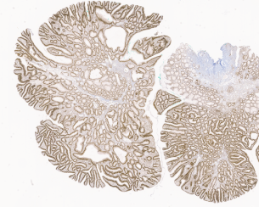
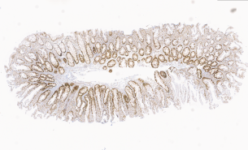
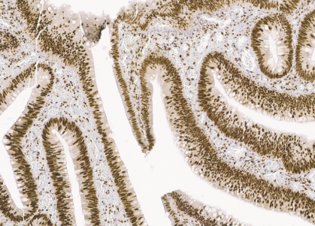
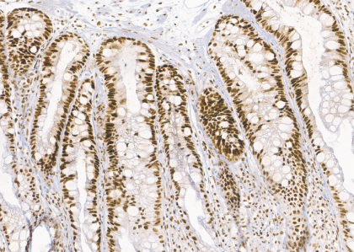
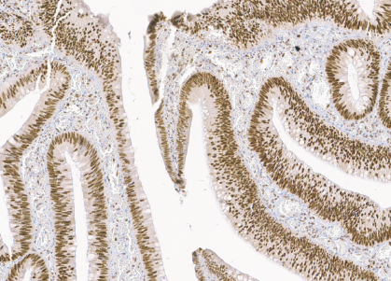
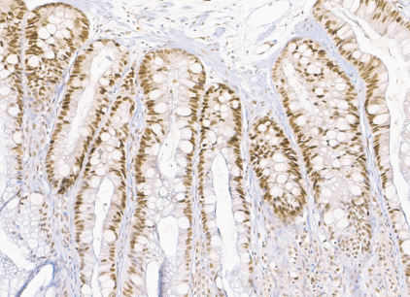
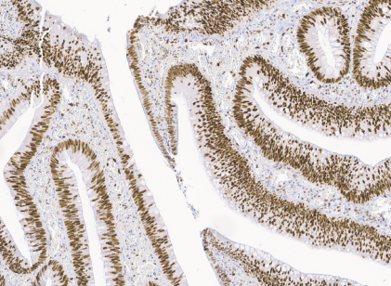
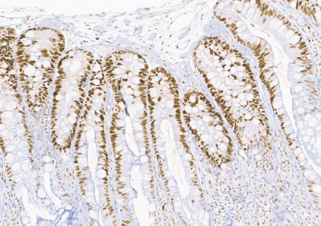
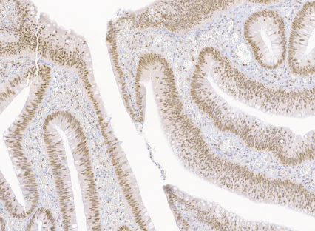
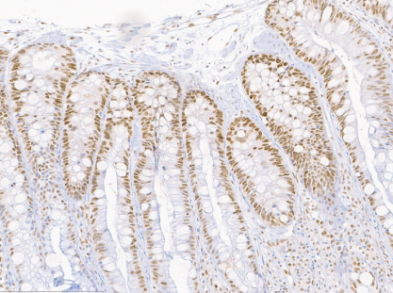
Supplementary figure 1. Expression of the mismatch repair genes MLH1, MSH2, MSH6 and PMS2 for sample #47 (tubulovillous adenoma with low grade dysplasia) and sample #67 (hyperplastic polyp)
sample 47
sample 67
MLH1
10x
15x
MSH2
MSH6
PMS2

