Slide 1
A
B
Supplementary Figure 1: Levels of TSA-1-specific antibodies.
Levels of TSA-1-specific IgG (A) and the ratio of IgG2a/IgG1 (B) were measured by ELISA in serum samples from T. cruzi infected mice that had received the indicated vaccines. There were no significant difference among treatment groups (ANOVA, P = 0.06 and P = 0.65, respectively).

Slide 2
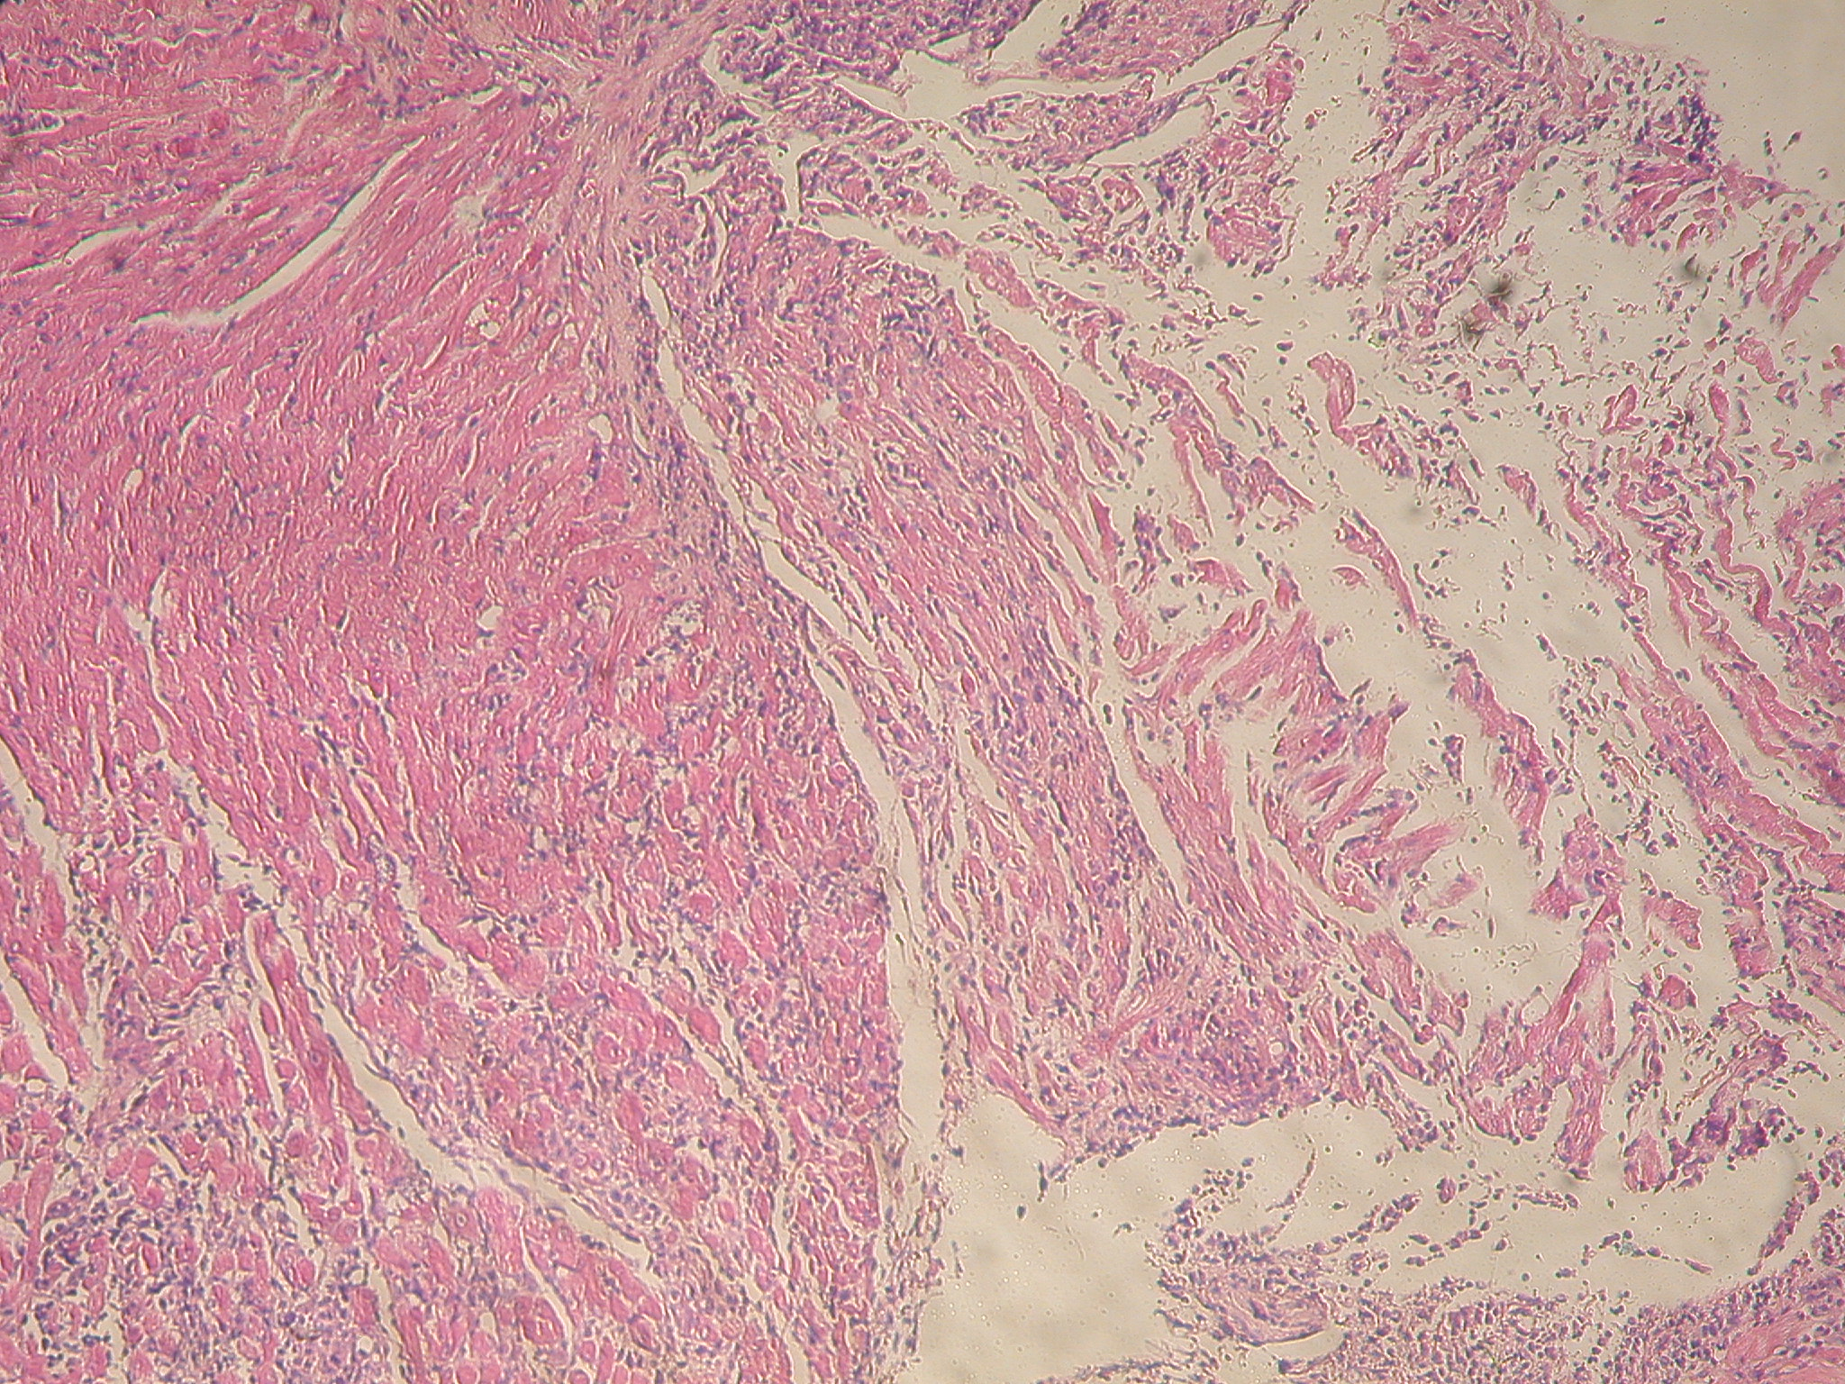
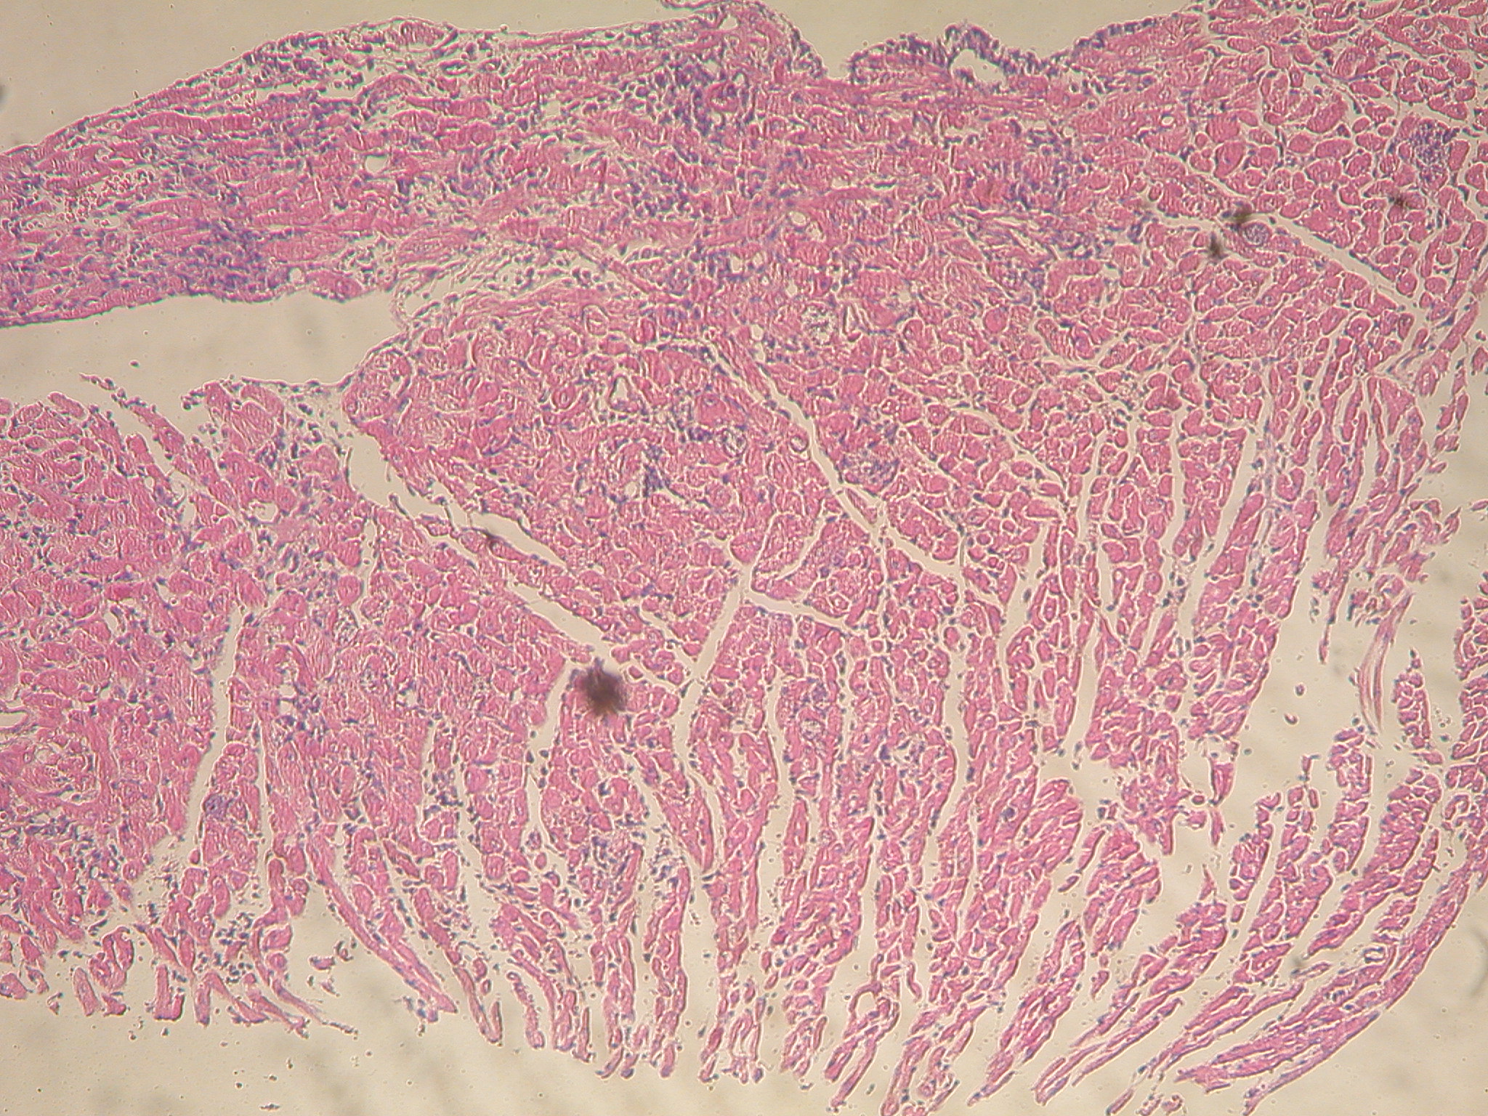
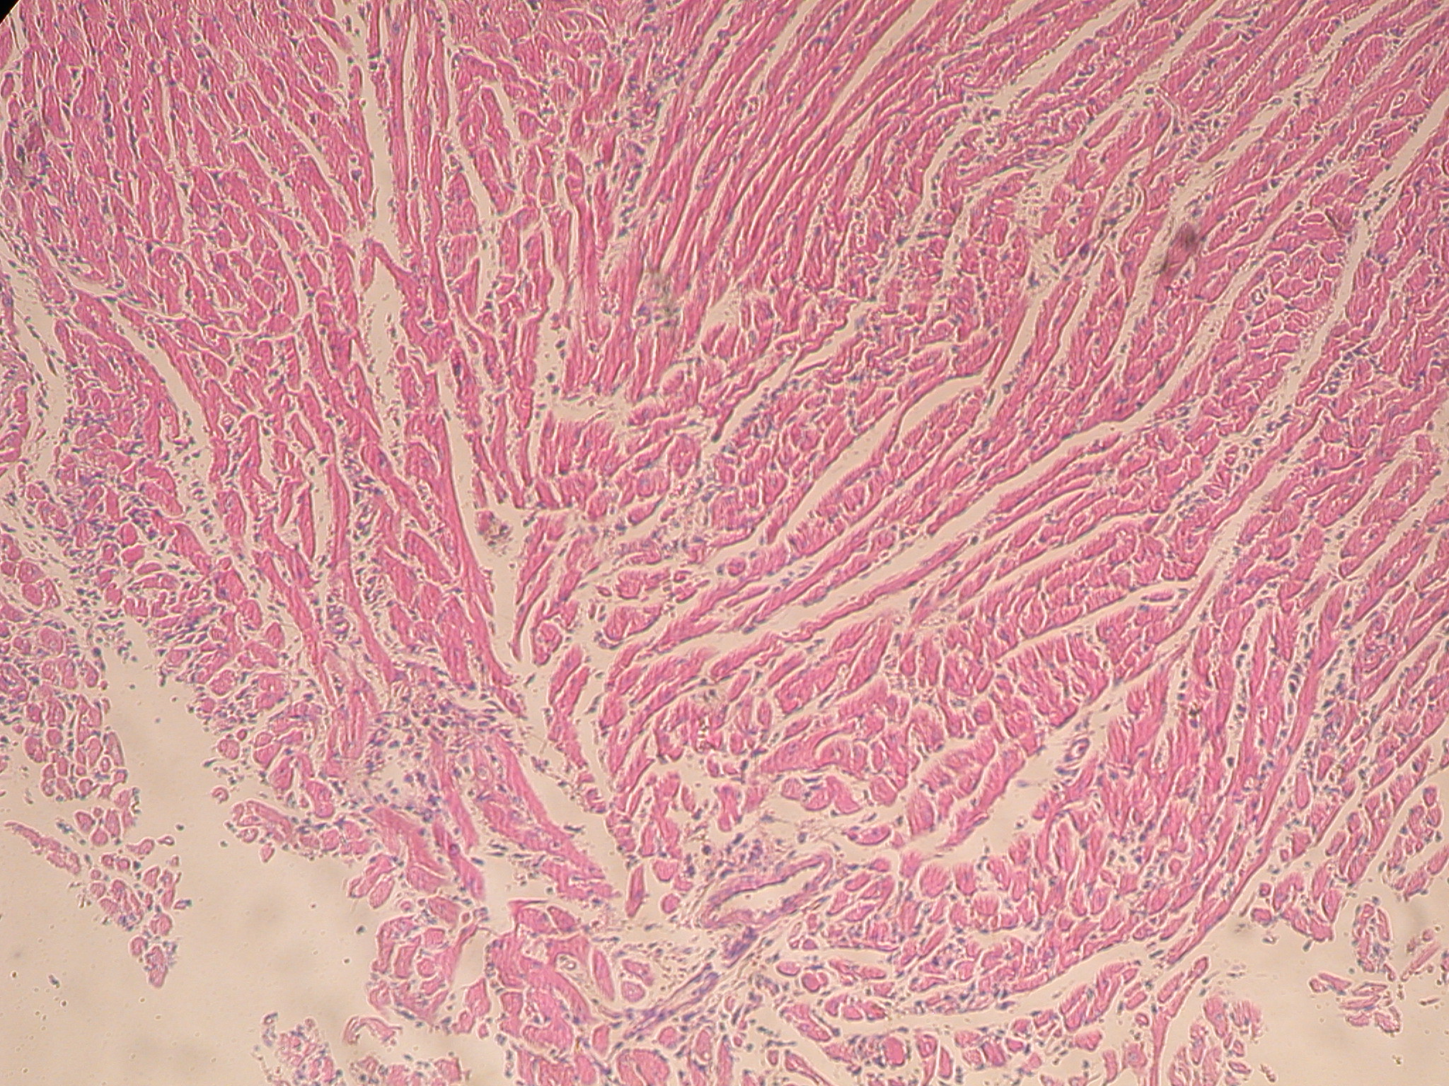
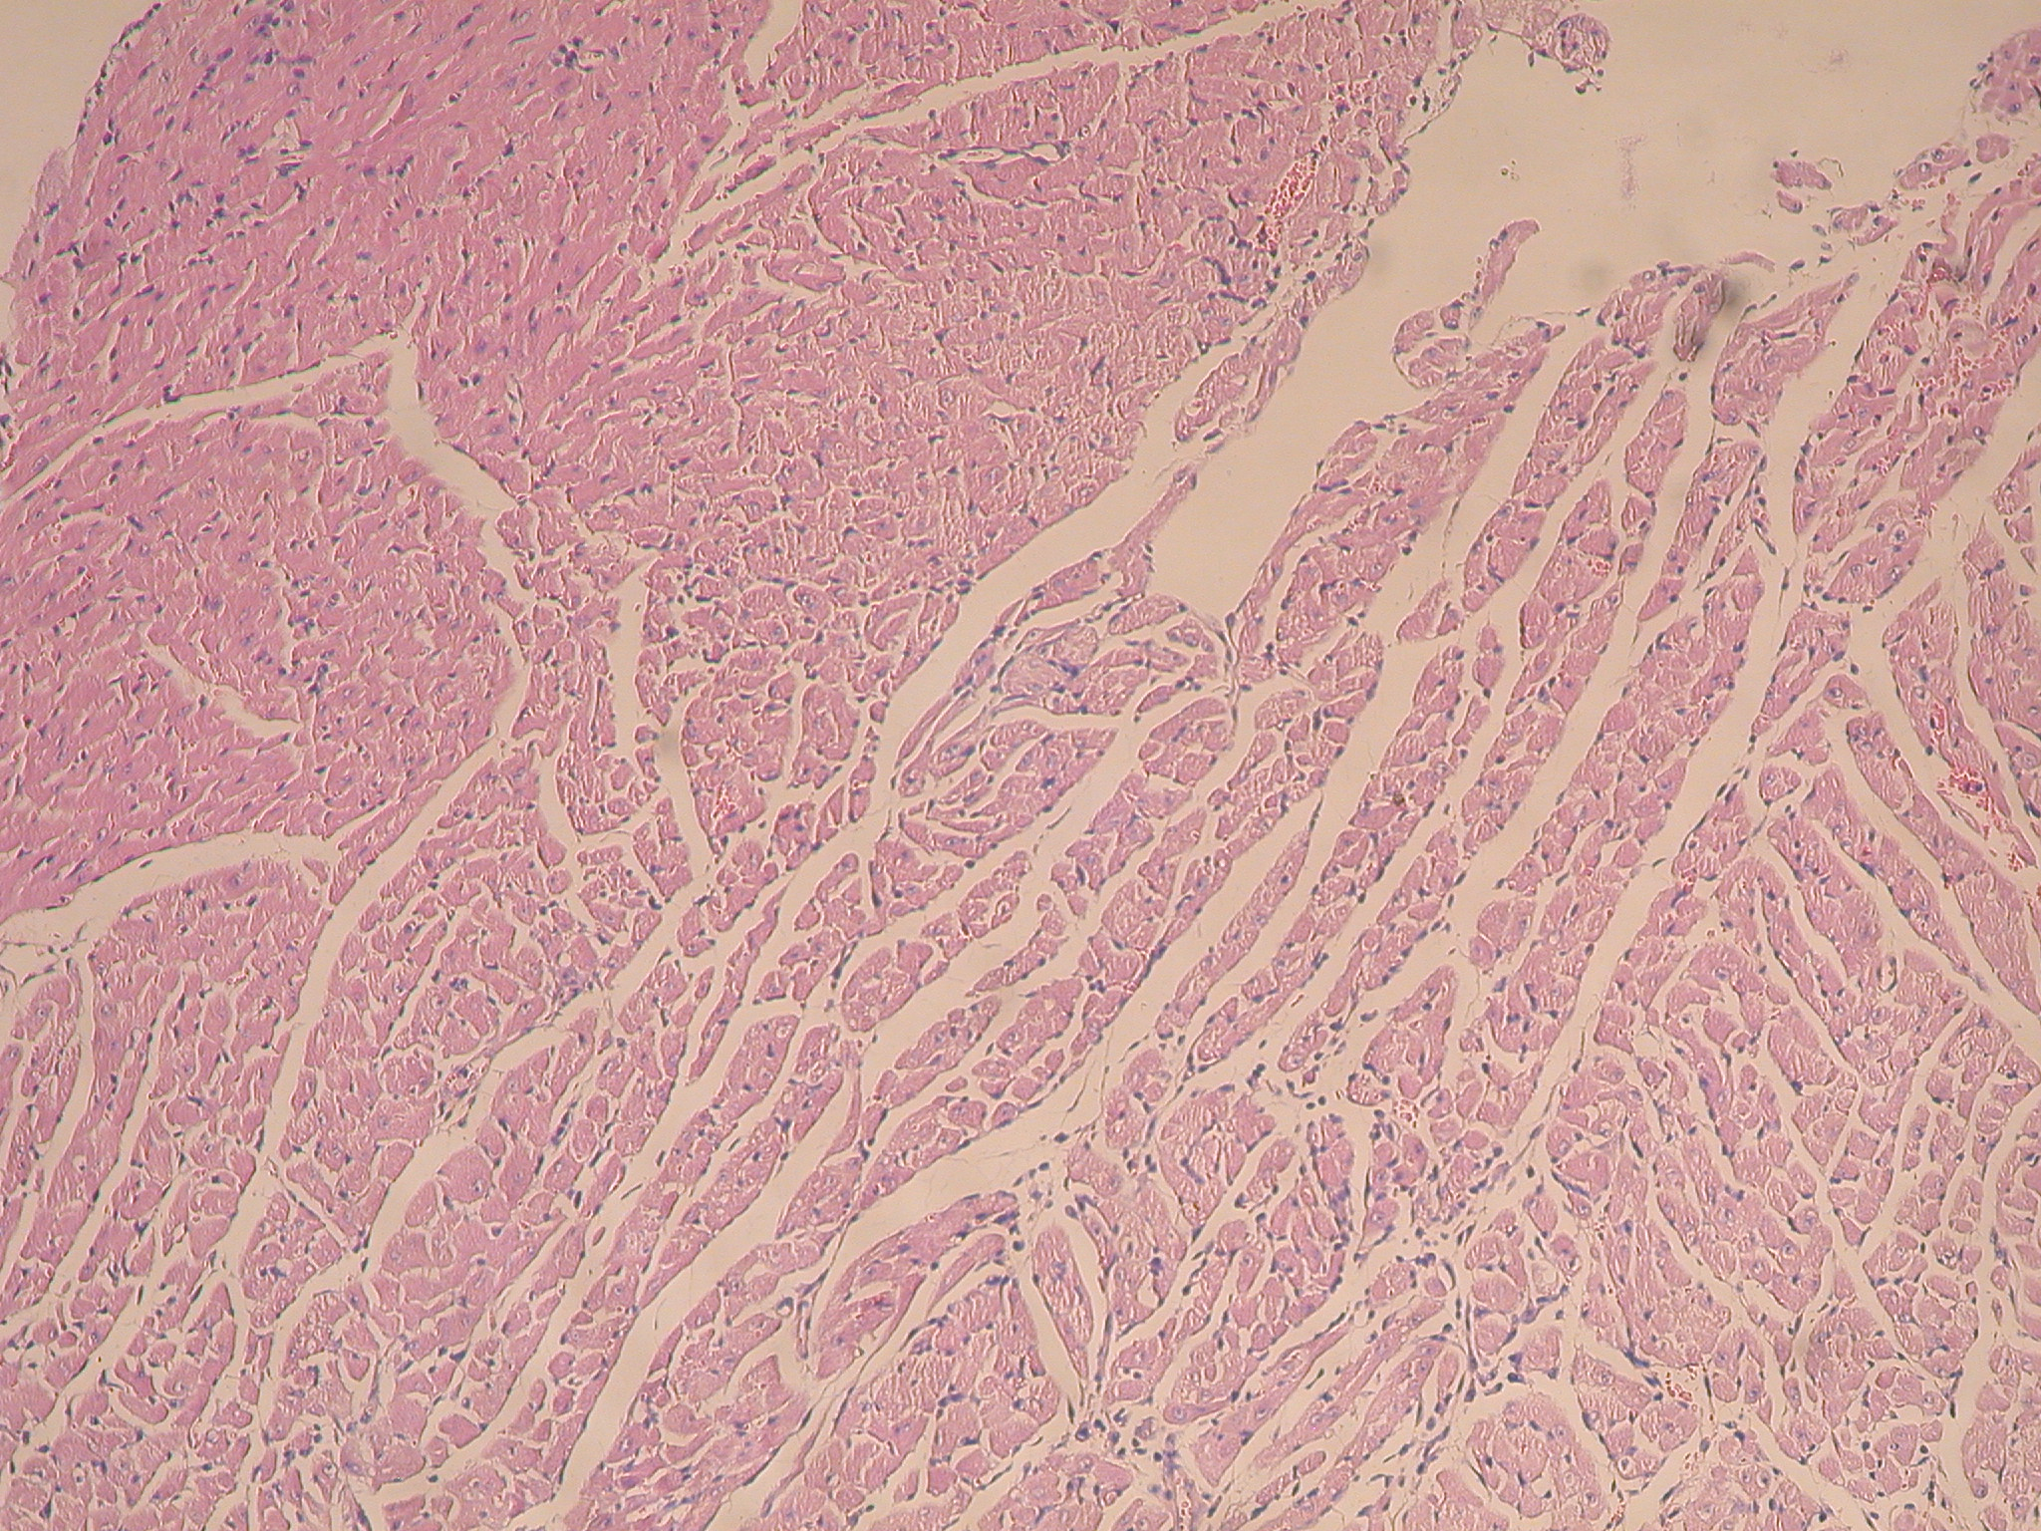
Saline
rTSA1
MPLA
rTSA-1 + MPLA
Supplementary Figure 2: Images of cardiac tissue sections from T. cruzi infected mice treated with different vaccine formulations.
Tissue sections were stained with hematoxylin and eosin and images taken at 40x magnification.

Slide 3
A
B
C
Supplementary figure 3: Effect of rTSA-1 formulation on therapeutic vaccine control of parasitemia.
Overall parasitemia of mice immunized with the indicated vaccine formulations was estimated as the area under the curve in arbitrary units, derived from curves presented in Figure 6. * indicates significant differences with the saline control group (ANOVA followed by Dunn’s post-hoc test with P < 0.05).

Slide 4
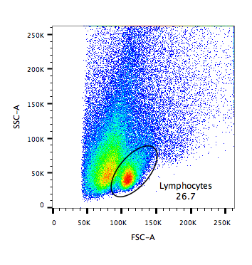
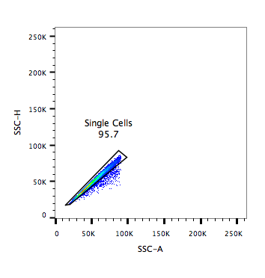
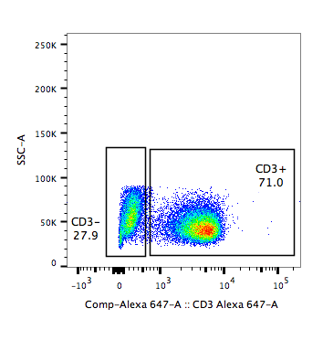
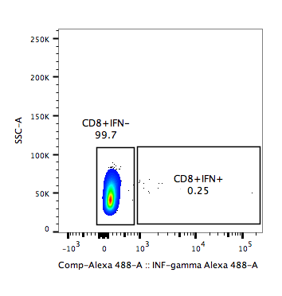
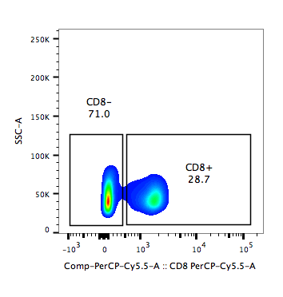
A
B
C
E
D
Supplementary Figure 4: Gating strategy for the analysis of T cells.
Lymphocytes were gated by size using a FSC-A vs SSC-A dot plot (A), single cells were selected using a dot plot of SSC-A vs SSC-H (B). T cells were further identified by their expression of CD3 on a CD3-Alexa647 vs SSC-A dot plot (C). Next, CD8⁺ or CD4⁺ T lymphocytes were selected using a dot plot of SSC-A vs their cluster of differentiation (D). Finally, intracellular expression of cytokines (% of IFNg⁺ or IL4⁺ cells) was evaluated using a dot plot of IFNg-Alexa fluor 488 (or IL4-PE) vs SSC-A (E).

