Slide 1
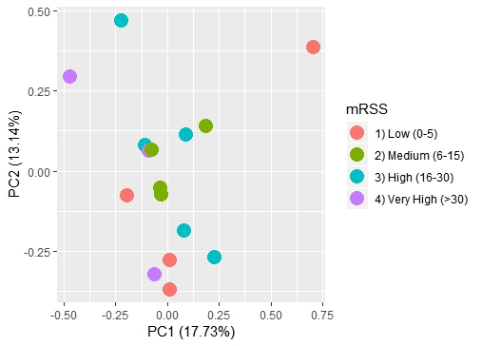
Supplemental Figure S3 : Principal component analysis of lesional forearm samples based on mRSS

