Slide 1
S. Materials and methods
Flowcytometry-Gating strategy
Dead cells and cellular debris were removed from analysis by having a FSC threshold of 110. The monocytes and lymphocytes were first gated on the FSC Vs SSC plot. Monocytes were further gated based on CD14 bright cell population on a CD14 Vs SSC plot. mDCs (Myeloid DCs) were further gated on CD11c Vs HLA-DR plot and were identified as double positive (CD11c⁺HLA-DR⁺) cells. B cells were further gated on a CD3 Vs CD19 plot and were identified as single positive (CD3⁻CD19⁺) cells. For ex vivo analysis the surface expression of TLR2 and 4 were studied in B cells, monocytes and dendritic cells separately. For the in vitro experiments, the expression of TNF-α, IL-6, CD69 and activated Caspase-3 on monocytes, DCs and B cells were further analysed on TNF-α/IL-6/CD69/Activated Caspase-3 Vs CD14/CD11c/CD19 plots. Both % of cells and mean fluorescence intensity (MFI) were analysed by dot plot and histogram analysis respectively for all the effector molecules including TNF-α, IL-6, CD69 and activated Caspase-3. 50,000 events were acquired for each tube to arrive at statistical significant results. The illustration for flowcytometric analysis has been uploaded separately.

Slide 2
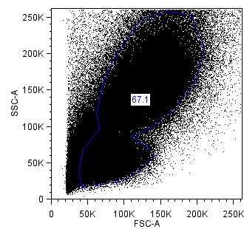
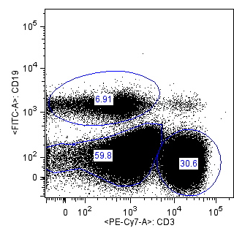
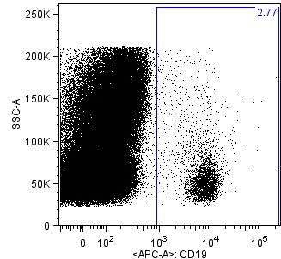
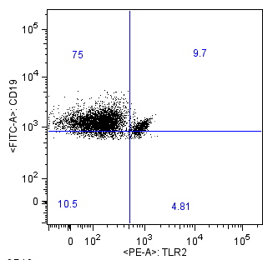
Expression of TLR2 in B cells

Slide 3
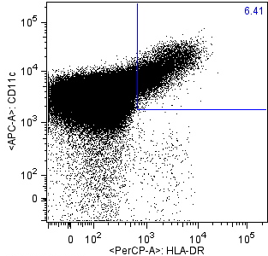
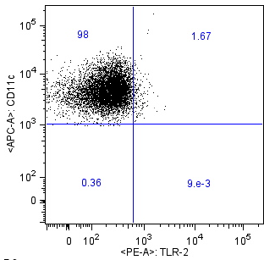
Expression of TLR2 in DCs

Slide 4
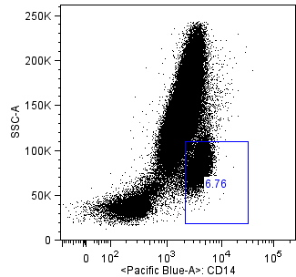
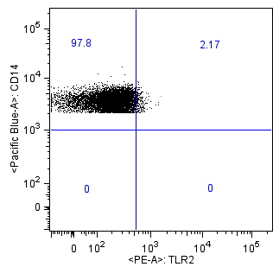
Expression of TLR2 in Monocytes

