Slide 1
Gate from lymphocytes
Vδ2
89.4
Vδ1
13.9
Vδ2
Vδ1
Not
γδT
CD3
Vδ2
0
0
NKT
28.4
CD8⁺
48.2
CD4⁺CD8⁺
1.77
CD56
CD56
CD8
NK
74.9
B cell
25.1
0
0
71.6
CD4⁺
28.2
CD3
CD3
CD4
Figure S1.
Purity of infused allogenic Vγ9Vδ2 T cells of all 8 treatment courses is > 85%. According to flow cytometry data, rest non Vδ2 T cells including Vδ1 T cells, NK cells, B cells, NKT cells, CD8⁺T cells, CD4⁺T cells, CD4⁺CD8⁺T cells, and CD4⁻CD8⁻T cells.

Slide 2
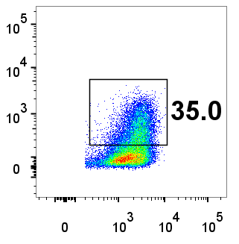
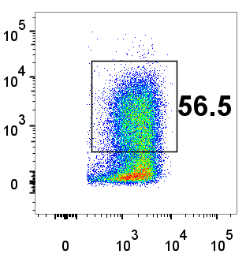
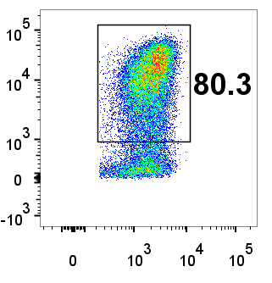
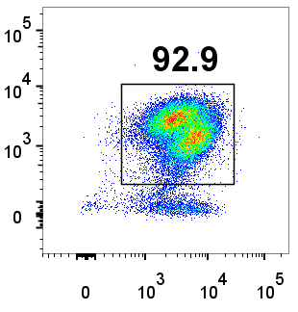
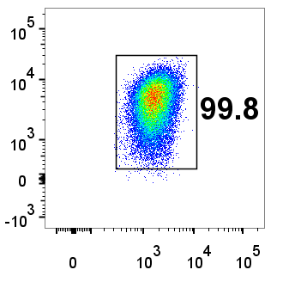
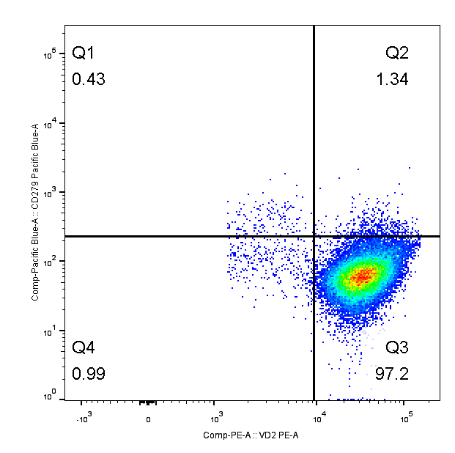
IFN-γ
CD107a
TNF-α
Vδ2
Vδ2
Vδ2
Vδ2
NKG2D
CD3
PD-1
Vδ2
Vδ2
Figure S2.
Molecular phenotypes of allogenic Vγ9Vδ2 T cells cultured using our developed specific culture formula, showing high expression of killing related molecules (like NKG2D, IFN-γ, TNF-α, CD107a) and low expression of inhibitory molecules like PD-1.

