Slide 1
P=0.078
Supplemental figure 1: Treatment of HEL cells with A661 and A665 Compounds upregulates the transcription of Fli-1, as detected using Q-RT-PCR. Compounds concentration 5μM.

Slide 2
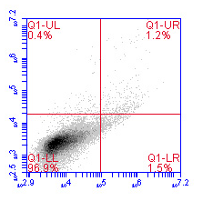
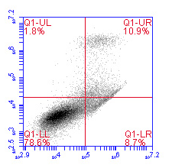
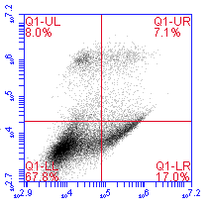
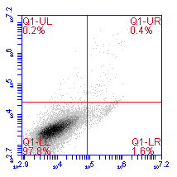
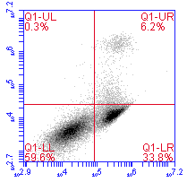
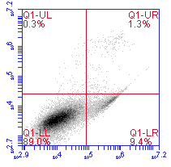
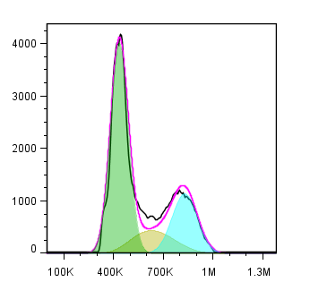
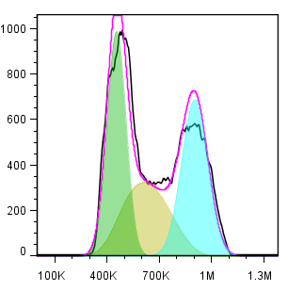
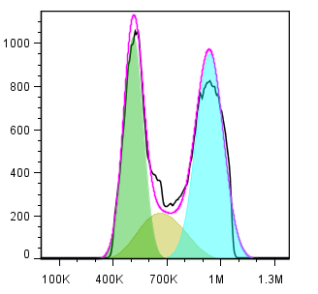
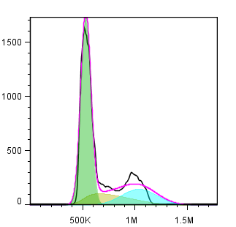
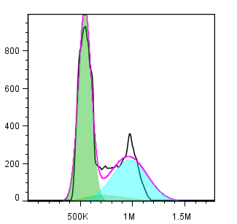
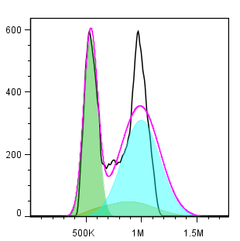
A
HEL (5μM)
PI
DMSO
A661
A665
CB7 (5μM)
Annexin V
PI
B
DMSO
A661
A665
HEL (5 μM)
Annexin V
G1: 60.30 %
G1: 35.76 %
G1: 36.08 %
S:15.62%
S: 29.25 %
S: 17.12 %
G2: 24.08 %
G2: 34.99 %
G2: 46.80 %
Numbers
DMSO
A661
A665
CB7 (5 μM)
PI
G1: 57.90 %
G1:58.06%
G1:35.44%
S: 24.39 %
S:6.33%
S:12.22%
G2: 17.71 %
G2:35.61%
G2:53.34%
DMSO
A661
A665
PI
Supplemental Figure 2: Fli-1 inhibiting compounds induce apoptosis and cell cycle arrest. (A) A661 or A665 treatment increases the percentage of Annexin V-positive apoptotic cells in HEL and CB7 cells 48 hours post drug treatment. (B) The compounds consistently induce accumulation in G2 phase of the cell cycle in HEL and CB7 cells, 48 hour post-drug treatment. Compound concentration, 2 μM.

Slide 3
A
B
SHIP-1
*
P=0.119
P=0.008
C
D
E
F
P=0.033
P=0.034
P=0.004
Supplemental figure 3: A661/A665 compounds induces differentiation of HEL cells in culture. (A-F) G-RT=PCR analysis of the indicated genes after treatment of HEL cells with A661/A665 compounds (5μM) for 9 hours. In figure 1A, HEL cells were treated with 1μM TPA to induce megakaryocytic differentiation¹⁶. While differentiation inducers compounds A661/A665 upregulated p27, this cell cycle inhibitor was downregulated by TPA. P< 0.005 denoted by ** . P< 0.05 denoted by *

Slide 4


A
DMSO
A661
A665
P-ERK
44kd
44kd
ERK
Supplemental Figure 4: Western blot of phospho-ERK and cMYC expression in HEL cells treated for 18 hours with the indicated compounds (5μM). β-actin and ERK were used as loading controls.
B
DMSO
A661
A665
48kd
cMYC
46kd
β-actin

Slide 5


-MG132
+MG132
DMSO
A661
A665
DMSO
A661
A665
FLI-1
51kd
RD 1 0.6 0.2 1.2 0.5 0.3
β-TUBULIN
50kd
Supplemental Figure 5: Western blot of FLI-1 expression in HEL cells treated for 18 hours with the indicated compounds (5μM), with or without 5μM MG132 (Selleckchem, Houston, TX, USA). β-Tubulin was used as loading control. RD: relative density measured by densitometry.

Slide 6
Relative mRNA expression
Supplemental figure 6: Treatment of Fli-1 negative K562 cells with compounds A661 and A665 (5μM) does not induce transcription of miR-145, as detected using Q-RT-PCR.

