Slide 1
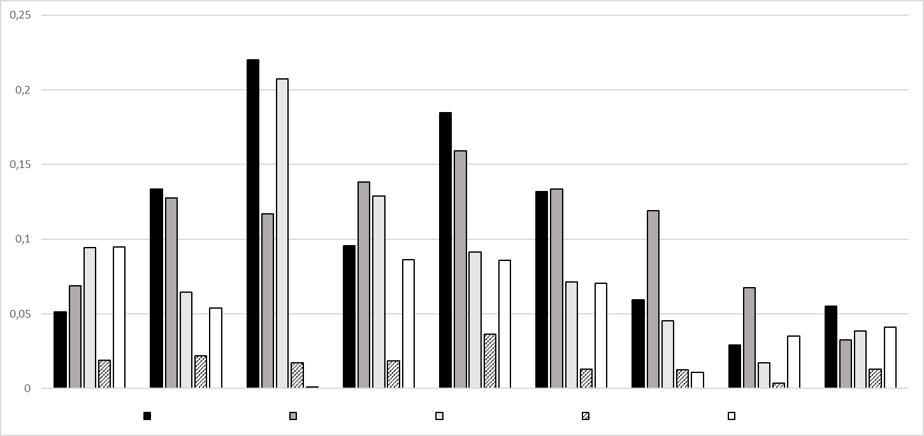
PHQ-9 score
&
&
&
&
&
&
&
&
&
&
&
Q1
Q2
Q3
Q4
Q5
Q6
Q7
Q8
Q9
female gender
age
BMI
pack years
smoking status
Q2
Figure S1. Effects of gender, age, BMI, pack years and smoking status on single PHQ-9 items. The figure shows mean values and standard errors of the effects of different baseline characteristics on the single items of the PHQ-9. The data are derived from regression analyses comprising all five influencing factors. The change in the PHQ-9 sum score is given for an increase of 10 years or 10 kg/m², respectively, in terms of age and BMI or 20 pack years, to adapt the effect size. The bars marked with „&“ were inverted for the sake of clarity. The figure illustrates that the different patients characteristics show different associations with the single PHQ-9 items.

Slide 2
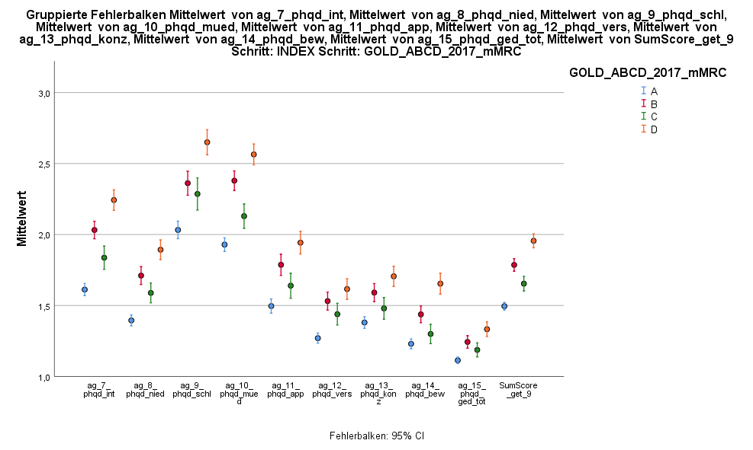
GOLD groups
2.0
A
B
C
D
1.5
1.5
Mean PHQ-9 sum score
1.0
1,0
0.5
0,5
0
0
Q1
Q2
Q3
Q4
Q5
Q6
Q7
Q8
Q9
Sum score/9
Figure S2. Distribution of the PHQ-9 sum score stratified according to groups A-D in terms of mean PHQ-9 sum score and standard deviation. The figure illustrates the additivity of symptoms and exacerbation risk regarding the single score items, when comparing the changes from A to B and B to D with those from A to C and B to D. The single questions of the PHQ-9 can be looked up in table S4.

Slide 3
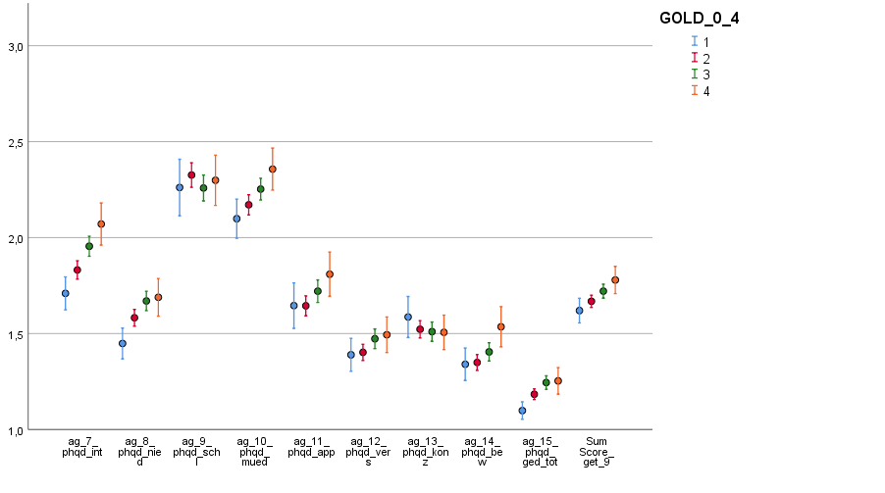
GOLD grades
2.0
1
2,0
2
3
4
1.5
1,5
Mean PHQ-9 sum score
1.0
1,0
0.5
0,5
0
0
Q1
Q2
Q3
Q4
Q5
Q6
Q7
Q8
Q9
Sum score/9
Figure S3. Distribution of the PHQ-9 sum score stratified according to grades 1-4 in terms of mean PHQ-9 sum score and standard deviation. The figure illustrates the different relationships between spirometric GOLD grades and the single items of the PHQ-9. risk regarding the sum score, when comparing the changes from A to B and B to D with those from A to C and B to D.

Slide 4
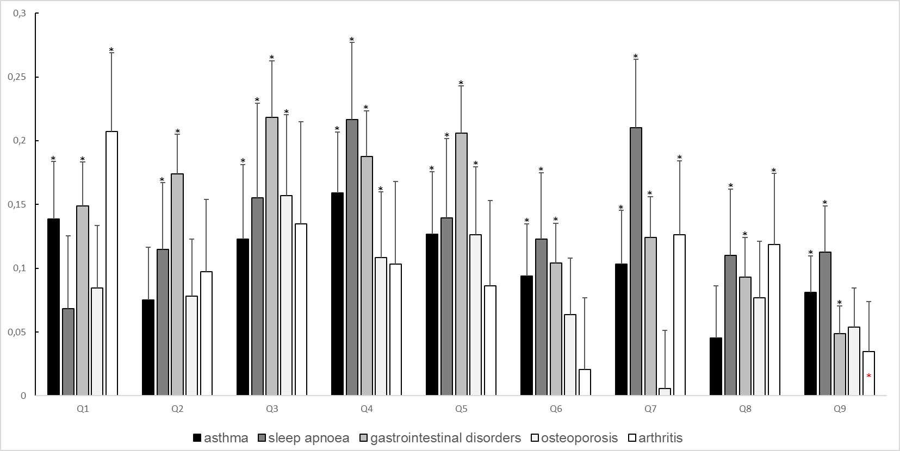
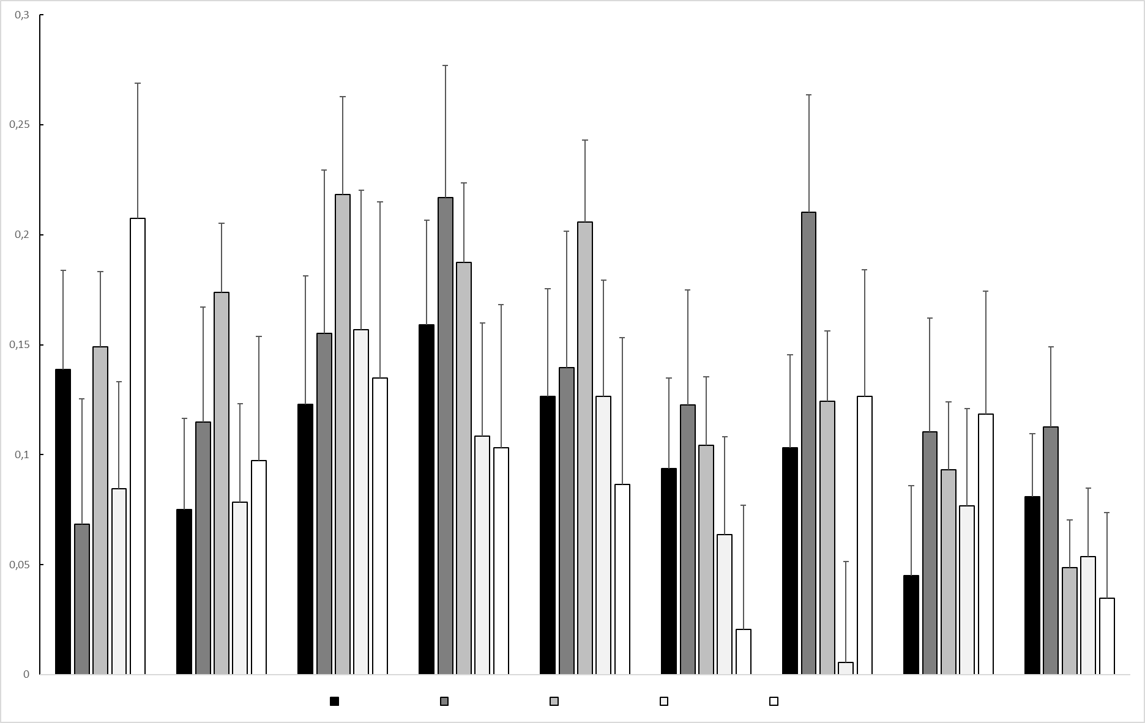
0.30
0.25
0.20
0.15
0.10
0.05
&
0
Q1
Q2
Q3
Q4
Q5
Q6
Q7
Q8
Q9
Asthma
Sleep apnoea
Gastrointestinal disorder
Osteoporosis
Arthritis
Figure S4. Effects of comorbidities on single PHQ-9 items. The figure shows mean values and standard errors of the effects of comorbidities on the single items of the PHQ-9 as derived from multiple regression analyses carrying the covariates age, gender, BMI, pack years and smoking status. In each analysis the comorbidity was introduced as a single variable to avoid problems from collinearity. The bar marked with „&“ was inverted for the sake of clarity. The figure illustrates that comorbidities show different associations with the single PHQ-9 items.

