Slide 1
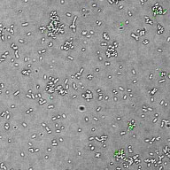
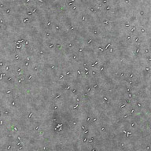
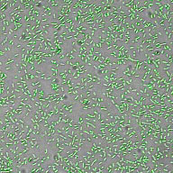
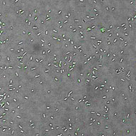
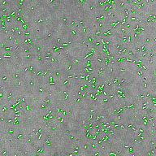
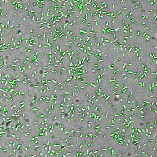
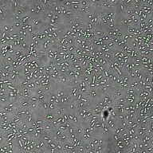
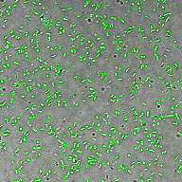
Pre-Bleed
2° α
CP4 CONTROLS
ɑ-NetB
αNetB + NetB
αNetB + FBA
ɑ-FBA
αFBA + FBA
αFBA + NetB
S2 Figure. Immunofluorescence of C. perfringens strain CP4.
Cells were incubated with pre-immune sera (Pre-Bleed),
secondary antibody only (2º α) or the indicated antisera
with or without prior incubation with the indicated
recombinant proteins as outlined in the Materials and
Methods section.
0 µm 100

