Slide 1
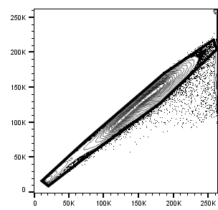
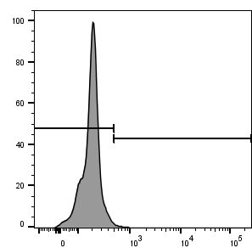
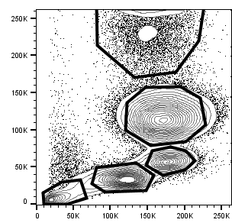
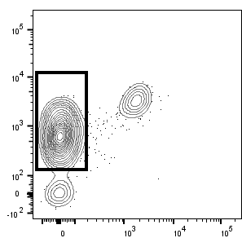
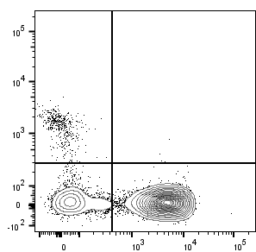
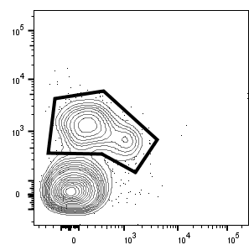
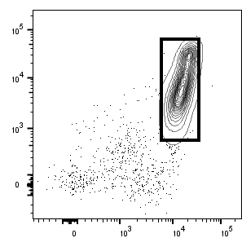
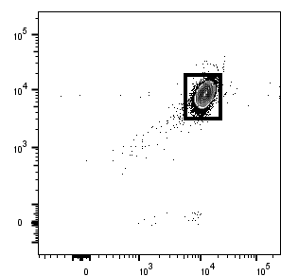
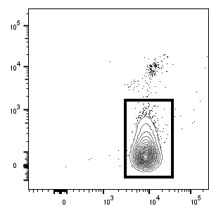
P5
P4
FSC-H
Count
SSC-A
P2
P1
P3
FSC-A
Zombie :: AmCyan
FSC-A
P1 – Platelets
P2 – Lymphocytes
79%
Platelets
2.9%
B cells
3.5%
NK cells
CD61 :: FITC
CD21 :: DyLight488
CD8a-BV786
84%
T cells
CD45 :: APC
CD3e :: BUV395
CD335 :: APC
P3 – Monocytes
P4 – Neutrophils
P5 – Eosinophils
90%
Monocytes
98%
Neutrophils
CD14 :: AF700
CD52 :: FITC
CD52 :: FITC
94%
Eosinophils
CD172a :: PerCP-Cy5.5
CD172a :: PerCP-Cy5.5
CD172a :: PerCP-Cy5.5

