Slide 1
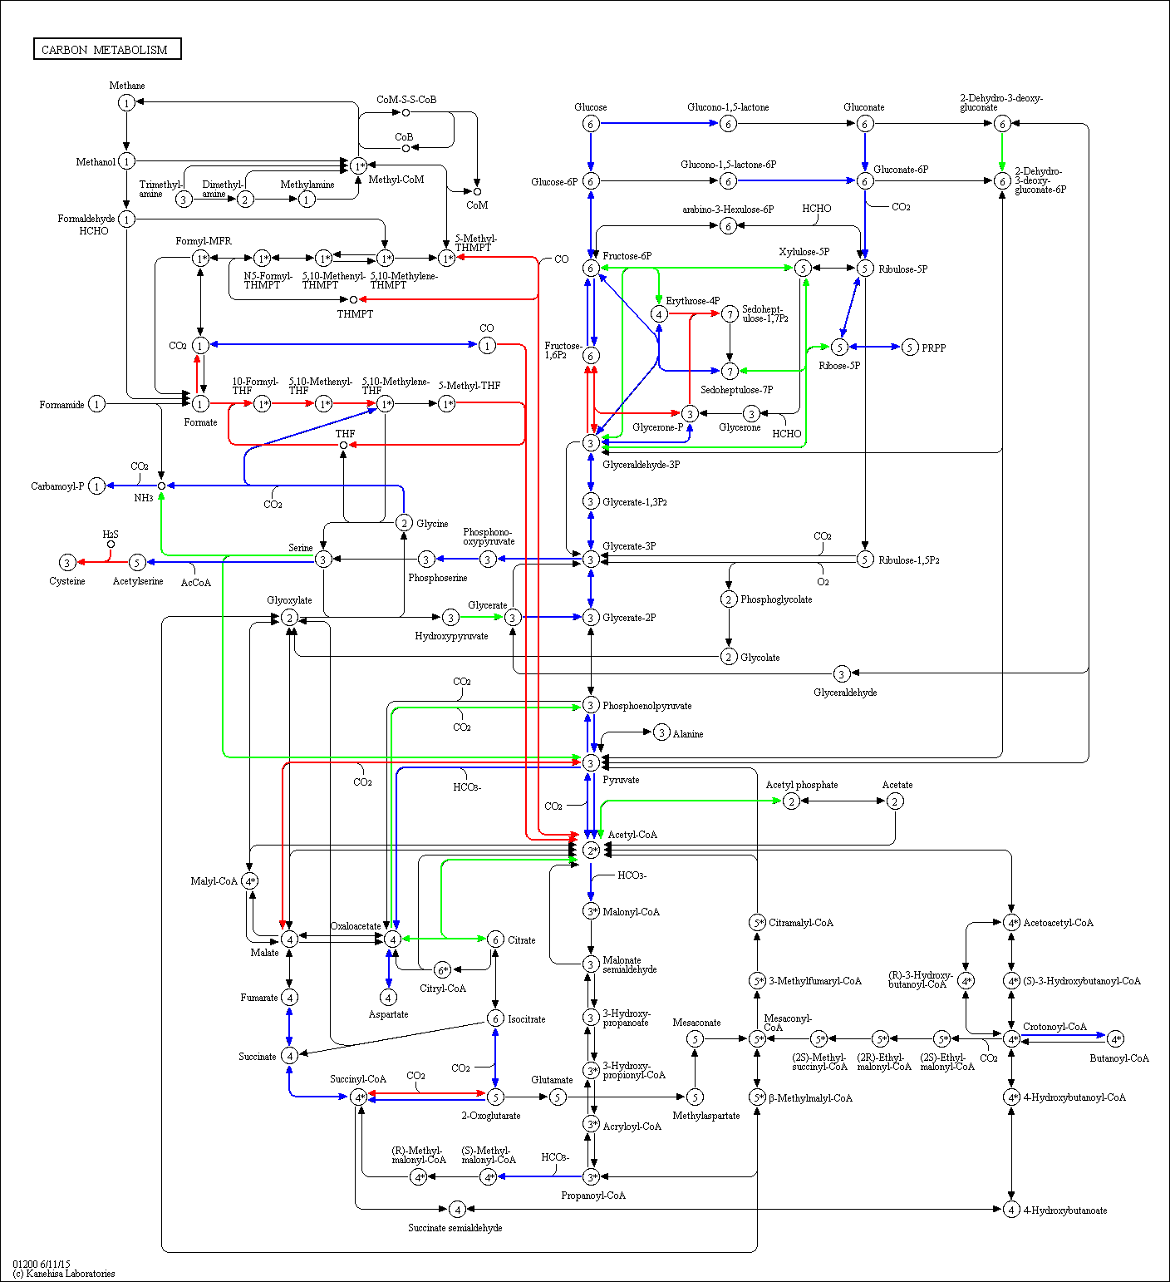
Supplementary Figure 4. KEGG Carbon metabolism pathway map for Blautia hydrogenotrophica. Genes present in the differentially expressed gene list are highlighted with those with up regulated expression in the co-culture compared to the mono-culture in red and those with down regulated expression in green. Genes with KEGG orthologs found by KAAS-KEGG, but no significant change in expression, are highlighted in blue. Numbers inside boxes are enzyme commission numbers.

