Slide 1
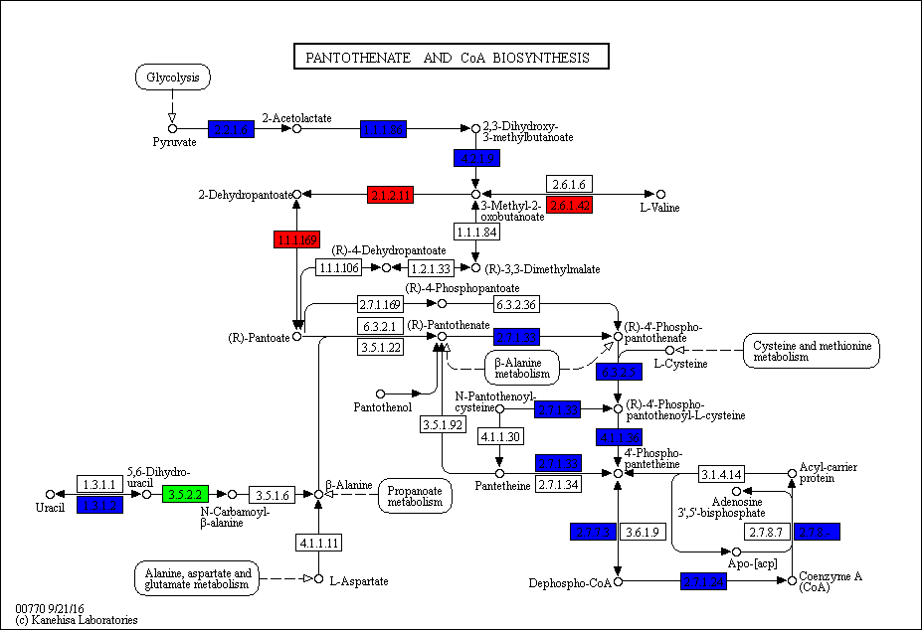
Supplementary Figure 5. KEGG pathway map for metabolism of pantothenate and CoA in Blautia hydrogenotrophica. Genes present in the differentially expressed gene list are highlighted with those with up regulated expression in the co-culture compared to the mono-culture in red and those with down regulated expression in green. Genes with KEGG orthologs found by KAAS-KEGG, but no significant change in expression, are highlighted in blue.

