Slide 1
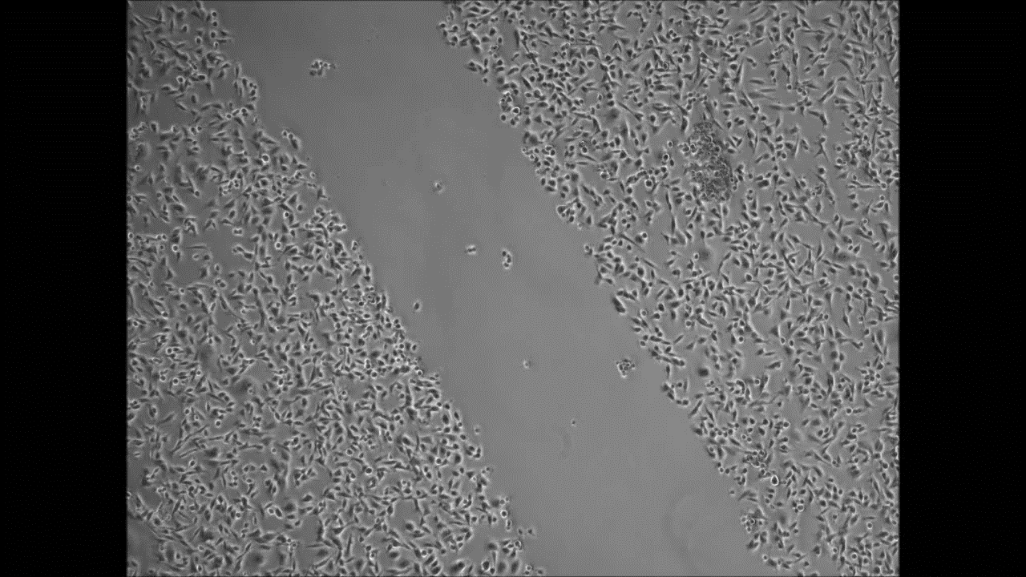
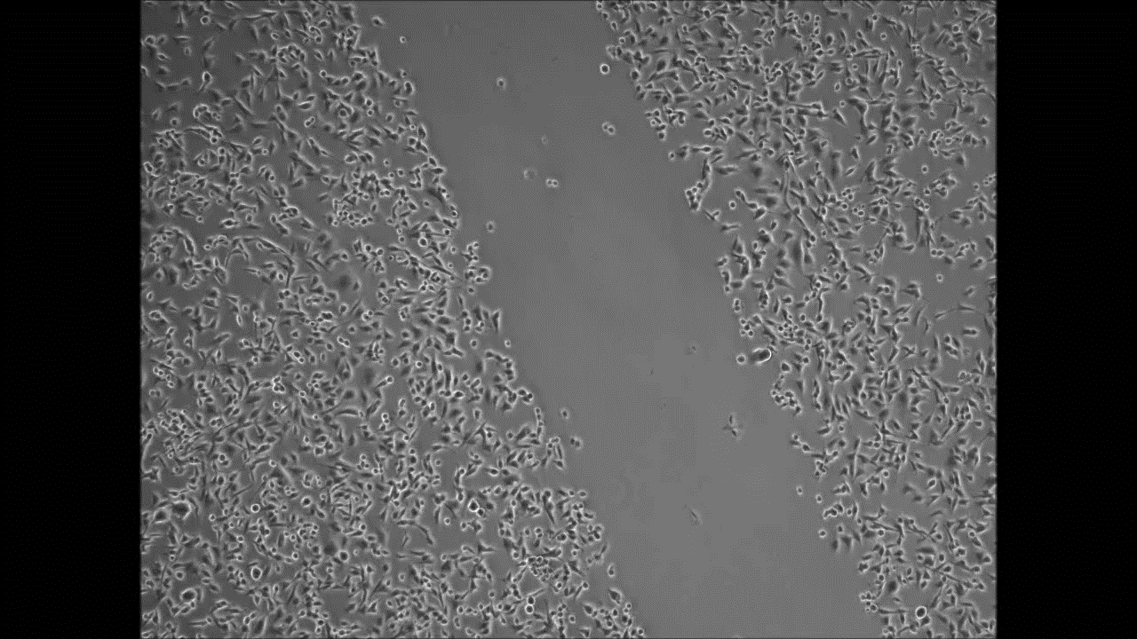
Control
NS1643
Notes:
MDA-MB-231 cells were plated onto 6-well plates. Cells were incubated for 24 hours to allow a monolayer to form. Cells were scratched with a small pipette, 25 mM Hepes was added, and cells were treated immediately with 50uM NS1643 or DMSO. The sealed plate was then placed on the automated heated stage of an Olympus IX71 microscope set at 37°C and imaged with a 5X UPlanFLN objective lens. Images were collected using a Retiga SRV CCD camera, taking a frame every 5 min for 16 h from each of the wells using Image-Pro Plus software. Subsequently, all the acquired time-lapse sequences were displayed as a movie. Movies were tracked using ImageJ tracking plugin and analyzed using in-house Mathematica software as previously described (24). Only edge cells were tracked for entire 16-hour movie – data is two independent experiments 30 cells tracked per condition.

