Slide 1
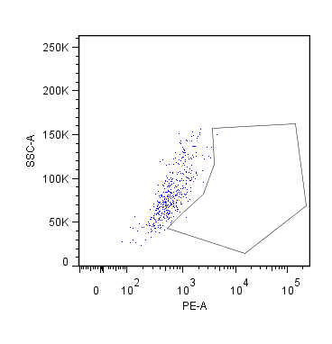
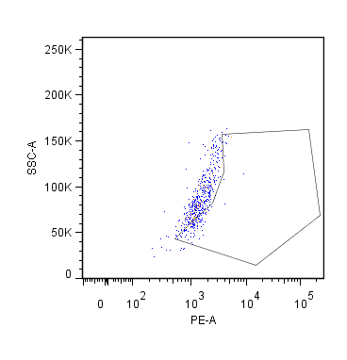
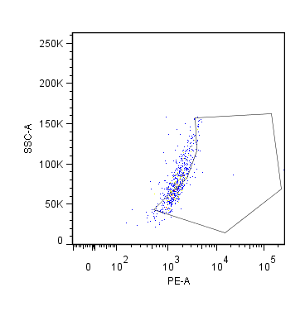






Supple Fig.1
(A)
Mouse AM
N.C.
Ctrl.
IL-4
SSC
0.64%
22.1%
44.1%
FoxO1
(B)
Lung Macrophages
(C)
(D)
BMDM
mIL-4
NT
AS1842856
**
CE
NE
Vehicle
IFNr
WT
FoxO1KO
WT
FoxO1KO
IRF4
IRF4 expression (AU)
###
IL-4 - + - + - + - +
IRF4
Arg1
FoxO1
Actin
Tubulin
mIL-4
Lamin B
(E)
Mouse AM
mIL-4
mIL-4
**
**
mRNA CCL17 (AU)
mRNA CCL22 (AU)
█ FoxO1^{fl/fl} █ FoxO1^{fl/fl}LysMcre

Slide 2
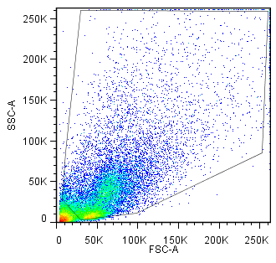
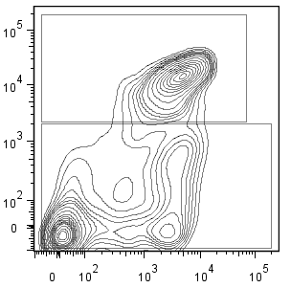
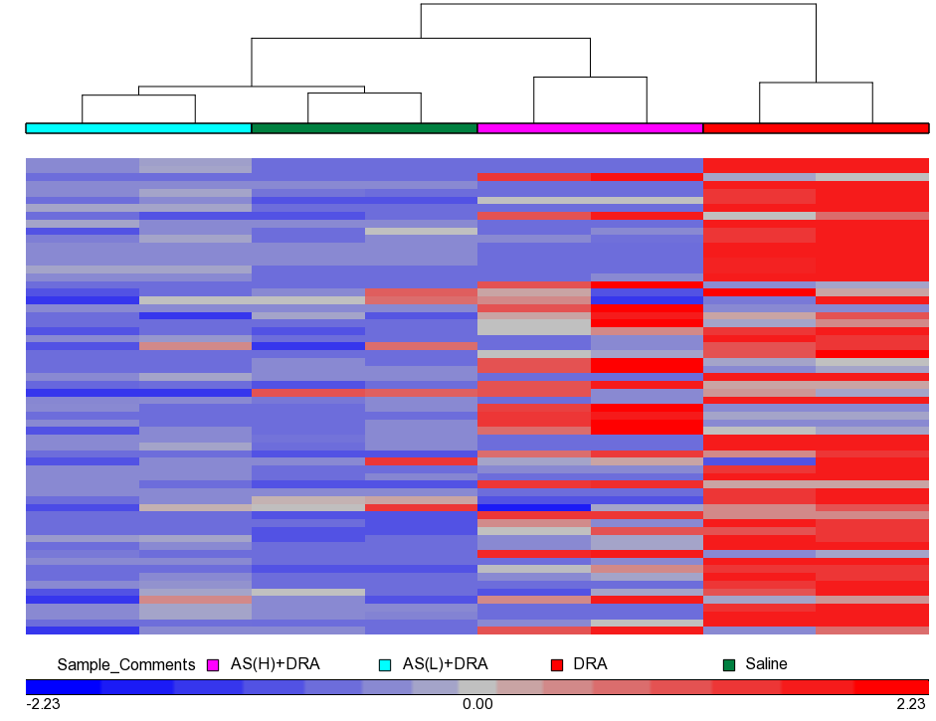
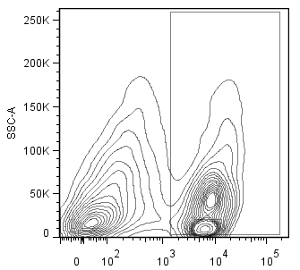
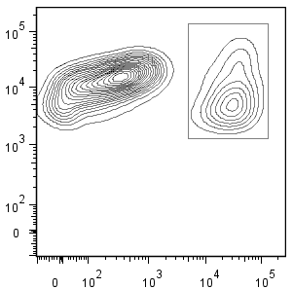
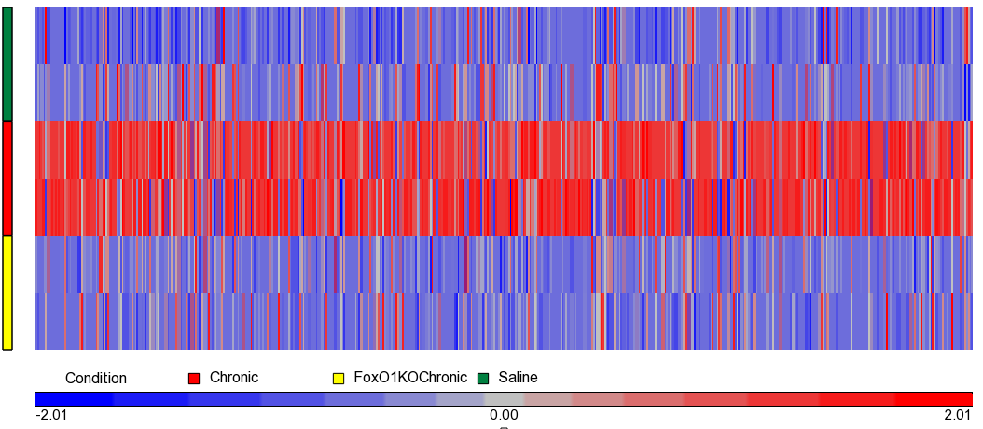
Supple Fig.2
(A)
Gate on FSC/SSC
Gated on Siglec F⁺ cells
(B)
AS1842856+DRA
Saline
DRA
Ccl2
Ccl22
Ccr2
Cd164
Cdkn1a
Csf1
Csf1r
Csf2
Csf2rb
Csf3r
Cxcl1
Fcgr2b
Fcgr3
Fcgrt
Fn1
Icam1
Icam2
Icam4
Icam5
Icos
Ifng
Il10
Il10ra
Il10rb
Il12a
Il12b
Il12rb1
Il13
Il13ra1
Il16
Il17b
Il17ra
Il2
Il27ra
Il5
Il6
Il6ra
Il6st
Irf1
Irf3
Irf4
Irf5
Irf7
Irf8
Marco
Nos2
Socs1
Socs3
Stat1
Stat2
Stat3
Stat4
Stat5a
Stat5b
Stat6
Tgfb1
Tgfb2
Tgfb3
Tgfbi
Tgfbr1
Tgfbr2
Vcam1
Siglec F
CD11b
Gate on CD45⁺ cells
Siglec F
AM
CD45
CD11c
high
low

Slide 3
(C)
Th2/M2-associated genes
Normalized counts
Profibrotic genes
Normalized counts

Slide 4





Supple Fig.3
(A)
Il4
Il5
Il13
IRF4
Arg1
Ccl17
Ccl22
mRNA
(relative expression)
mRNA
(relative expression)
mRNA
(relative expression)
mRNA
(relative expression)
mRNA
(relative expression)
mRNA
(relative expression)
mRNA
(relative expression)
*
**
**
*
**
**
█ FoxO1^{fl/fl} █ FoxO1^{fl/fl}LysMcre
(B)
(D)
DRA
Acute
FoxO1^{fl/fl} FoxO1^{fl/fl} FoxO1^{fl/fl}LysMcre
*
Chronic
IRF4
*
Total IgE (ng/ml)
IRF4/actin (AU)
Arg1/actin (AU)
Arg1
Actin
█ FoxO1^{fl/fl} █ FoxO1^{fl/fl}LysMcre
█ FoxO1^{fl/fl} █ FoxO1^{fl/fl}LysMcre
(C)
DRA
FoxO1^{fl/fl} FoxO1^{fl/fl} FoxO1^{fl/fl}LysMcre
Cells (x10⁵)
IRF4
IRF4/actin (AU)
Arg1/actin (AU)
*
Actin
**
Arg1
█ FoxO1^{fl/fl} █ FoxO1^{fl/fl}LysMcre

Slide 5
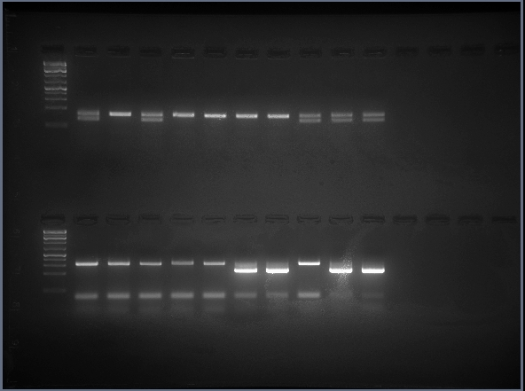
Supple Fig.4
(A)
(B)
■ w/o 4-OHT
■ w/ 4-OHT
FoxO1^{fl/fl}
FoxO1^{fl/fl}
FoxO1^{fl/fl}Csf1r
FoxO1^{fl/fl}Csf1r
145
← FoxO1^{flox}
mRNA-BMDMs
***
236
← Csf1r cre^{Tg}
Genotyping
(C)
***
***
***
#
##
Arg1 mRNA-BMDMs
IRF4 mRNA-BMDMs
Fizz1 mRNA-BMDMs
###

Slide 6


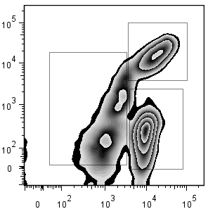
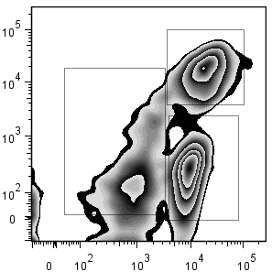

(D)
Tamoxifen - +
(E)
DRA (I.N.)
fl/fl fl/fl
DRA (I.P.)
Sac
(F)
Cre + +
D0-D4
D6
D11
D18-D20
D25-D27
D28
FoxO1
Tamoxifen
Actin
Csf1rFoxO1+Tamoxifen
*
*
WT+Tamoxifen
IL-5 (pg/ml/mg protein)
IL-13 (pg/ml/mg protein)
CD11c
Eos 60.5%
Eos 48.9%
Siglec F
(G)
Il5
Il13
Ccl17
Ccl22
Irf4
Arg1
(H)
DRA + +
mRNA
(relative expression)
Tamoxifen + +
fl/fl fl/fl
*
*
*
Cre - +
IRF4
Arg1
Actin

