Slide 1










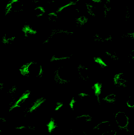
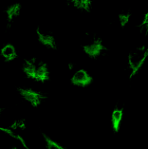
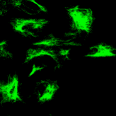
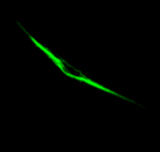
A
A549
ACHN
MCF 10A
E-CADHERIN
WB
ACTIN
VIMENTIN
ACTIN
TGFβ + TNFα
- +
- +
- +
B
A549
ACHN
-
IF VIMENTIN
TGFβ
+ TNFα
C
qRT-PCR MMP9/
GAPDH
1000
**
**
**
TGFβ +TNFα
0
- +
- +
- +
A549
ACHN
MCF 10A
Supp Figure 1

Slide 2


A
B
TGFβ
+TNFα
- +
A549
WB
MMP-9
90
MMP9
ACTIN
MMP2
TGFβ
+TNFα
- +
50
60
Zymography (AU)
*
**
TGFβ
0
- +
- +
+TNFα
MMP2
MMP9
Supp Figure 2

Slide 3
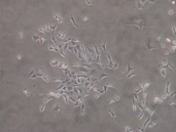
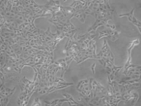
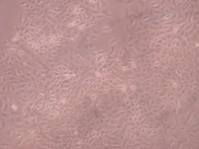
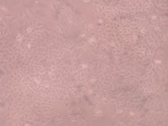

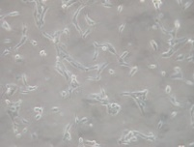
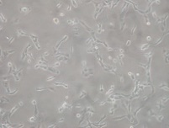
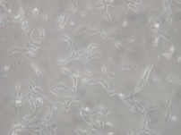
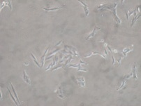
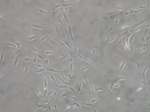
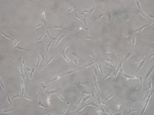
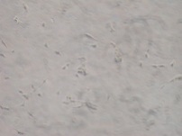
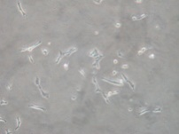
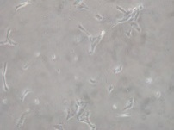
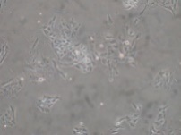
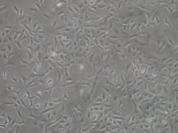
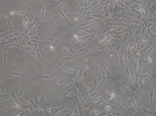
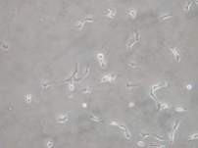
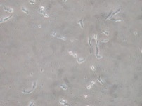
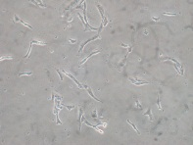
A
A549
B
ACHN
NT
NT
TGFβ
TNFα
TGFβ +TNFα
TGFβ
TNFα
TGFβ +TNFα
d1
d1
d3
d3
d5
d5
C
D
10
A549
10
ACHN
VIMENTIN
VIMENTIN
***
*
*
*
*
*
0
0
8
ZEB1
8
ZEB1
*
*
*
*
**
mRNA / GAPDH
**
*
mRNA / GAPDH
*
*
0
0
100
MMP9
100
MMP9
*
*
*
0
-
d1
d3
d5
d1
d3
d5
0
-
d1
d3
d5
d1
d3
d5
TNFα
TGFβ
TNFα
TGFβ
Supp Figure 3
Supp Figure 2

Slide 4
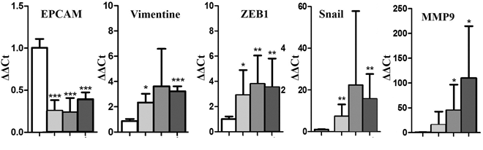
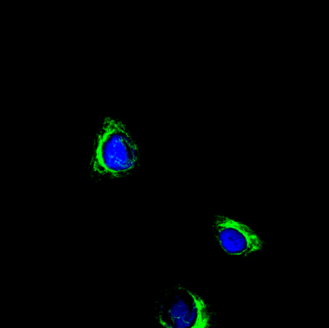
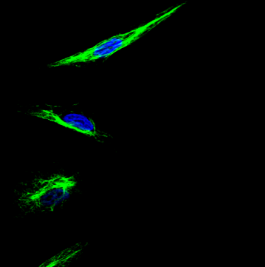
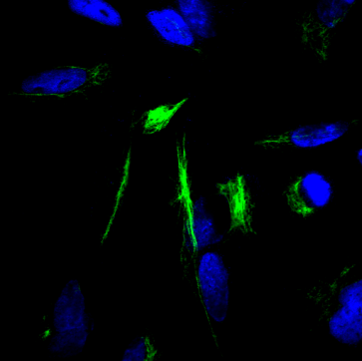
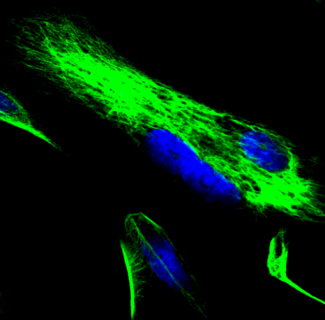
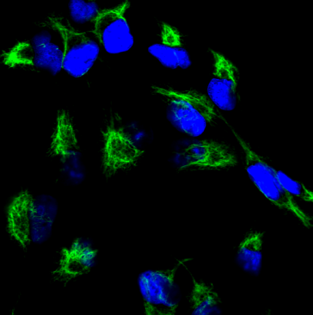
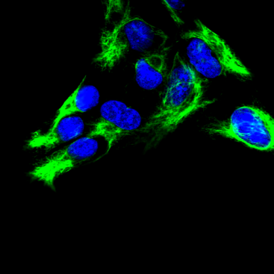
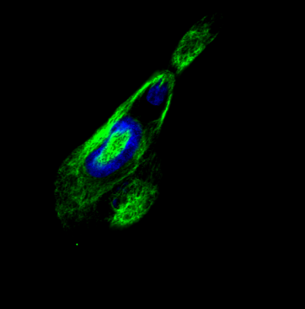
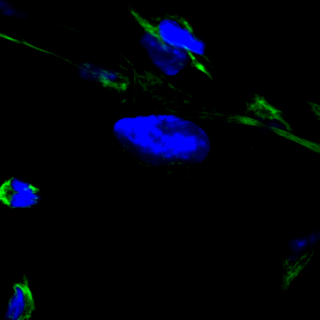
A
EPCAM
VIM
ZEB-1
SNAI1
MMP9
NT
d1 d3 d5
d1 d3 d5
d1 d3 d5
NT
NT
NT
NT
d1 d3 d5
d1 d3 d5
TGFβ +TNFα
TGFβ +TNFα
TGFβ +TNFα
TGFβ +TNFα
TGFβ +TNFα
B
TGFβ + TNFα
NT
d1
d3
d5
A549
IF VIM
ACHN
Supp Figure 4

Slide 5
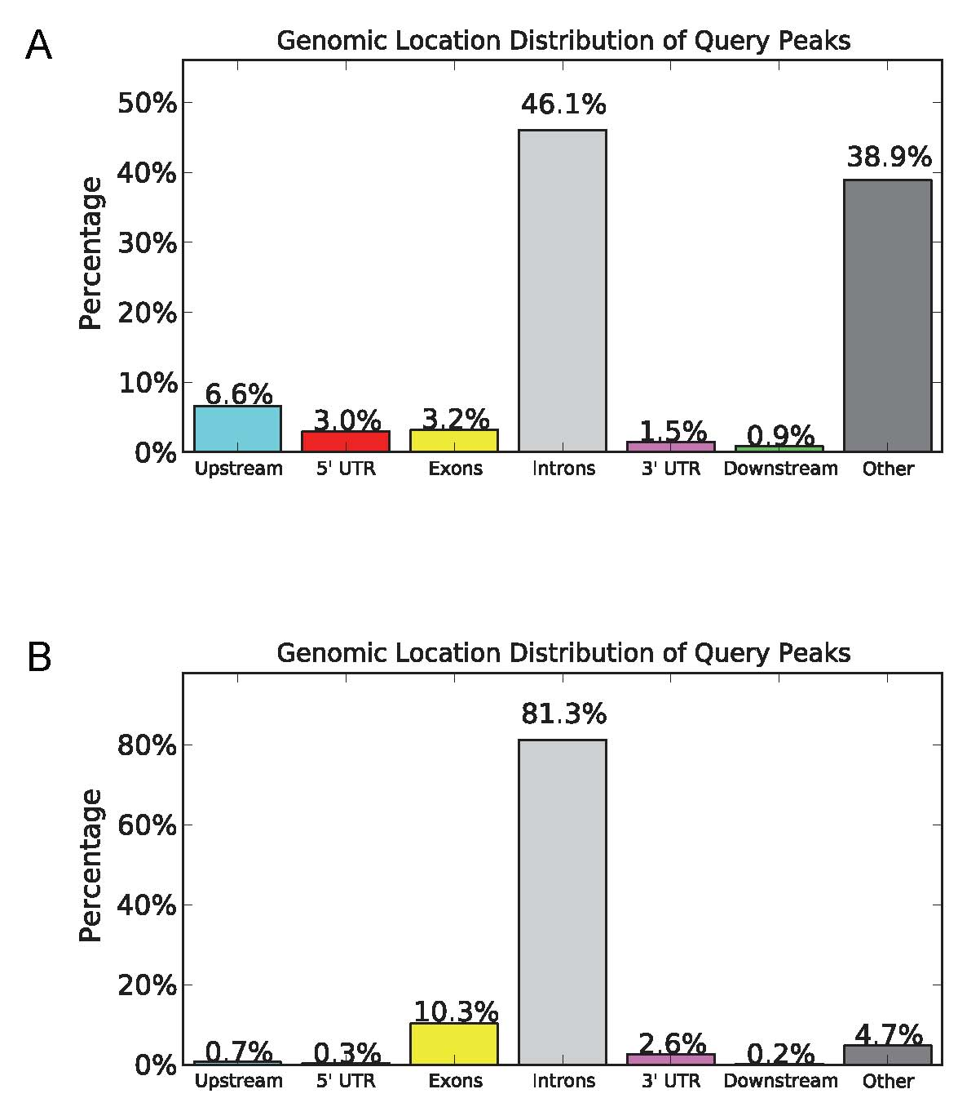
A
50
40
%
30
20
10
0
B
80
60
%
40
20
0
Supp Figure 5

Slide 6
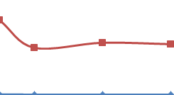
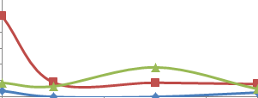
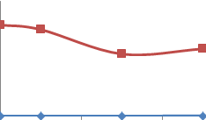
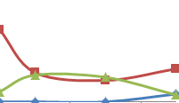
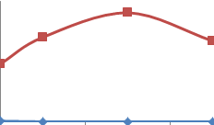
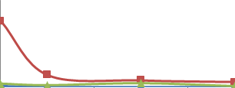
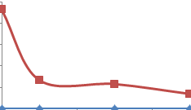
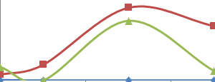
A
B
ACHN
A549
5
H3K4me2
150
Prom
0
IgG
ADAM19
H3K27me3
0,06
0
H3K9me3
IgG
0
100
2,5
H3K4me2
Prom
0
IgG
ADAMTS6
0,02
H3K27me3
H3K9me3
0
0
IgG
% Input (Fold Enrichment)
mRNA/GAPDH
2
H3K4me2
250
IgG
*
Prom
0
MMP9
*
H3K27me3
0,8
H3K9me3
IgG
*
0
0
4
2,5
H3K4me2
Prom
0
IgG
SCNN1A
0,05
H3K27me3
0
H3K9me3
IgG
d1
d3
d5
d1
d3
d5
0
0
d1
d3
d5
NT
TGFβ +TNFα
TGFβ +TNFα
Supp Figure 6

Slide 7
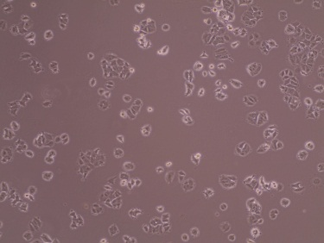
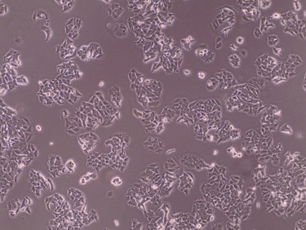
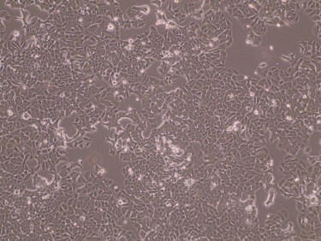
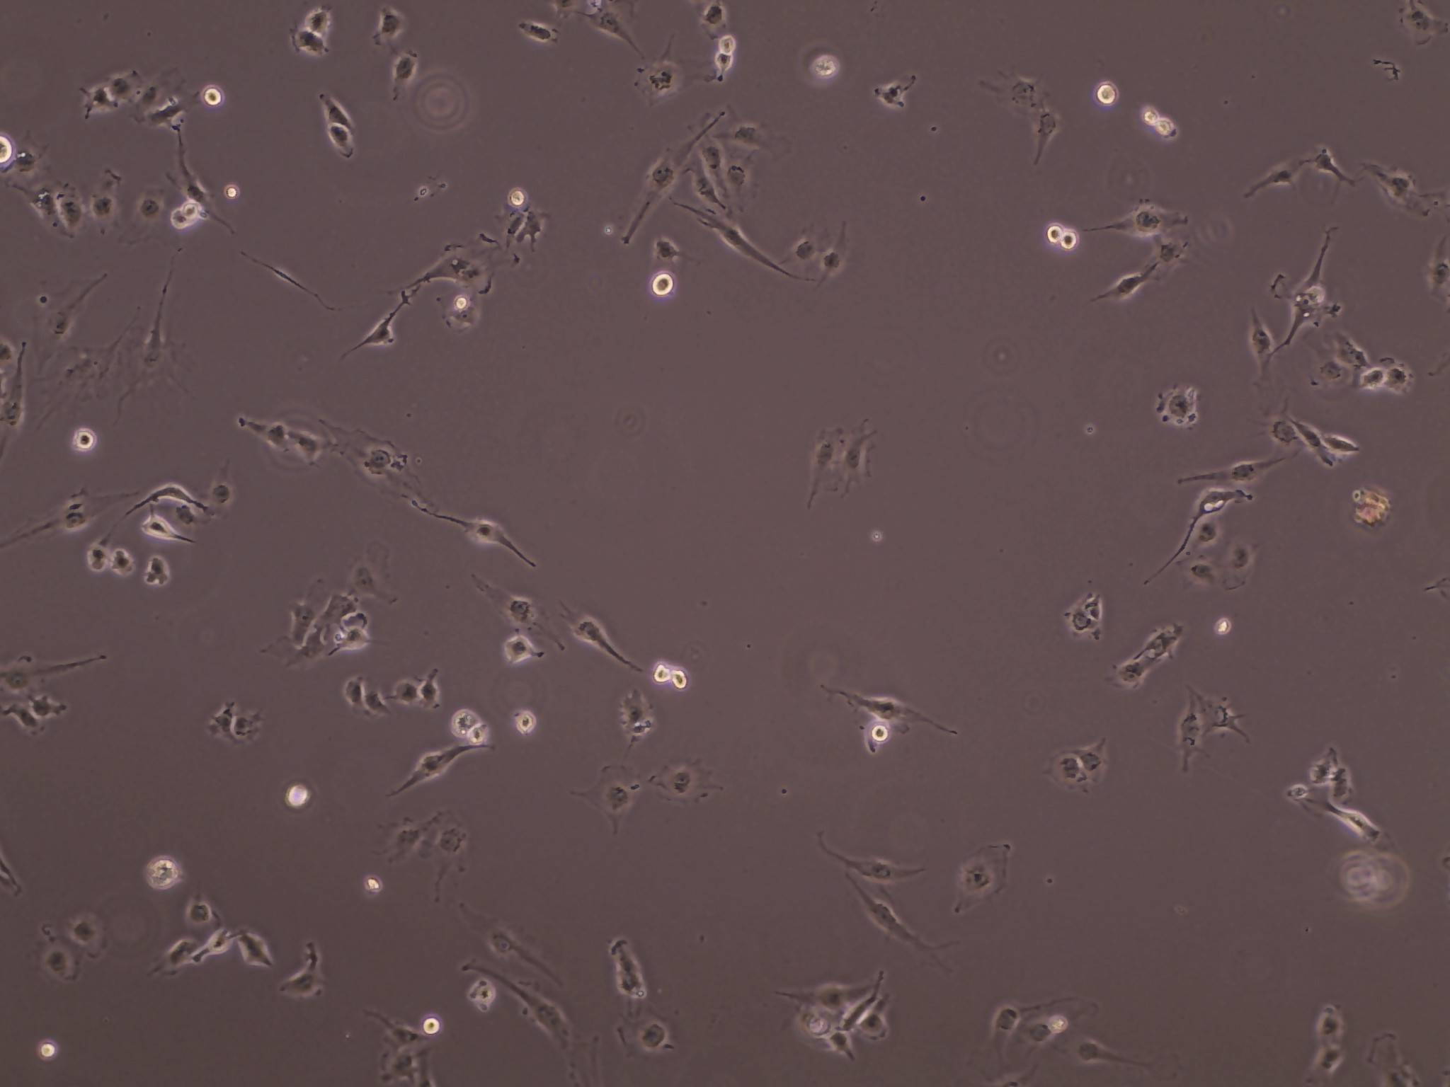
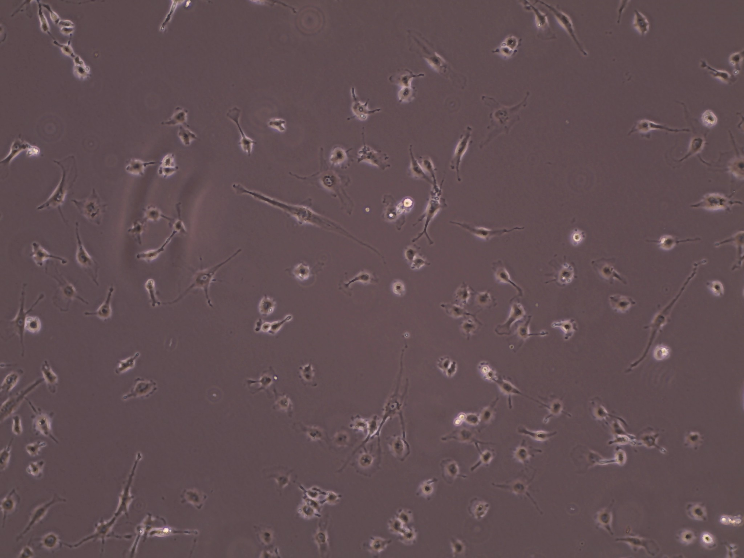
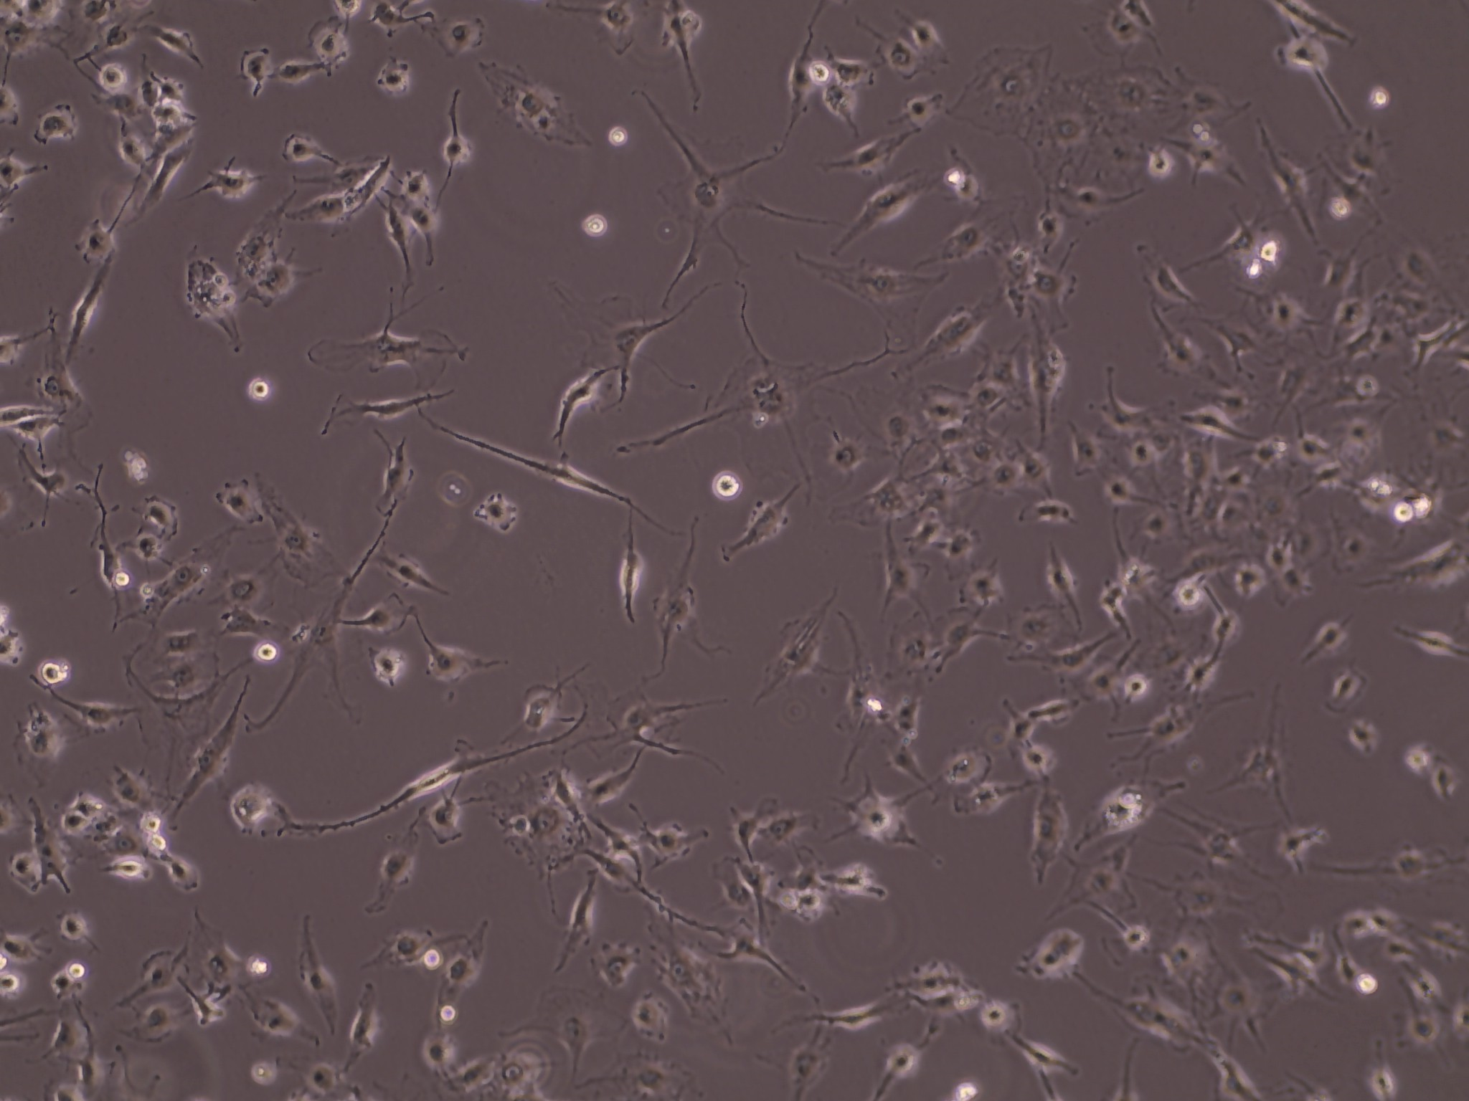
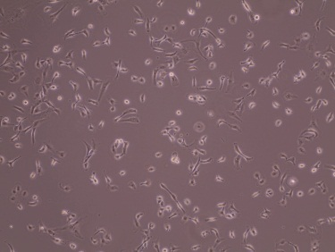
A
-
TGFβ +TNFα d3
TGFβ +TNFα d5
MCF-7
MDA-MB-157
MDA-MB-231
B
2
MMP9
MMP9/GAPDH
mRNA
0
1.5
ADAM19
ADAM19/GAPDH
mRNA
0
TGFβ/TNFα
-
- +
- +
MDA-MB-231
MCF7
MDA-MB-157
Supp Figure 7

Slide 8
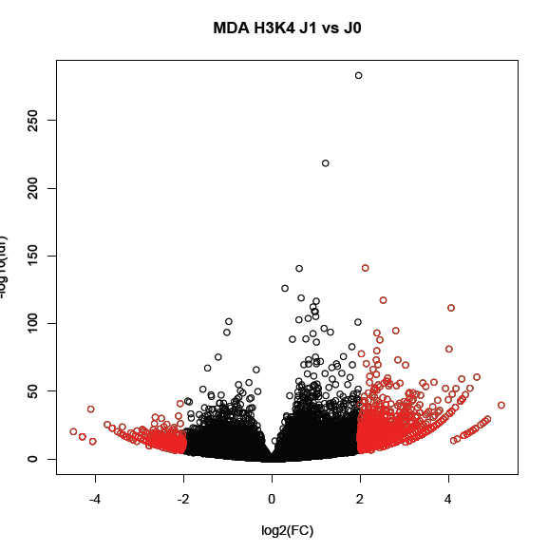
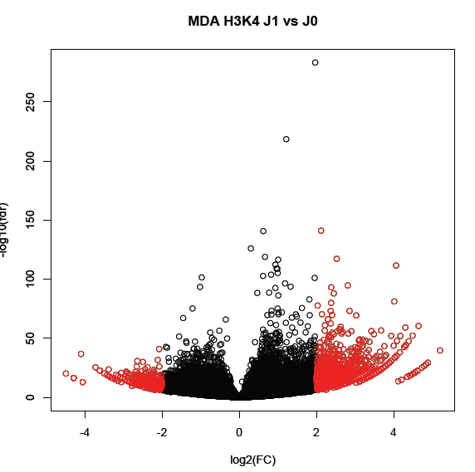

MDA-MB-468 H3K4me2 EMT (d1) vs NT
MDA-MB-468 H3K4me2 EMT (d2) vs NT
A
B
C
EGF MDA-MB-468
H3K4me2 vs NT d1
EGF MDA-MB-468
H3K4me2 vs NT d2
780
909
1722
100
150
241
5148
TGFβ/TNFα A549
H3K4me2 vs NT d5
D
TGFβ/TNFα A549
upregulated
Intersection
EGF MDA-MB-468
H3K4me2 vs NT
TGFβ/TNFα A549
H3K4me2 vs NT
TGFβ/TNFα ACHN
upregulated
TGFβ/TNFα MCF 10A
upregulated
Supp Figure 8

Slide 9
A
B
Non parametric test
15
MMP9
5
Pearson r
0.4521
**
**
mRNA/GAPDH
ADAM19/GAPDH
mRNA
0
ER+PR+HER-
TNBC
0
0
VIM/GAPDH mRNA
5
5
ADAM19
60
Pearson r
0.6863
**
***
mRNA/GAPDH
MMP9/GAPDH
mRNA
0
0
VIM/GAPDH mRNA
5
ER+PR+HER-
TNBC
6
SCNN1A
6
Pearson r
****
mRNA/GAPDH
SCNN1A/GAPDH
mRNA
0
ER+PR+HER-
TNBC
0
0
VIM/GAPDH mRNA
5
Supp Figure 9

Slide 10





Lung cancer
http://kmplot.com/analysis/
ADAM19
MMP9
ADAMTS6
MMP10
SCNN1A
Supp Figure 10

