Slide 1
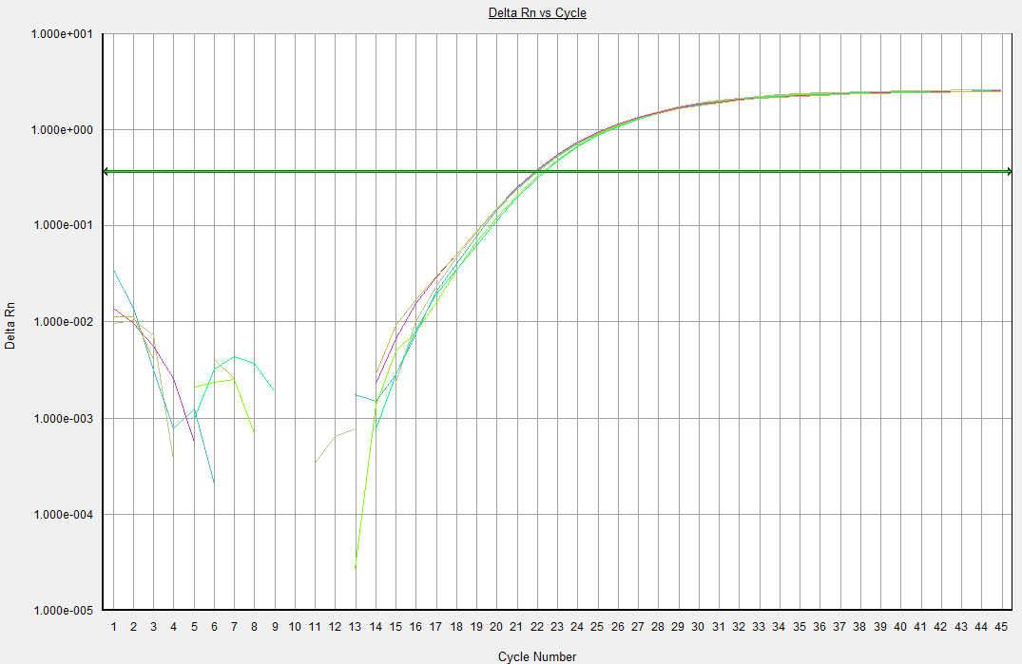
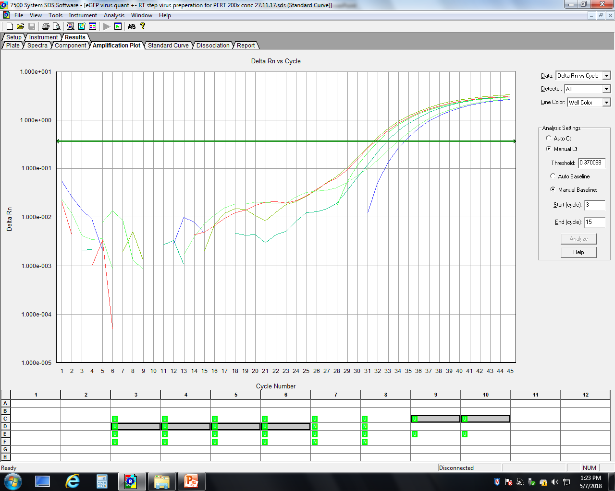
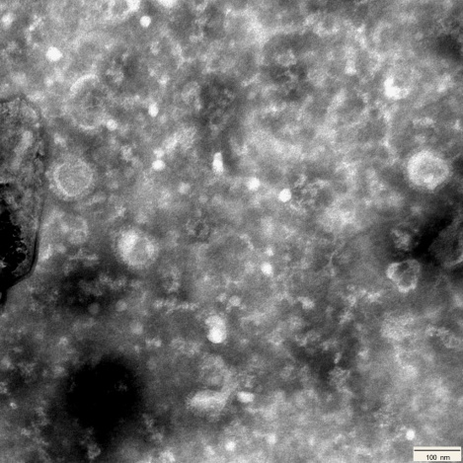
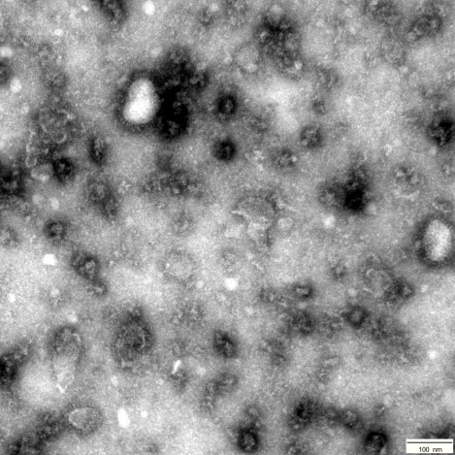
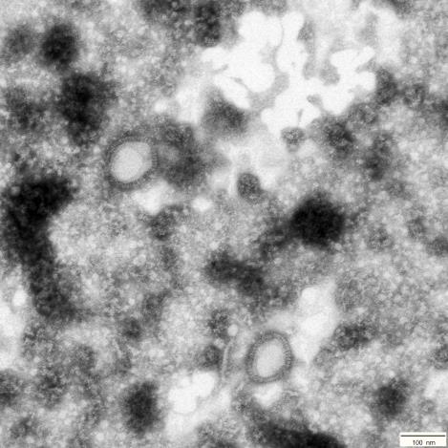
A
RT step included
RT step omitted
ΔRn
B
Cycle number
C
n.s.
HIV-1
MMTV WT
MMTV F120L
n.s.
n.s.
S3 Fig

