Slide 1
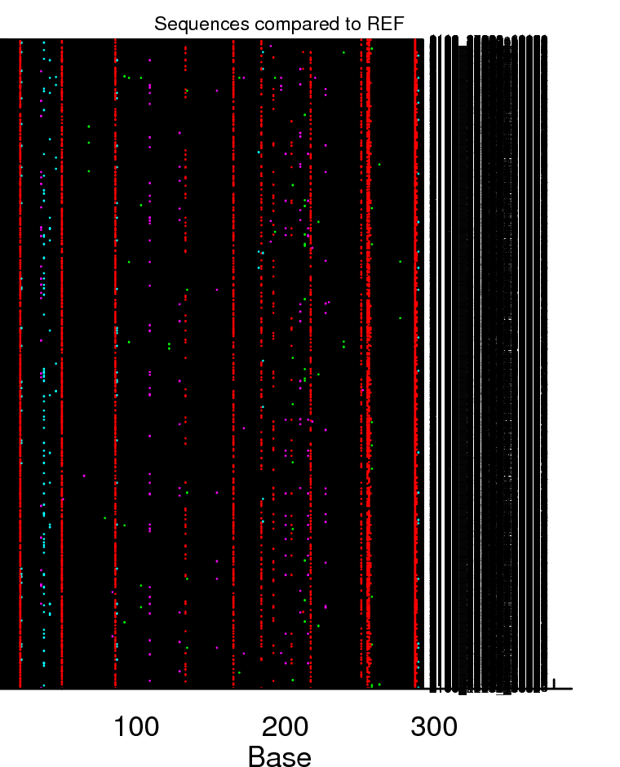
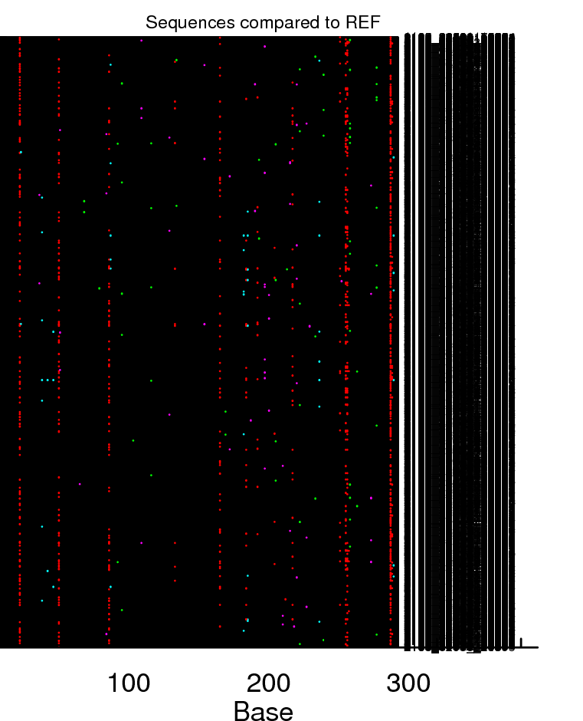
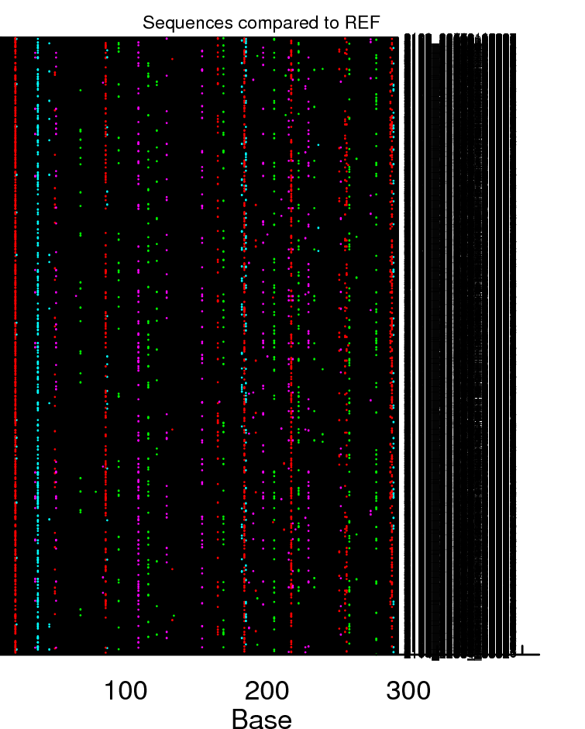
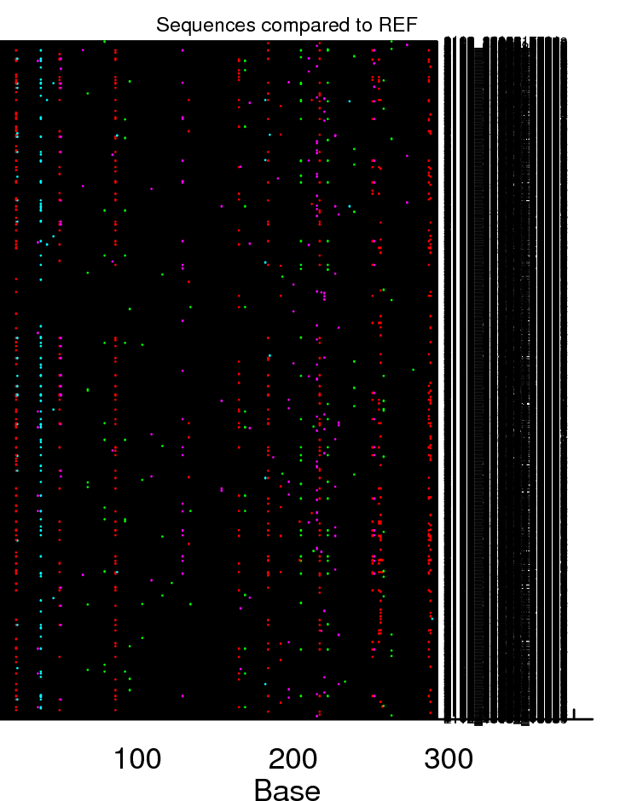
GG→AG
GA→AA
GT→AG
GC→AC
F120L
A3G
WT
n=2500
n=2500
0
0
number mutations/ sequence | 0-5 | 6-10 | >10
% sequences | 88 | 10 | 2
number mutations/ sequence | 0-5 | 6-10 | >10
% sequences | 99.2 | 0.8 | 0
F120L
mA3
n=2215
n=2500
WT
0
0
number mutations/ sequence | 0-5 | 6-10 | >10
% sequences | 98 | 1.4 | 0.5
number mutations/ sequence | 0-5 | 6-10 | >10
% sequences | 97 | 2.6 | 0.4
S5 Fig

