Slide 1

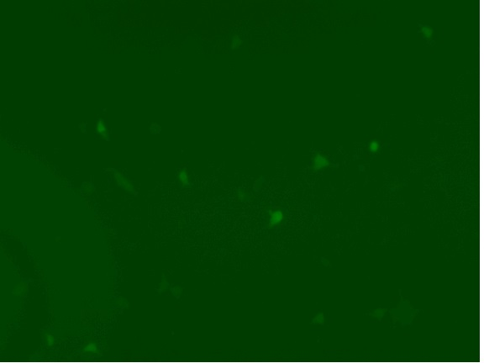
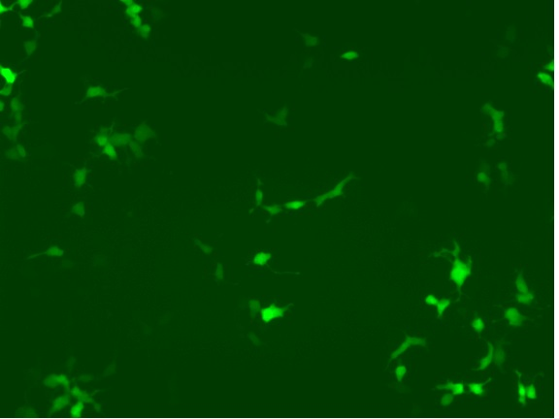
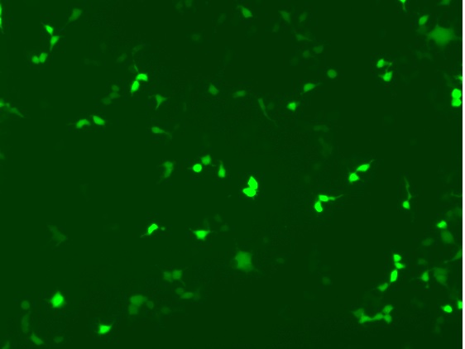
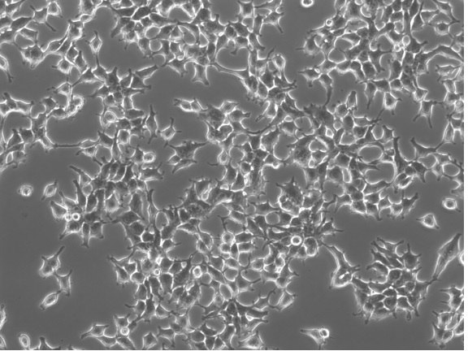
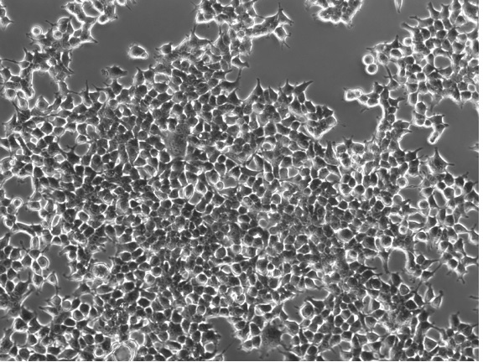
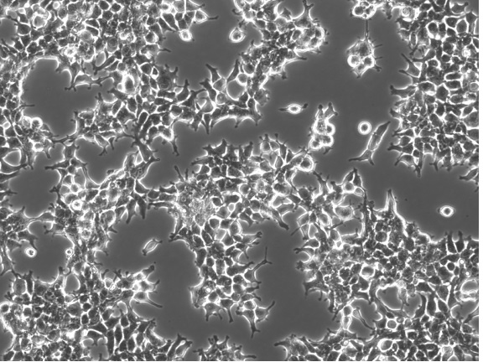
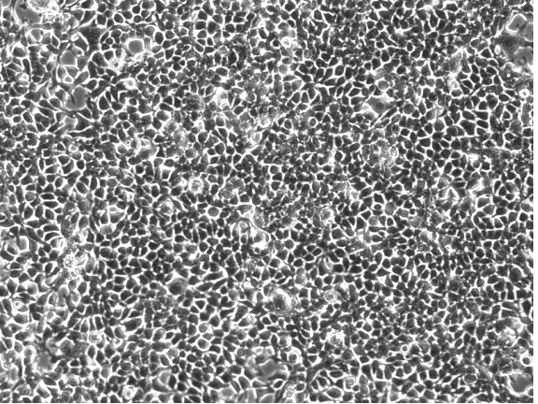
A
ZEN
FAM
primer
IBFQ
probe
A A T A A A T A A A
5‘
template
dA
3‘
ZEN
FAM
T T T
IBFQ
probe
A A T A A A T A A A
ZEN
FAM
IBFQ
probe
T T A T T T A T T T
A A T A A A T A A A
dATP
B
24 h HU (20 hpi)
48 hpi
HU 0.2 mM
HU 0 mM
HU 0.2 mM
HU 0 mM
eGFP
phase
contrast
S6 Fig

