Slide 1
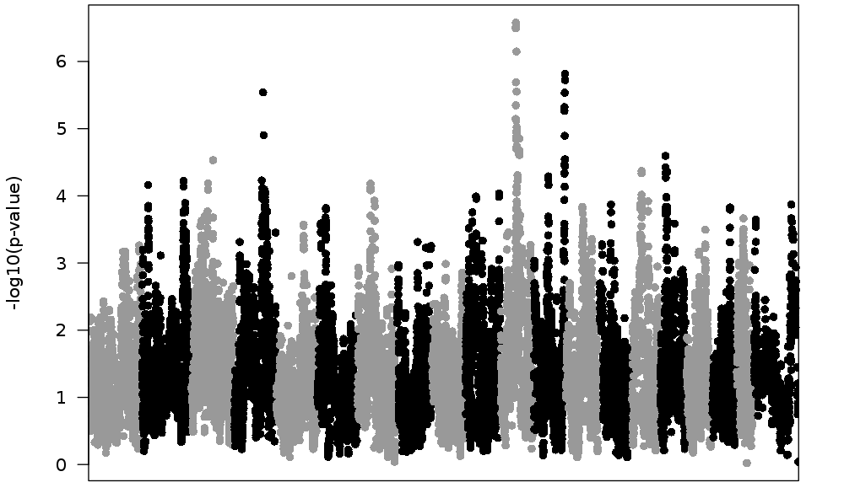
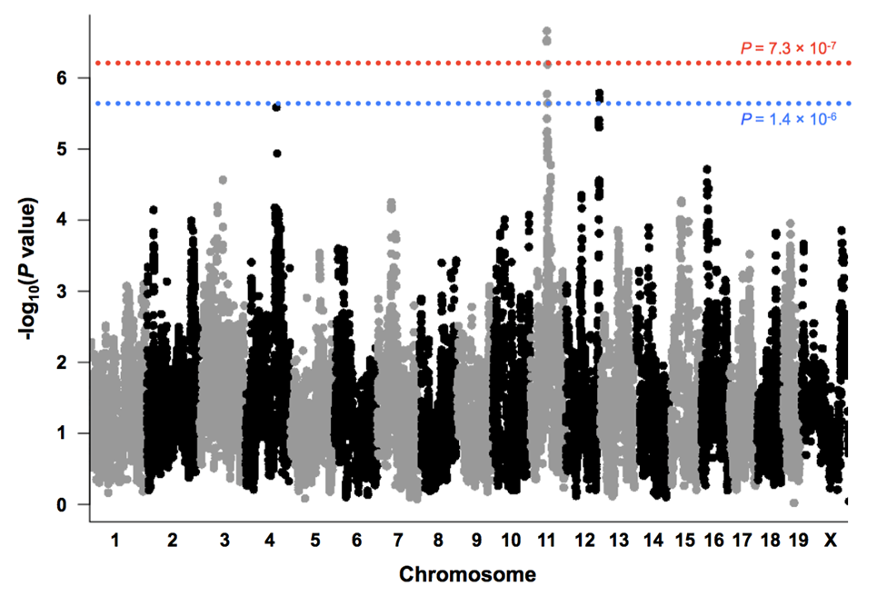
P = 7.3 × 10⁻⁷
P = 1.4 × 10⁻⁶
Notes:
Figure S1. Genome-wide association mapping of testis weight without covariates. Each point plots the –log10(P- value) for the association between one SNP and testis weight. Values were plotted against their respective positions on the chromosomes. The dashed red and blue lines represent the genome-wide significant (p < 0.05) and genome-wide suggestive (p < 0.1) thresholds, respectively.

Slide 2
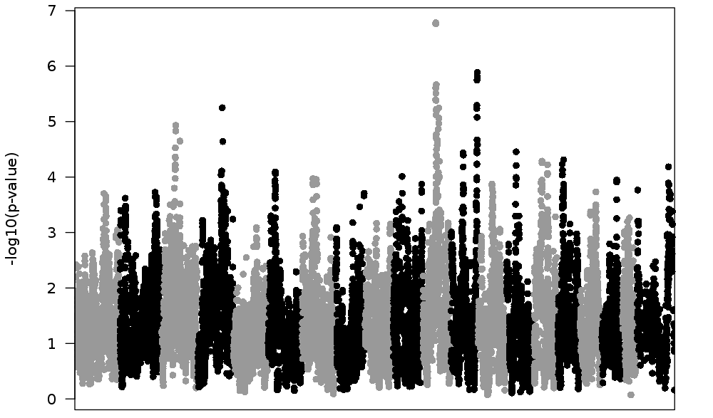
P = 7.3 × 10⁻⁷
P = 1.4 × 10⁻⁶
Notes:
Figure S2. Genome-wide association mapping of testis weight with Age and Generation as covariates. Each point plots the –log10(P- value) for the association between one SNP and testis weight. Values were plotted against their respective positions on the chromosomes. The dashed red and blue lines represent the genome-wide significant (p < 0.05) and genome-wide suggestive (p < 0.1) thresholds, respectively.

Slide 3
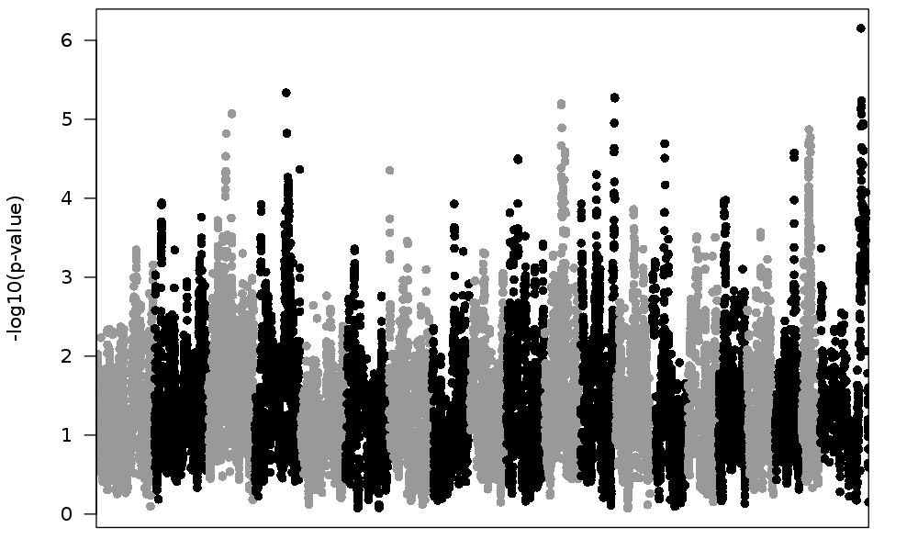
P = 7.3 × 10⁻⁷
P = 1.4 × 10⁻⁶
Notes:
Figure S3. Genome-wide association mapping of testis weight with Age and rankZ transformed Weight and Generation as covariates. Each point plots the –log10(P- value) for the association between one SNP and testis weight. Values were plotted against their respective positions on the chromosomes. The dashed red and blue lines represent the genome-wide significant (p < 0.05) and genome-wide suggestive (p < 0.1) thresholds, respectively.

Slide 4
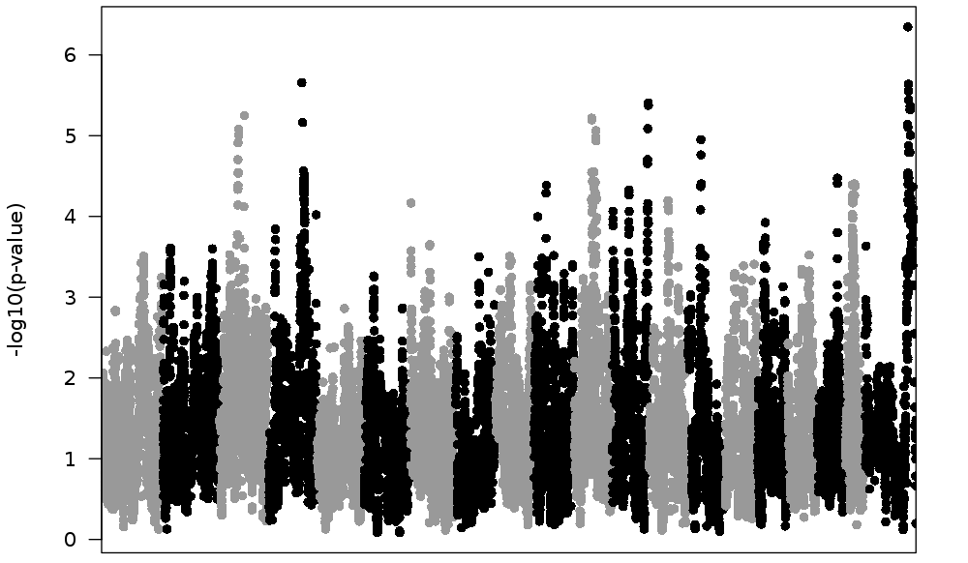
P = 7.3 × 10⁻⁷
P = 1.4 × 10⁻⁶
Notes:
Figure S4. Genome-wide association mapping of testis weight with rankZ transformed Weight and Generation as covariates. Each point plots the –log10(P- value) for the association between one SNP and testis weight. Values were plotted against their respective positions on the chromosomes. The dashed red and blue lines represent the genome-wide significant (p < 0.05) and genome-wide suggestive (p < 0.1) thresholds, respectively.

Slide 5
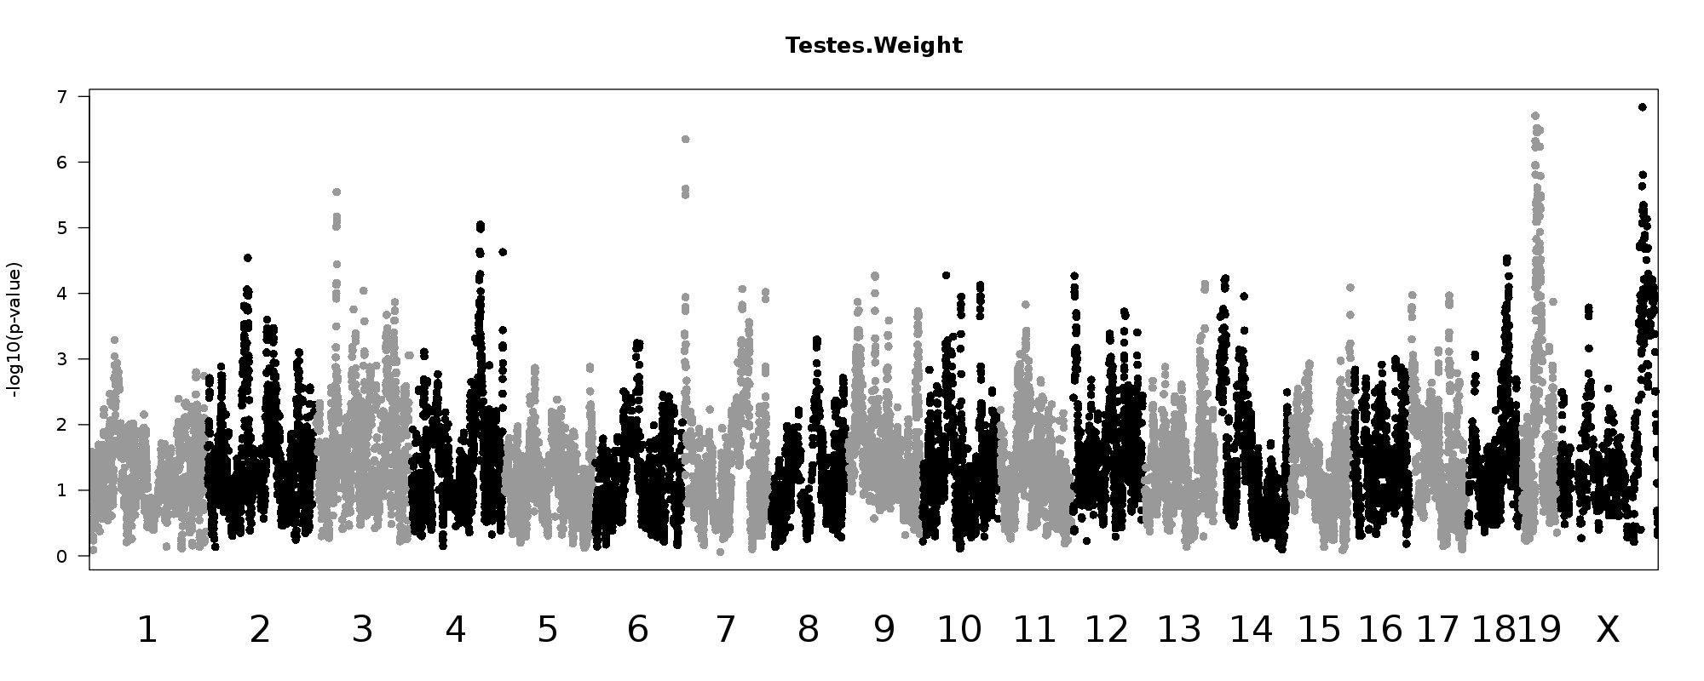
P = 7.3 × 10⁻⁷
P = 1.4 × 10⁻⁶
Notes:
Figure S5. Genome-wide association mapping of testis weight with rankZ transformed ratio of testes weight to body weight. Each point plots the –log10(P- value) for the association between one SNP and testis weight. Values were plotted against their respective positions on the chromosomes. The dashed red and blue lines represent the genome-wide significant (p < 0.05) and genome-wide suggestive (p < 0.1) thresholds, respectively.

