Slide 1
Supplementary Figures – P. Rajendran et al.,
Figure S1. CCAR2 acetylation in SW480 colon cancer cells treated with SFN and other deacetylase inhibitors. Following incubation with the test agents for 6 h, as described in HCT116 cells (Fig. 1A), cell lysates were subjected to IP with Ac-Lys antibody and then IB for targets of interest.
Figure S2. CCAR2 acetylation in SW480 cells after HDAC3 knockdown. SW480 cells were treated with Negative control siRNA or HDAC3 siRNA(3), and cell lysates were subjected to Ac-Lys IP followed by IB, as indicated.
Figure S3. Amino acid sequence of CCAR2, and peptide maps of novel acetylation sites conserved among human, rat, and mouse, from protein mass spectrometry studies in SFN-treated colon cancer cells.
Figure S4. A, CCAR2 acetylation mutants were less effective than WT CCAR2 at increasing MMP7 expression. WT CCAR2 (red) or the acetylation mutants K54R, K97R, or K54R/K97R (gray) were transiently transfected into CCAR2 null HCT116 cells for 24 h followed by detection of MMP7 by RT-qPCR. B, WT CCAR2 or the K54R acetylation mutant was transiently transfected into CCAR2 null HCT116 cells, followed by treatment with SFN or vehicle (DMSO) for 24 h. MMP7 expression was determined by RT-qPCR (*P<0.05, mean±SD, n=3).
Figure S5. Working model that integrates HDAC3 inhibition/turnover by SFN, increased CCAR2 acetylation, displacement of CCAR2 from β-catenin, and reduced Wnt/β-catenin gene activation.
Figure S6. A, IB of HA-tagged CCAR2 in HCT116 colon cancer cells containing stably transfected HA-K54-TAG or HA-K97-TAG. Upon addition of Ac-Lys, a band was detected for CCAR2-K54, implicating inducible acetylation at the Lys 54 target site (right lane), whereas no such band was detected for CCAR2-K97 (blue box). B, Dendra2 expression (green dots) in HA-K97-TAG-containing HCT116 cells treated with Ac-Lys, indicating that the requisite components of the assay were functioning according to the reported methodology (22).

Slide 2
Supplementary Figures – P. Rajendran et al.,
Figure S7. Docking studies in silico. A, BRD2; B, BRD3; C, BRD4; and D, BRD9 were predicted to interact favorably with CCAR2K916ac peptide (in green) compared with acetylated histone H4K16 (in orange). Docking scores (kcal/mol) were assessed as outlined in Methods. E-G, CCAR2K916ac peptide in relation to H4K16ac and JQ1 binding to BRD2, BRD3, and BRD4, respectively.
Figure S8. A, Combination index (CI) data for JQ1+SAHA and JQ1+6-SFN in HCT116 human colon cancer cells, determined using CompuSyn software (CompuSyn, Inc.). For the corresponding data on JQ1+SFN, refer to Fig. 4C. B, HCT116 cells were treated with test agents, and 24 h later cell lysates were subjected to IB for PARP, Caspase-3, and β-actin.
Figure S9. CCAR2/β-catenin interactions in human adenomatous colon polyps. IHC was used to stratify archived tissues from a screening colonoscopy trial (12) into ‘CCAR2 high’ and ‘CCAR2 low’ groups, along with the corresponding expression of β-catenin, MMP7, c-Myc and cyclin D1. β-Catenin/CCAR2 interactions in the same tissue sections were detected using PLA in situ (36,37). The images shown are representative findings from five or more separate tissue sections.
Figure S10. The combination of SFN+JQ1 decreases CCAR2 interactions on MYC promoter and superenhancer regions. Primers were designed around Promoter and Superenhancer regions, E1-E4, as illustrated in the figure (top). A, CCAR2 and B, BRD3 interactions on MYC were interrogated using ChIP assays in HCT116 colon cancer cells. Non-specific IgG served as a negative control. Data = mean±SD, and are representative of the findings from two independent experiments; *P<0.05, ***P<0.001, ****P<0.0001.

Slide 3

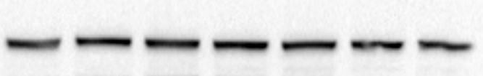

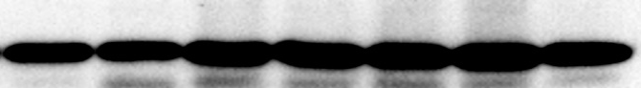


IP: Ac-Lys
Input controls
IB:
CCAR2
Histone H3
14-3-3
CCAR1
DMSO SFN TSA SAHA SAHA NaB VPA DMSO SFN TSA SAHA SAHA NaB VPA (6 h)
(1 µM) (5 µM) (1 µM) (5 µM)
SW480 cells
Fig. S1.

Slide 4


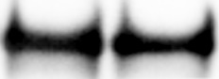

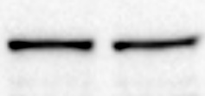
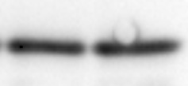
SW480 cells
CCAR2
IP:
Ac-Lys
Histone H3
IgG
HDAC3
Input controls
CCAR2
Histone H3
Negative
siRNA
HDAC3
siRNA(3)
Fig. S2.

Slide 5
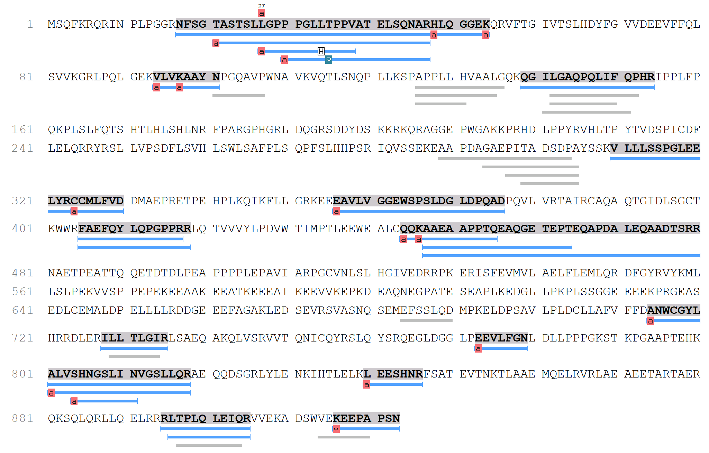
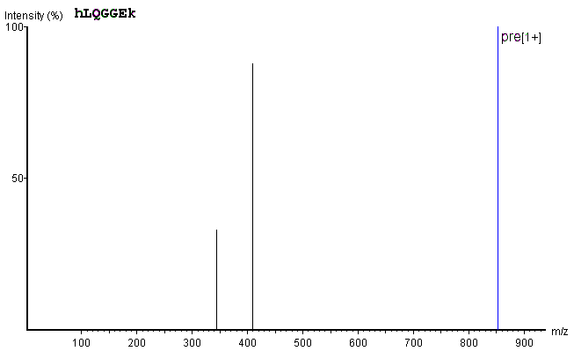
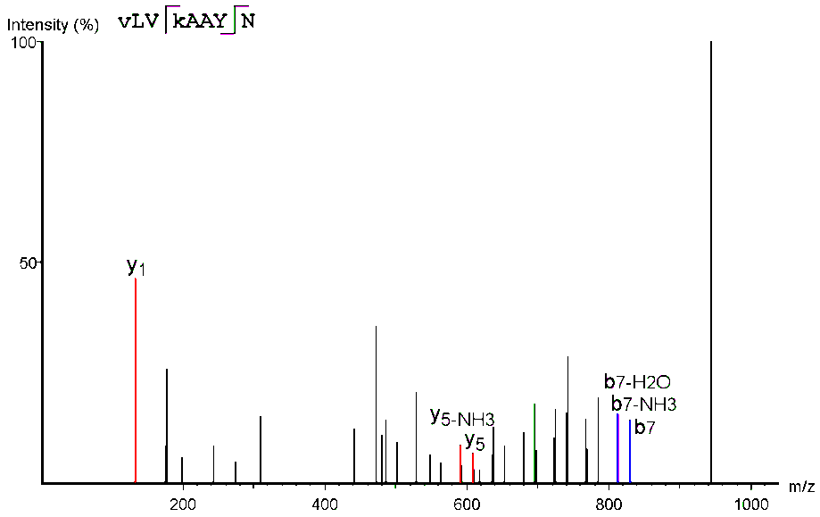
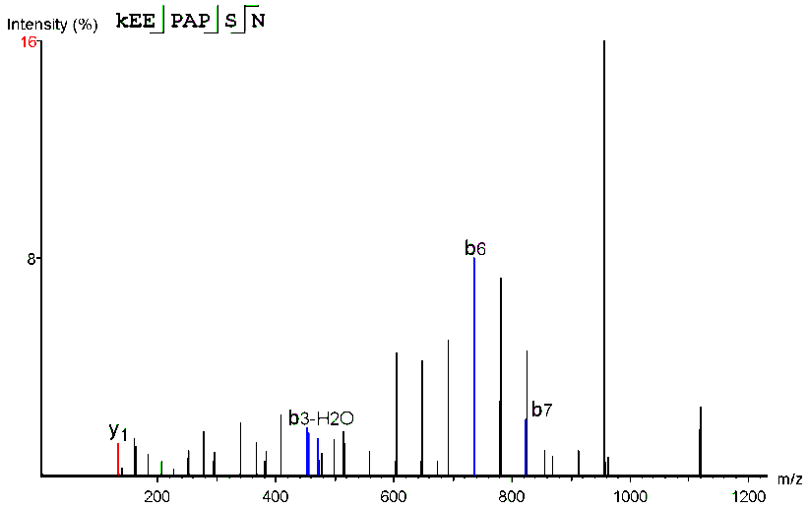
K54
CCAR2 HUMAN HLQGGEK
CCAR2 MOUSE HLQSGEK
CCAR2 RAT HLQSGEK
K97
K54
CCAR2 Human VLVKAAYNP
CCAR2 Mouse VLVKAAYNP
CCAR2 Rat VLVKAAYNP
K97
CCAR2 Human KEEPAPSN
CCAR2 Mouse KEEPTPSN
CCAR2 Rat KEEPTPSN
K916
Acetylation (K), (N-term), (Protein N-term) (+42.01)
Pyrophosphorylation (ST) (+159.93)
K916
L→H
Fig. S3.

Slide 6
A
B
6
6
*
*
4
4
*
2
2
0
0
KO+WT
KO+
K54R
KO+
K97R
KO+
K54R
+K97R
DMSO
SFN
DMSO
SFN
KO+WT
KO+K54R
Fig. S4.

Slide 7
HDAC3
CCAR2
MMP7, CCND1,
MYC, etc.
β-cat
Tcf
SFN
CCAR2
CCAR2 acetylation and displacement from β-cat, loss of co-activator role
Ac
Ac
Ac
β-cat
Tcf
MMP7, CCND1,
MYC, etc.
Reduced activation of Wnt/β-catenin target genes
Fig. S5.

Slide 8
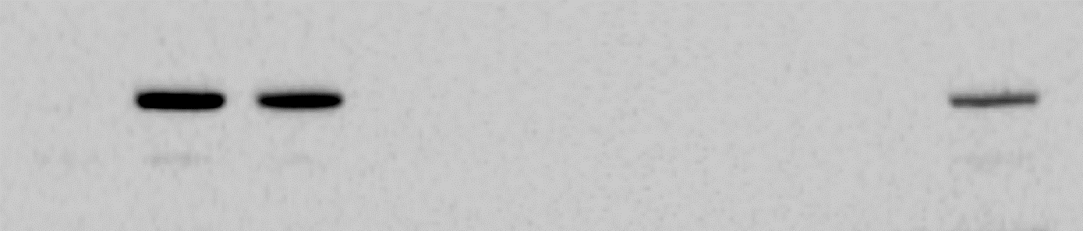

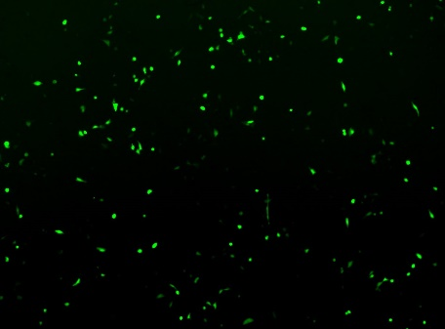
A
HA-CCAR2
HA-Empty
HA-K97-TAG
HA-K54-TAG
- + - + - + - + Ac-Lys (24 h)
HA-Tag (CCAR2)
- Ac-Lys
+Ac-Lys
B
HA-K97-TAG
Fig. S6.

Slide 9
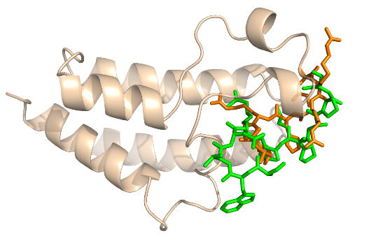
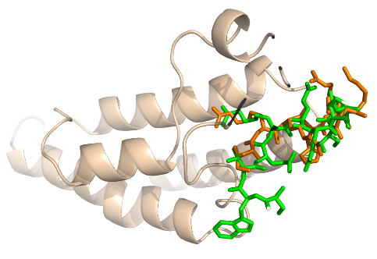
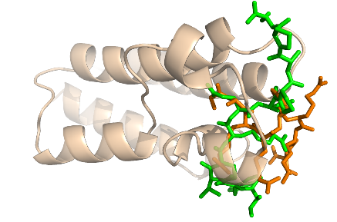
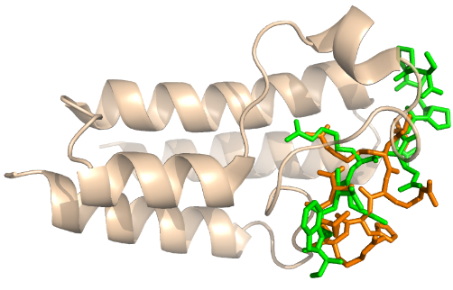
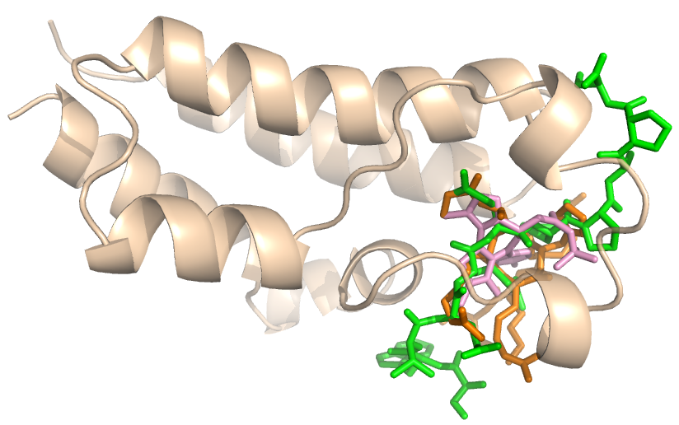
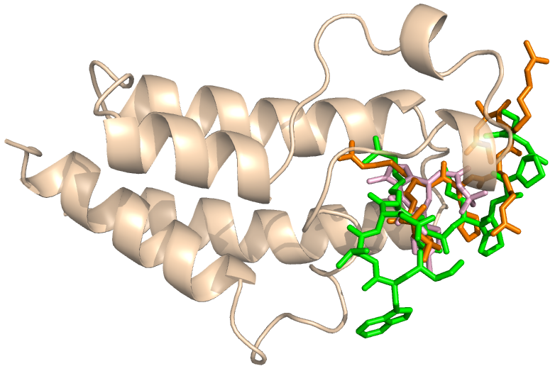
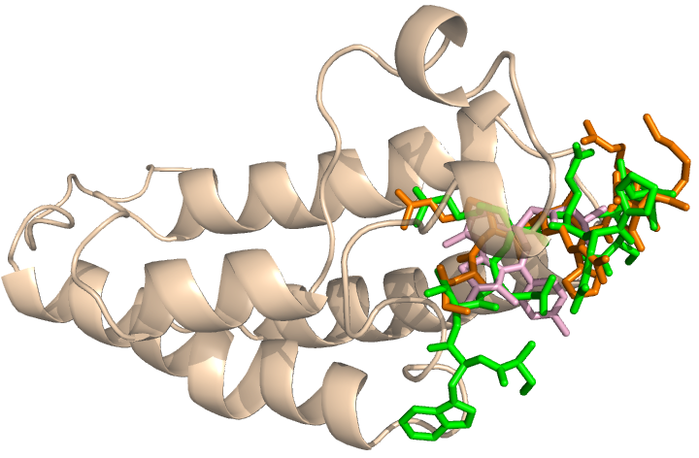
A
B
C
D
BRD2 docking in silico | Affinity, kcal/mol
H4K16ac | –5.0
CCAR2K54ac | –5.2
CCAR2K96ac | –5.5
CCAR2K916ac | –6.6
BRD3 docking in silico | Affinity, kcal/mol
H4K16ac | –5.3
CCAR2K54ac | –5.7
CCAR2K96ac | –5.9
CCAR2K916ac | –6.1
BRD4 docking in silico | Affinity, kcal/mol
H4K16ac | –4.8
CCAR2K54ac | –4.7
CCAR2K96ac | –5.2
CCAR2K916ac | –5.9
BRD9 docking in silico | Affinity, kcal/mol
H4K16ac | –5.1
CCAR2K54ac | –5.0
CCAR2K96ac | –5.2
CCAR2K916ac | –6.1
E
F
G
BRD2
BRD3
H4K16ac
BRD4
H4K16ac
JQ1
JQ1
JQ1
CCAR2K916ac
H4K16ac
CCAR2K916ac
CCAR2K916ac
Fig. S7.

Slide 10
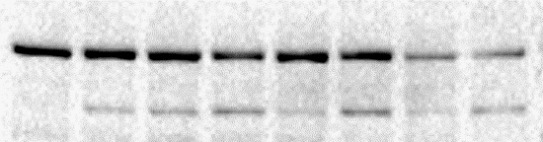

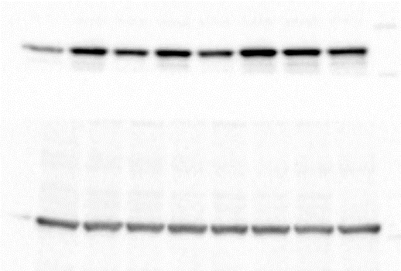
A
B
2
PARP
cleaved
JQ1+SAHA
JQ1+6-SFN
Additive
Additive
Caspase-3
cleaved
1
Combination index
Synergistic (CI=0.13)
Synergistic (CI=0.33)
β-actin
0
0
0.5
1
0.5
1
JQ1
SFN
DMSO
6-SFN
SFN+JQ1
Fraction affected
6-SFN+JQ1
Fig. S8.

Slide 11
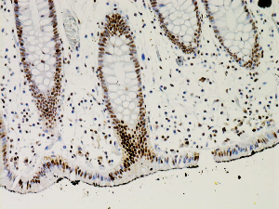
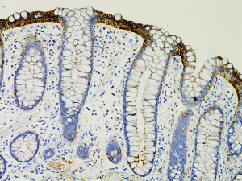
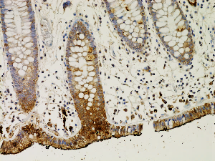
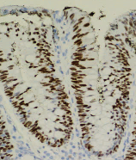
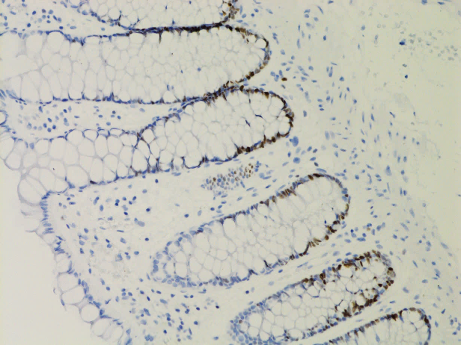
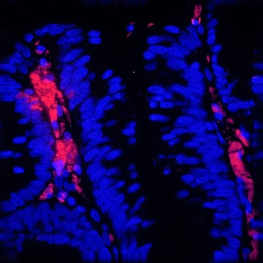
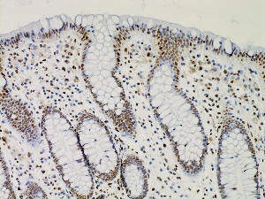
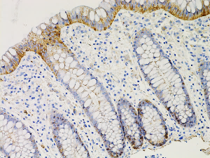
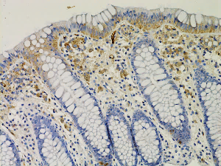
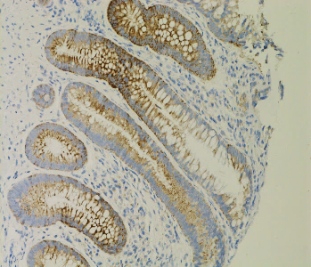
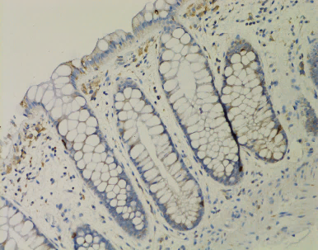
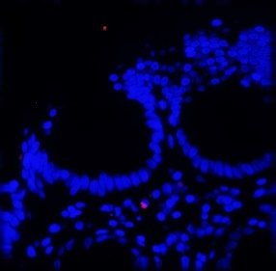
CCAR2
β-catenin
MMP7
c-Myc
Cyclin D1
β-catenin/CCAR2
CCAR2 high
CCAR2 low
Adenomatous colon polyps (IHC)
PLA in situ
Fig. S9.

Slide 12
Super Enhancer
Promoter
MYC
-520 kb
E1 E2 E3 E4
A
*
*
*
*
*
*
*
*
*
*
*
*
*
*
*
*
*
*
*
*
*
*
*
*
*
*
*
*
*
*
*
*
*
*
*
ChIP signal relative to input (HCT116 cells)
B
*
*
*
Fig. S10.

