Slide 1




Diagnostic Performance of an Artificial Intelligence Driven Cardiac Structured Reporting System for Myocardial Perfusion SPECT Imaging
Journal of Nuclear Cardiology | Official Journal of the American Society of Nuclear Cardiology
Ernest V Garcia, PhD ¹, J Larry Klein, MD ², Valeria Moncayo, MD¹ , C David Cooke, MSEE ^{1,3}, Christian Del’Aune ³, Russell Folks, CNMT ¹ , Liudmila Verdes Moreiras MSN¹ , Fabio Esteves, MD¹
¹Department of Radiology and Imaging Sciences, Emory University, Atlanta, GA, USA, ²Department of Medicine, Division of Cardiology, UNC School of Medicine, Chapel Hill, NC, USA ³Syntermed, Inc., Atlanta, GA, USA
Copyright American Society of Nuclear Cardiology

Slide 2
BACKGROUND
Journal of Nuclear Cardiology | Official Journal of the American Society of Nuclear Cardiology
1- AI methods to aid diagnosticians in making clinical image interpretation of MPI studies have been reported.
2- No one has developed automatically generated and/or validated natural language structured reports that follow ASNC guidelines.
3- The high prevalence of CAD, increased complexity of MPI techniques, increasing amount of patient-specific information and the reduced time the diagnostician has to dedicate to each patient inevitably lead to misdiagnosis and mismanagement.
4- Here we report on an expert system which applies its knowledge to extracted patients' LV perfusion and function information from MPI imagery to propagate this AI driven structured Report (AIsR) following ASNC guidelines.
Copyright American Society of Nuclear Cardiology

Slide 3
METHODS
Journal of Nuclear Cardiology | Official Journal of the American Society of Nuclear Cardiology
Study type: This is a single center retrospective study designed to compare the diagnostic agreement between an automatically generated AIsR report and the clinical rest/stress MPI report dictated by human experts.
Study subjects: Agreement between the AIsR and the clinical report by 9 experts was compared in a 100 patient cohort to the agreement between the same MPI studies interpreted and reported a second time by another independent human. The 1000 MPI study group was used to determine agreement rates between AIsR and experts.
Study endpoints: A) Non-inferiority of AIsR vs 9 experts in interpreting CAD and ischemia, B)AIsR Diagnostic agreement rates
Study variables: Global and segmental CAD (hypoperfusion) and ischemia (reversibility).
Copyright American Society of Nuclear Cardiology

Slide 4
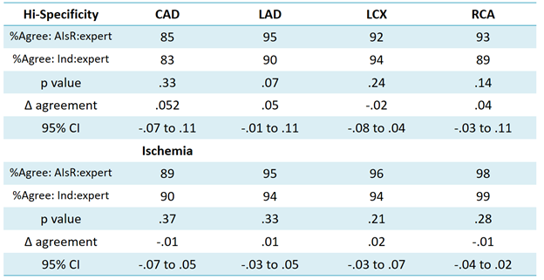
RESULTS
Journal of Nuclear Cardiology | Official Journal of the American Society of Nuclear Cardiology
Agreement between automated smart-report results and human experts at the high-specificity mode (n=100): No significant difference
Copyright American Society of Nuclear Cardiology

Slide 5
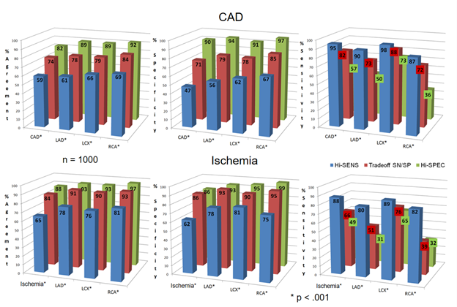
RESULTS
Journal of Nuclear Cardiology | Official Journal of the American Society of Nuclear Cardiology
Diagnostic performance of the AI Structured Report in reporting stress-induced hypoperfusion as indicative of CAD (top row) and reversibility at rest as indicative of ischemia (bottom row). Results for the modes: high specificity (green bars), sensitivity (SN)-specificity (SP) tradeoff, (red bars) and high sensitivity (blue bars) results are shown for agreement (i.e., accuracy - left column), specificity (middle column) and sensitivity (right column) (* p < .001). High specificity mode = best agreement with experts.
Copyright American Society of Nuclear Cardiology

Slide 6
CONCLUSIONS
Journal of Nuclear Cardiology | Official Journal of the American Society of Nuclear Cardiology
1- Automatic structured reports from computer-assisted interpretation of rest/stress myocardial perfusion SPECT studies by an AI expert system when operating at a high-specificity level statistically agrees (is not inferior) with the interpretations of nuclear cardiology experts
2- This AIsR exhibits diagnostic accuracy consistent with that of experts when their clinical reports are used as the reference standard.
Copyright American Society of Nuclear Cardiology

