Slide 1
Contents
  This is a tutorial for TCC-GUI.
TCC-GUI GitHub page
  prerequisites, standalone version, and online version
Data Simulation (Step 0)
Exploratory Analysis (Step 1)
TCC Computation (Step 2)
Visualization (Step 3)
  MA Plot, Volcano Plot
  Heatmap, Expression Level
Report (Step 4)

Slide 2
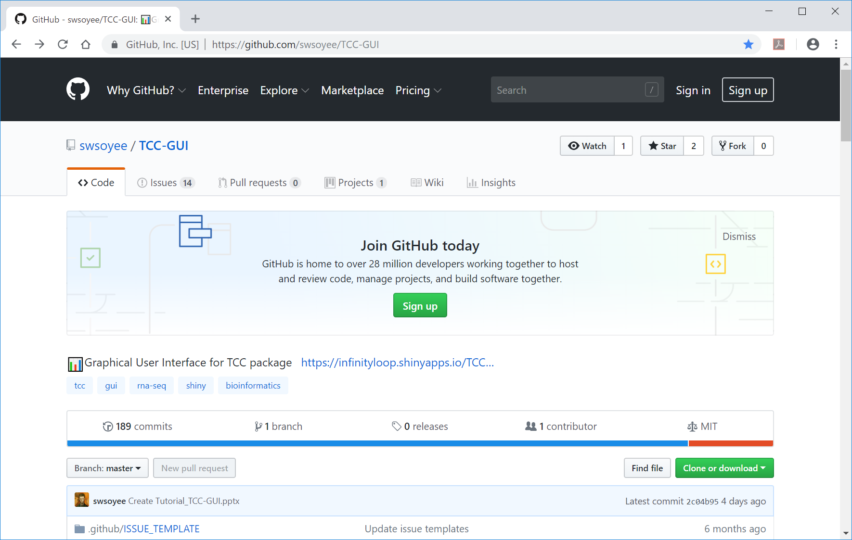
TCC-GUI GitHub page
  ①This is the TCC-GUI GitHub page. ②Move to the bottom of this page.
②
①
https://github.com/swsoyee/TCC-GUI

Slide 3
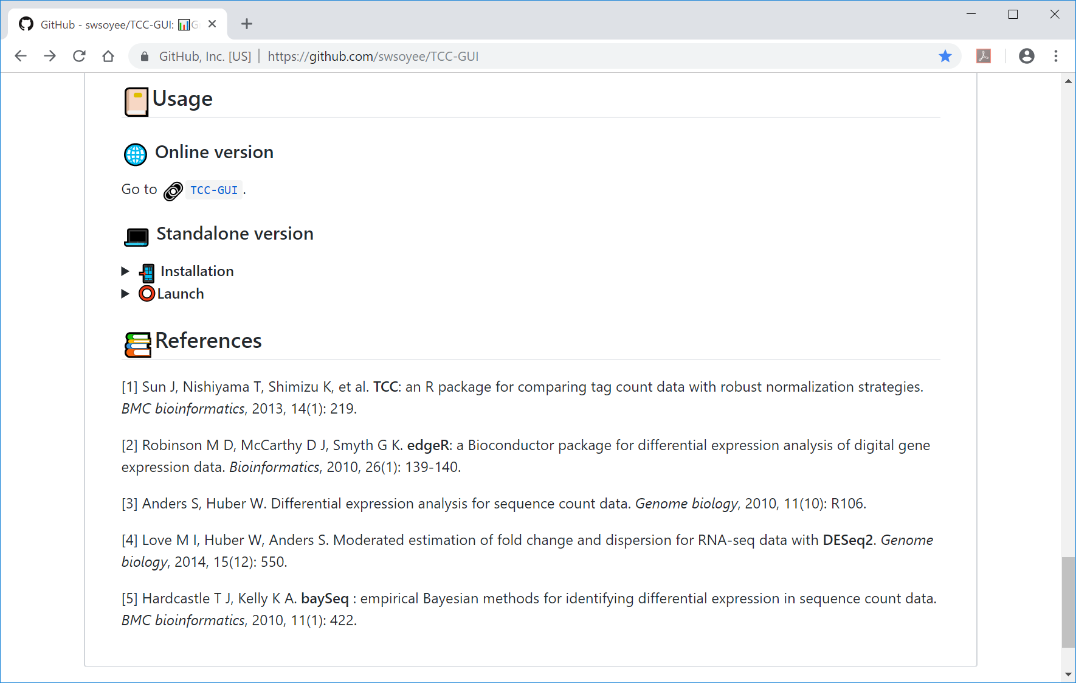
Standalone version
  ①When using the standalone version, ②the user must install all the necessary packages in advance before launch.
①
②

Slide 4
Online version
  ①The online version can be launched here.
①

Slide 5
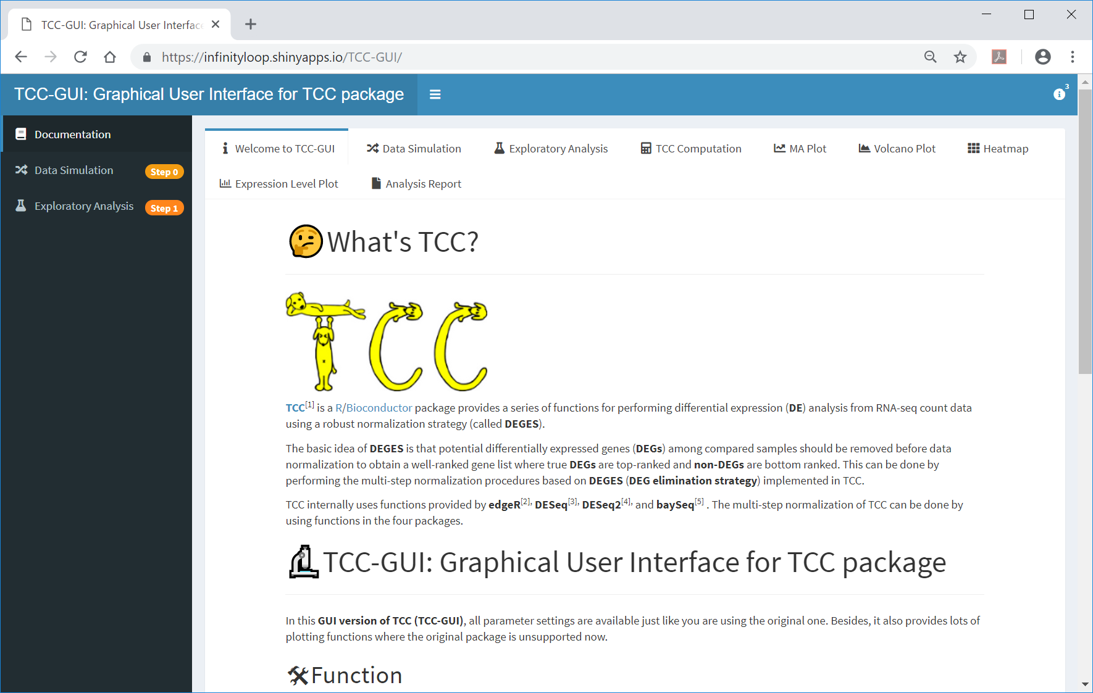
Online version
  ①This is the initial screen of TCC-GUI.
https://infinityloop.shinyapps.io/TCC-GUI/

Slide 6
Contents
TCC-GUI GitHub page
  prerequisites, standalone version, and online version
Data Simulation (Step 0)
Exploratory Analysis (Step 1)
TCC Computation (Step 2)
Visualization (Step 3)
  MA Plot, Volcano Plot
  Heatmap, Expression Level
Report (Step 4)

Slide 7
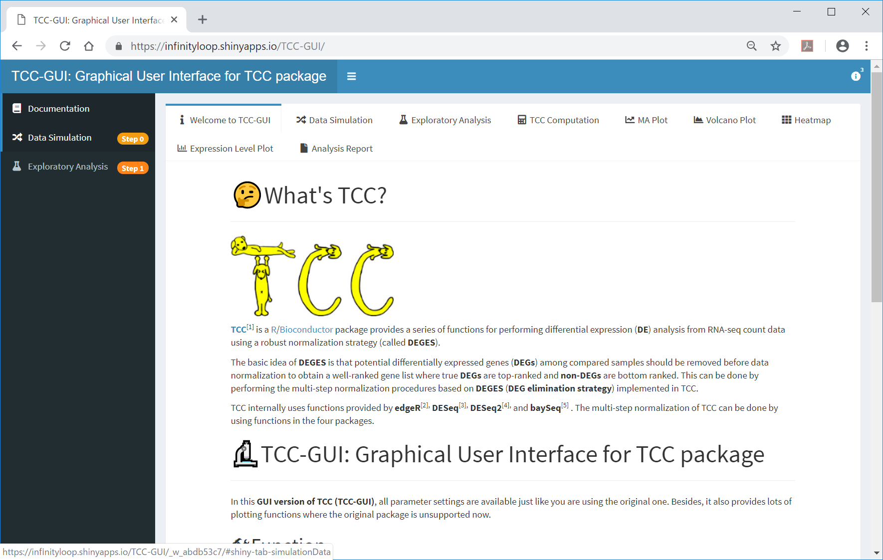
Step 0
  ①Simulation data can be generated here (Step 0).
①

Slide 8
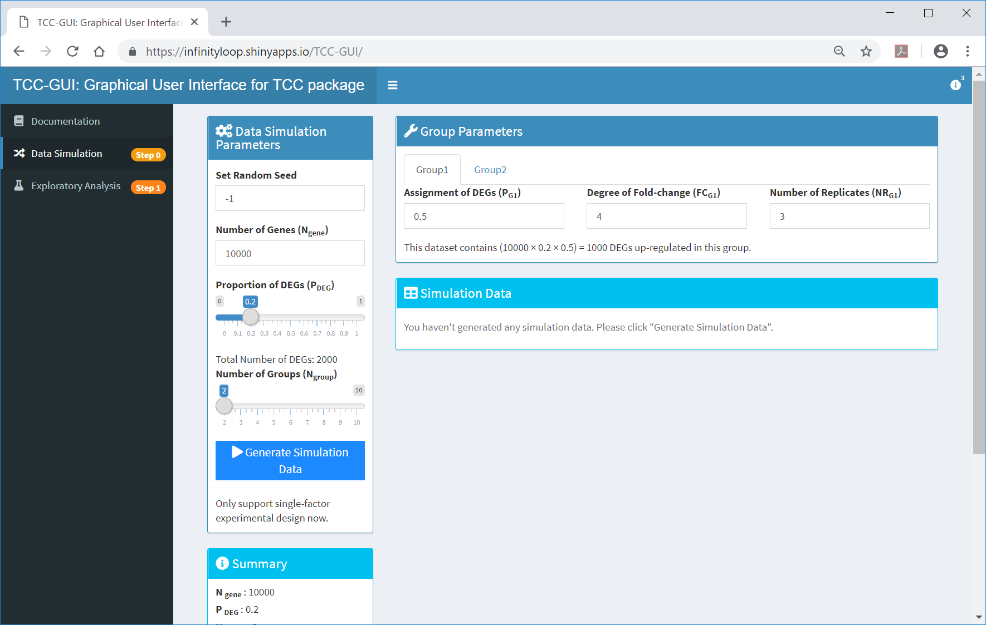
Step 0
  This is the initial screen in Step 0.

Slide 9
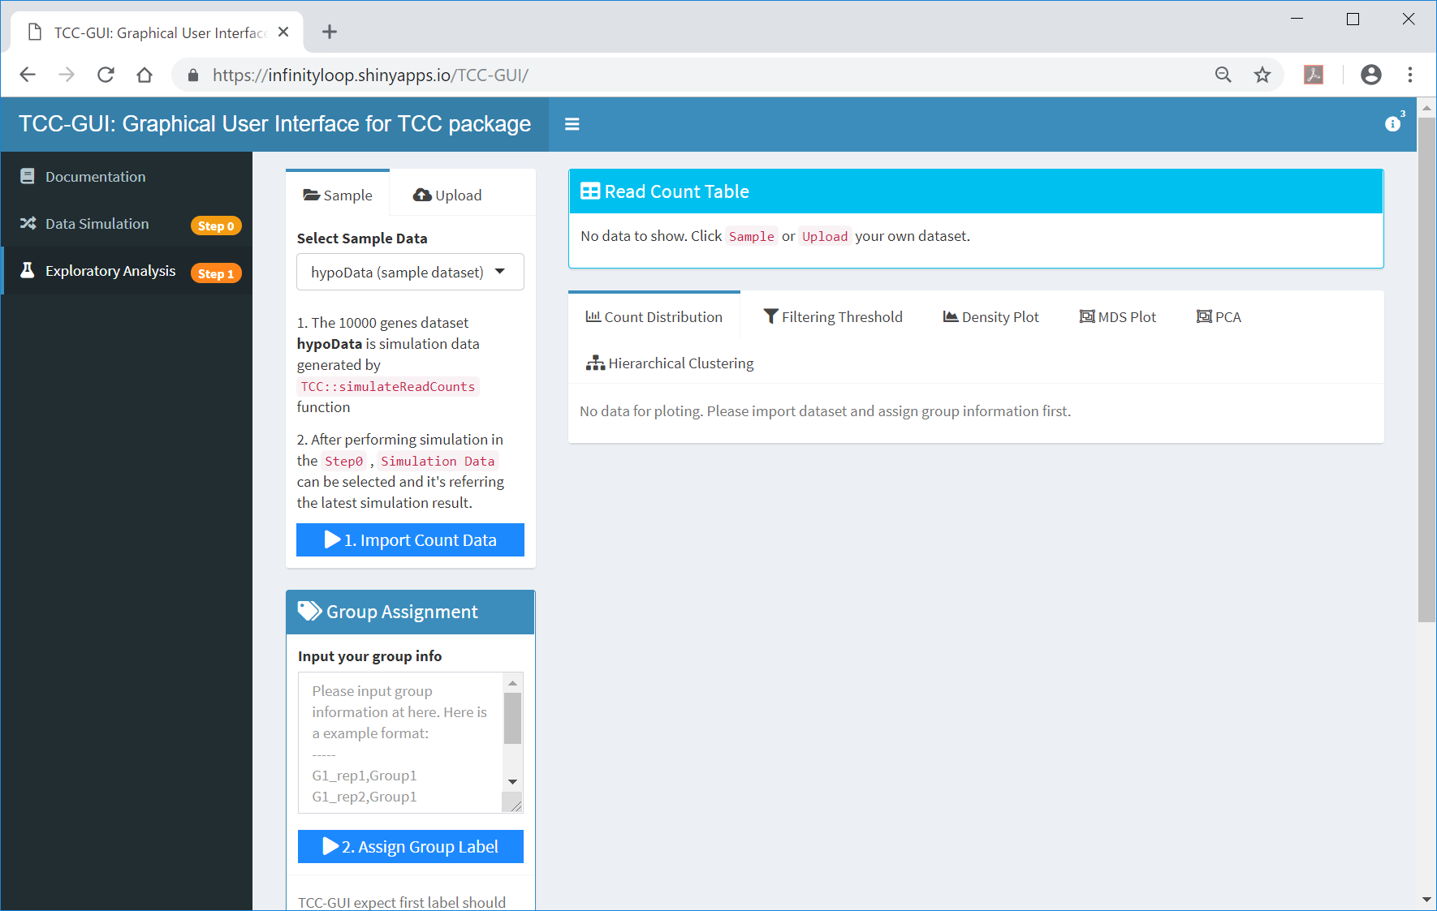
Step 1: initial screen
  ① Before generating simulation data in Step 0, Step 1 provides ②hypoData as the sample data.
①
②

Slide 10

Re-generation of hypoData
  The sample data (hypoData) can be re-generated by setting ①the seed as 1, ②P_{G1} as ③0.9, and …
②
①
③

Slide 11

Re-generation of hypoData
  …④P_{G2} as ⑤0.1
④
⑤

Slide 12
Re-generation of hypoData
  ①Click on “Generate Simulation Data”.
①

Slide 13
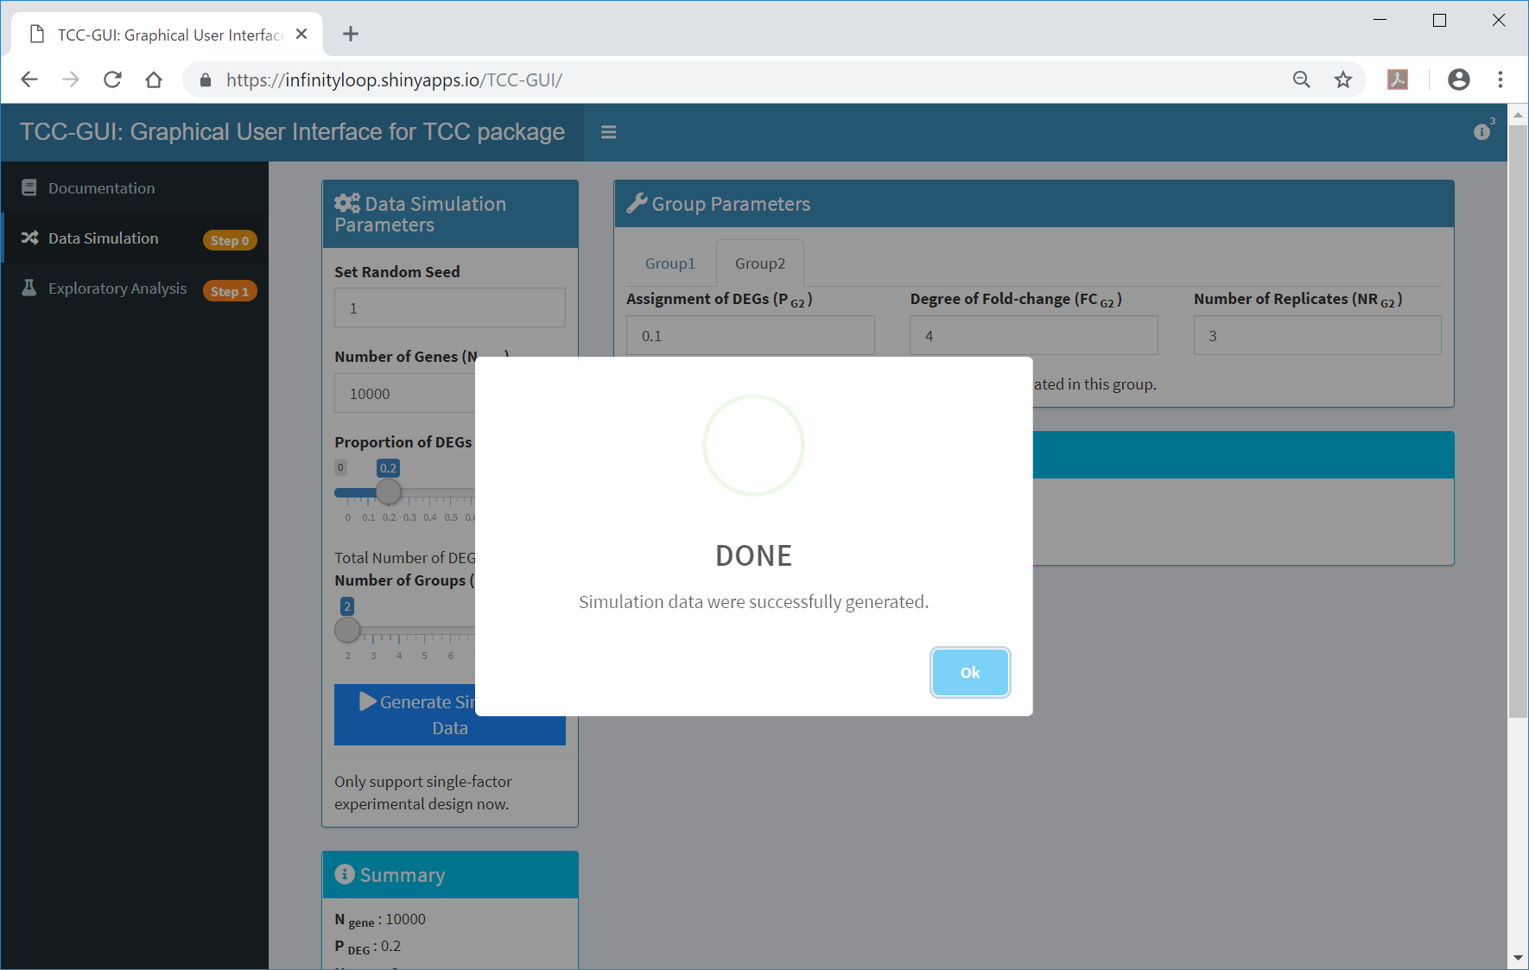
Done
  Simulation data are successfully generated.
①

Slide 14
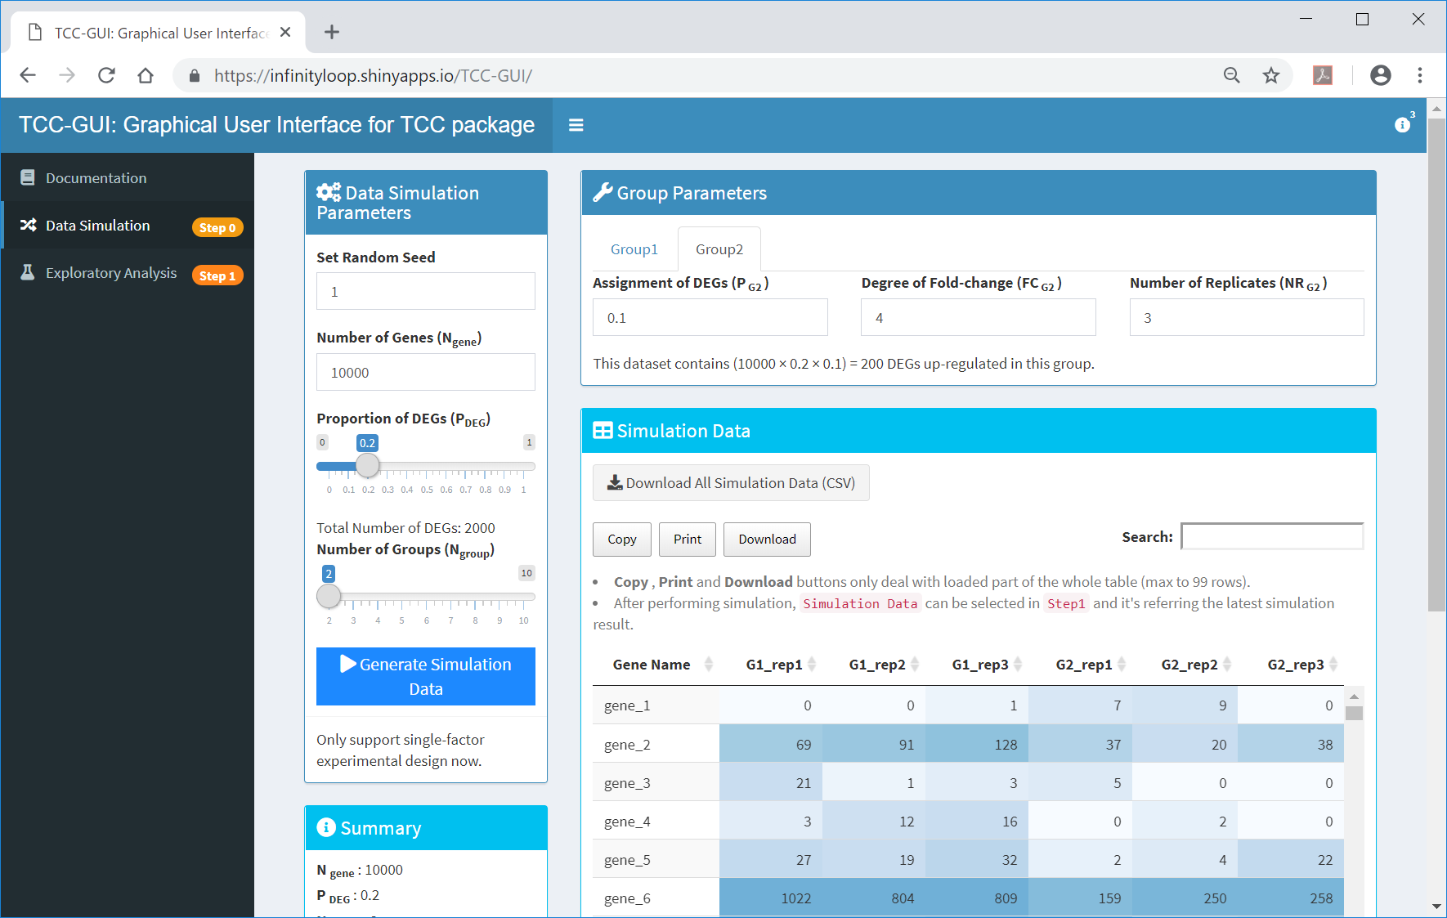
After generation
  ①The generated data can now be downloaded from here, and ②the summary information can be viewed here.
①
②

Slide 15
Contents
TCC-GUI GitHub page
  prerequisites, standalone version, and online version
Data Simulation (Step 0)
Exploratory Analysis (Step 1)
TCC Computation (Step 2)
Visualization (Step 3)
  MA Plot, Volcano Plot
  Heatmap, Expression Level
Report (Step 4)

Slide 16
Step 1
  ①The generated data can be used in ②Step 1.
②
①

Slide 17

1. Import Count Data
  ①The generated data may be selected as the default sample data in Step 1. A simple way to use these data is to just click on ② and ….
①
②

Slide 18
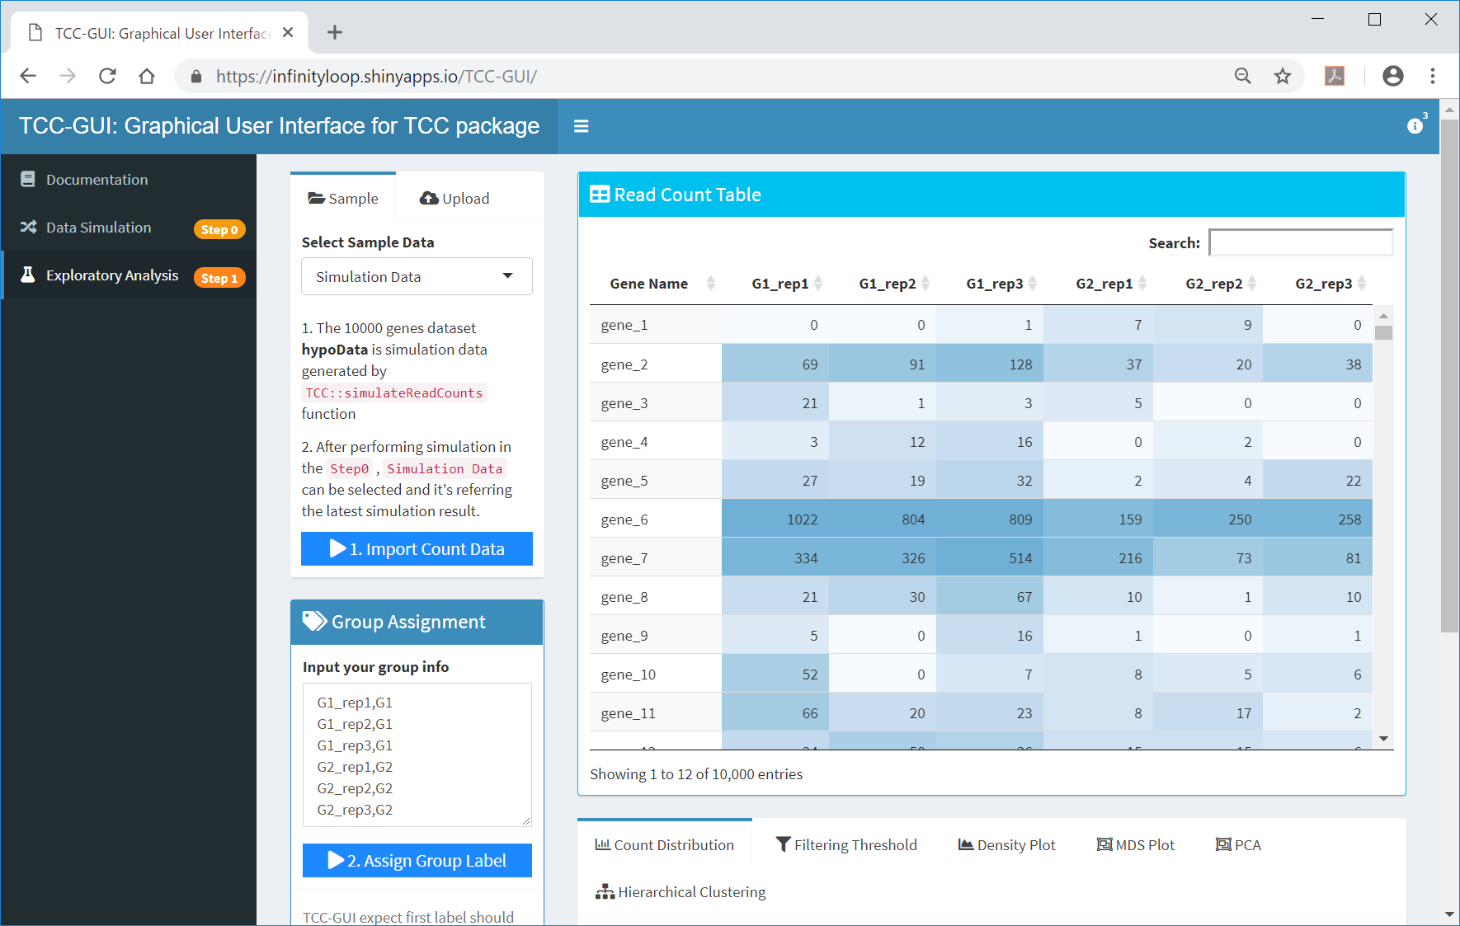
2. Assign Group Label
  …③.
③

Slide 19
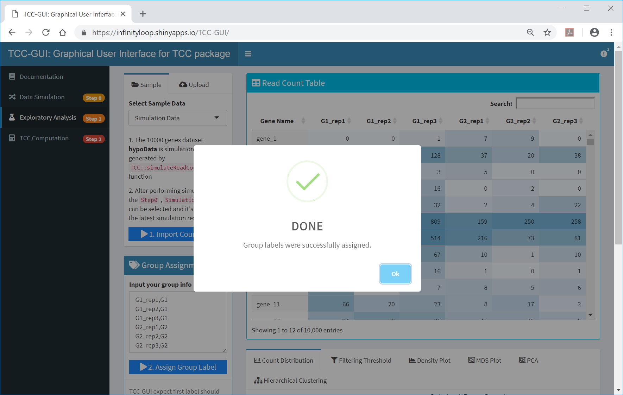
Done
  Group labels are successfully assigned. ①click ok, and ②Move to the bottom of this page.
②
①

Slide 20
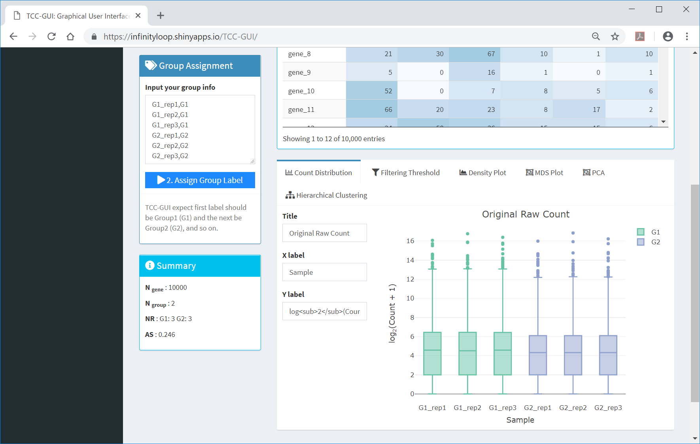
Exploratory Analysis
  TCC-GUI provides several tools for exploratory analysis. ①Count Distribution provides box plots for raw counts of individual samples.
①

Slide 21
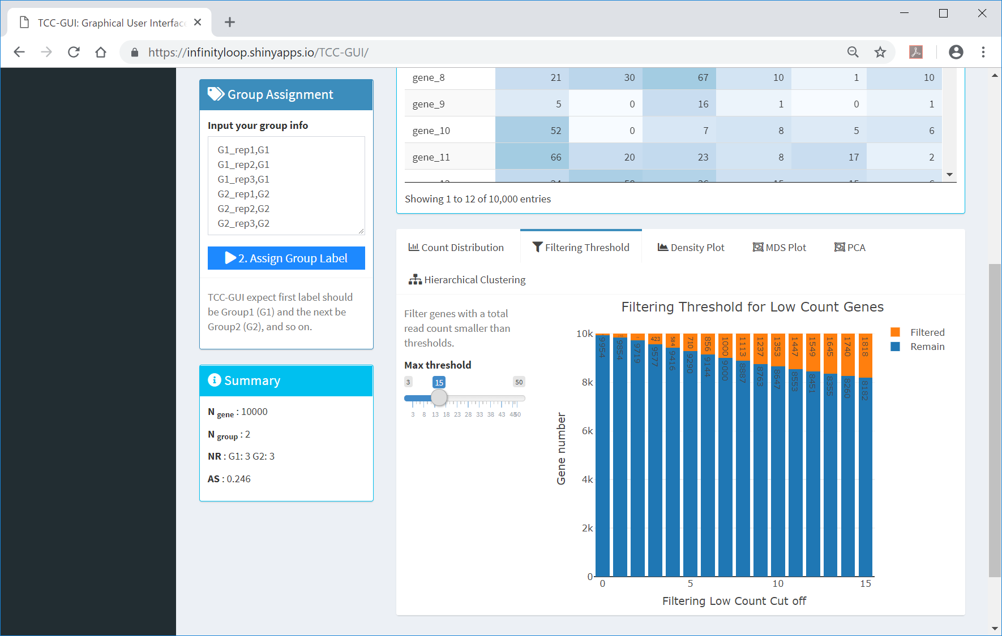
Filtering Threshold
  ①Filtering Threshold provides the threshold filters for low count genes. ② The user can change the maximum threshold.
①
②

Slide 22
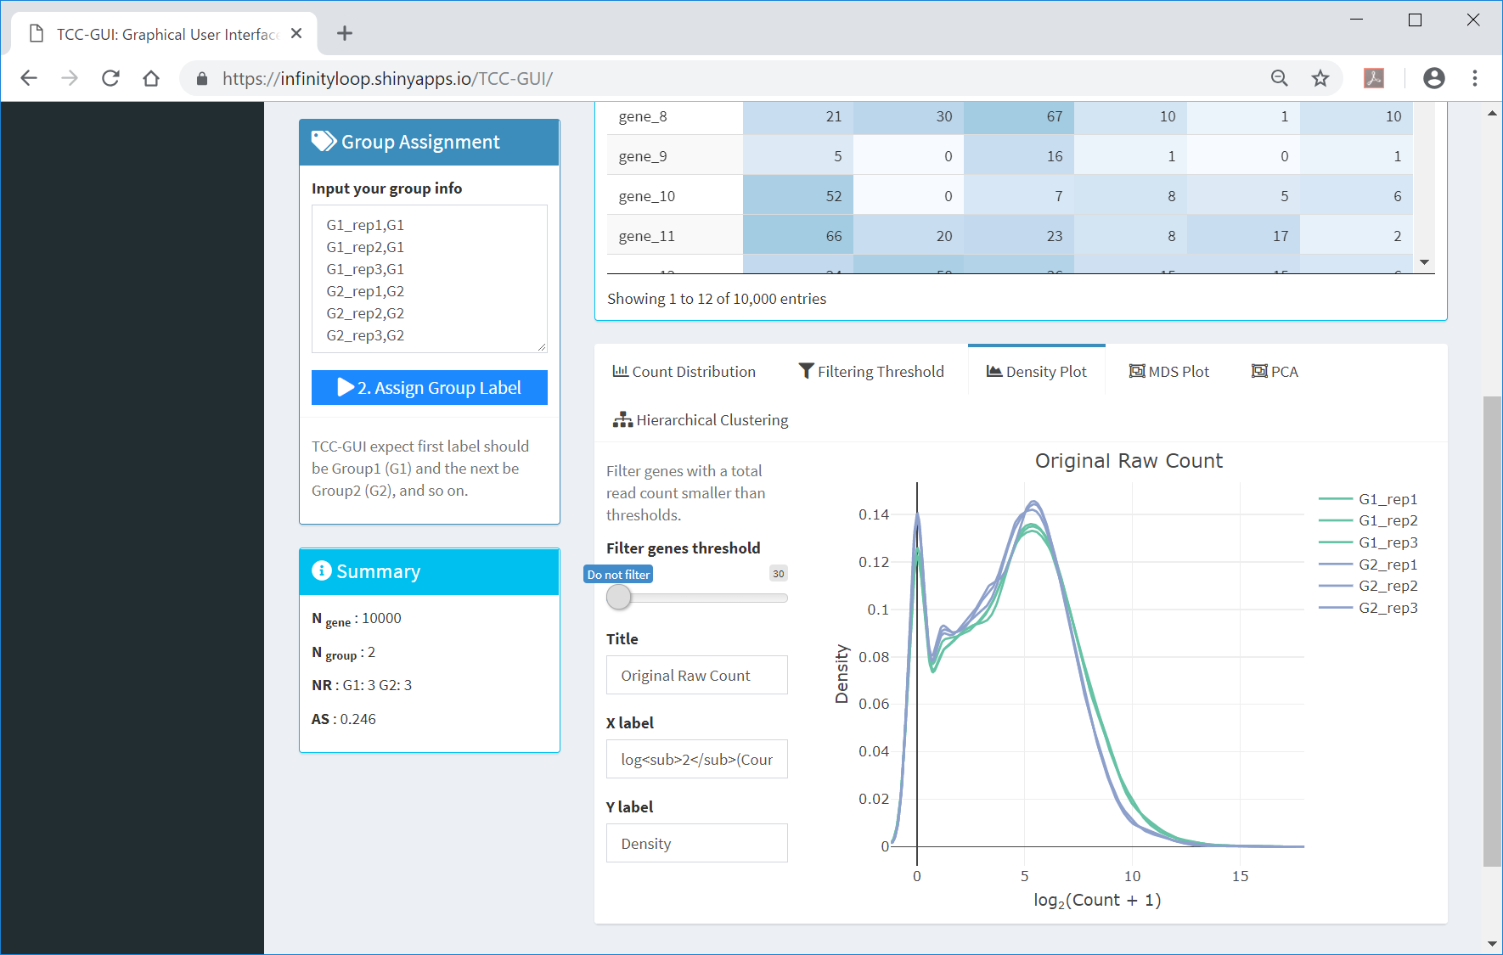
Density Plot
  Similar to Count Distribution, ①Density Plot option provides density plots for raw counts of individual samples. ②By changing the threshold to filter low count genes, the user can see the change of plot in real-time.
①
②

Slide 23

Density Plot
  As seen here.
①
②

Slide 24
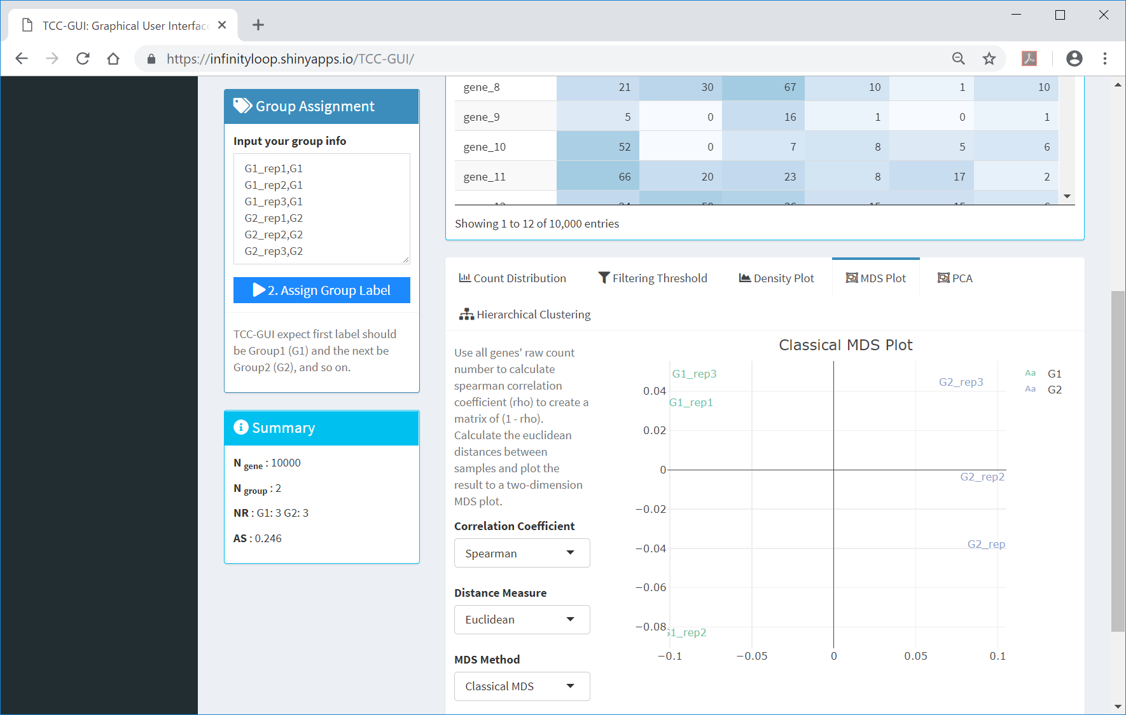
MDS Plot
  ①MDS Plot provides the result of multi-dimensional scaling (MDS).
①

Slide 25
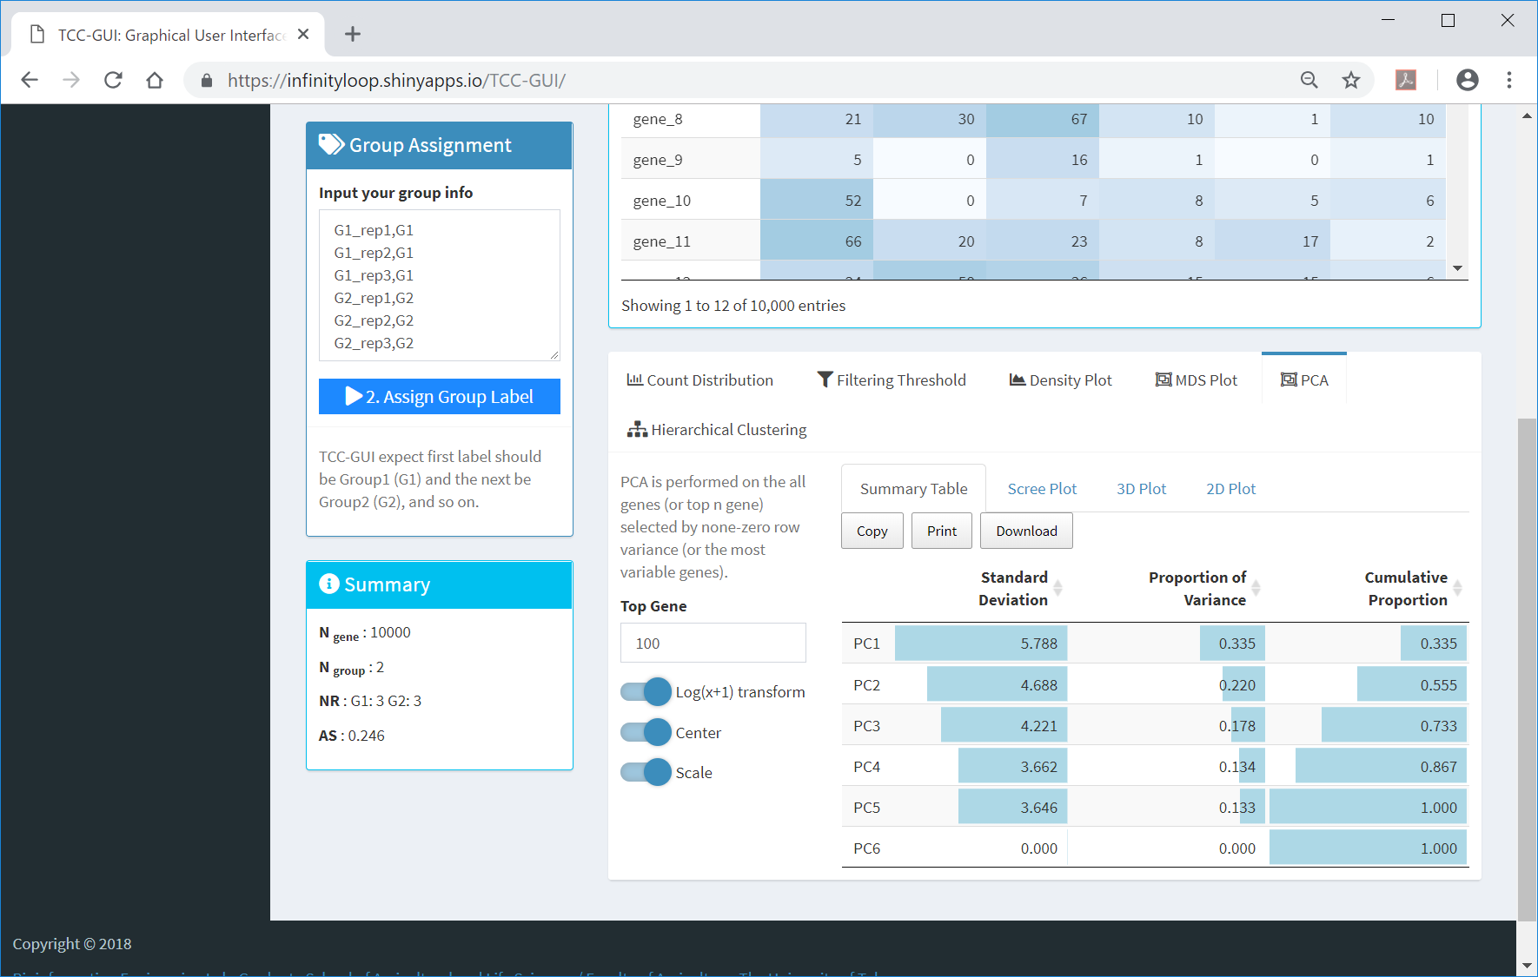
PCA
  ①In PCA, the user can see the ②Summary Table, ③Scree Plot, ④3D Plot, and ⑤2D Plot.
①
②
③
④
⑤

Slide 26
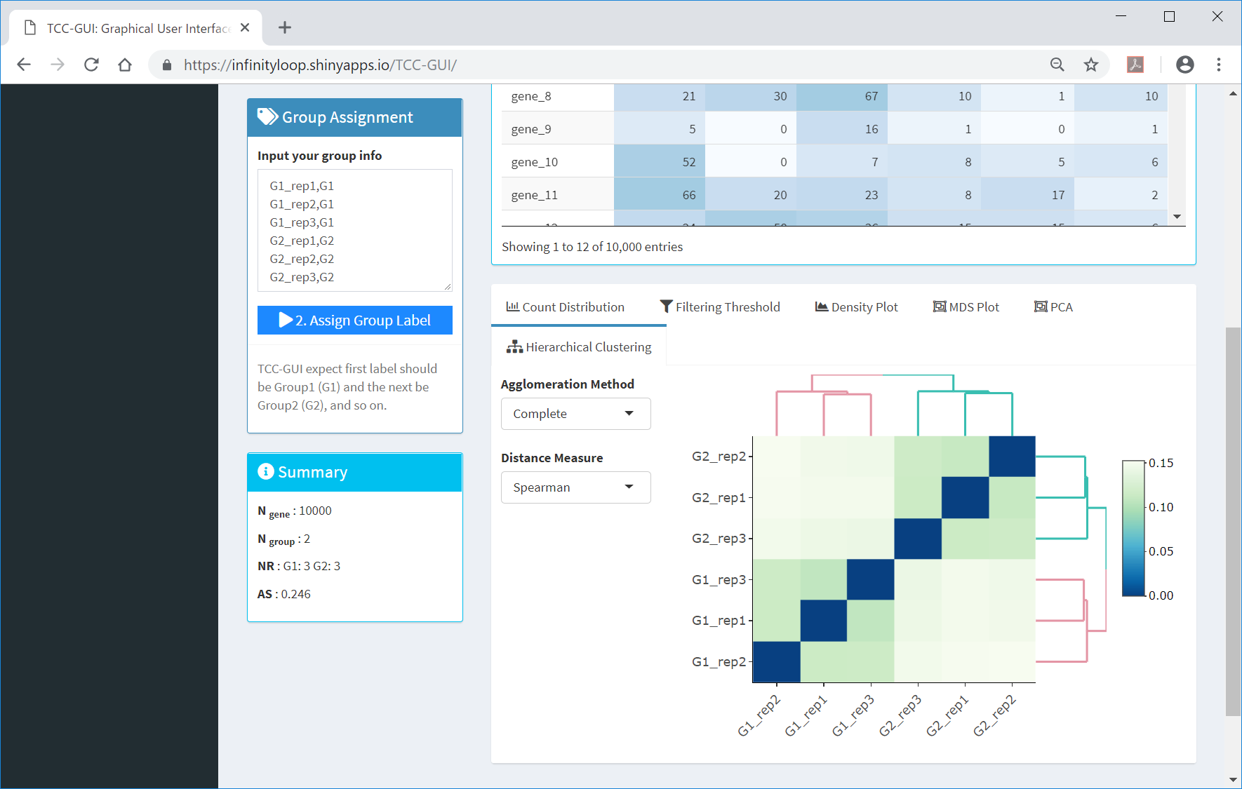
Hierarchical Clustering
  ①In Hierarchical Clustering, the user can see the result as a ②dendrogram of sample cluster. As expected from the nature of this simulation data (20% of genes are DEGs; P_{DEG} = 0.2), and a higher degree of group separation can be seen.
①
②

Slide 27
Average Silhouettes (AS)
  Although evaluation of ①the dendrogram is subjective, ②the average silhouettes (AS) score provides an objective measure of estimating the degree of group separation (Zhao et al.. 2018). It ranges from -1.0 to 1.0, a higher AS value indicating a higher degree of group separation (i.e., a higher percentage of DEGs).
①
②
Zhao et al., Biol. Proced. Online, 20:5, 2018

Slide 28
Contents
TCC-GUI GitHub page
  prerequisites, standalone version, and online version
Data Simulation (Step 0)
Exploratory Analysis (Step 1)
TCC Computation (Step 2)
Visualization (Step 3)
  MA Plot, Volcano Plot
  Heatmap, Expression Level
Report (Step 4)

Slide 29
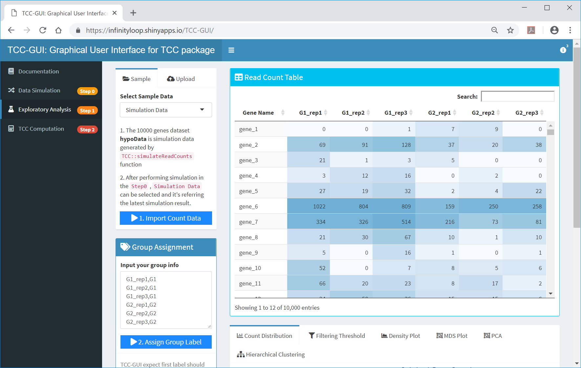
Step 2
  ①TCC Computation (Step 2) can be performed just after finishing ②the assignment of group label in Step 1.
①
②

Slide 30
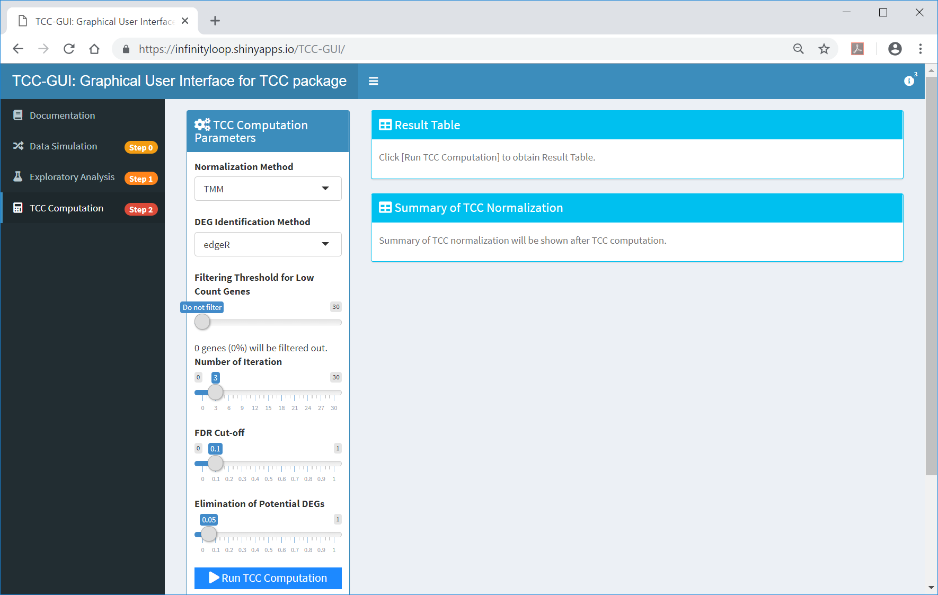
Run TCC Computation
  ①Although several options are provided in the parameter setting panel, a simple way to perform DE analysis with TCC is to just click on ②Run TCC Computation.
①
②

Slide 31
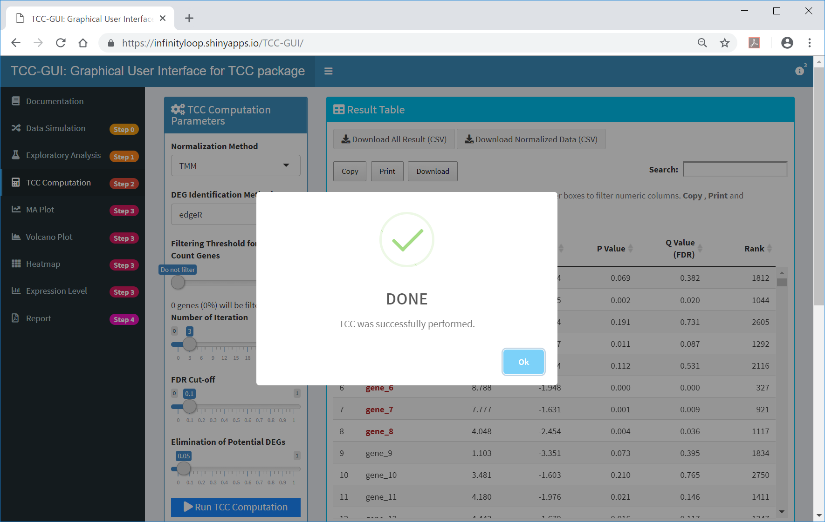
Done
  TCC is successfully performed.

Slide 32
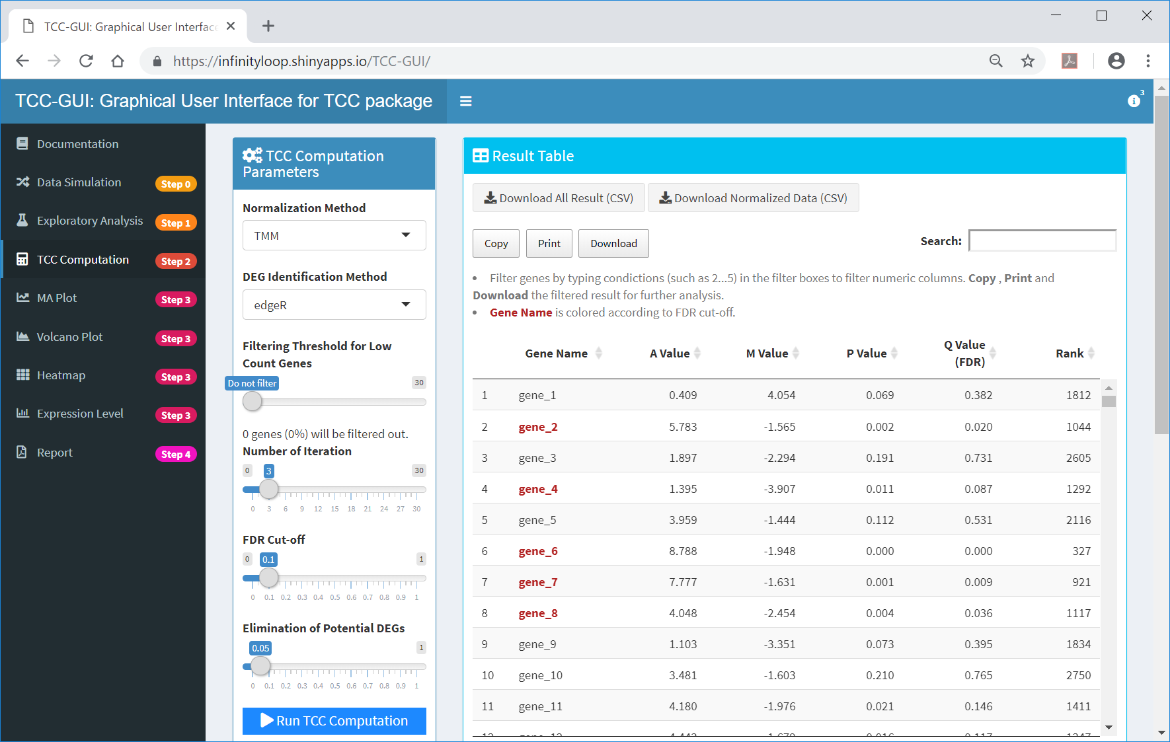
Step 2 finished
  The user can download ①the DE result and ②TCC-normalized data from here; ③ the remaining steps are optional.
①
②
③

Slide 33
Step 2 finished
  ①Genes satisfying ②10% FDR (i.e., ③Q-value < 0.1) are shown in red by default.
②
①
③

Slide 34
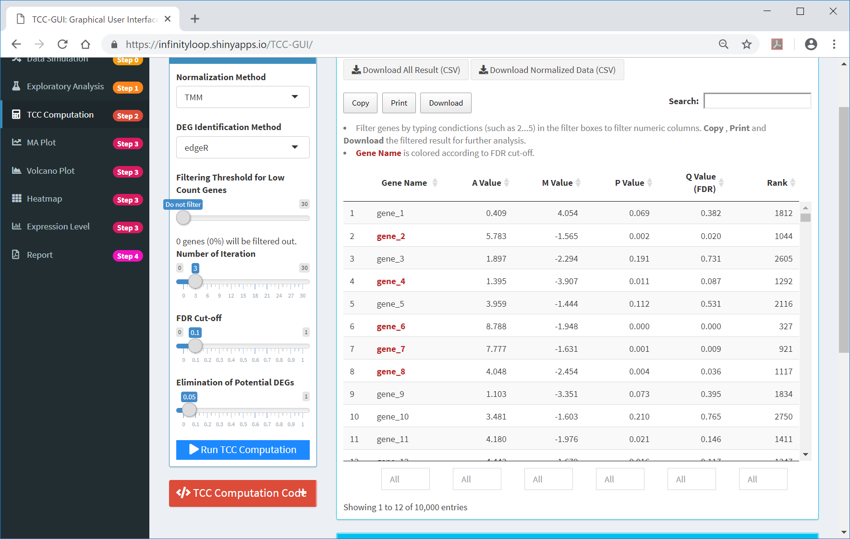
Filtering
  ①The boxes at the bottom of the Result Table panel can be used to filter genes by the column of interest.
①

Slide 35
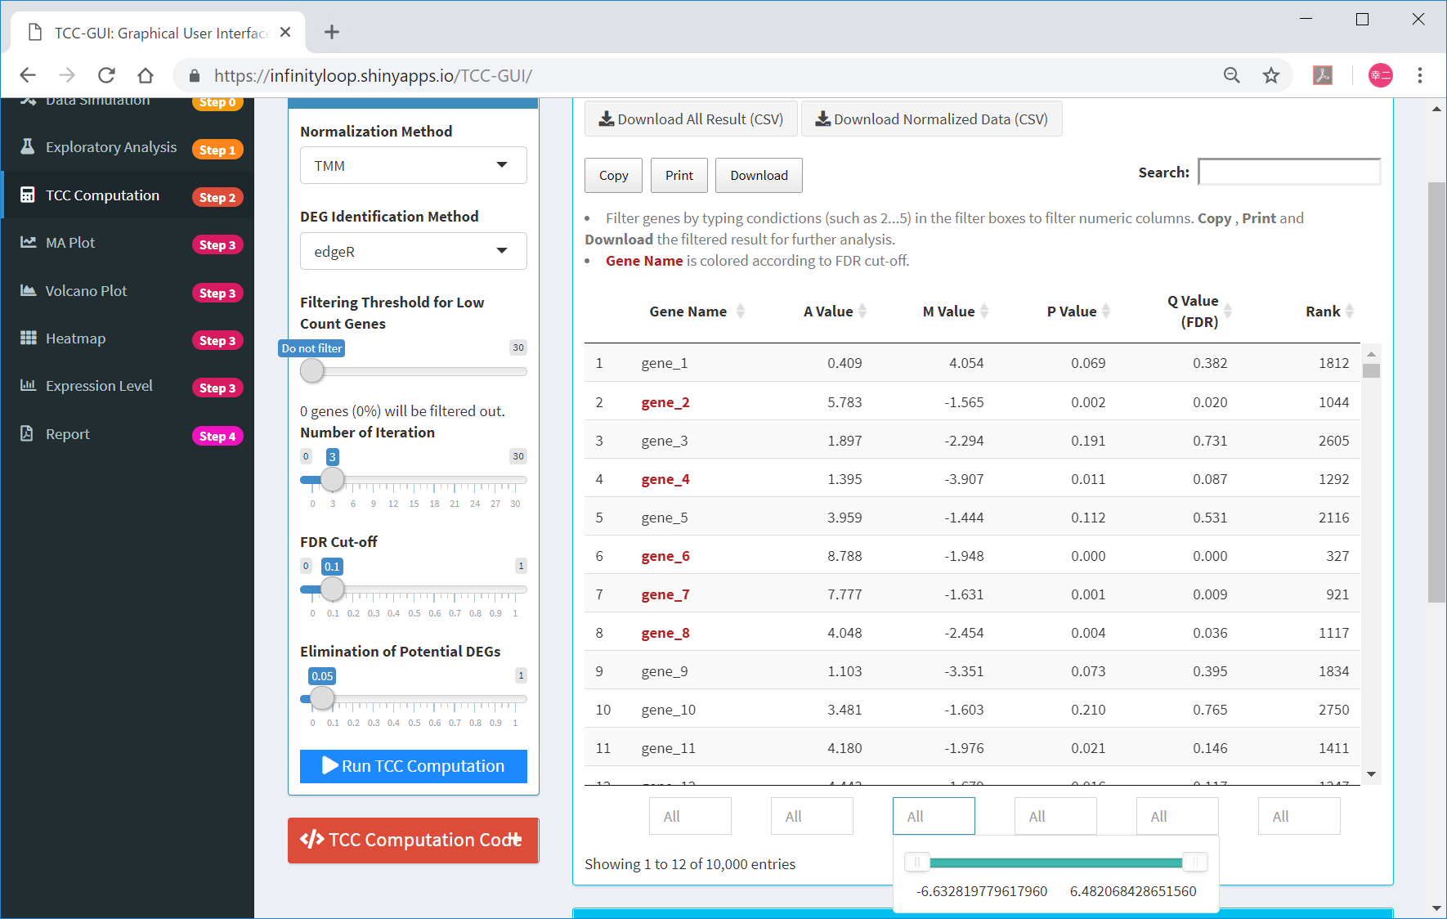
Filtering
  For example, ①the user can see the range of M Value (i.e., log-ratios); in case of “hypoData”, the range can be seen as [-6.63, 6.48].
①

Slide 36

Filtering
  ①The user can filter genes having M values within the range [0.52, 6.48] as shown.
①

Slide 37

Filtering
  Alternatively, the user may indicate the range of interest directly as ①“1.0...7.0” in the box. ②The user will see the number of genes satisfying the range here.
①
②

Slide 38

R code
  ①TCC-GUI provides R codes internally used to execute the TCC.
①

Slide 39
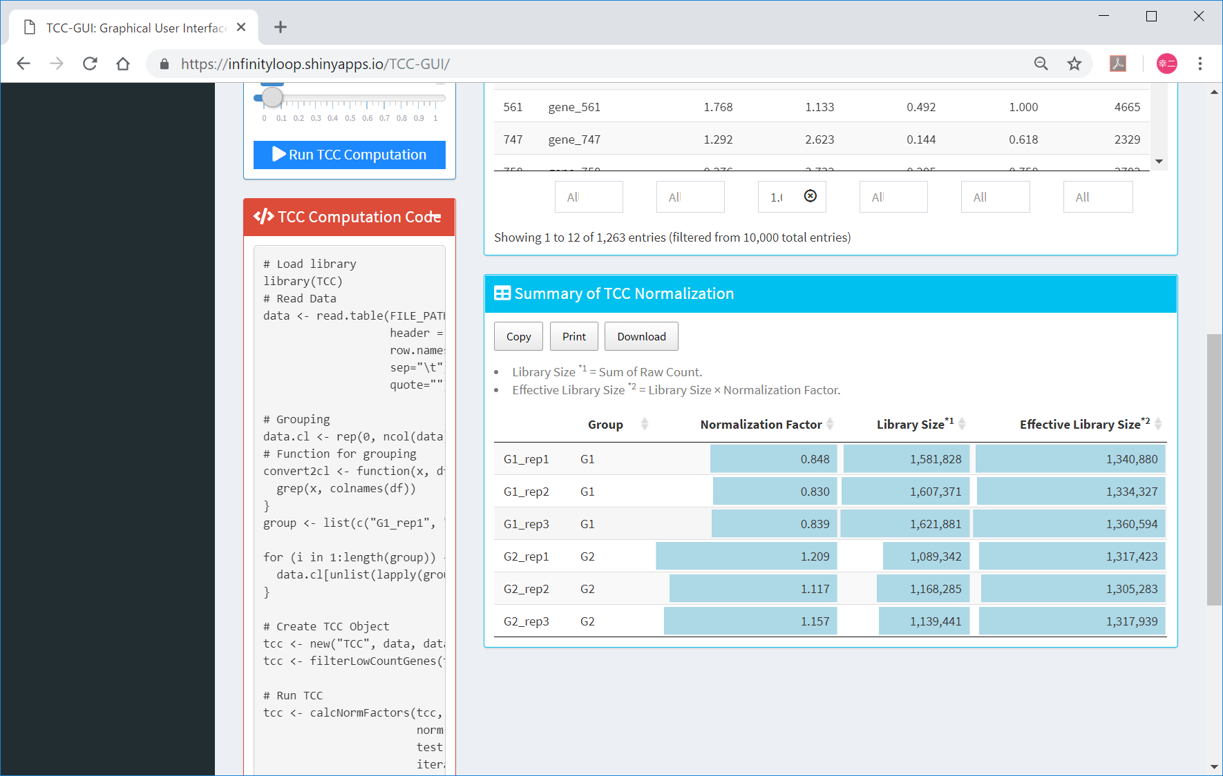
R code
  The R codes are shown here.

Slide 40
Contents
TCC-GUI GitHub page
  prerequisites, standalone version, and online version
Data Simulation (Step 0)
Exploratory Analysis (Step 1)
TCC Computation (Step 2)
Visualization (Step 3)
  MA Plot, Volcano Plot
  Heatmap, Expression Level
Report (Step 4)

Slide 41

Step 3
  ①MA plot can be generated in Step 3 …
①

Slide 42
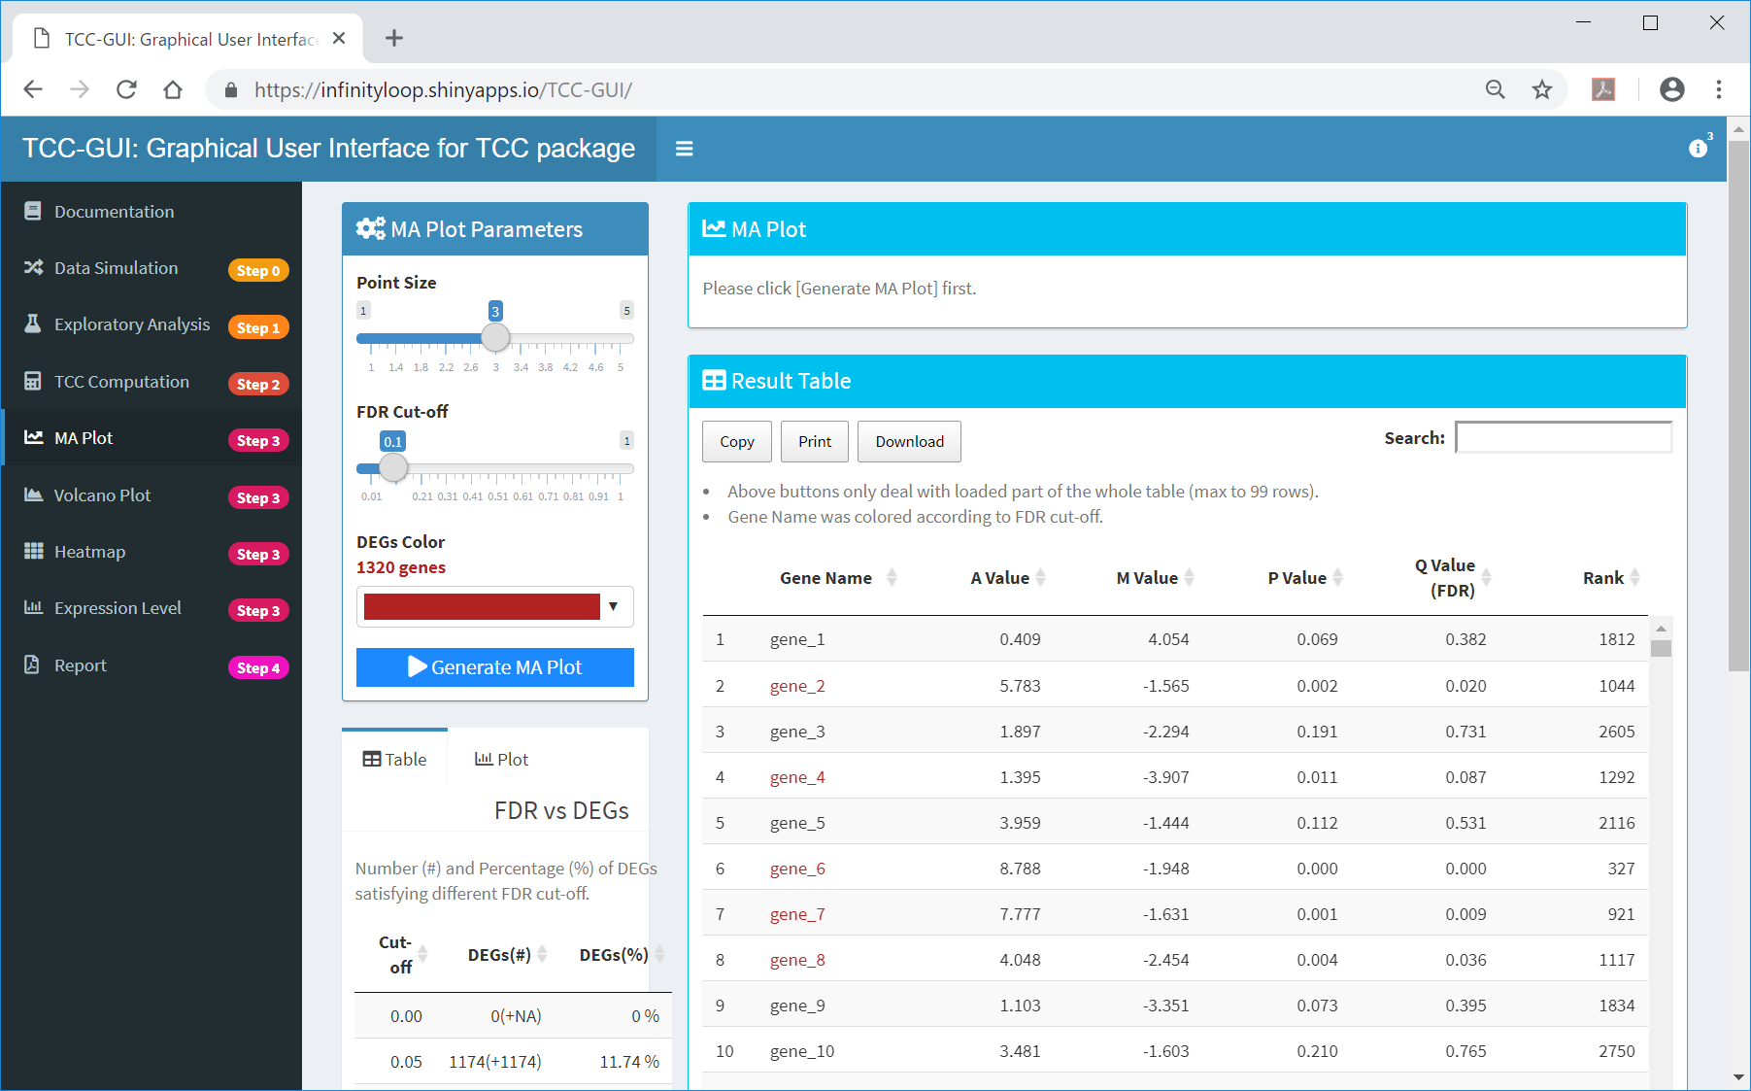
MA Plot
  ①… by clicking on “Generate MA Plot”
①

Slide 43
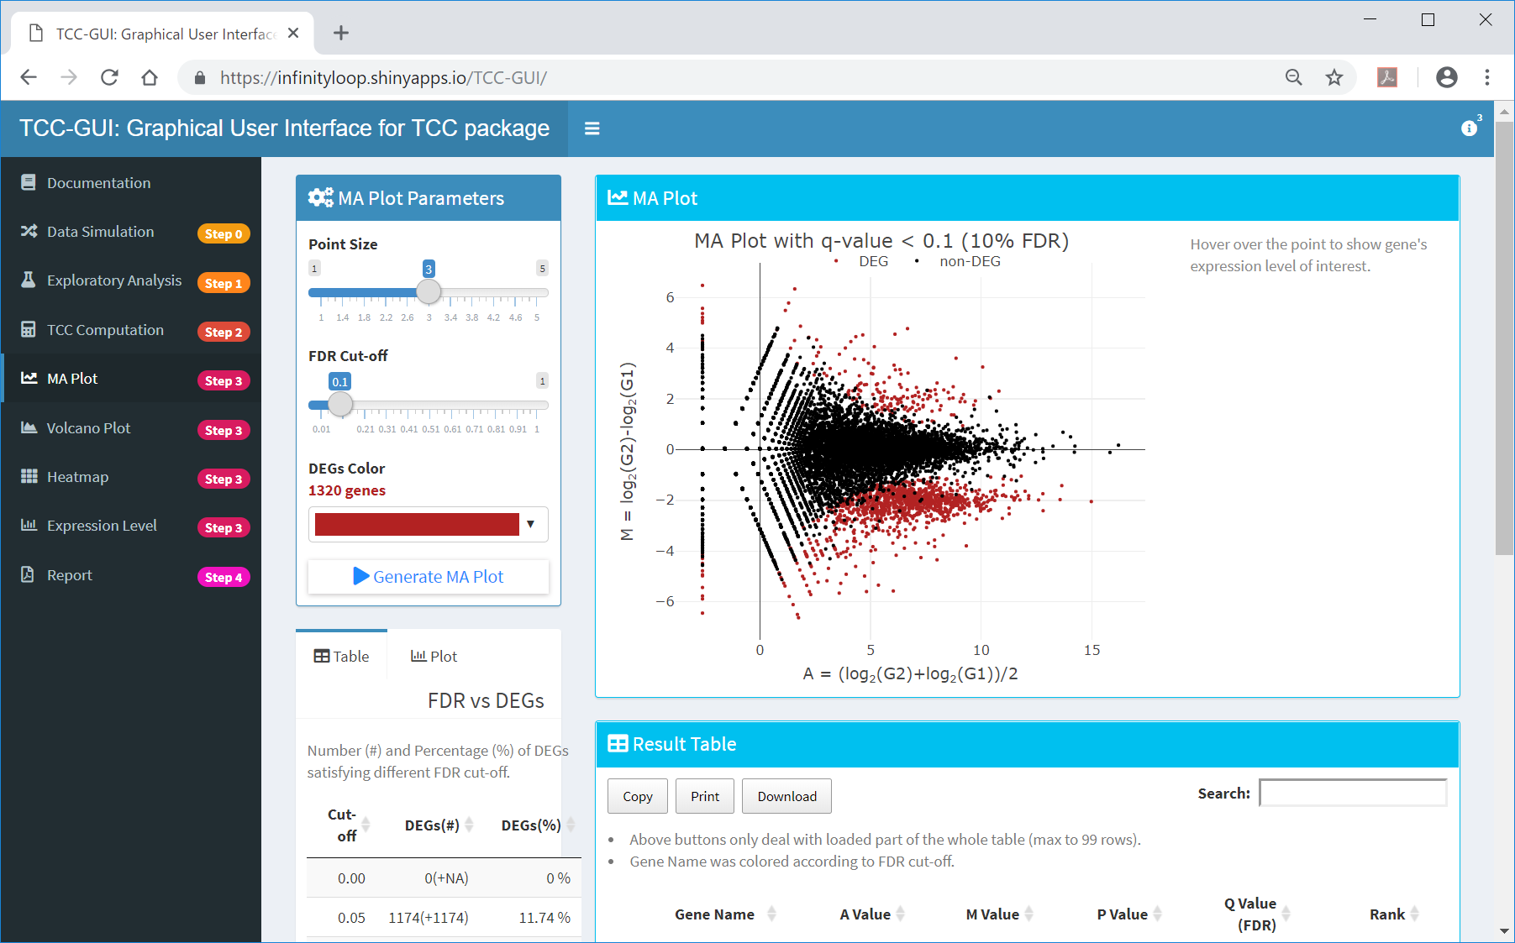
MA Plot generated
  By default, genes satisfying ①10% FDR are colored in ②dark red.
①
②

Slide 44
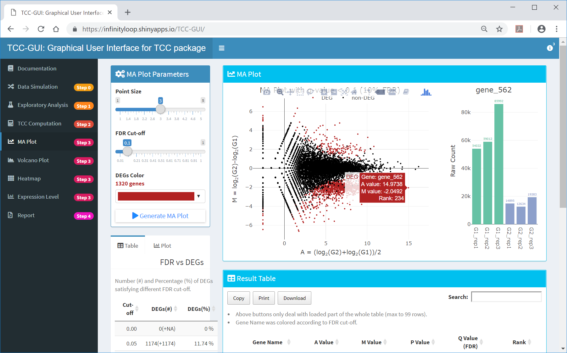
Detailed information
  The user can obtain more detailed information about the gene of interest (e.g., “gene_562”) by placing the cursor in ①that location.
①

Slide 45
Number of genes satisfying…
  ①The number of genes satisfying ②various FDR thresholds can be seen here in real-time.
②
①

Slide 46
FDR vs DEGs
  ①The number of genes satisfying various FDR cut-offs in increments of 0.05 is also provided in tabular form. This information as well as the AS value would be helpful to estimate how true DEGs are included in the input data.
①

Slide 47
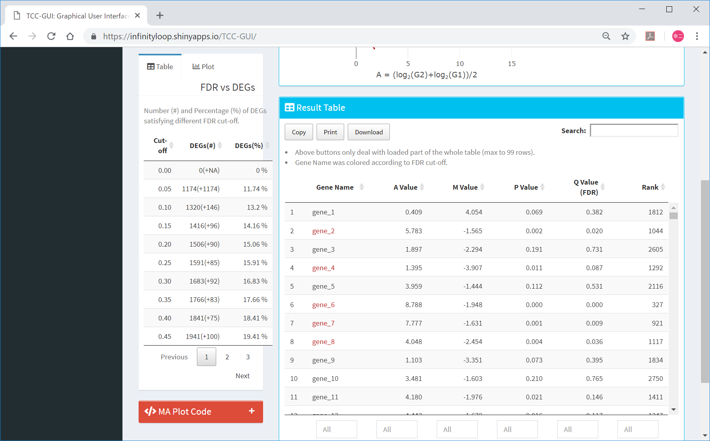
FDR vs DEGs
  ①The number of genes satisfying various FDR cut-offs in increments of 0.05 is also provided in tabular form.
①

Slide 48
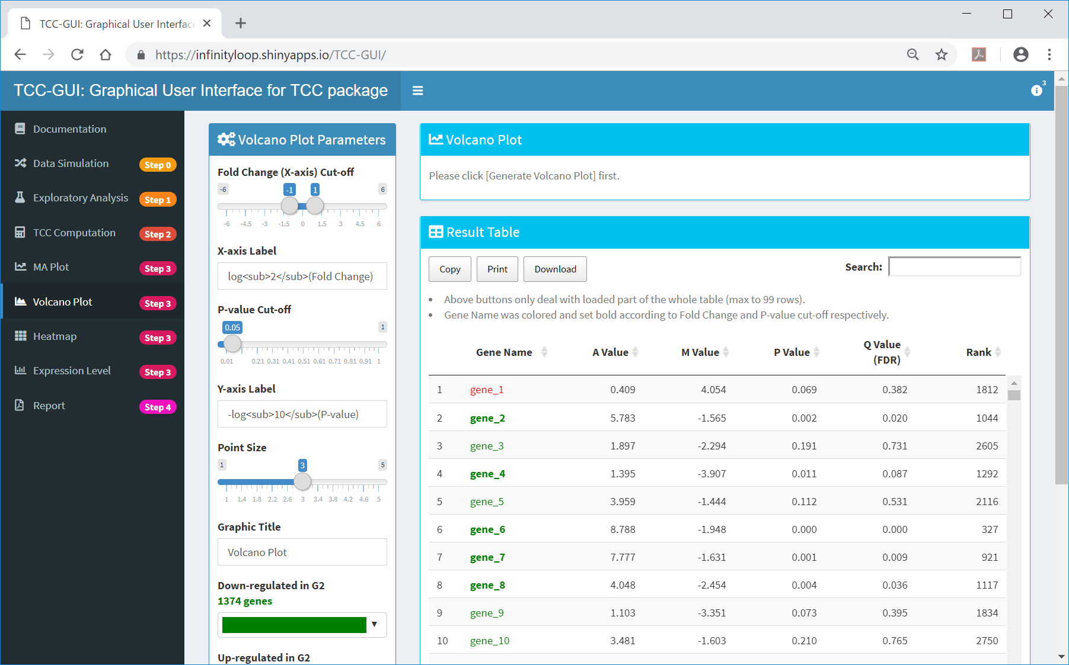
Volcano Plot
  ①Volcano Plot is another option in Step 3.
①

Slide 49
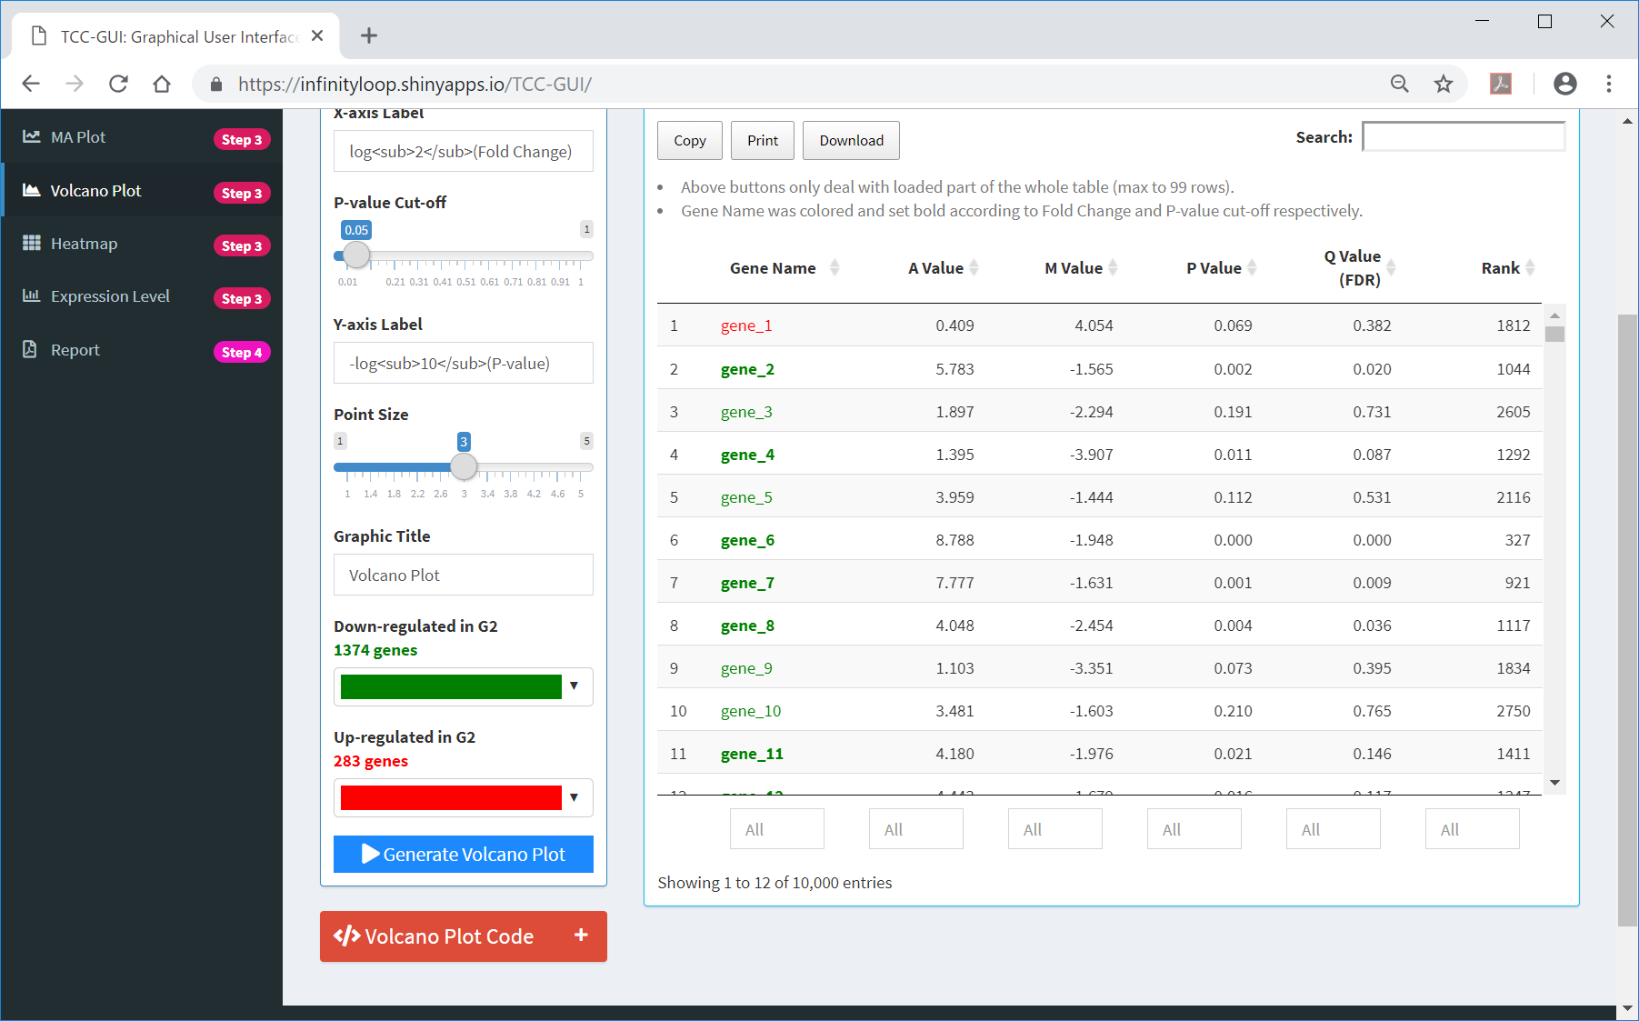
Volcano Plot
  ①To generate the volcano plot, click here.
①

Slide 50
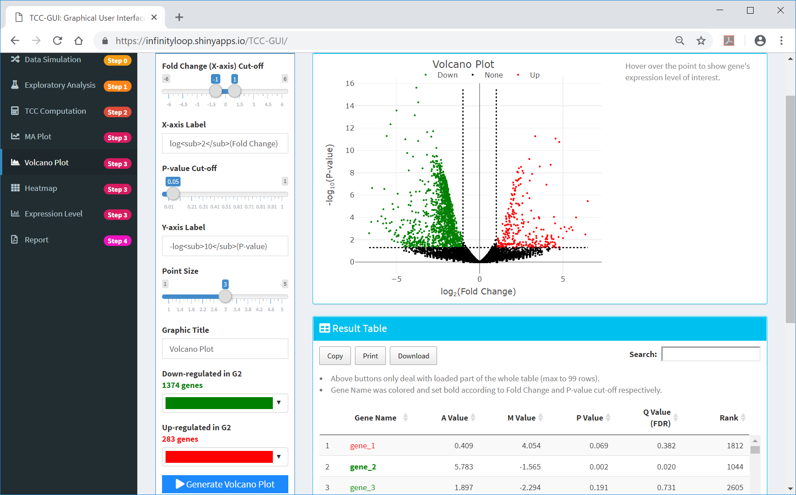
Volcano Plot generated
  ①A volcano plot is generated. For hypoData with default settings, ②the user will see 1,374 genes down-regulated and 283 genes up-regulated in G2. This is reasonable because the hypoData contains 1,800 genes down-regulated and 200 genes up-regulated in G2.
①
②

Slide 51
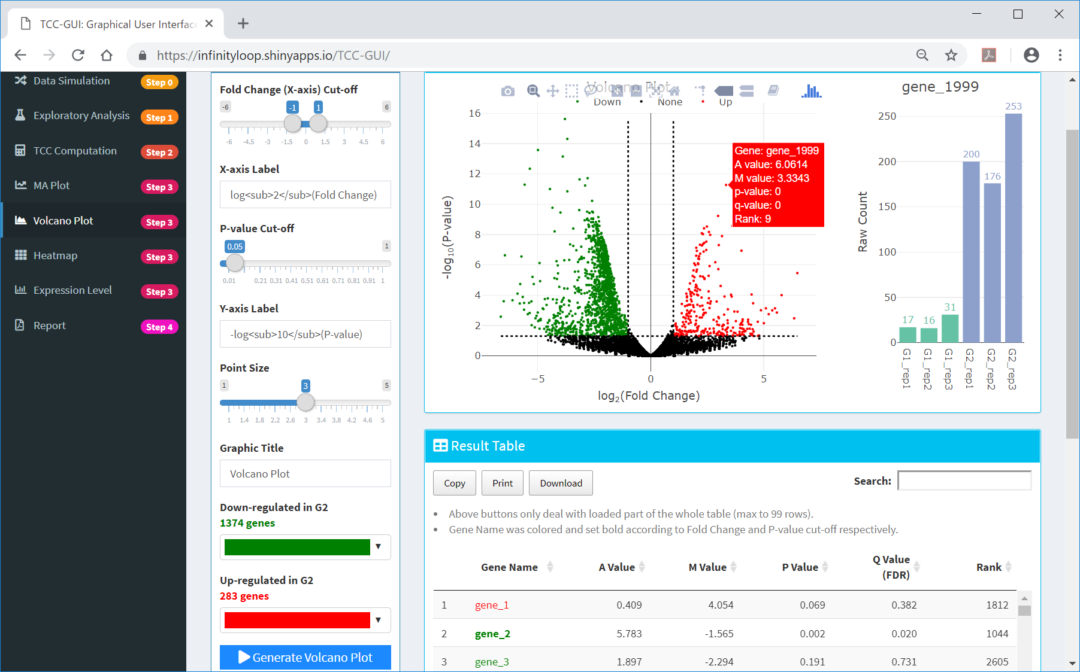
Detailed information
  the user can obtain more detailed information about the gene of interest (e.g., “gene_1999”) by placing the cursor in ①that location.
①

Slide 52
Contents
TCC-GUI GitHub page
  prerequisites, standalone version, and online version
Data Simulation (Step 0)
Exploratory Analysis (Step 1)
TCC Computation (Step 2)
Visualization (Step 3)
  MA Plot, Volcano Plot
  Heatmap, Expression Level
Report (Step 4)

Slide 53
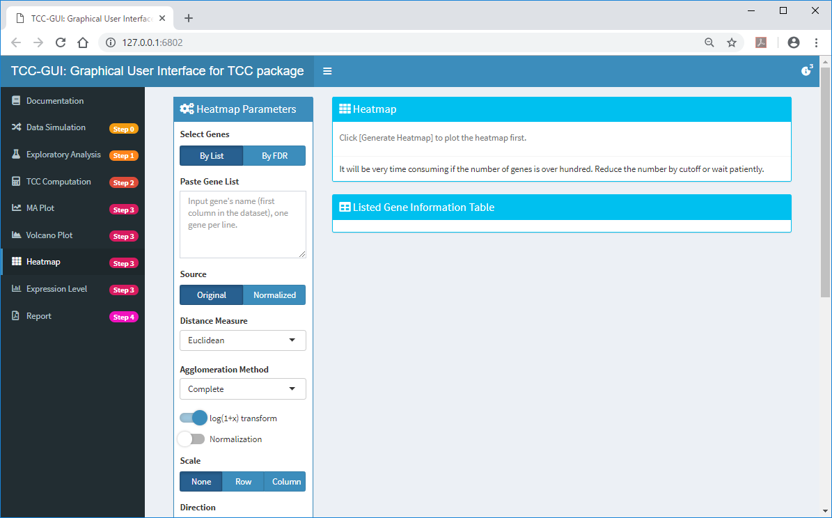
Heatmap
  ①Heatmap is a graphical representation of data where the individual count values contained in a matrix are represented as pseudo-colors.
①

Slide 54
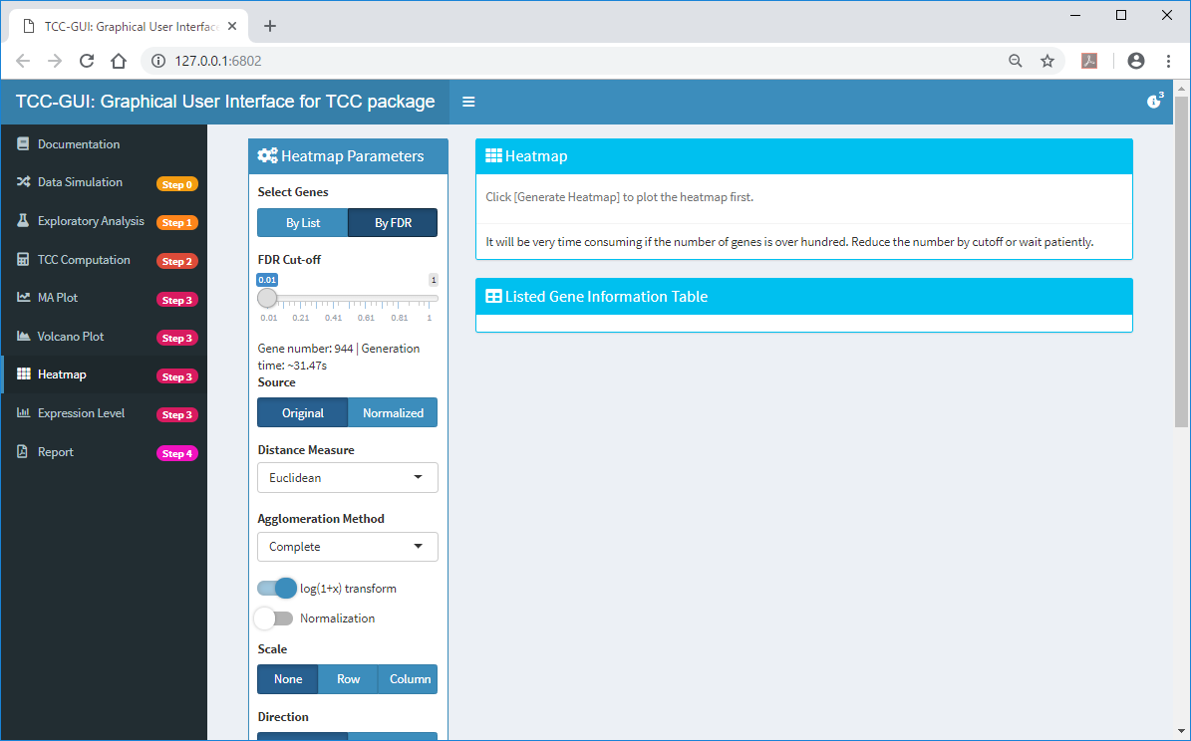
Heatmap
  ①Users can generate heatmap for genes satisfying arbitrarily defined FDR cut-off. Here, we use 944 genes satisfying ③1% FDR cut-off.
①
③
②

Slide 55
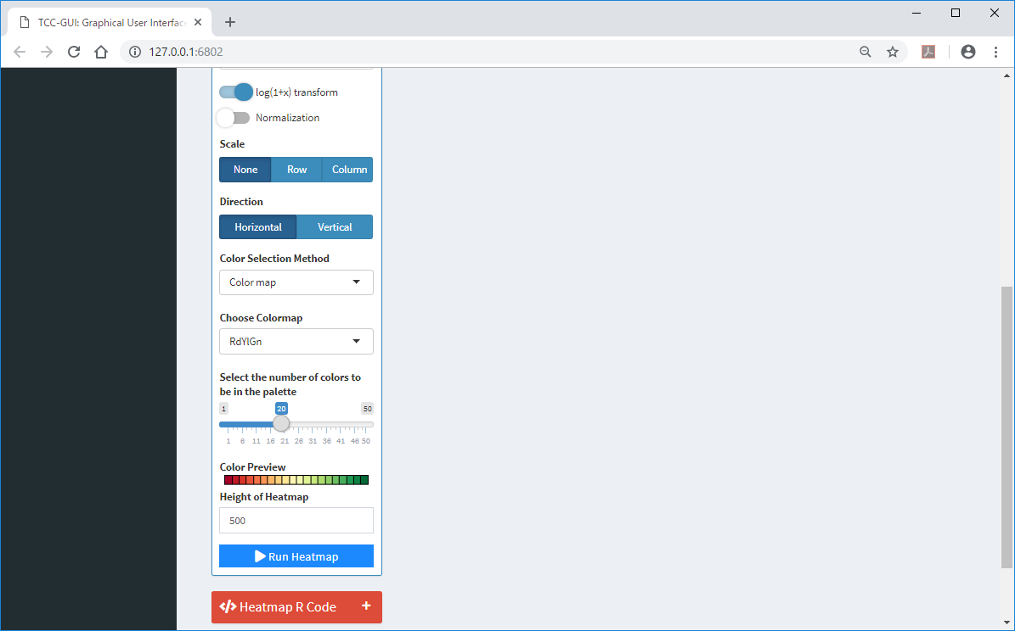
Heatmap
  ①Click on “Run Heatmap”.
①

Slide 56
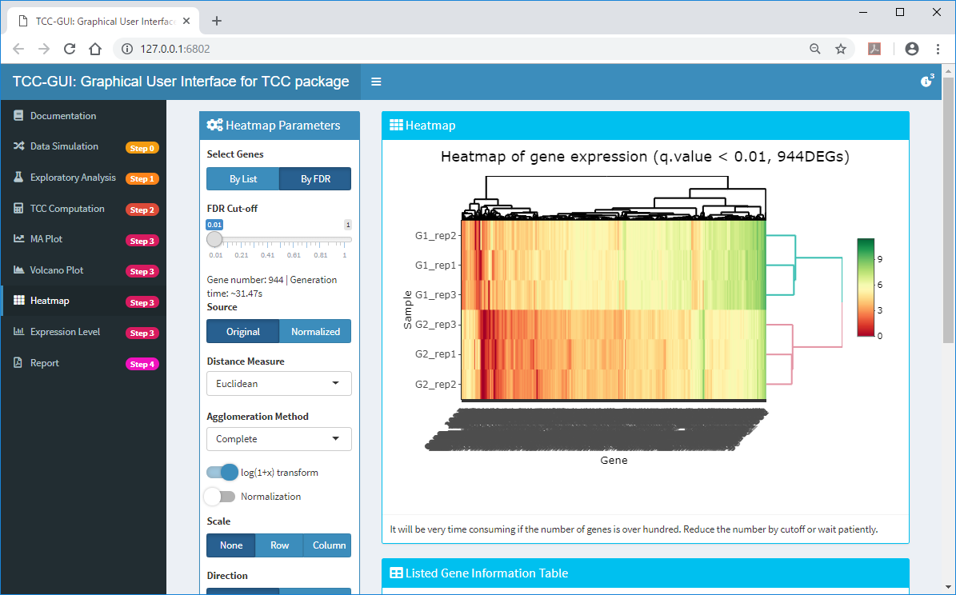
Heatmap generated
  Since the 944 genes were differentially expressed between the two groups, hierarchical clustering on heatmap displays two distinct clusters as individual groups.

Slide 57
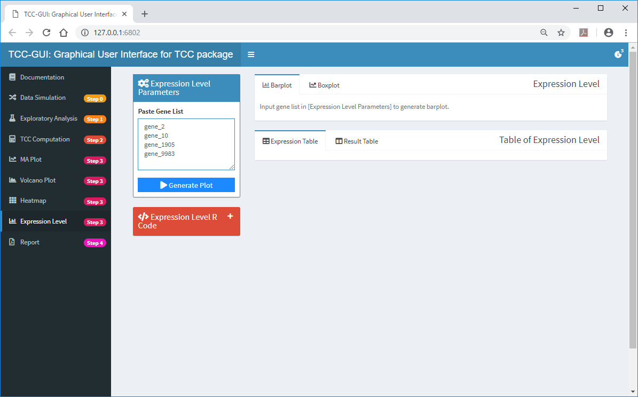
Expression Level
  ①Expression Level can be used to visualize expression patterns for genes of interest. ②Here, we applied the four genes and clicked on ③”Generate Plot”.
②
③
①

Slide 58
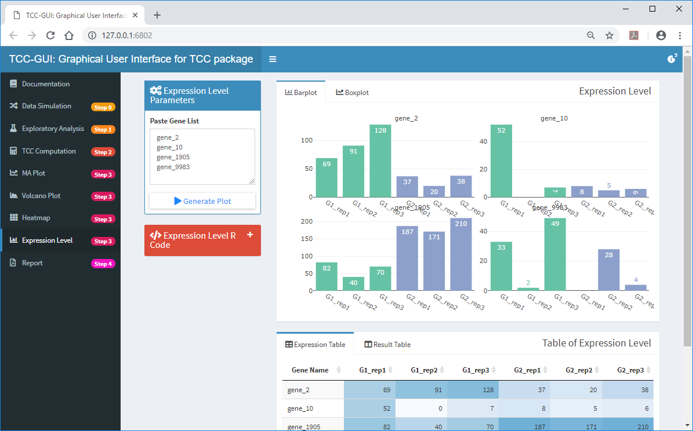
Expression Level generated
  By default, ①Barplot and ②Expression Table are displayed.
①
②

Slide 59
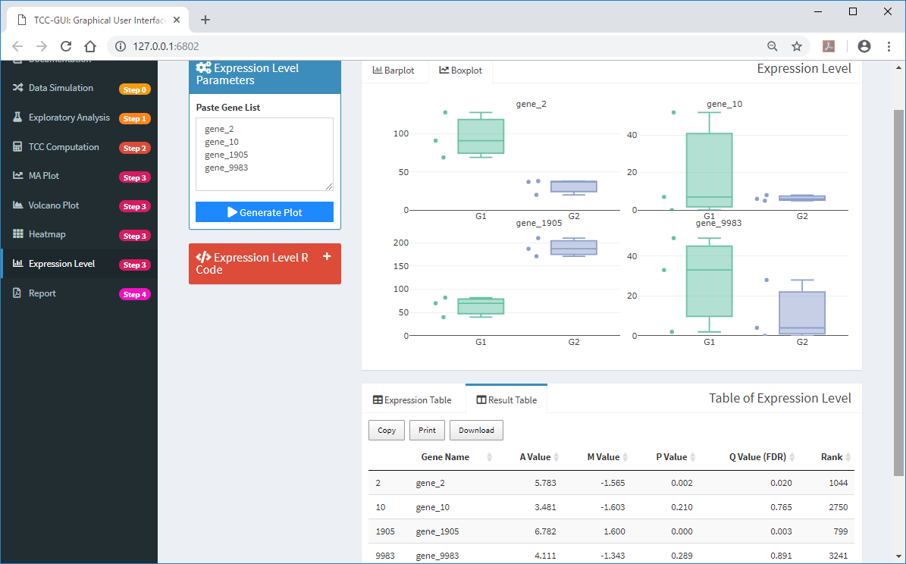
Expression Level generated
  ①Boxplot and ②Result Table can also be chosen for display.
①
②

Slide 60
Contents
TCC-GUI GitHub page
  prerequisites, standalone version, and online version
Data Simulation (Step 0)
Exploratory Analysis (Step 1)
TCC Computation (Step 2)
Visualization (Step 3)
  MA Plot, Volcano Plot
  Heatmap, Expression Level
Report (Step 4)

Slide 61
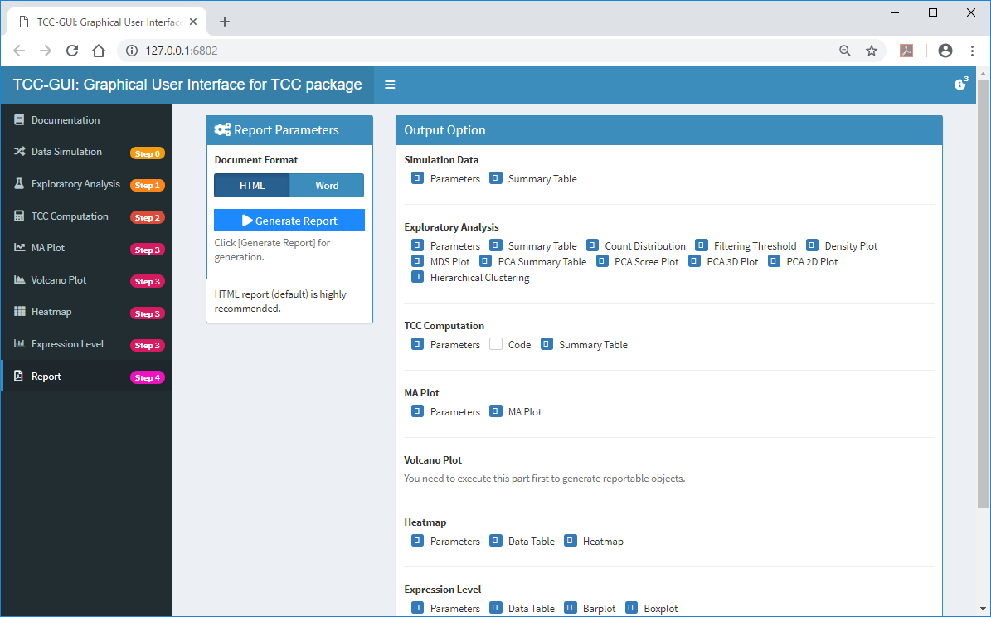
Step 4
  While all the results including R codes can be saved in individual steps, some users may prefer these results in one file. To do this, ①select Step 4, and ②click on “Generate Report”.
③
①

Slide 62

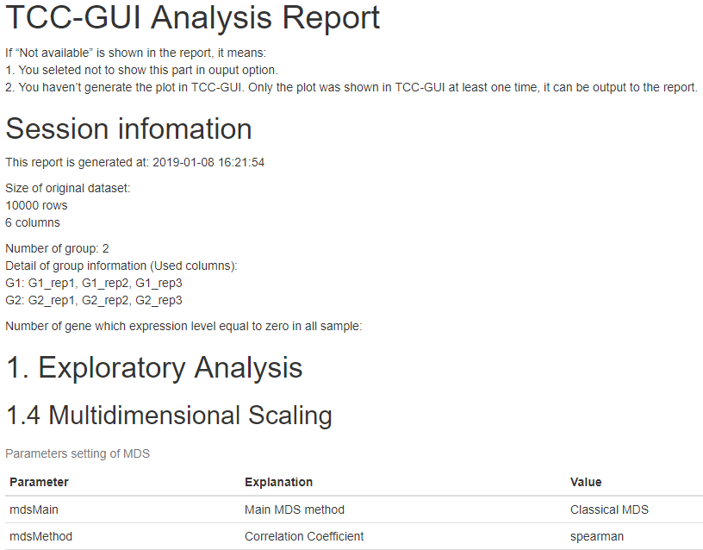
Report generated
  ①Click “Download”; the html report (Plot_Report.html) will be obtained, ②as seen in the red frame.
②
①

