Slide 1
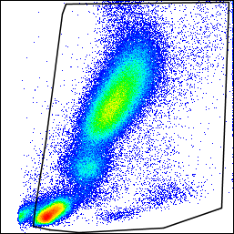
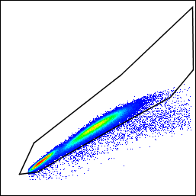
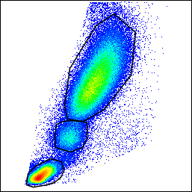
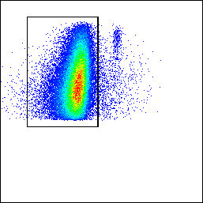
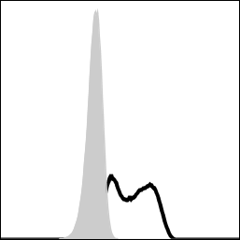
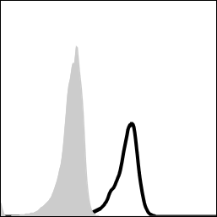
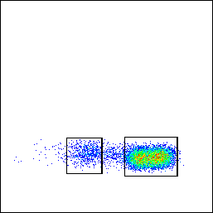
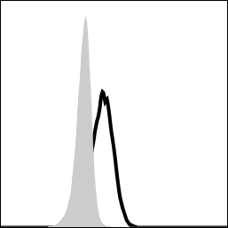
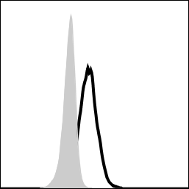
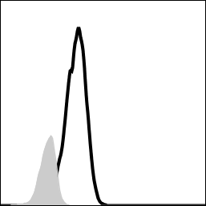
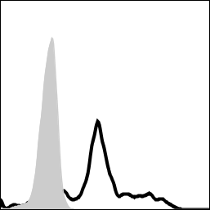
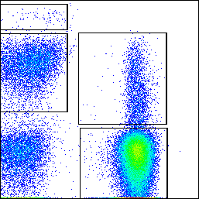
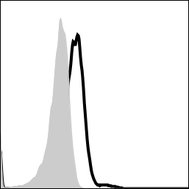
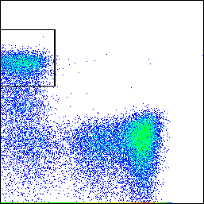
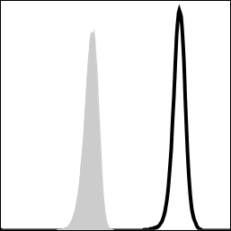
Supplementary Figure 1
(A)
SSC-A
Granulocytes
SSC-A
FSC-H
Monocytes
Lymphocytes
FSC-A
FSC-A
FSC-A
(B)
Granulocytes
SSC-A
CD14
FcγRIIa
FcγRIIIb
(C)
CD14^{hi} classical
(D)
CD14^{lo} non-classical
Supplementary Figure 1: FACS gating strategy for quantifying immune cell subsets and FcγR expression in whole blood samples. All immune cells subsets are gated on A) live/single cells and histograms show relevant FcγR expression levels for B) Granulocytes (SSC^{hi}CD14⁻), C) classical monocytes (FSC^{int}CD14^{hi}), D) non-classical monocytes (FSC^{int}CD14^{lo}), E) NK cells (SSC^{lo}FSC^{lo}CD3⁻CD56^{dim}) and F) B cells (SSC^{lo}FSC^{lo}CD3⁻CD19⁺).
FSC-A
CD14
FcγRI
FcγRIIa
FcγRIIa
FcγRIIIa
(E)
NK cells
(F)
B cells
CD56
CD19
CD3
FcγRIIIa
CD3
FcγRIIb

Slide 2
Supplementary Figure 2
Supplementary Figure 2: IFN-γ responses to mAb stimulation of PBMCs is stable over time. PBMCs from 5 healthy donors were stimulated with (A) OKT3, (B) TGN1412 or (C) Campath in 5 independent cytokine release assays carried out over a period of 6 months. Each point represents data from a single assay.

Slide 3
Supplementary Figure 3
Supplementary Figure 3: IFN-γ release in response to mAb stimulation is significantly correlated with TNF-α, IL-1-β and IL-6. Correlation of IFN-γ release with TNF-α, IL-1β or IL-6 (log₁₀ transformed cytokine measurements) in freeze-thawed PBMC cultures stimulated with (A-C) OKT3, (D-F) TGN1412 or (G-I) Campath. Each point represents a donor, (n=36). ns = non-significant

Slide 4
Supplementary Figure 4
Supplementary Figure 4: FcγR expression on pre- and post-high density culture of freeze-thawed PBMCs. FcγR expression was quantified on A-D) CD14⁺ cells (monocytes), E) B cells and F) NK cells pre- and post-high density culture for 24 hours. Each point represents a donor (n=5). *p<0.05, **p<0.01 and ns = non-significant.

Slide 5
Supplementary Figure 5
Supplementary Figure 5: IFN-γ responses to Campath and IgG1 Hexamer in a whole blood assay format. A) IFN-γ release in response to PBS (negative control), Campath and IgG1 Fc Hexamer using a whole blood assay format (n = 89). ***p<0.001, ns = non-significant. B) Correlation of IFN-γ release (log₁₀ transformed) between Campath and IgG1 Fc Hexamer responses.

Slide 6
Supplementary Figure 6: Longitudinal study of IFN-γ release using a whole blood assay format. Whole blood was sourced from 9 heathy donors on 5 separate days over a 4 month period and stimulated with A) 100 μg/mL IgG1 Fc hexamer or B) 10 μg/mL Campath. Data points represent individual IFN-γ measurements averaged from triplicate cultures over 3-5 time points for each donor A-I and bars represent mean IFN-γ response for each donor.
Supplementary Figure 6

Slide 7
Supplementary Figure 7
(A)
100
Supplementary Figure 7: Power calculation curves based on the IFN-γ response to A) Campath and B) IgG1 hexamer stimulation in whole blood cultures.
80
60
Power (%)
40
20
5
10
15
20
25
Number of donors per group
(B)
100
80
60
Power (%)
40
20
5
10
15
20
25
Number of donors per group
Fold change between groups:
10
5
3
2

