Slide 1
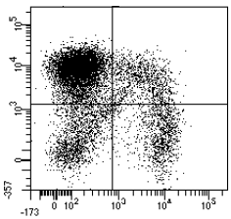
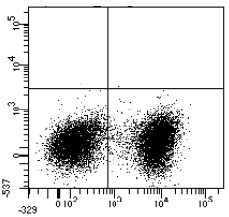
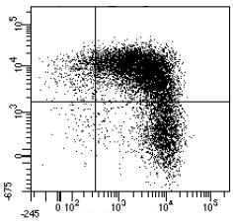
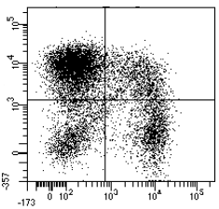
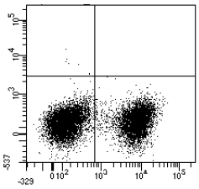
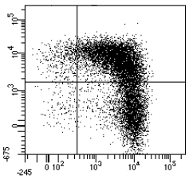
Supplemental figure 1
S1
After transduction
After αβTCR depletion
Infused TEGs
54%
15%
0%
0%
5,2%
69,5%
TEG001
15%
16%
46%
55%
0,8%
24,5%
61%
11%
0,1%
0%
4,4%
59%
TEG-LM1
αβTCR
16%
12%
42,6%
57%
1,3%
35,3%
γδTCR

