Slide 1
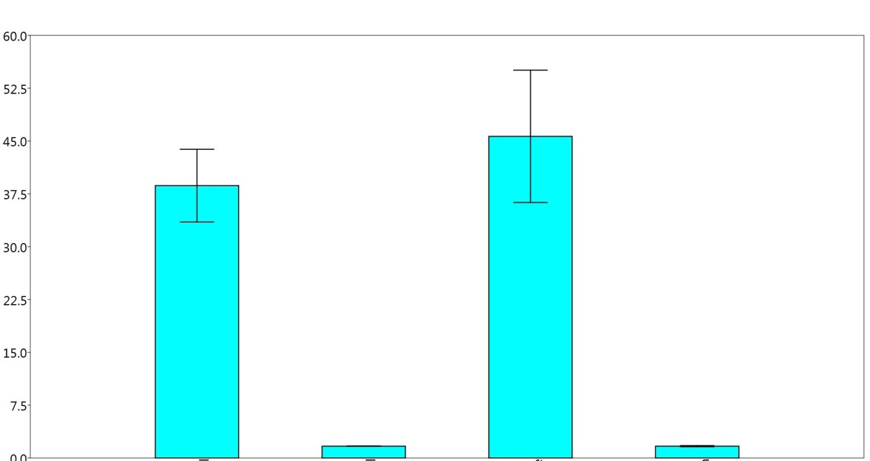
Fold changes to M82
Fruits
(all genes)
Leaves
(all genes)
Fruits
(metabolism genes)
Leaves
(metabolism genes)
Supplemental Figure 4. Genes expression from Solanum pennellii and Solanum lycopersicum (cultivar M82). Data are fold changes with respect to M82 in the fruit and leaves.

