Slide 1
Guiding the First Biopsy in Glioma Patients using Estimated Ki67 Maps Derived from Magnetic Resonance Imaging: Conventional versus Advanced Imaging
Evan D. H. Gates, MS^{1,2†}, Jonathan S. Lin, MD PhD^{1,3,4†}, Jeffrey S. Weinberg, MD⁵, Jackson Hamilton, MD^{6,7}, Sujit S. Prabhu, MD⁵, John D. Hazle, PhD¹, Gregory N. Fuller, MD PhD⁸, Veera Baladandayuthapani, PhD⁹, David Fuentes, PhD¹, and Dawid Schellingerhout, MD^{6,10*}
† contributed equally, *corresponding
Department of Imaging Physics, University of Texas MD Anderson Cancer Center, Houston, TX, 77030
The University of Texas MD Anderson Cancer Center UTHealth Graduate School of Biomedical Sciences, Houston, TX, 77030
Baylor College of Medicine, Houston, TX, 77030
Department of Bioengineering, Rice University, Houston, TX, 77005
Department of Neurosurgery, University of Texas MD Anderson Cancer Center
Department of Diagnostic Radiology, University of Texas MD Anderson Cancer Center
Now at: Radiology Partners, Houston, TX, 77040
Department of Pathology, University of Texas MD Anderson Cancer Center
Department of Biostatistics, University of Texas MD Anderson Cancer Center
Department of Cancer Systems Imaging, University of Texas MD Anderson Cancer Center

Slide 2
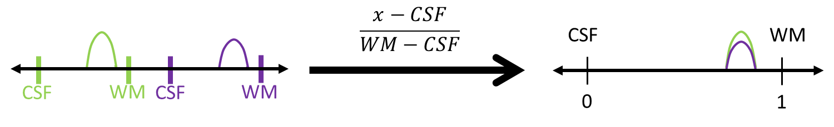
Figure S1, Conceptual diagram of histogram normalization. Intensity values from two images are normalized to a single reference scale based on internal intensity reference standards. The different scaling pairs used in this process of normalization by natural landmarks were: CSF-WM (applied to T1, FLAIR, and SWAN), WM-CSF (applied to T2 and T2*), and CSF-GM (applied to TC).

Slide 3
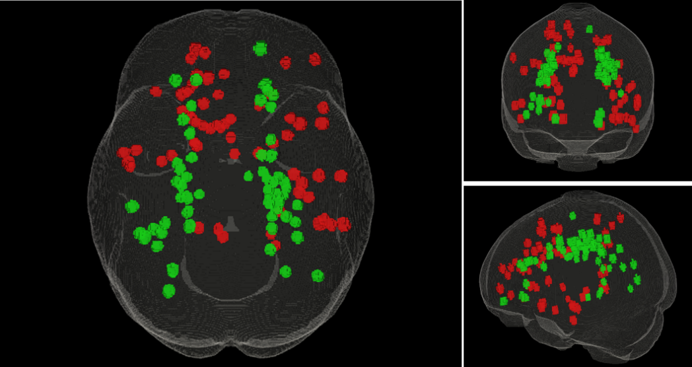
Figure S2, Three-plane views (axial, coronal, and sagittal) of all biopsy sites. Both real (red, n=64) and imputed biopsy sites (green, n=64) are projected into a single idealized brain volume. Note the roughly symmetrical distribution of real and imputed biopsy sites, a deliberate choice to minimize variability.

Slide 4
Figure S3: Model Building Diagram. This schematic illustrates the five-fold cross validation where the 102 samples are divided into five “folds.” Four folds are combined and used to select important features before training a random forest model and making predictions on the remaining fold (a). This process is repeated five times, each time with a different fold in the “test” set. Using the most frequent variable selections from the analysis in a) we repeated the five-fold cross validation with the same four variables in each repetition. The results of a) and b) are shown in the corresponding graphs in Figure 2.

Slide 5
Figure S4, Variable correlation plots. Visualized Pearson correlations between all variables and the four variable subset selected by random forest and clinical intuition. Larger and darker disks indicate a stronger correlation

